Slide 1
Pequea Valley School District
2022 Audit
January 3, 2023

Slide 2
Introduction
Independent Auditors’ Report for the year ended June 30, 2022
Management’s Discussion and Analysis. Unaudited information prepared by John Bowden, Chief of Finance and Operations.
Government Wide Statements - Full accrual basis statements.

Slide 3
Governmental Activities Highlights
Capital asset additions of $4.1M included architectural costs for Middle/High School construction project, Paradise Elementary playground project, Salisbury Elementary roof top units, and district office improvements.
Issuance of $29.3M in General Obligation Bonds to provide funds for various capital projects, including Middle/High School construction project.
Net position increased by $5.33M as of June 30, 2022.

Slide 4

PSERS Rates
Employer Contribution Rates
2021-2022 | 34.9%
2022-2023 | 35.3%
2023-2024 | 34.0%
2024-2025 | 34.7%
2025-2026 | 35.5%
As of 6/30/21, PSERS Plan was approximately 63.7% funded (about $41.1 billion unfunded liability)
PV’s proportionate share is .0944% with a liability of $38,758,000
The PSERs OPEB Plan is 5.3% funded as of June 30, 2021
PV’s portion of the unfunded OPEB liability is $2,231,000

Slide 5
Governmental Activities
Historical Analysis
 | June 30, 2020 | June 30, 2021 | June 30, 2022
Current Assets | 20,419,851 | 82,007,374 | 111,599,380
Noncurrent Assets | 36,206,492 | 36,363,639 | 38,272,892
Total Assets | 56,626,343 | 118,371,013 | 149,872,272
Deferred Outflows | 8,657,807 | 10,180,000 | 9,047,000
Current Liabilities | 7,805,398 | 7,237,980 | 8,372,677
Noncurrent Liabilities | 50,352,942 | 113,049,540 | 129,984,158
Total Liabilities | 58,158,340 | 120,287,520 | 138,356,835
Deferred Inflows | 1,741,000 | 1,481,000 | 8,450,000
Total Net Position | 5,384,810 | 6,782,493 | 12,112,437

Slide 6
General Fund Results
 | 2020 | 2021 | 2022 Actual | 2022 Final Budget
Local Revenues | 29,007,788 | 29,888,694 | 30,938,655 | 29,709,575
State Revenues | 8,725,158 | 8,723,887 | 8,670,875 | 8,513,073
Federal Revenues | 1,393,117 | 2,621,180 | 5,541,898 | 4,899,288
Total Revenues | 39,126,063 | 41,233,761 | 45,151,428 | 43,121,936
% Increase vs. Prior Year | 2.0% | 5.4% | 9.5%
Instructional Services | 21,056,721 | 21,274,895 | 23,109,236 | 21,773,982
Instructional Student Support | 4,119,427 | 4,138,533 | 4,245,827 | 4,361,450
Admin & Financial Support | 3,477,993 | 2,989,341 | 3,093,171 | 3,016,169
Operation & Maintenance | 2,756,499 | 3,294,437 | 3,812,022 | 3,161,076
Student Transportation | 2,174,085 | 2,358,781 | 2,578,523 | 2,653,063
Other | 1,010,610 | 766,497 | 967,566 | 889,456
Total Expenditures | 34,595,335 | 34,822,484 | 37,806,345 | 35,855,196
% Increase vs. Prior Year | 3.9% | 0.7% | 8.6%
Excess of Revenues over Expenditures | 4,530,728 | 6,411,277 | 7,345,083 | 7,266,740

Slide 7
General Fund Results
 | 2020 | 2021 | 2022 Actual | 2022 Final Budget
Excess of Revenues over Expenditures | 4,530,728 | 6,411,277 | 7,345,083 | 7,266,740
Transfers In | -0- | -0- | 1,039,275 | -0-
Transfers Out | (3,736,400) | (3,024,300) | (4,098,056) | (4,203,053)
Other Sources | 188,195 | 75,233 | 44,392 | -0-
Budgetary Reserve | -0- | -0- | -0- | (3,063,917)
Total Net Other Financing Uses | (3,548,205) | (2,949,067) | (3,014,389) | (7,266,970)
Change in Fund Balance | 982,523 | 3,462,210 | 4,330,694 | (230)
Ending Fund Balance | 12,546,084* | 16,173,091 | 20,503,785
* Ending fund balance was restated upon implementation of GASB 84, Fiduciary Activities. Restated balance at 7/1/20, as noted within the 2021 financial statements, was $12,710,881.

Slide 8
General Fund – Expense Analysis

Slide 9
Capital Reserve Fund
Fiscal Year | Fund Additions | Expenditures | Ending Fund Balance
2021-22 | 1,134 | 273,311 | 1,375,764
2020-21 | 737 | 406,073 | 1,647,941
2019-20 | 28,269 | 371,316 | 2,053,277

Slide 10
Capital Project Fund
 | 2021 | 2022
Total Revenue | 938 | 34,280
Total Expenditures | 1,645,096 | 3,312,639
Other Financing Sources, Net | 60,038,916 | 28,826,282
Change in Fund Balance | 58,394,758 | 25,547,923
Beginning Fund Balance | -0- | 58,394,758
Ending Fund Balance | 58,394,758 | 83,942,681

Slide 11
Fund Balance Components
 | General Fund | Capital Projects Fund | Capital Reserve Fund
Nonspendable Prepaid Expenses | 5,851 | -0- | -0-
Nonspendable Interfund Advance | 428,344 | -0- | -0-
Restricted for Capital Outlays | -0- | 83,942,681 | -0-
Committed (Board) for Future Capital Projects | 9,800,000 | -0- | -0-
Committed (Board) for Future Health Care Costs | 3,500,000 | -0- | -0-
Assigned for Future Capital Outlays | 4,000,000 | -0- | 1,375,764
Unassigned (Residual General Fund Balance) | 2,769,590 | -0- | -0-
Total | 20,503,785 | 83,942,681 | 1,375,764

Slide 12
Food Service Fund
 | 2019-20 | 2020-21 | 2021-22
Operating Revenues | 176,911 | 81,155 | 127,650
Non-operating Revenues | 423,232 | 435,561 | 895,736
Total Revenues | 600,143 | 516,716 | 1,023,386
Salaries and Benefits | 261,348 | 247,687 | 249,145
Purchased Services | 176,018 | 176,030 | 209,210
Supplies | 230,109 | 197,473 | 313,327
Depreciation | 19,194 | 19,194 | 19,194
Total Expenses | 686,669 | 640,384 | 790,876
Change in Net Position | (86,526) | (123,668) | 232,510

Slide 13
Internal Service Fund
 | 2019-20 | 2020-21 | 2021-22
Charges for Services | 3,935,870 | 4,024,093 | 3,073,166
Employee Benefits | 4,010,904 | 4,024,093 | 2,831,745
Non Operating Revenues | 4,209 | 31 | 582
Interfund Transfers | -0- | -0- | (1,039,275)
Change in Net Position | (70,825) | 31 | (797,272)

Slide 14
Other Financial Statement Components
Notes to Financial Statements
  Note 1 - Summary of Significant Accounting Policies
  Note 10 - Long-Term Debt
  Note 14 - Defined Benefit Pension Plan
  Note 15 - Other Postemployment Benefits (OPEB)
Supplemental Schedules provide additional detail to basic financial statements
Single Audit (Compliance Audit of the School District’s Federal Grants) and Related Reports

Slide 15
Single Audit
Compliance audit of federal awards
Major programs tested were School Breakfast Program, National School Lunch Program, and Education Stabilization Fund
No questioned costs, two findings
  #2022-001 – Schedule of Expenditures of Federal Awards
  #2022-004 – COVID-19 Education Stabilization Fund

Slide 16
Thank You & Staff Recognition
John Bowden and Britney Hevner
Thanks to John, Britney, and the rest of the Business Office staff for helping us during our audit.
Pequea Valley School District
We value our relationship with you and thank you for your business.

Slide 17
About
Trout CPA

Slide 25
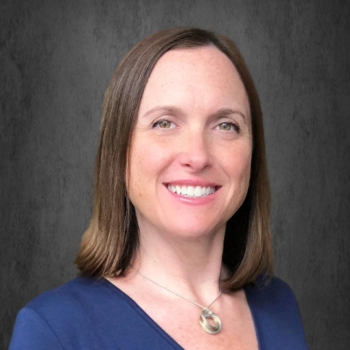

Practice Areas
Audit & Attest Services
Government Agencies
Employee Benefit Plans
Employee Stock Ownership Plans
Non-profit Organizations
Education & Credentials
BS in Accounting - Villanova University - 1999
Certified Public Accountant – 2001
Professional Organizations
American Institute of Certified Public Accountants
Pennsylvania Institute of Certified Public Accountants
Certifications
AICPA Advanced Defined Contribution Plans Audit Certificate
AICPA Intermediate Single Audit Certificate
Board of Directors
Lancaster Early Education Center - Board President
Megan Senkowski
CPA, Partner
msenkowski@troutcpa.com
717-358-9194

Slide 26
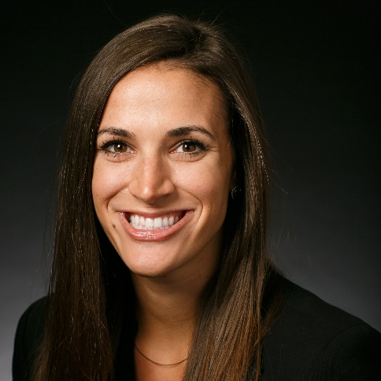
Practice Areas
Audit & Attest Services
Government Agencies
Employee Benefit Plans
Education & Credentials
BS in Accounting (cum laude) - Albright College - 2013
Certified Public Accountant – 2016
Professional Organizations
Pennsylvania Institute of Certified Public Accountants
Lancaster Young Professionals
Community Involvement
Leadership Lancaster - Core Class of 2019 Graduate, Finance Committee
Lancaster Early Education Center - Treasurer, Board Member
Kelly Deihm
CPA, Talent Development Manager
kdeihm@troutcpa.com
717-358-9117

Slide 27
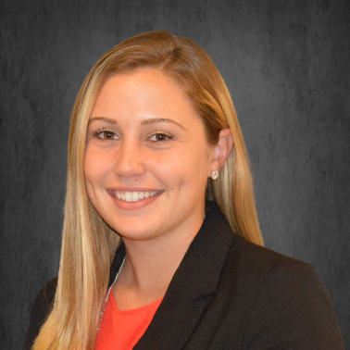
Practice Areas
Audit & Attest Services
Government Agencies
Employee Benefit Plans
Construction & Real Estate Entities
Education & Credentials
BS in Accounting and a minor in Information Technology - Monmouth University - 2019
Certified Public Accountant - 2020
Professional Organizations
Pennsylvania Institute of Certified Public Accountants
American Institute of Certified Public Accountants
Lancaster Young Professionals
Community Involvement
Lancaster County Junior Golf Tour - Assistant Tournament Director
Haley Brubaker
CPA, Senior Accountant
hbrubaker@troutcpa.com
717-358-9098

