Slide 1
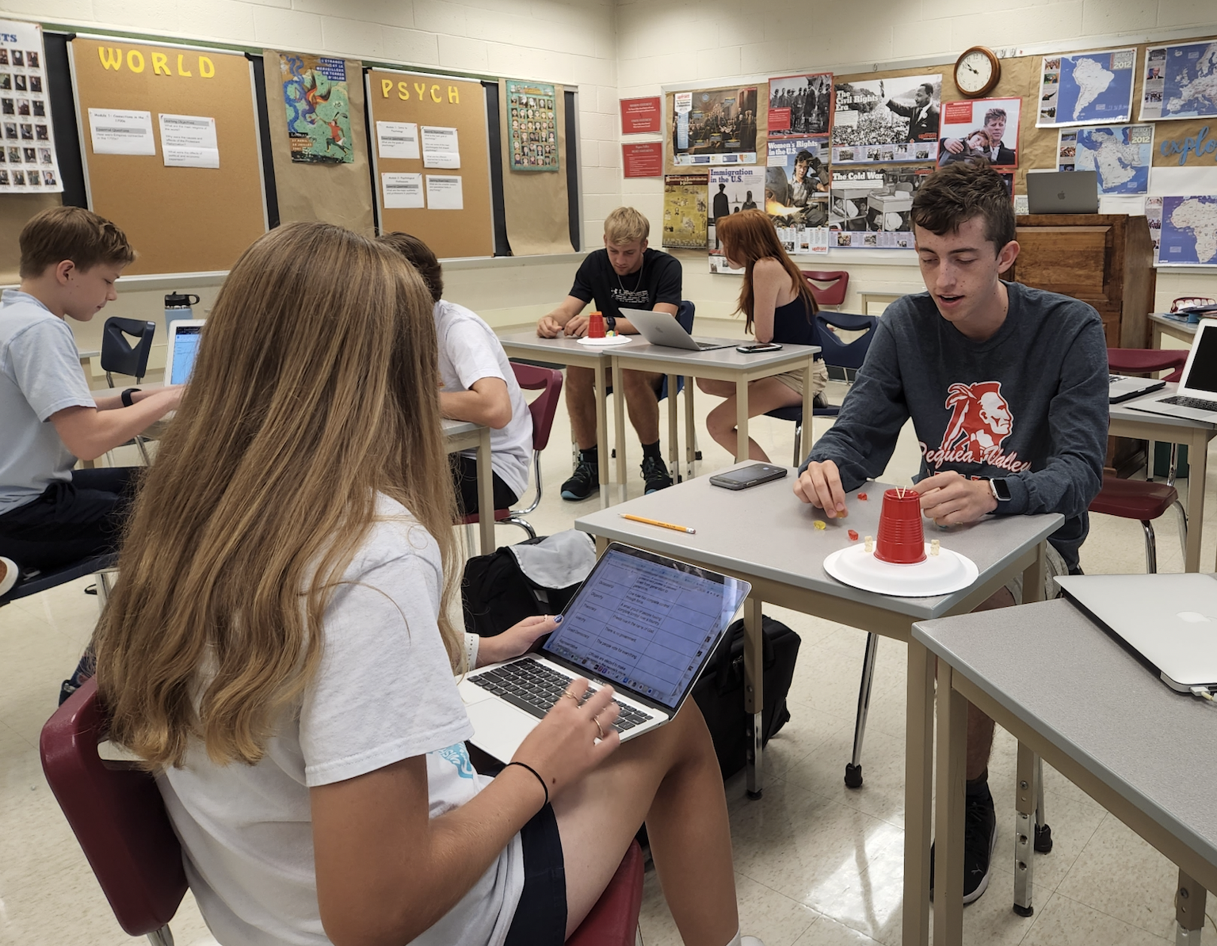
Civil Discourse

Slide 2
Civil Discourse
“Opposing arguments are grounded in reason and evidence and they are put forward within strict guidelines for courtroom decorum. Each side tests the arguments of the other side, and a judge holds everyone to the same protocol and standards of appropriate behavior. Asking questions of each side is an integral part of the process.” (uscourts.gov/education)

Slide 3
PA CORE STANDARDS
“Present information, findings, and supporting evidence, conveying a clear and distinct perspective.”
“Evaluate how the speaker’s perspective, reasoning, and use of evidence and rhetoric affect the credibility of an argument through the author’s stance, premises, links among ideas, word choice, points of emphasis, and tone.”
“Initiate and participate effectively in a range of collaborative discussions on grade-level topics, texts, and issues, building on others’ ideas and expressing their own clearly and persuasively.”

Slide 4
PA CORE STANDARDS
“Create organization that logically sequences claim(s), counterclaims, reasons, and evidence; use words, phrases, and clauses as well as varied syntax to link the major sections of the text to create cohesion and clarify the relationships between claim(s) and reasons, between reasons and evidence, and between claim(s) and counterclaims; provide a concluding statement or section that follows from and supports the argument presented.”

Slide 5
PUBLIC SPEAKING
● “”Consistent debating of ideas in impromptu speaking and discussions on issues going on in society.”

Slide 6
Methods of Fostering Discourse in the Classroom
Movement-Based Strategies
1 on 1 Rotating Discussions
Full-class Debates - variety of methods
Intentional Structures to Foster Active Listening
Readings from varied perspectives (primary sources, opinion pieces, etc.) followed by class discussion in multiple formats
Defend the Opposite View

Slide 7
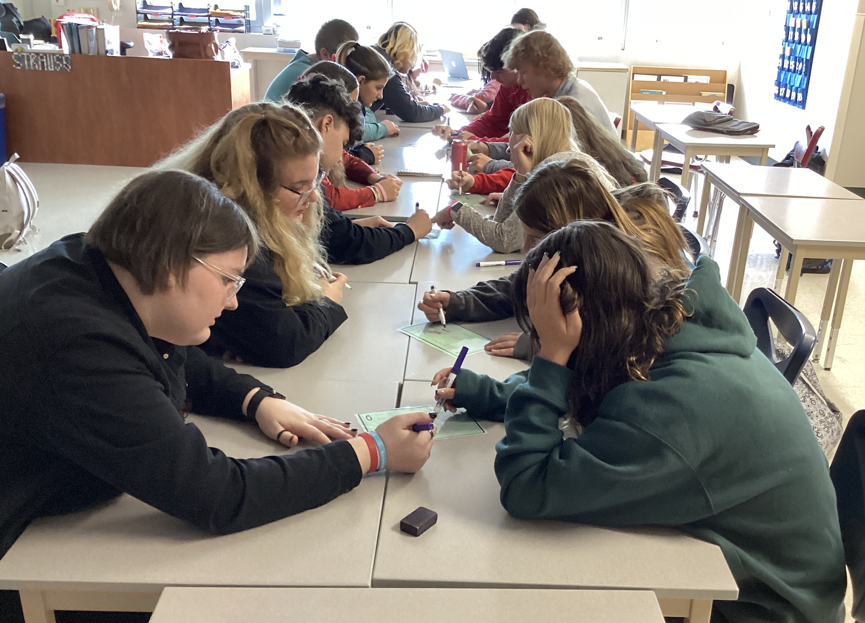

Slide 8
These strategies are used in many classes…
Social Studies
ELA
Math
STEM
Science
Agriculture
Wellness

Slide 9
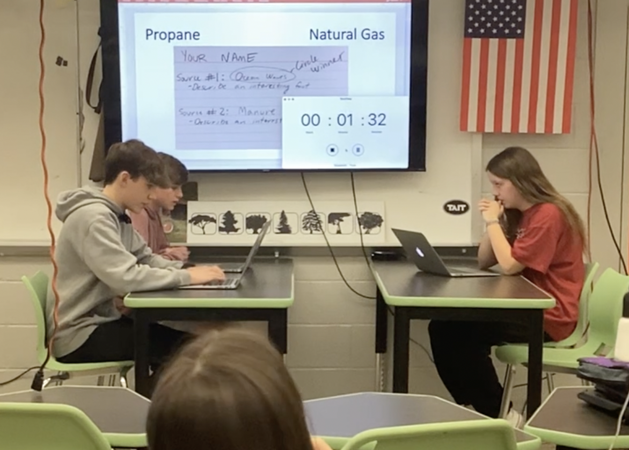

Slide 10
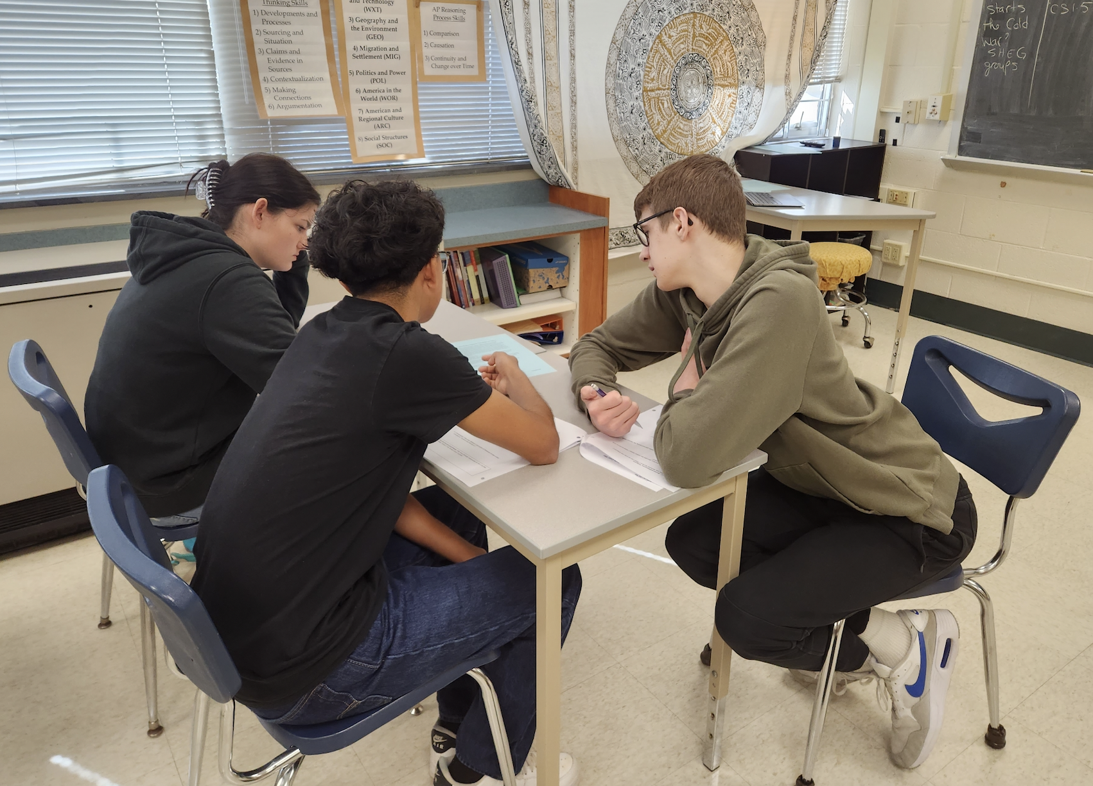

Slide 11
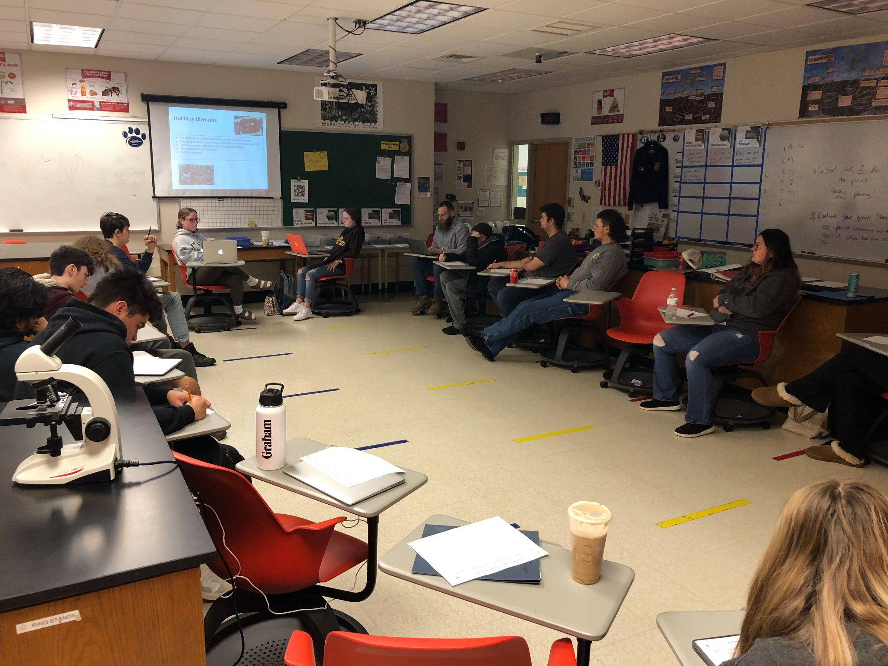

Slide 12
