Slide 1
Safety:
School Resource/ Security Officer
Pequea Valley School District
May 2, 2023
Board Presentation

Slide 2
Goal of School Resource / Security Officer in District:
A safe learning environment at PVSD
Provide valuable resources to school staff
Foster a positive relationship with our learners
Develop strategies to resolve problems affecting our youth

Slide 3
Looking at the DATA ...
20 schools in Lancaster - Lebanon responded.
19 schools have an SRO/Security officer

Slide 4
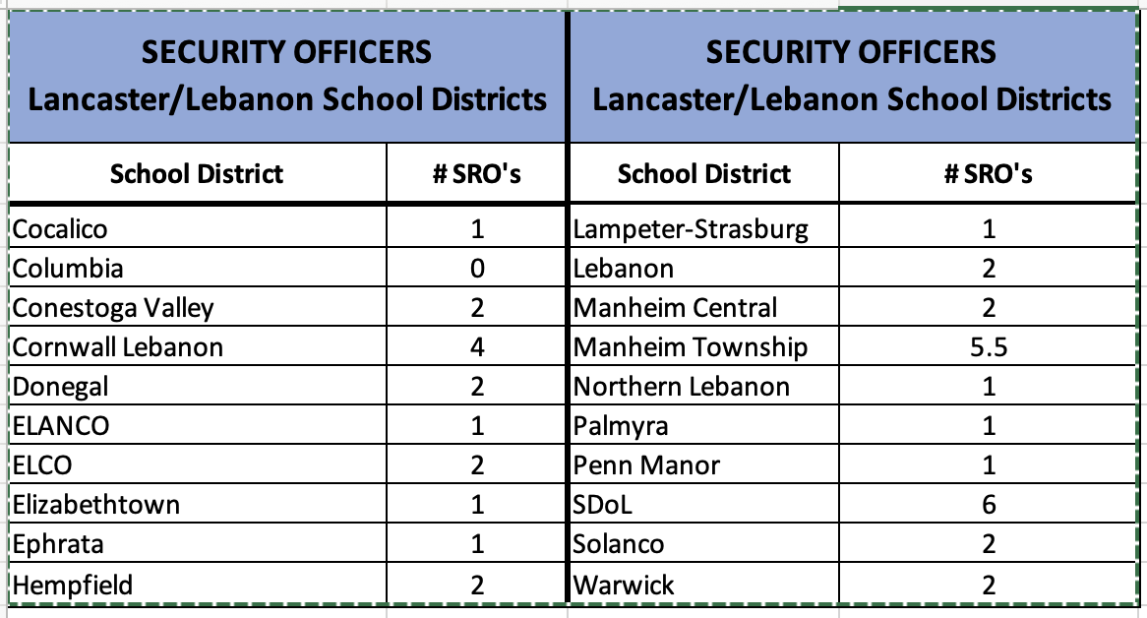
Looking at the DATA ...

Slide 5
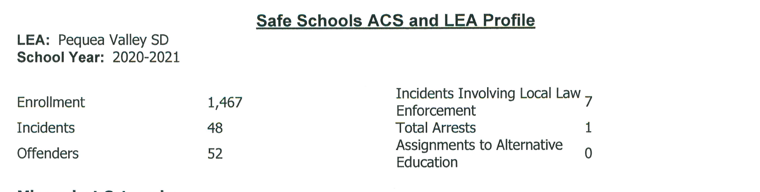
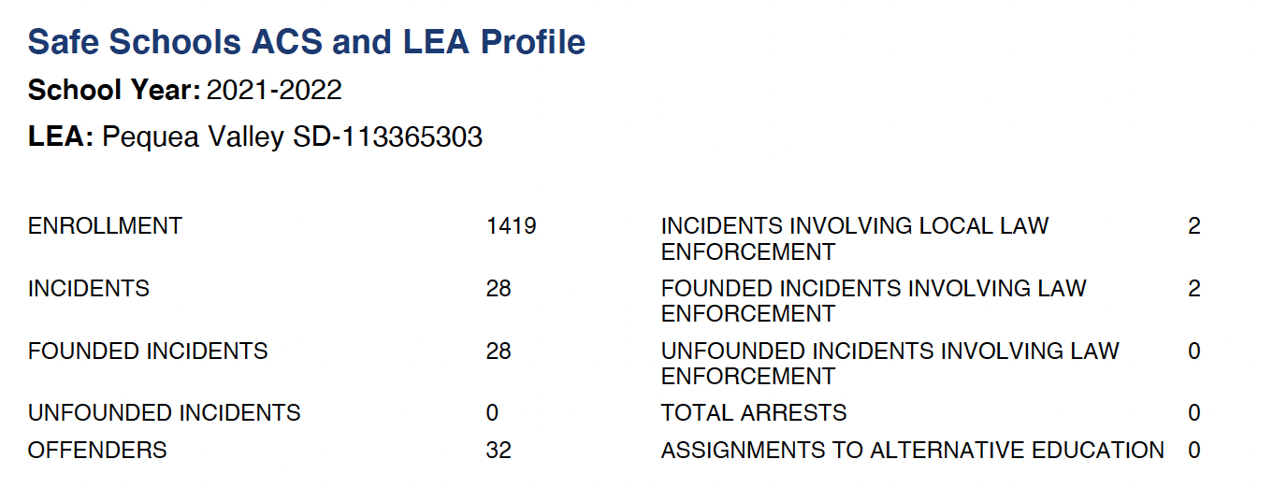

Safe Schools Report

Slide 6
Positive reason for ...
Safety & Security
Faster response time
Presence in common areas
Relationships
Connection to the community
They become a part of the culture
Get police perspective in discussions

Slide 7
Concerns...
Delineate responsibilities of staff
Cost : $94,000 - 124,000/ per officer

Slide 8
Discussion and Questions

