Slide 1

Crabtree, Rohrbaugh & Associates

Slide 2
WHAT IS A CHANGE ORDER?
CURRENT CHANGE ORDERS UNDER REVIEW
DETAIL REVIEW OF PROPOSED CHANGE ORDER 18r1
AGENDA

Slide 3

DEFINITION
The change order is fundamental to construction contracting as the primary means to modify the contract for construction. In fact, the term “change order” is found 23 times in the text of the AIA’s A201™ General Conditions of the Contract for Construction (2017) and is defined therein as “A written instrument prepared by the Architect and signed by the Owner, Contractor, and Architect stating their agreement upon all of the following: 1) the change in the Work; 2) the amount of the adjustment, if any, in the Contract Sum; and 3) the extent of the adjustment, if any, in the Contract Time.” The operative language is that a change order is an “agreement” amongst the parties and, therefore, the terms are settled and become a part of the contract. AIA CONTRACT DOCUMENTS (AIACONTRACTS.COM)

Slide 4
ORIGINS OF CHANGE ORDERS
UNFORESEEN OR DIFFERING CONDITIONS
  SITE CONDITIONS
  SEVERE ADVERSE WEATHER
  DAMAGE (FIRE)
  OTHER ISSUES NOT CAUSED BY ANY PARTY
    SUPPLY CHAIN ISSUES
    COVID
OWNER / ARCHITECT / CONTRACTORS
  OWNER-DIRECTED CHANGES
  DIFFERING INTERPRETATION OF DOCUMENTS
CODE OFFICIAL (LATE DRAWING REVIEW COMMENTS RECEIVED)
MUNICIPAL AUTHORITY (ADDITIONAL WATER/SEWER REQUIREMENTS)

Slide 5
ORIGINS OF CHANGE ORDERS
NOT ALL CHANGE ORDERS ARE ADDS
  DEDUCTS ARE PURSUED WHEN POSSIBLE
  A NO-COST CHANGE ORDER COULD MODIFY PROJECT DURATION

Slide 6
CATEGORIES OF CHANGE ORDERS
OMISSIONS: IF INCLUDED, WOULD HAVE BEEN REALIZED ON BID DAY
UNFORESEEN: SUBSURFACE CONDITIONS, ANTICIPATED CONDITIONS DIFFERENT THAN ANTICIPATED; GEOTECH
VALUE ADDED: OWNER REQUESTED CHANGES
NO VALUE ADDED: DESIGN TEAM CHANGES (ERROR)

Slide 7
PROCESS / OVERSIGHT OF CHANGE ORDERS
INITIATED BY ONE OR MORE OF THE FOLLOWING DOCUMENTS
  PROPOSAL REQUEST
  ARCHITECT’S SUPPLEMENTAL INSTRUCTIONS (ASI)
  CONSTRUCTION CHANGE DIRECTIVE (CCD)
  REQUEST FOR INFORMATION (RFI)
  REQUEST FOR A CHANGE ORDER
ALL CHANGE ORDERS ARE REVIEWED BY THE DESIGN TEAM FOR ACCURACY AND VALIDITY
ALL CHANGE ORDERS ARE REVIEWED BY THE OWNERS REPRESENTATIVE

Slide 8
PROJECT CHANGE ORDER STATUS
CHANGE ORDER REQUESTS RECEIVED: 25
  CHANGE ORDER CREDITS: 3
  CODE / MUNICIPALITY COMMENTS: 7
  REJECTED / VOIDED: 3
  ACTIVELY CONTESTED: 3
  DETAIL COORDINATION: 8
  OMISSIONS 1

Slide 9
PROJECT CHANGE ORDER STATUS
 |  |  |  |  | CHANGE ORDER STATUS LEGEND
PROJECT NAME: PEQUEA VALLEY MS/HS
 |  |  |  |  |  | CHANGE ORDERS FULLY PROCESSED (BOARD APPROVED)
CRA JOB NO: 3448
CONSTRUCTION ADMINISTRATOR: John Yarnall |  |  |  |  |  | CHANGE ORDERS APPROVED BY OWNER (READY FOR BOARD)
 |  |  |  |  |  | CHANGE ORDERS UNDER REVIEW (PENDING APPROVAL)
 | CURRENT PCO LOG DATE: | 5/1/2023
GENERAL INFORMATION |  |  |  |  |  | STATUS | REASON FOR CHANGE ORDER
CONTRACTOR PCO # | DESCRIPTION | COST | CRA C0 # |  | DATE PCO RECEIVED | CURRENT STATUS OF PCO | OWNER | UNFORESEEN | OMISSION | ERROR
GENERAL CONTRACTOR
1 | Change Door A148C Stage Sliding Door to OH Type | ($85,000.00) |  |  | 10/11/2022 |  | ($85,000.00)
2 | CCD #01 WON Door Changes per Code Review | $60,836.96 |  |  | 2/6/2023 |  |  | $60,836.96
3 | CCD #05 Concrete Elevator Lid per Code Review | $8,347.64 |  |  | 2/7/2023 |  |  | $8,347.64
4 | CCD #02 Relocate Door A140B per Code Review | $3,468.33 |  |  | 2/8/2023 |  |  | $3,468.33
5R | CCD #06 Unit D Fire Rating per Code - windows were deleted so just other fire rated items | $19,282.94 |  |  | 2/10/2023 |  |  | $19,282.94
6 | RFI #06 Revised Openings B172 & B186B | $50,360.25 |  |  | 2/10/2023
7 | CCD #15 Revised Foundation at Pre-Engineered Building | $6,476.15 |  |  | 2/13/2023 |  |  | $6,476.15
8 | CCD #12 Test Ports at Concession Grease Interceptor | $2,473.43 |  |  | 2/16/2023 |  |  | $2,473.43
9 | CCD #13 Water Vault Changes | $25,890.91 |  |  | 2/16/2023 |  |  | $25,890.91
10 | CCD #16 Misc. Foundation and Chase Changes | $23,962.80 |  |  | 2/17/2023 |  |  |  | $23,962.80
11 | Additional Step Footer for Plumber ??? CCD #16?? | $26,729.18 |  |  | 2/23/2023 |  |  |  | $26,729.18
12 | CCD #26 Ag Science Top of Wall Sound Detail | $12,664.69 |  |  | 2/24/2023
13 | VOID |  |  |  |  | VOID
14 | CCD #29 Chiller Line Footer Steps | $3,570.27 |  |  | 2/28/2023 |  |  |  | $3,570.27
15 | CCD #23 Mullion Mate at Folding Partition | $4,946.53 |  |  | 2/28/2023 |  |  |  | $4,946.53

Slide 10
PROJECT CHANGE ORDER STATUS
16 | VOID |  |  |  |  | VOID
17R1 | VOID |  |  |  |  | VOID
18R1 | CCD #22 Change Roof Insulation rom 4" to 6" | $426,300.00 |  |  | 3/17/2023 |  |  |  | $426,300.00
19 | CCD #077 P7 Change Door Fire Rating | $10,770.17 |  |  | 3/14/2023
20 | CCD #35 RFIs 34 35 and Lowered Piers for Elec Work | $4,613.39 |  |  | 3/28/2023 |  |  |  | $4,613.39
21 | CCD #32 Pipe Chase in Room A217 | $1,340.03 |  |  | 3/29/2023 |  |  |  | $1,340.03
22 | CCD #33 - Add Wall Type S1 to A201 A205 | $6,231.82 |  |  | 3/29/2023
23 | CCD #34 Dock Canopy Bulkhead | $2,596.55 |  |  | 4/4/2023 |  |  |  | $2,596.55
 | ALLOWANCES -NONE
HVAC CONTRACTOR
1 | HVAC equipment pre-pay discount | ($23,600.00) | 1 |  | 10/28/2022 | Approved | ($23,600.00)
2 | Heat pump room wall insulation change | ($40,000.00) |  |  | 3/20/2023 |  | ($40,000.00)
 | ALLOWANCES-SEE TAB
PLUMBING CONTRACTOR
 | ALLOWANCES-SEE TAB
ELECTRICAL CONTRACTOR
 | ALLOWANCES-SEE TAB
CONTRACTOR | TOTAL CONTRACT AMOUNTS | CO's ACCEPTED |  |  |  |  | ($148,600.00) | $126,776.36 | $494,058.75 | $0.00
GENERAL | $51,793,500.00 | $615,862.04
HVAC | $11,368,000.00 | ($63,600.00)
PLUMBING | $4,165,300.00 | $0.00
ELECTRIC | $9,475,500.00 | $0.00
TOTAL ORIGINAL COMBINED CONTRACT AMOUNT |  | $76,802,300.00
TOTAL ACCEPTED / PENDING CHANGE ORDERS (ALL TRADES): |  | $552,262.04
TOTAL AMOUNT ALL CONTRACTS AND ALL COS |  | $77,354,562.04
 | CONTINGENCY $2,138,000.00
 | ALLOWANCE BALANCE ($148,627.00)

Slide 11
PROJECT CHANGE ORDER STATUS
PROJECT BUDGET INCLUDES CONSTRUCTION CONTINGENCY / ALLOWANCES = $2.3M
BUDGETED 3% OF CONSTRUCTION COST: INDUSTRY STANDARD IS 3-5%
  CHANGE ORDERS ARE ANTICIPATED AND PROCESS IN PLACE (CRA B101 REQ’S)
CHANGE ORDERS RECEIVED TO DATE: 0.7% OF TOTAL PROJECT VALUE
                24% OF PROJECT CONTINGENCY
                (NOT APPROVED)

Slide 12
KNOWNS / UNKNOWNS
MOST UNFORESEEN CONDITIONS OCCUR AT THE START OF CONSTRUCTION
  SOIL CONDITIONS (ADDRESSED FOR THIS PROJECT)
  EXISTING UTILITY COORDINATION
  NEW UTILITY COORDINATION
  INITIAL COORDINATION
SHOP DRAWINGS ARE +/- 90% APPROVED
CRA’s TYPICAL PROJECT CHANGE ORDERS FOR NEW CONSTRUCTION: 2 – 2.5% (BUDGET 3%)

Slide 13
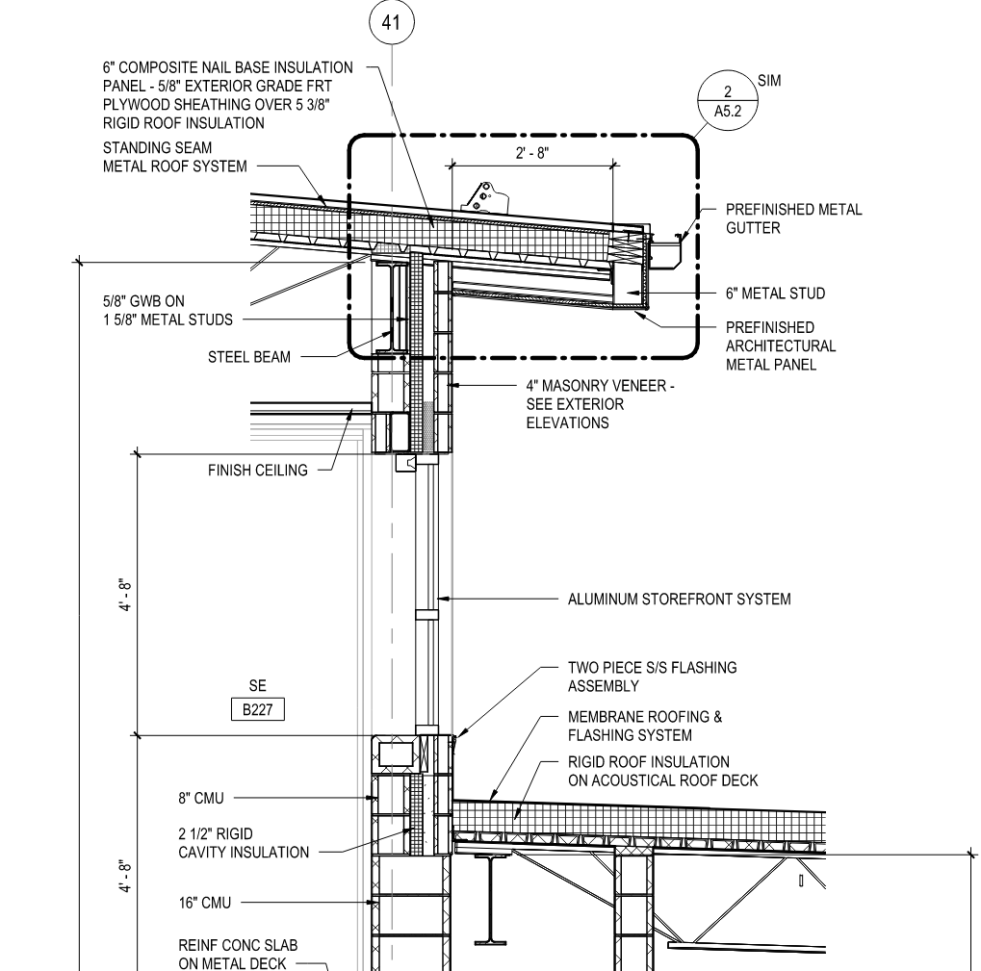
OMISSION: ROOF INSULATION
CODE REQUIRE ROOF INSULATION: R-30
METAL ROOF: 6” @ R-5 PER/IN
MEMBRANE ROOF: SEE SPECIFICATIONS
SPECIFICATIONS: R-20
PROPOSED CHANGE ORDER: $426,300
OMISSION – IF INCLUDED WOULD HAVE BEEN REALIZED IN THE BID
CONTINUED EFFORTS TO MITIGATE IMPACT

Slide 14


