Slide 1

Pequea Valley School District (Pennsylvania)
Series of 2021 and 2022 Bonds Investment Discussion
Public Finance Investment Strategies Group
Discussion Materials
Confidential | June 2023
Notes:
Update date.

Slide 2
Situational background
Pequea School District (the “District”) issued its General Obligation Bonds, Series of 2021 (the “Series 2021 Bonds”) in April 2021 in the par amount of $55,400,000 and issued its General Obligation Bonds, Series of 2022 (the “Series 2022 Bonds”) in May 2022 in the par amount of $29,265,000.
Due to the low interest rate environment over the last few years, the District was able to issue the Series 2021 Bonds with a federal arbitrage yield of 2.0265% and the Series 2022 Bonds with an arbitrage yield of 3.8043%.
As a result of supply chain issues from COVID, the District has approximately $47.7 million remaining in its Series 2021 project fund and $28.9 million in its Series 2022 project fund. As discussed on the next slide, because the District has been unable to achieve the IRS spend-down benchmarks required to retain positive arbitrage, it will be required to rebate any positive arbitrage earned above its respective arbitrage yields of 2.03% and 3.80%.
Currently, the District has accrued approximately $1.4 million in negative arbitrage on its Series 2021 project fund and approximately $56,000 on its Series 2022 project fund.
Notes:
Share\GDNT\Rate History Charts (New RJMK) main file – Chart Pack Charts tab

Slide 3
Arbitrage and Rebate Basics
Temporary Period (Usually 3-year capital projects) — Ability to invest bond proceeds at an unrestricted rate for 3 years after issuance of the bonds.
Rebate — Computation should be conducted utilizing the elected schedule pattern from those identified below, and if investment returns result in a higher rate than the arbitrage yield, the issuer will owe the difference back to the U.S. Treasury after five years if unable to meet the selected schedule.
  6-Month exception requires the issuer to spend 100% of the proceeds within the first six months from the date of issuance.
  18-Month exception requires the issuer to spend based on the below schedule:
    6 months – 15%
    12 months – 60%
    18 months – 100%
  24-Month exception requires the issuer to spend based on the below schedule:
    6 months – 10%
    12 months – 45%
    18 months – 75%
    24 months – 100%
Year 2
End of Exception Period
Year 3
End of Temporary Period
Year 5
Rebate of Positive Arbitrage Due
Year 0
Issuer allowed to earn and keep positive arbitrage if meets the spend down schedule
Issuer allowed to earn positive arbitrage to offset previously incurred negative arbitrage
Any cumulative positive arbitrage must be rebated to the IRS by the 5-year bond anniversary

Slide 4
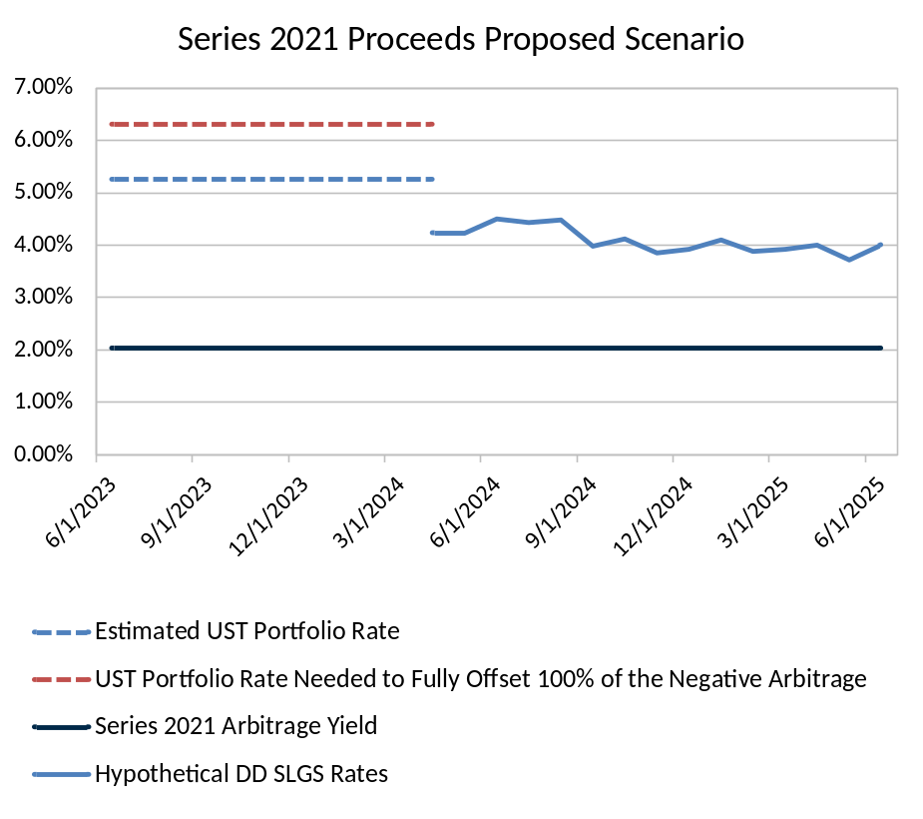
Series 2021 Bond Proceeds Investment Strategy and discussion
The combination of high taxable rates in the current market and the likelihood that funds are anticipated to be remaining unspent as of the 3rd anniversary of the Series 2021 issuance presents the District with a unique investment opportunity
  The high taxable rates, which are well in excess now above the 2.03% Series 2021 federal arbitrage yield, present an opportunity to invest the remaining funds in a manner to fund anticipated draws through the 3-year anniversary and limit the maturity on the remaining funds to no later than the 3rd anniversary of the issue
  Such a term limitation should enable the District to generate earnings at a rate well above 4.00% which can generate positive arbitrage to help recover some of the approximate $1.3 million of accumulated negative arbitrage in the Construction Fund
  After the 3rd anniversary of issuance, the District can avoid yield restriction on the remaining funds by investing all remaining funds at that time in Demand Deposit SLGS (described more fully herein)
6.30%
5.25%
Positive Arbitrage of $980,000 to Partially Offset Negative Arbitrage of $1.3 Million
Any Yield Above 2.03% Generates Positive Arbitrage NOT Subject to Rebate
2.03%
April 2024: 3-Year Anniversary of Series 2021 Issuance
The net outcome is the District can utilize the high taxable rates to recapture the some of the accumulated negative arbitrage and capitalize on the really low 2.03% arbitrage yield by investing in the tax-exempt demand deposit SLGS to generate earnings above 2.03% which will not be subject to rebate
As long as the demand deposit SLGS rate exceeds that of the 2.03% arbitrage yield it will make sense to leave remaining funds invested in those whereas if the demand deposit SLGS rate declines below the 2.03% rate, then the District should shift the investments to taxable instruments to lock in at LEAST the 2.03% rate to avoid subsequently re-incurring more negative arbitrage
The entire program should be vetted with bond counsel prior to implementation

Slide 5
Investment alternative with U.S. Treasuries & demand deposit slgs – Series 2021 Bonds
Investment Scenario | Estimated Yield | Investment Amount | Estimated Earnings
Series of 2021 Project Fund
Scenario 1a: Earnings Limited to Arbitrage Yield up to 3-Year Issuance Anniversary (April 2024) | 2.03% | $47,700,000 | $660,540
Scenario 2b: Remaining Draws after 3-Year Issuance Anniversary (April 2024) Invested at Arbitrage Yield | 2.03% | $27,825,000 | $348,400
Scenario 2a: Earnings from Draws Invested in U.S. Treasuries up to 3-Year Issuance Anniversary (April 2024) | 5.25% | $47,700,000 | $1,640,748
Scenario 2b: Remaining Draws after 3-Year Issuance Anniversary (April 2024) Invested in Demand Deposit SLGS | 4.23% | $27,825,000 | $741,557
*Market Rates as of June 6, 2023, and subject to change
**Does not assume compounding
The earnings assumptions in the table above assumes the District spends its remaining Series 2021 Project Fund proceeds of $47.7 million over 24, equal monthly installments through June 2025.*
The scenarios presented above are structured as follows:
  Scenario 1a: Highlights the earnings the District could keep if the investment yield was restricted to the arbitrage yield of 2.03% up to the 3-Year Issuance Anniversary of April 2024.
  Scenario 1b: Highlights the earnings the District could keep if the investment yield was restricted to the arbitrage yield of 2.03% after the 3-Year Issuance Anniversary of April 2024.
  Scenario 2a: Illustrates the potential investment earnings assuming the District invests the remaining proceeds in U.S. Treasury securities up to the 3-Year Issuance Anniversary of April 2024 to recapture some or all of the previously accrued negative arbitrage.
  Scenario 2b: Illustrates the potential investment earnings assuming the remaining draws after the 3-Year Issuance Anniversary of April 2024 are invested in the current demand deposit SLGS rate of 4.23% throughout the remainder of the 24-month draw schedule.
*Source: April 30, 2023 PSDLAF statement
Notes:
Share\GDNT\Rate History Charts (New RJMK) main file – Chart Pack Charts tab

Slide 6
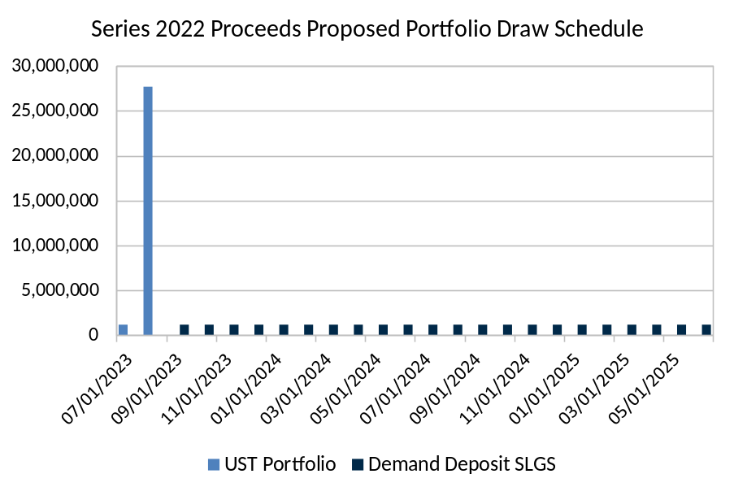
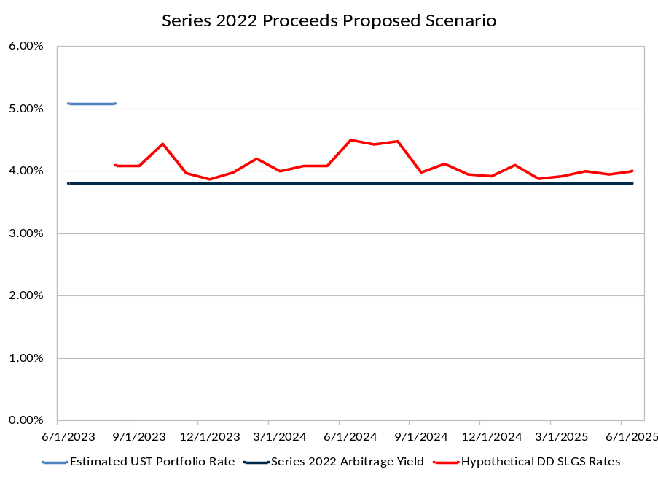
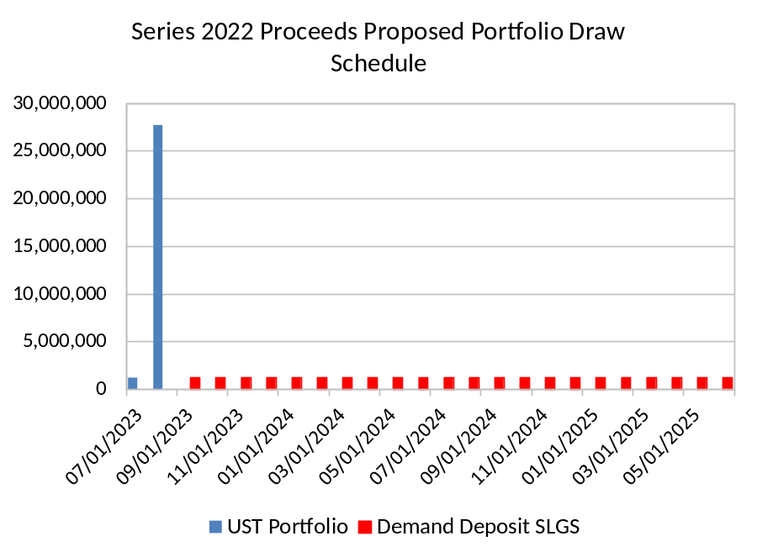
Series 2022 Bond Proceeds Investment Strategy and discussion
The combination of current high taxable and tax-exempt Demand Deposit SLGS rates in the current market present the District with a unique investment opportunity with respect to the Series 2022 Bonds
  The high taxable rates, which are well in excess now above the 3.80% Series 2022 federal arbitrage yield, present an opportunity to invest all of the remaining funds for a short period of time at a yield in excess of the 3.80% in order to re-capture all of the approximate $56,000 of accumulated negative arbitrage in the Construction Fund
  The balance of funds for the remaining draws after the first short-term investment can be invested in Demand Deposit SLGS at a rate in excess of the 3.80% federal arbitrage yield, and as long as the variable demand deposit SLGS rate remains above the 3.80% arbitrage yield, the District can keep all of that positive arbitrage as it will be exempt from rebate
The entire program should be vetted with bond counsel prior to implementation
Any Yield Above 3.80% Generates Positive Arbitrage NOT Subject to Rebate
5.17%
3.80%
Positive Arbitrage From Investing In UST for 2 Months to Offset $56,000 of Negative Arbitrage

Slide 7
Investment alternative with U.S. Treasuries & demand deposit slgs – Series 2022 Bonds
Investment Scenario | Estimated Yield | Investment Amount | Estimated Earnings
Series of 2022 Project Fund
Scenario 1a: Earnings Limited to Arbitrage Yield for Initial 2 Months | 3.80% | $28,900,000 | $182,051
Scenario 2b: Earnings Limited to Arbitrage Yield for Remaining Draws after 2 Months | 3.80% | $26,491,667 | $933,578
Scenario 2a: Earnings from Draws Invested in U.S. Treasuries for 2 Months to Recover Negative Arbitrage | 5.17% | $28,900,000 | $239,862
Scenario 2b: Remaining Draws after 2 Months Invested in Demand Deposit SLGS | 4.23% | $26,491,667 | $1,103,744
*Demand Deposit SLGS and UST Rate as of June 6, 2023, and subject to change
**Does not assume compounding
The earnings assumptions in the table above assumes the District spends its remaining Series 2022 Project Fund proceeds of $28.9 million over 24, equal monthly installments through June 2025.*
The scenarios presented above are structured as follows:
  Scenario 1a: Highlights the earnings the District could keep if the investment yield was restricted to the arbitrage yield of 3.80% if invested for two months.
  Scenario 1b: Highlights the earnings the District could keep if the investment yield was restricted to the arbitrage yield of 3.80% for the remaining proceed after the initial two-month investment.
  Scenario 2a: Illustrates the rate needed on a two-month U.S. Treasury investment to recapture all of the previously accrued negative arbitrage of approximately $56,000.
  Scenario 2b: Upon maturity of the U.S. Treasury investment and the full recapture of negative arbitrage, this scenario assumes the remaining proceeds are invested at the current Demand Deposit SLGS rate of 4.23% through the end of the draw schedule in June 2025.
*Source: April 30, 2023 PSDLAF statement
Notes:
Share\GDNT\Rate History Charts (New RJMK) main file – Chart Pack Charts tab

Slide 8
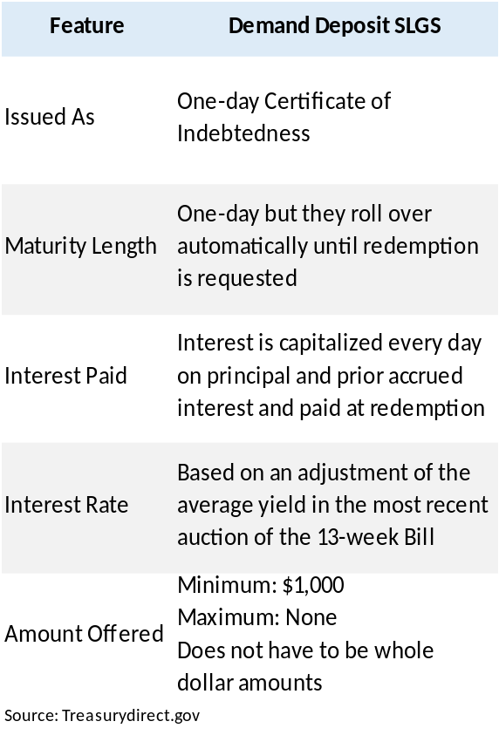
Demand deposit slgs overview
What Are Demand Deposit SLGS?
  Variable rate securities backed by the full faith and credit of the U.S. government.
  Have a maturity length of one day which are reinvested daily at the next day’s rate.
  Interest is reinvested and paid out upon redemption.
Procurement and Redemption Process
  Procured in the same manner as Time Deposit SLGS through the SLGSafe platform by the client’s custodian.
  Once purchased, the balance is automatically reinvested the next day until the client asks the custodian to submit a redemption request.
  If withdrawing less than $10 million at one time, the Treasury only needs one business day’s notice with the redemption request submitted through the SLGSafe platform.
Benefit of Demand Deposit SLGS
  Provides the client with 24-hour liquidity similar to a money market account.
  Allows the client to potentially generate legally retainable positive arbitrage above the bond yield.
Considerations
  Based upon comments from Treasurer Yellen, the federal government may reach the debt ceiling by June 1 or shortly thereafter in the summer 2023, and as a result has temporarily closed the SLGS window. As a result, the District will have to wait until the SLGS window re-opens in order to access this portion of the investment program.
Source: Treasurydirect.gov

Slide 9
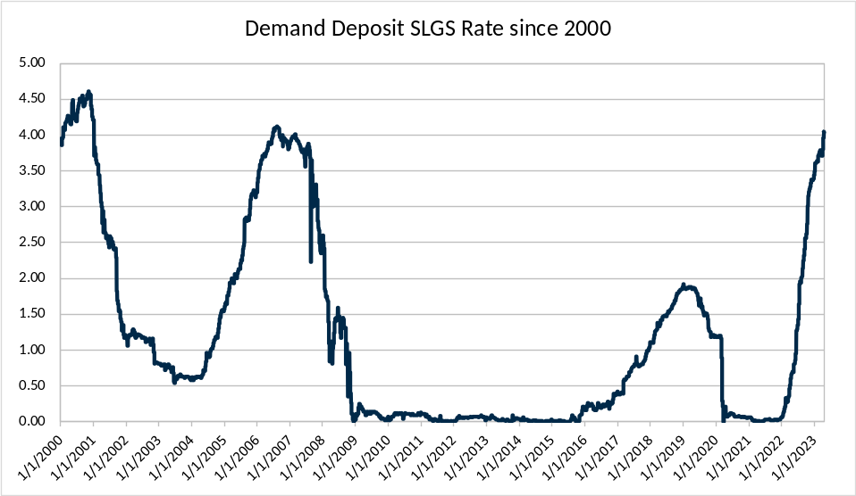
Demand deposit slgs overview (cont.)
Demand Deposit SLGS Pricing
  Priced off of the most recent 13-week T-Bill auction minus some spread.
  Given these securities are priced at a level below the prevailing short-term taxable rate, these securities are treated like non-AMT tax-exempt municipal securities and are exempt from rebate.*
  Current rate as of May 10, 2023 is 4.09%.
What Happens During a SLGS Window Closure?
  If the SLGS Window is closed while funds are invested in Demand Deposit SLGS, the Demand Deposit SLGS convert to normal Time Deposit SLGS with a 90-day maturity at the prevailing Demand Deposit SLGS rate at the window closure.
  Even though the security is converted to a Time Deposit SLG, clients are able to redeem this security early according to the Demand Deposit SLGS redemption rules without a penalty.
Subject to change on a daily basis
*Always confirm with bond and/or tax counsel

Slide 10
Arbitrage Relationship of expenditures and Demand deposit slgs rates
With respect to the Series 2021 Proceeds, once the taxable investments mature and Demand Deposit SLGS are procured (or Demand Deposit SLGS may be initially purchased soon after the plan starts to provide liquidity), then:
  To the extent short-term rates increase and it takes longer than planned to expend the funds, the District will have a greater chance to earn more earnings exempt from rebate.
  To the extent short-term rates decline and/or funds are expended faster than planned, the District will likely earn less earnings exempt from rebate.
With respect to the Series 2022 Proceeds, again, to the extent it takes longer to expend the proceeds and Demand Deposit SLGS rates remain higher, the more potential retainable arbitrage there will be
Higher Rates
Less Arbitrage
More Arbitrage
Faster Expenditures
Lower Rates
Slower Expenditures

Slide 11
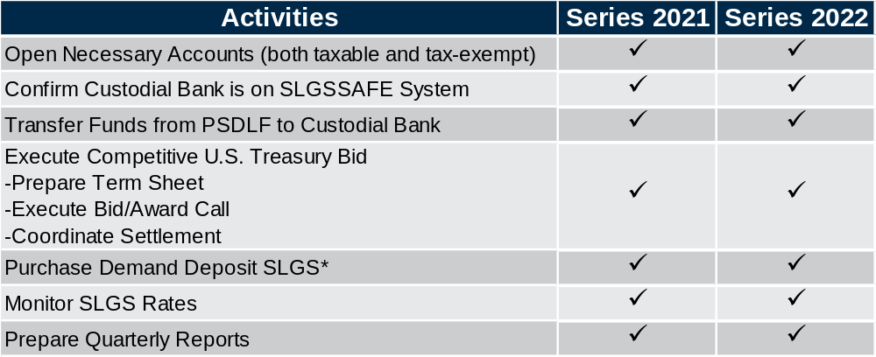
Potential action steps
*SLGS window is currently closed but as soon as window re-opens, SLGS can be purchased

Slide 12
Disclaimer
The information contained herein is solely intended to facilitate discussion of potentially applicable financing applications and is not intended to be a specific buy/sell recommendation, nor is it an official confirmation of terms. Any terms discussed herein are preliminary until confirmed in a definitive written agreement. While we believe that the outlined financial structure or marketing strategy is the best approach under the current market conditions, the market conditions at the time any proposed transaction is structured or sold may be different, which may require a different approach.
The analysis or information presented herein is based upon hypothetical projections and/or past performance that have certain limitations. No representation is made that it is accurate or complete or that any results indicated will be achieved. In no way is past performance indicative of future results. Changes to any prices, levels, or assumptions contained herein may have a material impact on results. Any estimates or assumptions contained herein represent our best judgment as of the date indicated and are subject to change without notice. Examples are merely representative and are not meant to be all-inclusive.
Raymond James shall have no liability, contingent or otherwise, to the recipient hereof or to any third party, or any responsibility whatsoever, for the accuracy, correctness, timeliness, reliability or completeness of the data or formulae provided herein or for the performance of or any other aspect of the materials, structures and strategies presented herein.
Raymond James does not provide accounting, tax or legal advice; however, you should be aware that any proposed transaction could have accounting, tax, legal or other implications that should be discussed with your accounting, tax and other advisors and/or legal counsel.
Raymond James and affiliates, and officers, directors and employees thereof, including individuals who may be involved in the preparation or presentation of this material, may from time to time have positions in, and buy or sell, the securities, derivatives (including options) or other financial products of entities mentioned herein. In addition, Raymond James or affiliates thereof may have served as an underwriter or placement agent with respect to a public or private offering of securities by one or more of the entities referenced herein.

