Slide 1

PEQUEA VALLEY
EARLY LEARNING PROGRAMS
Building Braves: A program committed to helping children become kindergarten ready by empowering parents to be their child's first teacher and promoting positive connections to their school district and community.

Slide 2
PATH TO FIRST CHOICE
Proficient Readers
Learners have academic and social emotional supports in school.
Positive Learning environment in home.
After School and Mentorship programs.
Families have basic needs met.
Graduate High School
Ninth grade Career Ready Course
Graduate high school, with post secondary first choice.
Plan for future with supports in place to achieve goals.
First Choice Portfolio Sr Presentation
Families have basic needs met.
Healthy Families
Books In Homes
PAT- Parent Supports
Play and Learns
Preschool Programs
Positive Learning Environment
Families have basic needs met
.
Middle School
Adult
Kindergarten
Birth-5
End of 3rd Grade
High School
Kindergarten Ready
Kindergarten Transition Programs
Learners have academic and social emotional learning experiences.
Elementary School Supports
Positive learning environment in home.
Families have basic needs met
End Generational Poverty Cycle
Complete post secondary plan and become contributing member of community.
Families have basic needs met.
Families have supports and resources to start path to first choice for children.
Begin Path To First Choice
Learners have support in making post secondary First Choice choice.
CORE program, academic and social emotional supports.
Youth center opportunities.
Positive Learning environment in home.
Families have basic needs met.
Prep for Success Career Ready Course

Slide 3
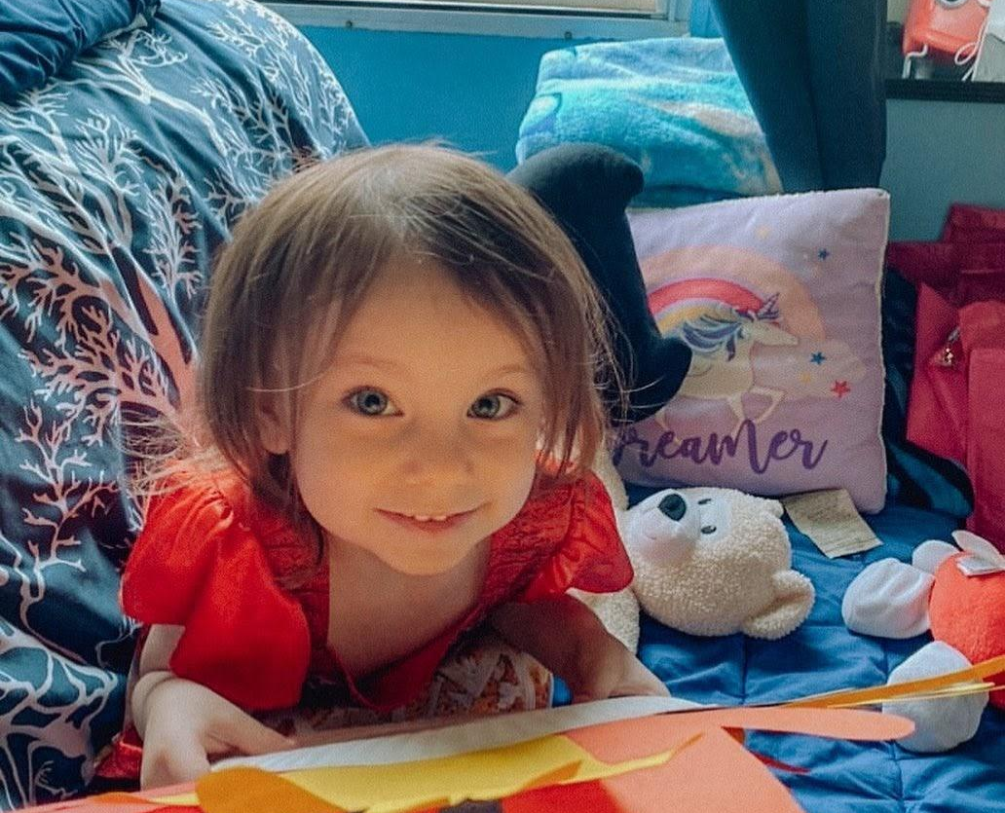
EARLY LEARNING PROGRAMS
Outreach
Play and Learns
Home Visiting
Kindergarten Transition
“I really love and appreciate what everyone does…It has helped my family so much and I’m just forever grateful. Chloe is going to have so much fun and will be learning at the same time.”

Slide 4
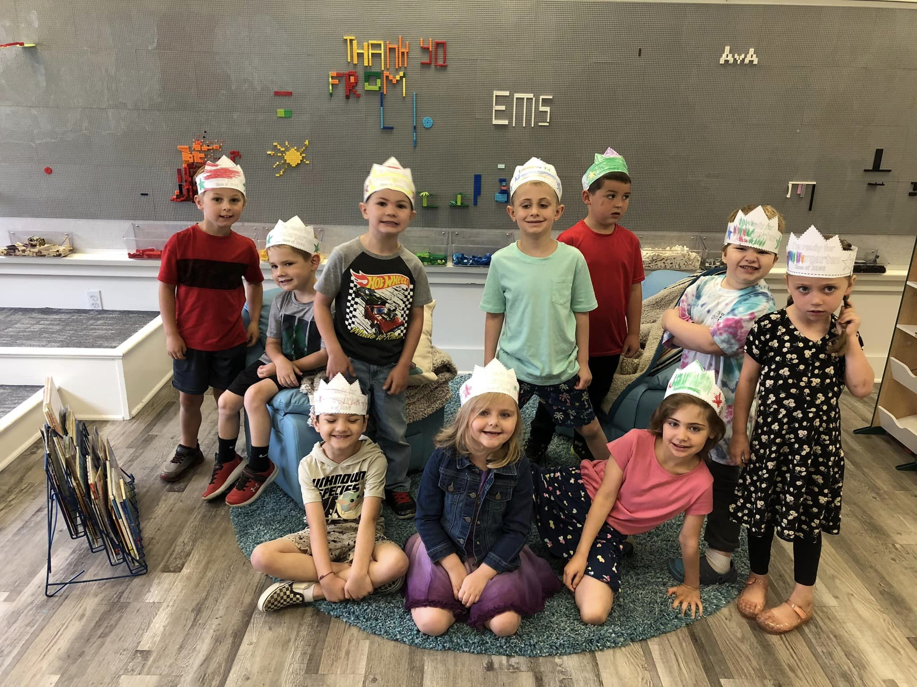
EARLY LEARNING PROGRAMS
2022-2023
237 Households Served
302 Children Assisted
3,410 New Books Received
291 Hours of Programming

Slide 5
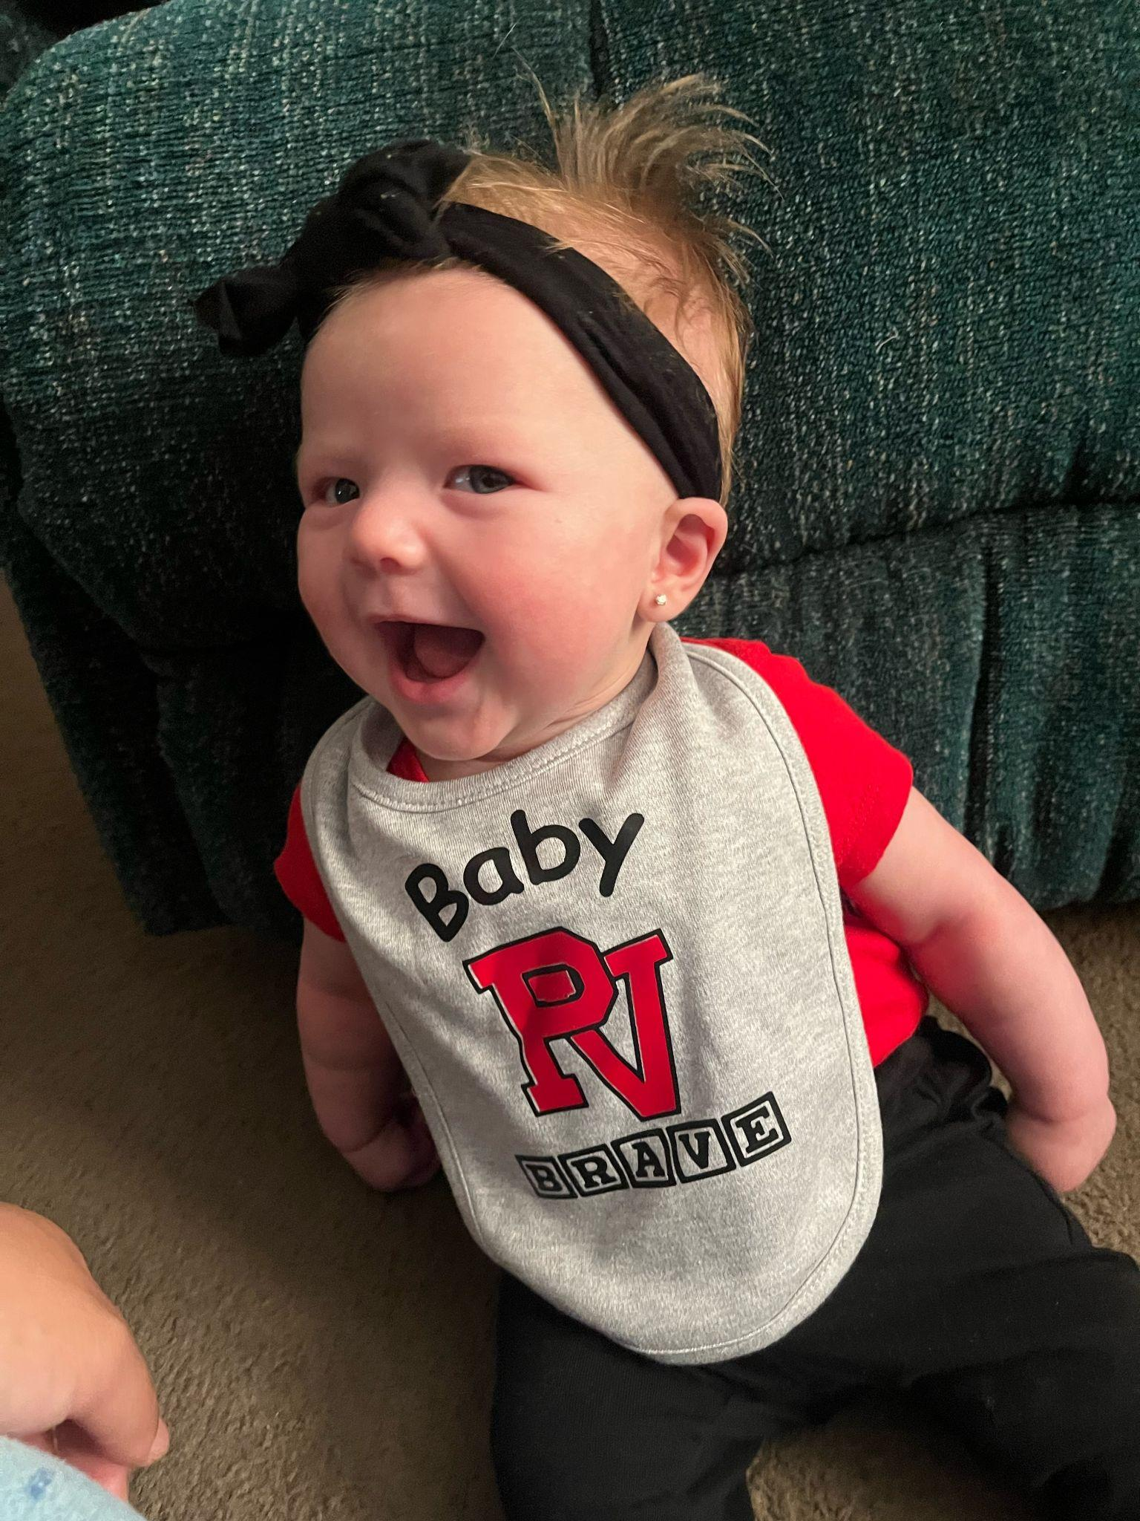

OUTREACH
Provide families with resources, activities, and child development information while connecting them to PV School District and Early Learning Team.
Welcome Baby Brave Kits - 30 kits delivered
Imagination Library- 229 children enrolled and 2421 new books mailed to PV early learners.
Preschool Referrals

Slide 6
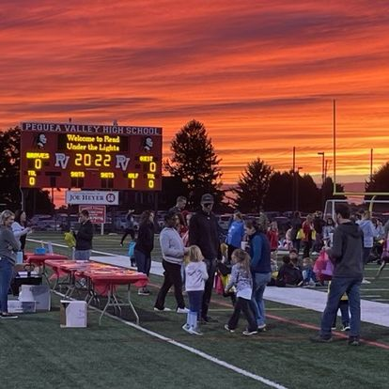
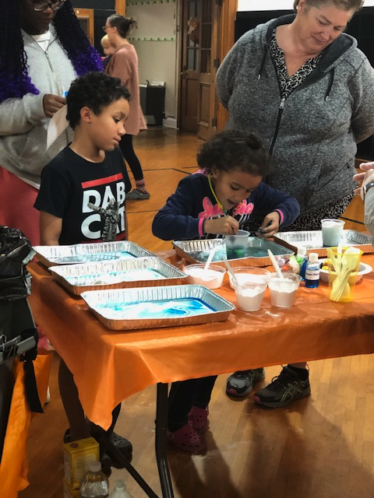
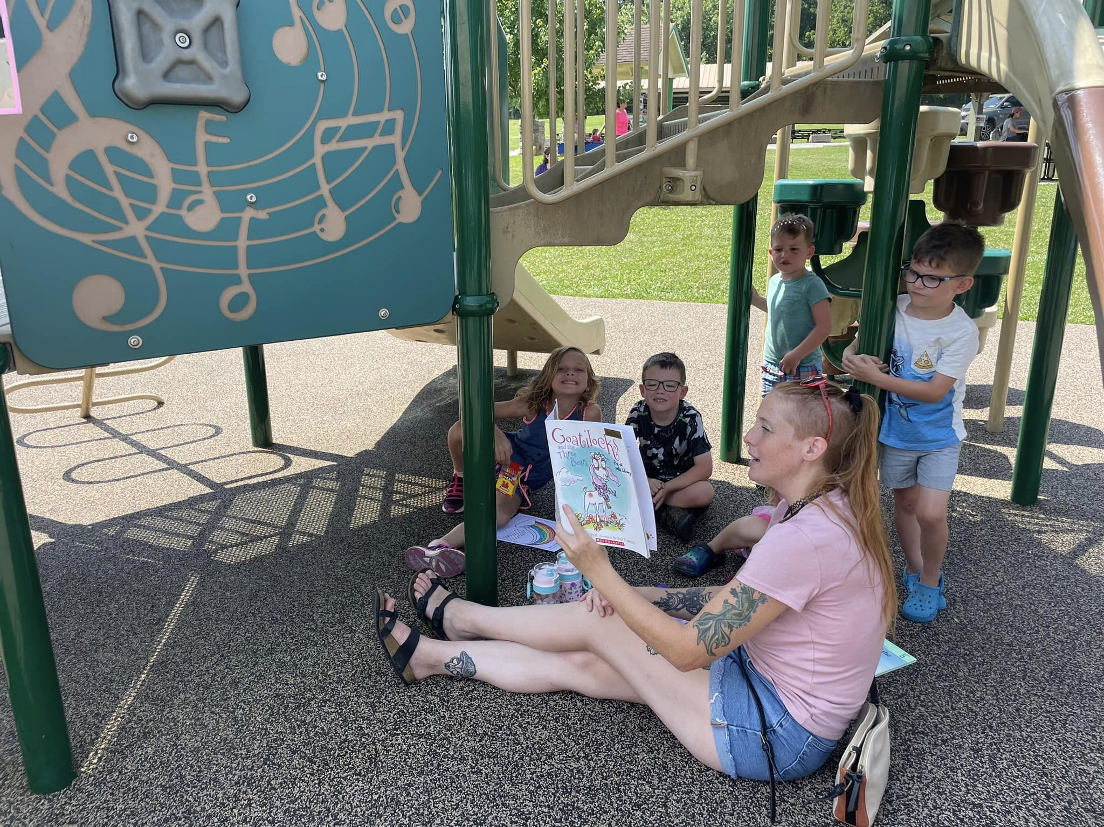
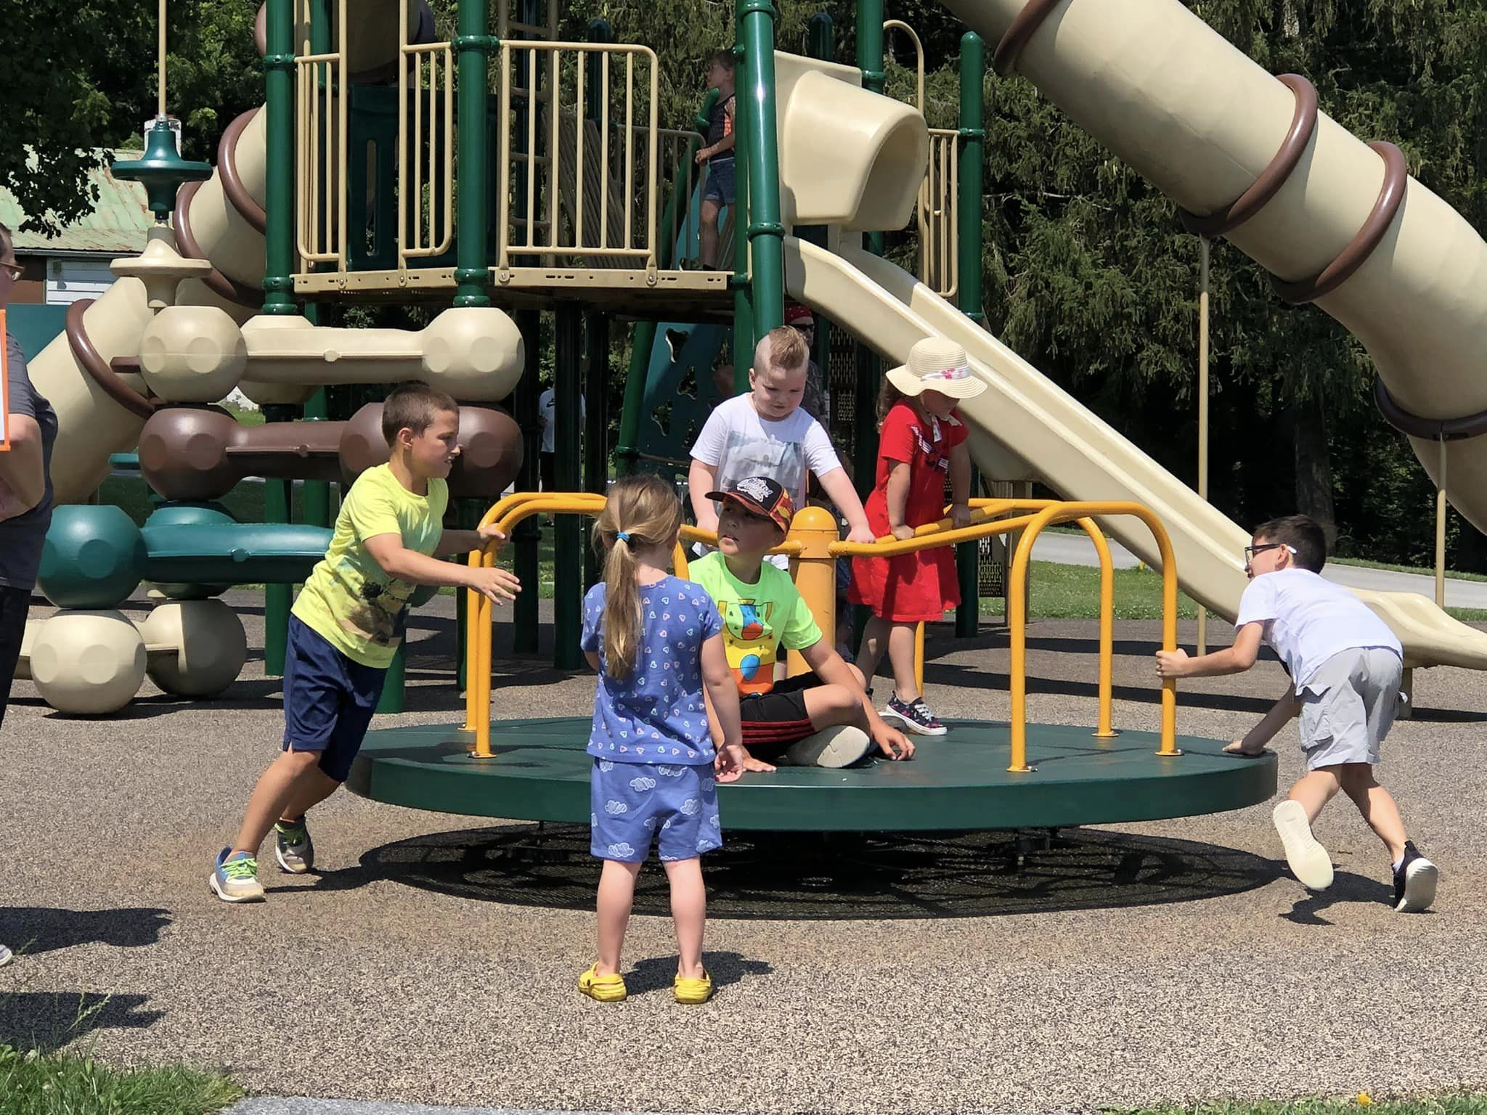
OUTREACH
Summer 2022 PV Lunch and Learn Program- 62 families, 157 learners.
Read Under the Lights 2022 attendance 288 learners, 161 parents/caregivers, 72 athletes (10 teams), 17 volunteers.
Braves Full STEAM Ahead - 15 families, 36 learners.

Slide 7
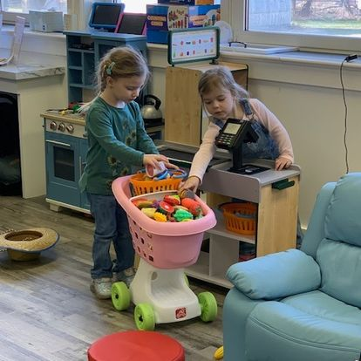
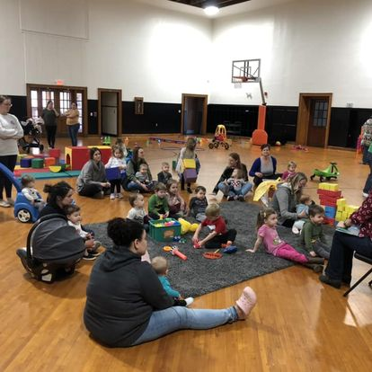
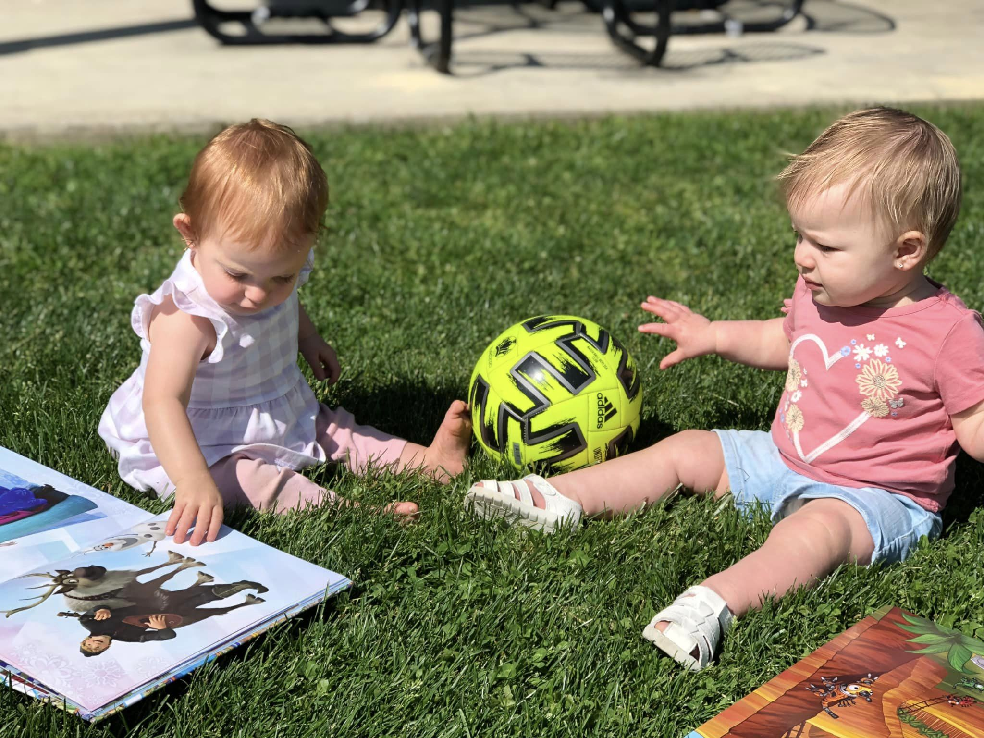
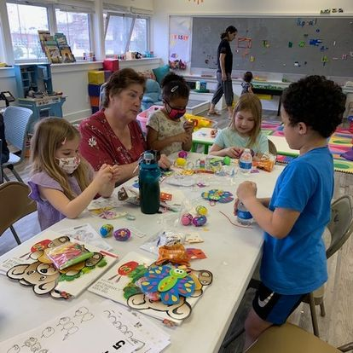
PLAY AND LEARNS
2022-2023
113 children attended
45 hours of play and learn programming.
Paradise Park Playdates
Braves Book Clubs
Braves Open Gym
PTSL/GTSL
STEM Connections
“My child loves the activities and books… I love the chance to interact with other moms..”

Slide 8
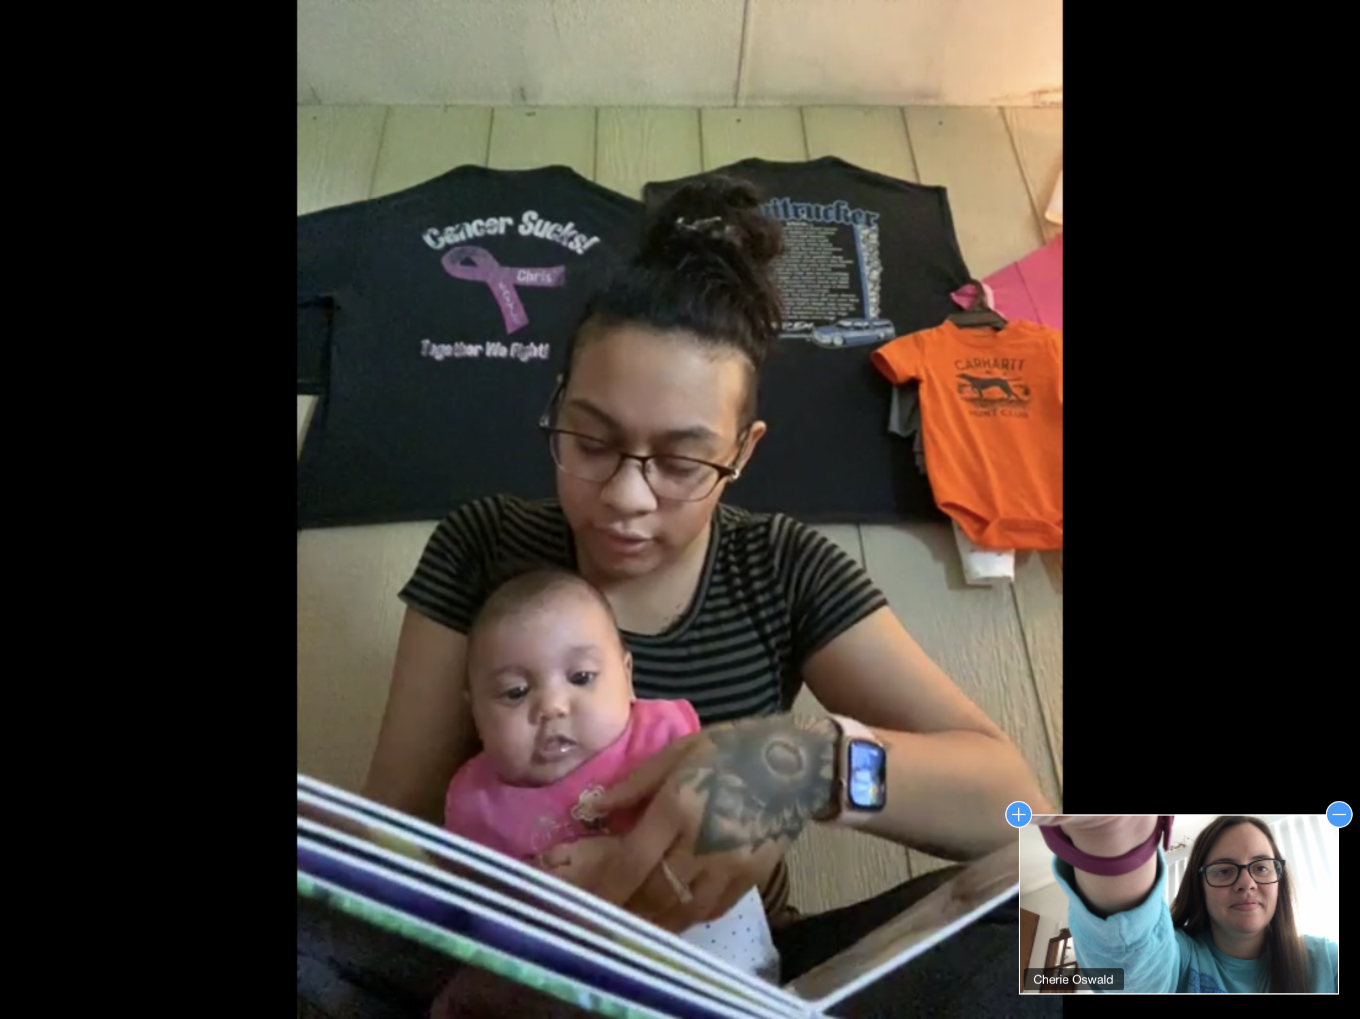
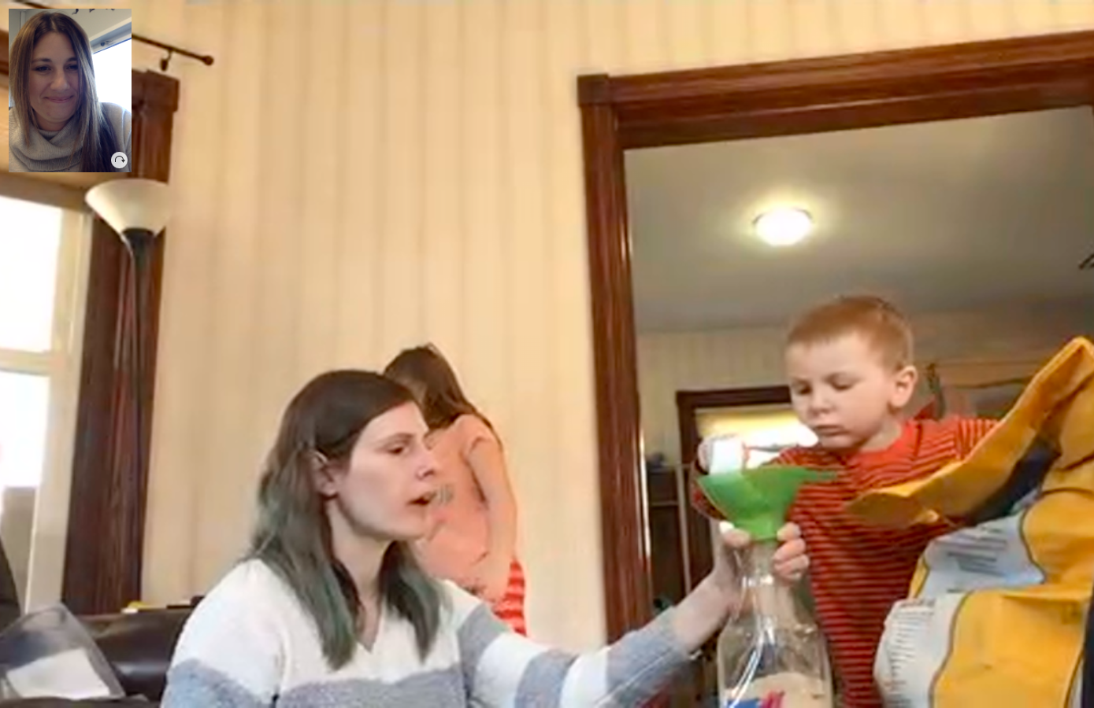
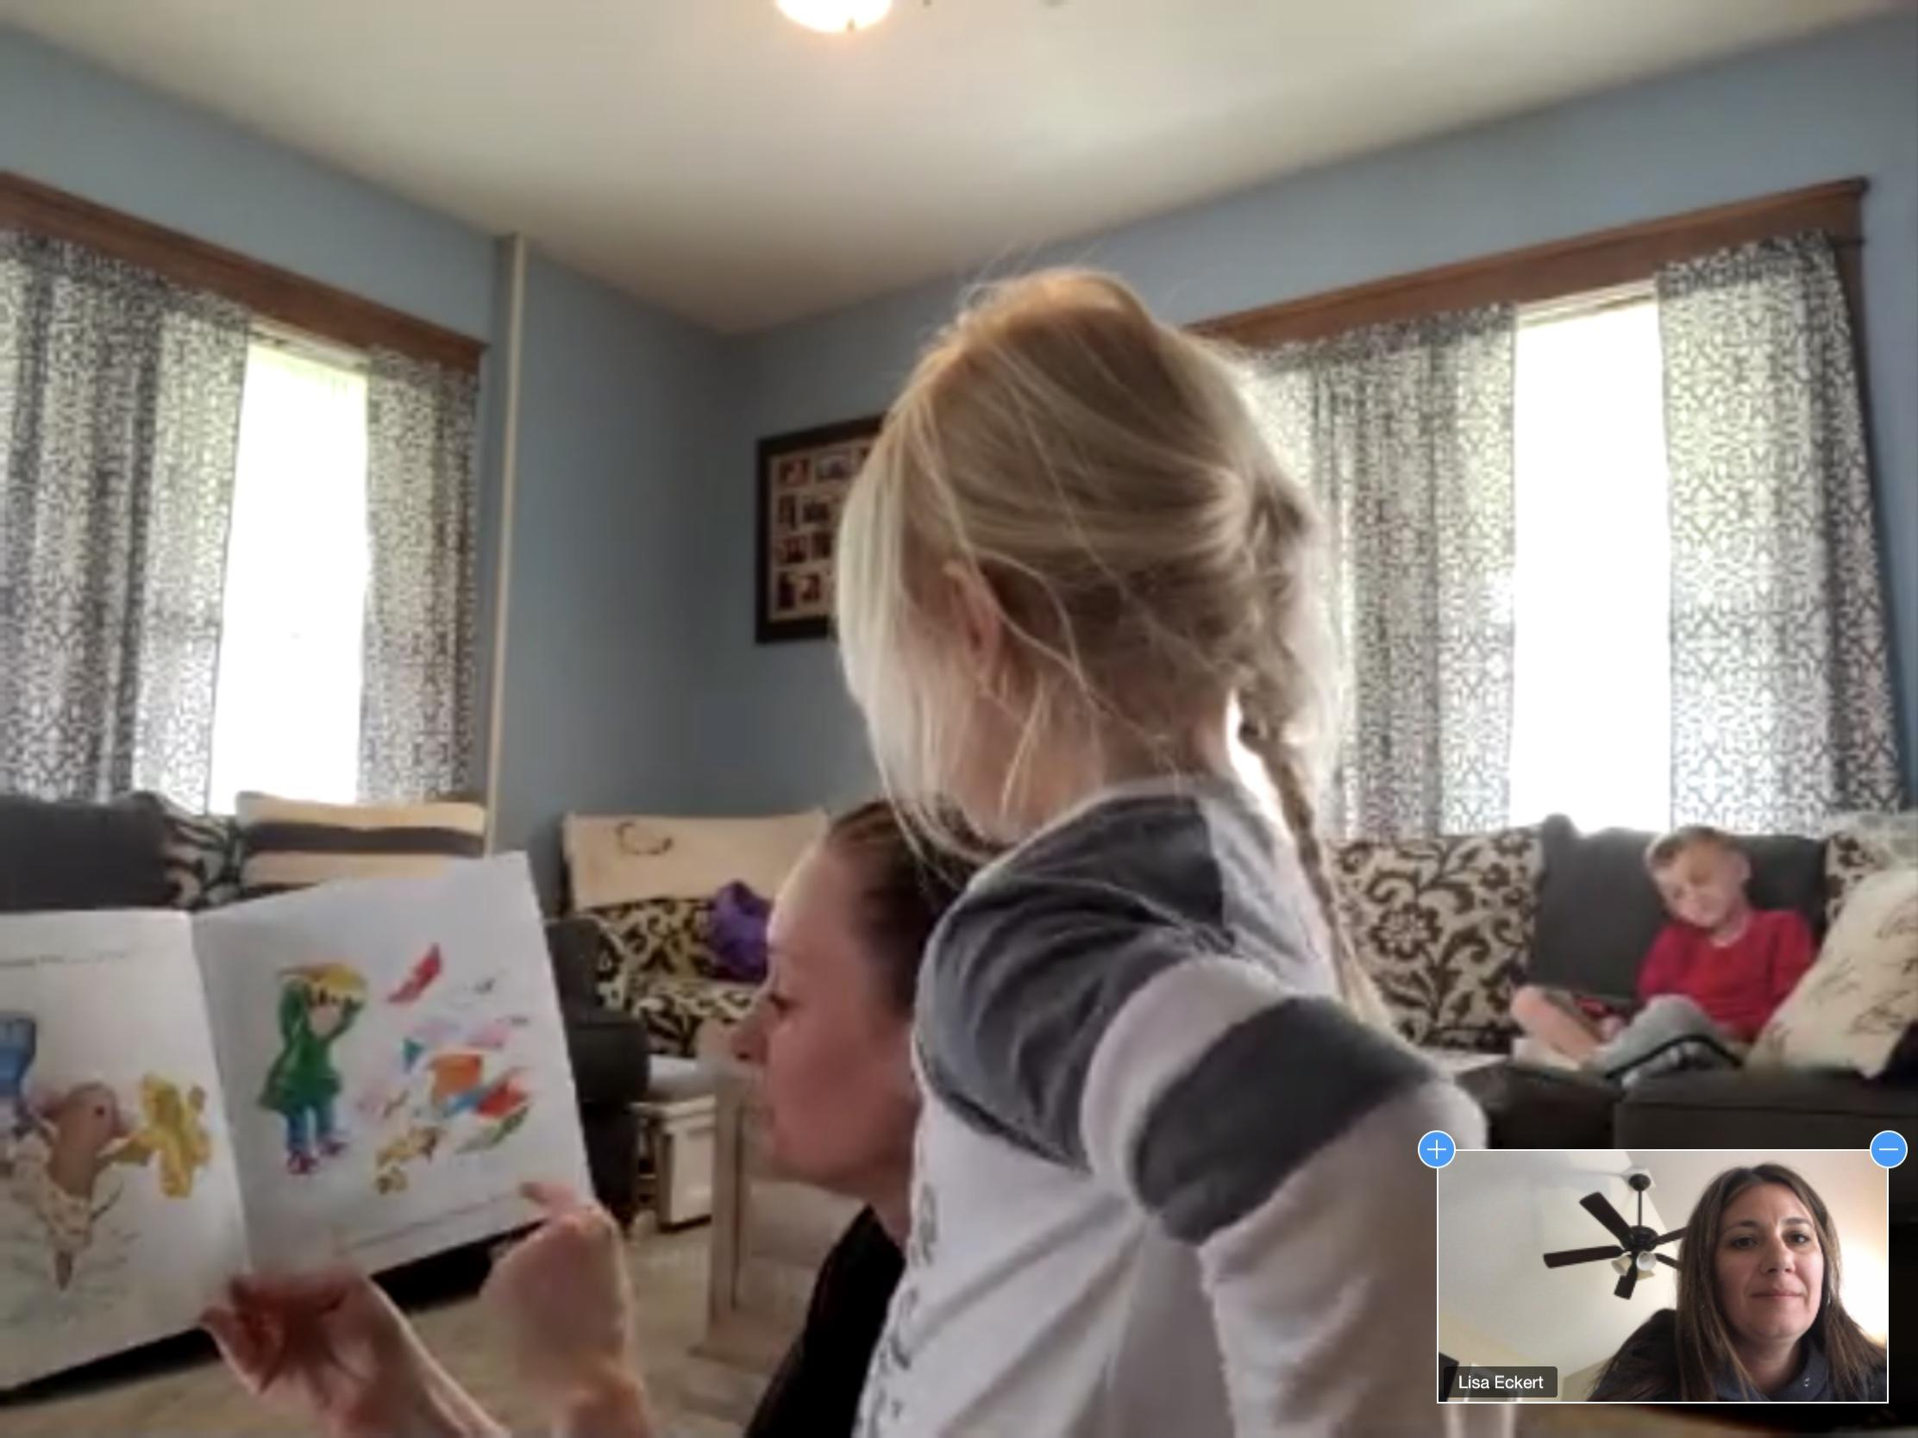
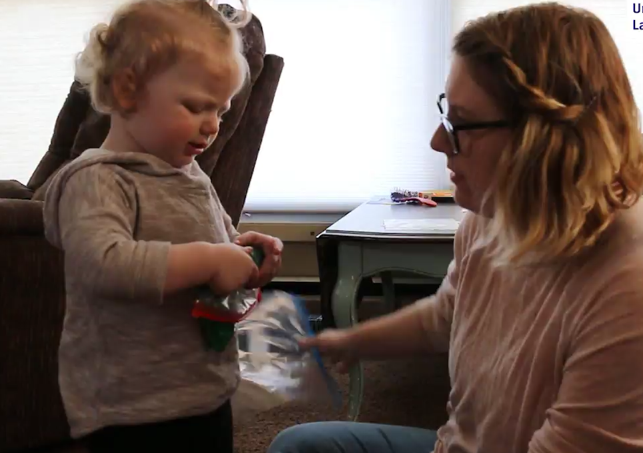
HOME VISITING
Parents as Teachers
A total of 22 children and 18 families served.
11 new families enrolled this year.
Over 190 hrs of home visits.
100% of home visiting parents reported positive connection to the school district, children have access to books, and families acknowledged the importance of reading to child daily.
“This program has been a big help and support to my family and kids. I have seen so many improvements in not only my children but myself.”

Slide 9
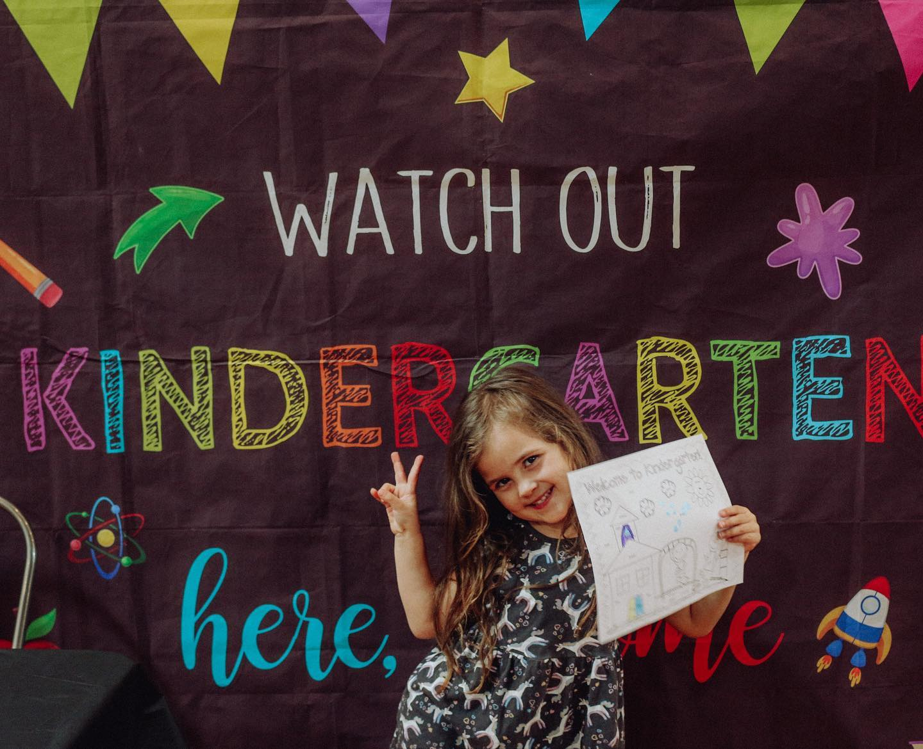
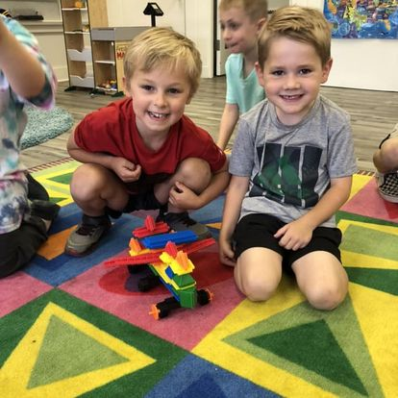
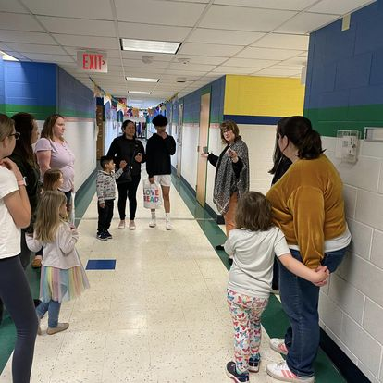
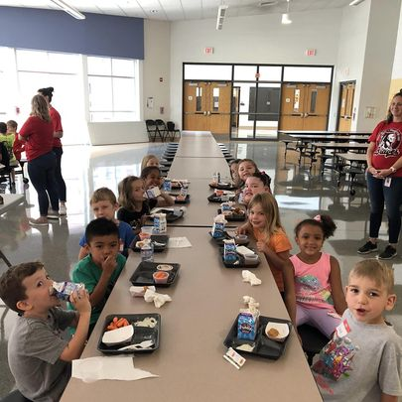
KINDERGARTEN TRANSITION
2023
Kindergarten EXPO: 90 learners/caregivers attended
Kindergarten Readiness Kits: 74 kits delivered
Kindergarten Registration and Screening:
Kindergarten Transition Nights: 42 learners attended
STEM Connections Program: 12 learners attended
Kindergarten Ready Camp: 24 learners attended
Popsicles on the Playground
“I am so thankful for these opportunities for our earliest learners to "transition" to the school. I love that they were able to meet different adults and tour the building!”

Slide 10
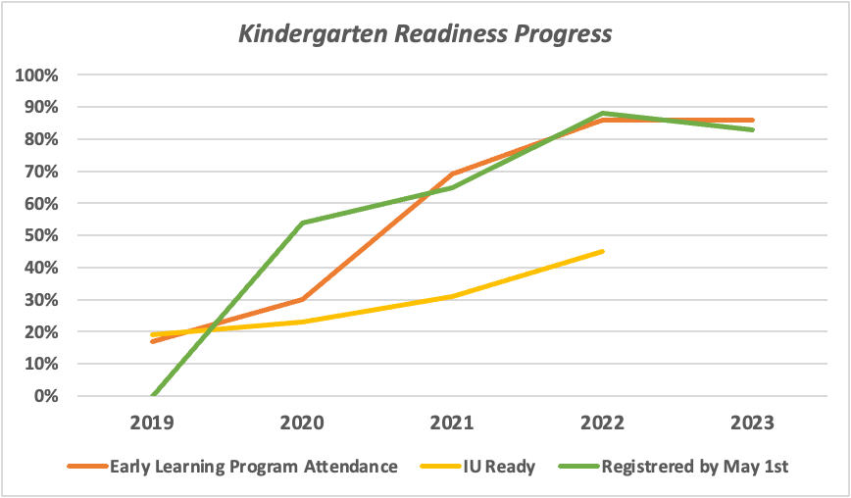
KINDERGARTEN READINESS
Early Learning Program attendance 17% to 86%
Increase of 69%
IU Readiness 19% to 45%
Increase of 26%
Early Registration 54% to 88%
Increase of 34%

Slide 11
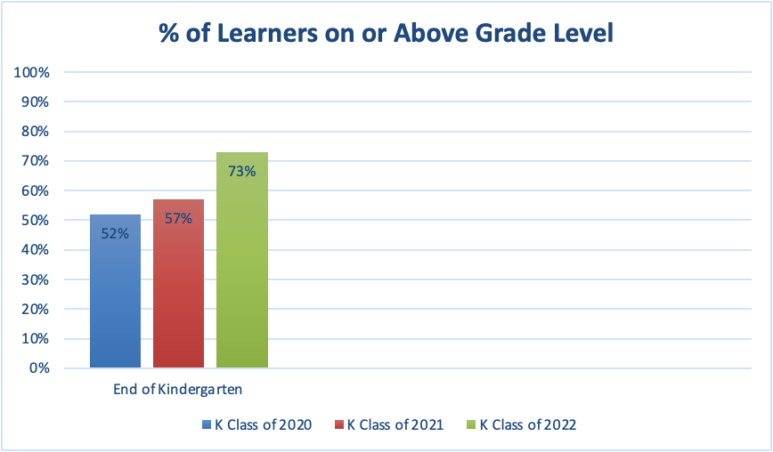
MAP Data Impact
Kindergarten learners on or above grade level at end of Kindergarten 52% to 73%
Increase of 21%

Slide 12
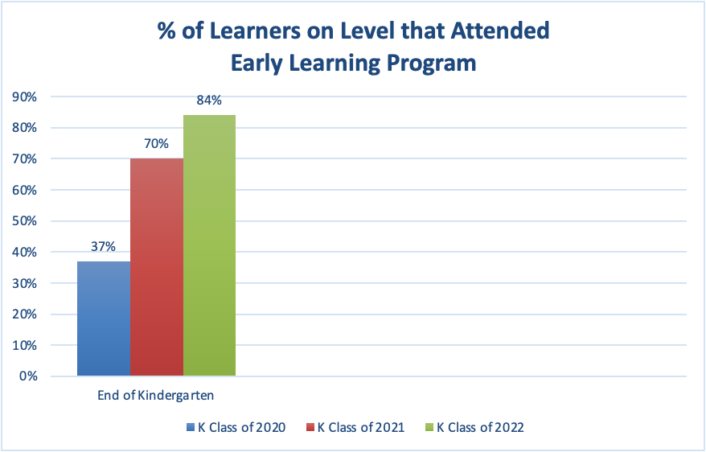
MAP Data Impact

Slide 13
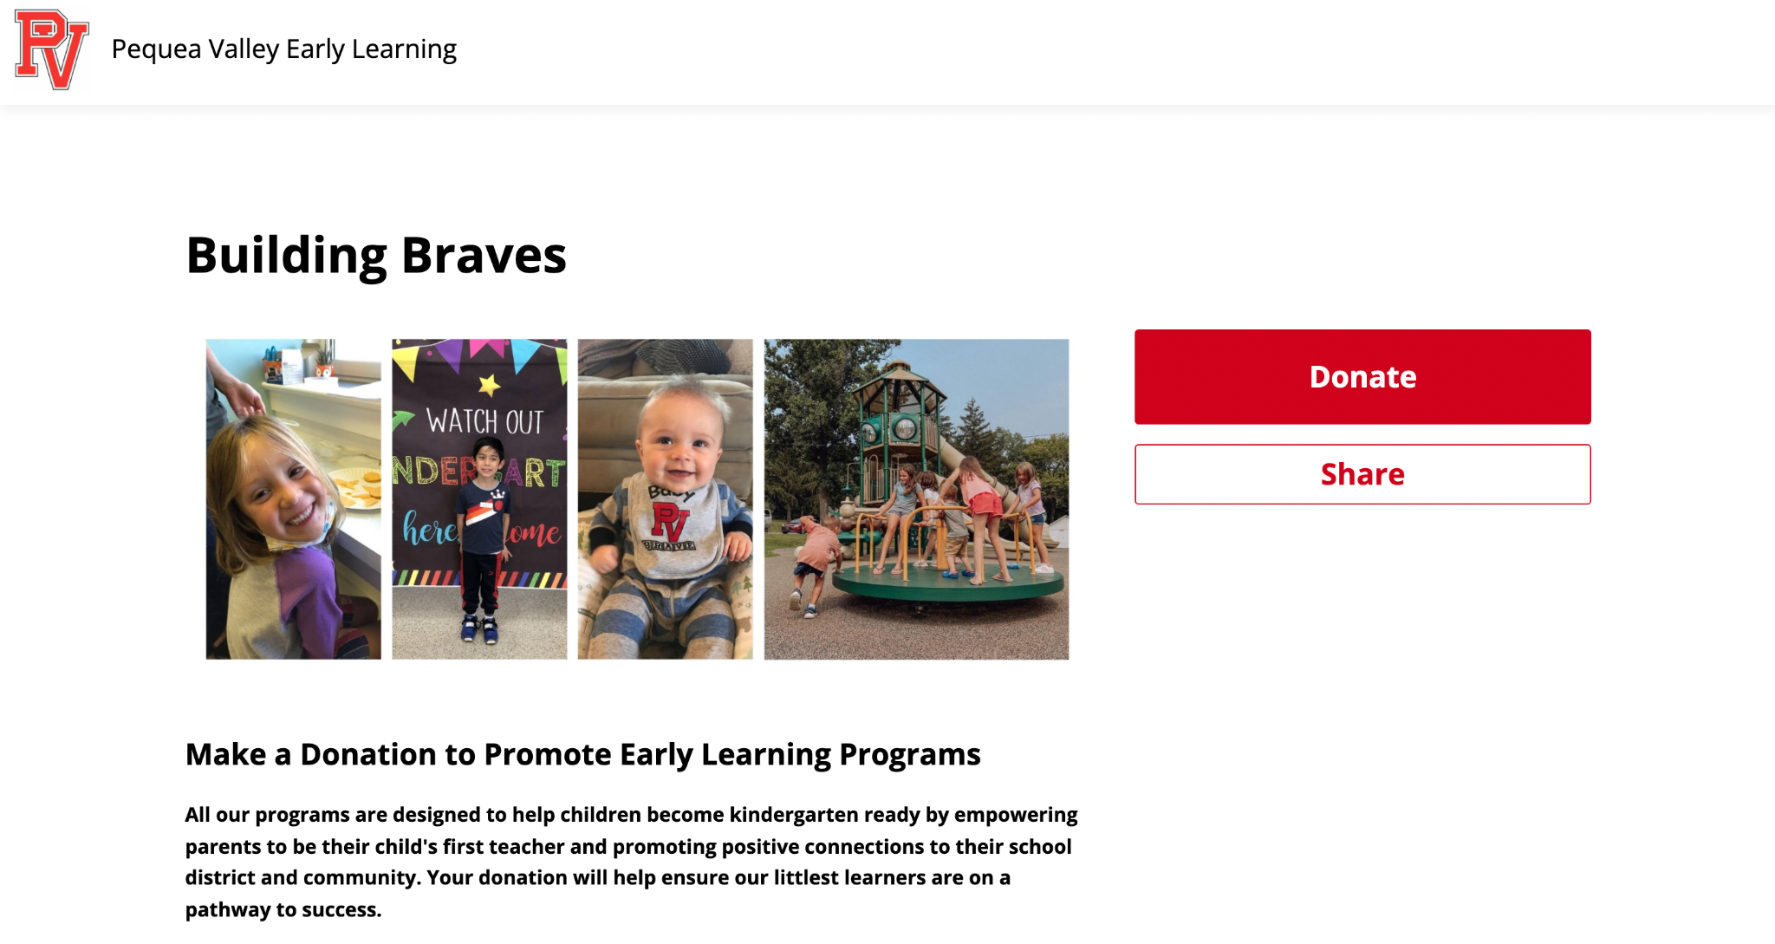
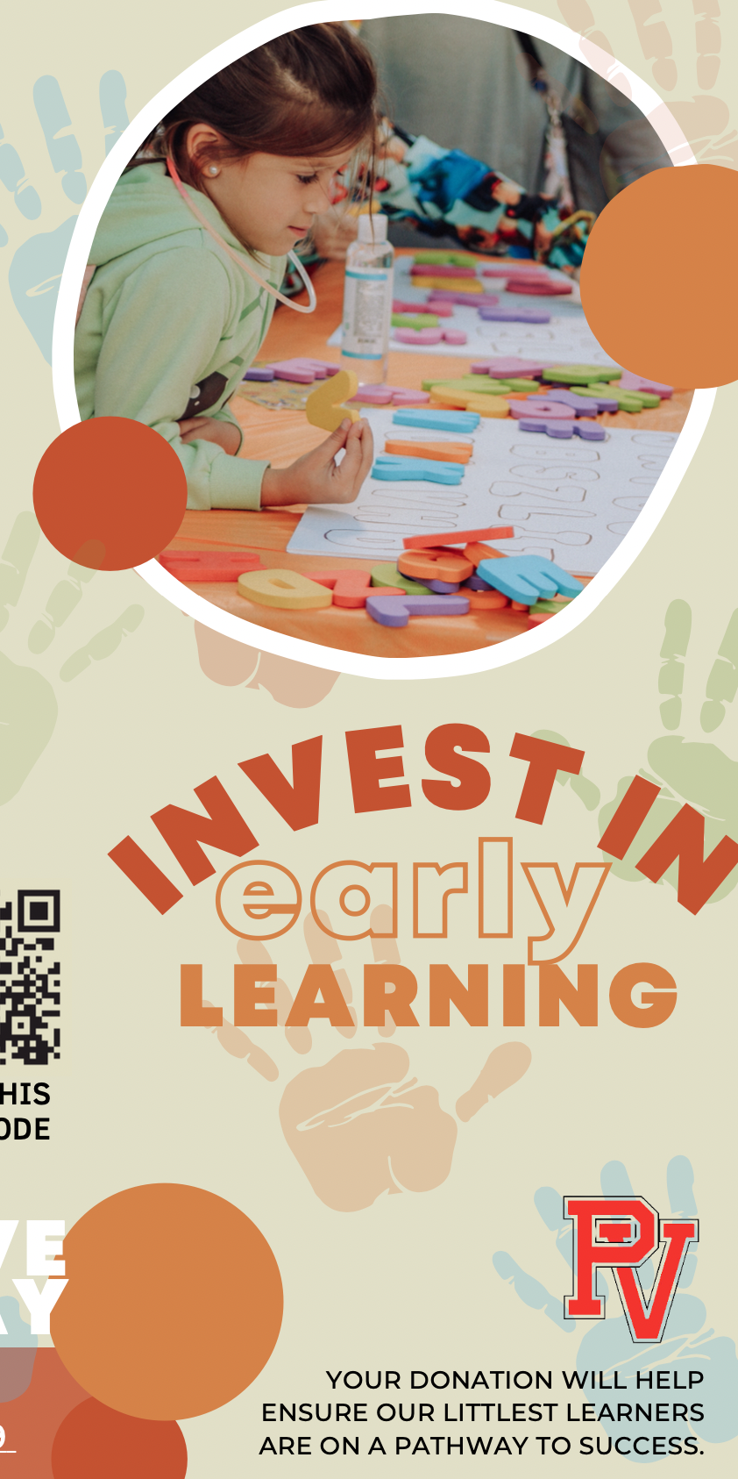
Investing in Early Learning
PV Early Learning Program is committed to community engagement and outreach with the goal of gaining additional support financially to aid in program sustainability and growth.
Partnership with Staples
Paradise Rotary Club Grant
STEM Connections Grant (CAP Partnership)
Touchstone Play and Learn Grant (CAP Partnership)
Lancaster Legacy Foundation (Factory Partnership)
Support of the TIN (Together Initiative Network) adaptation of goal to increase 3rd grade reading scores to 90% in 5 years.
https://tinyurl.com/pvfunraise

