Slide 1

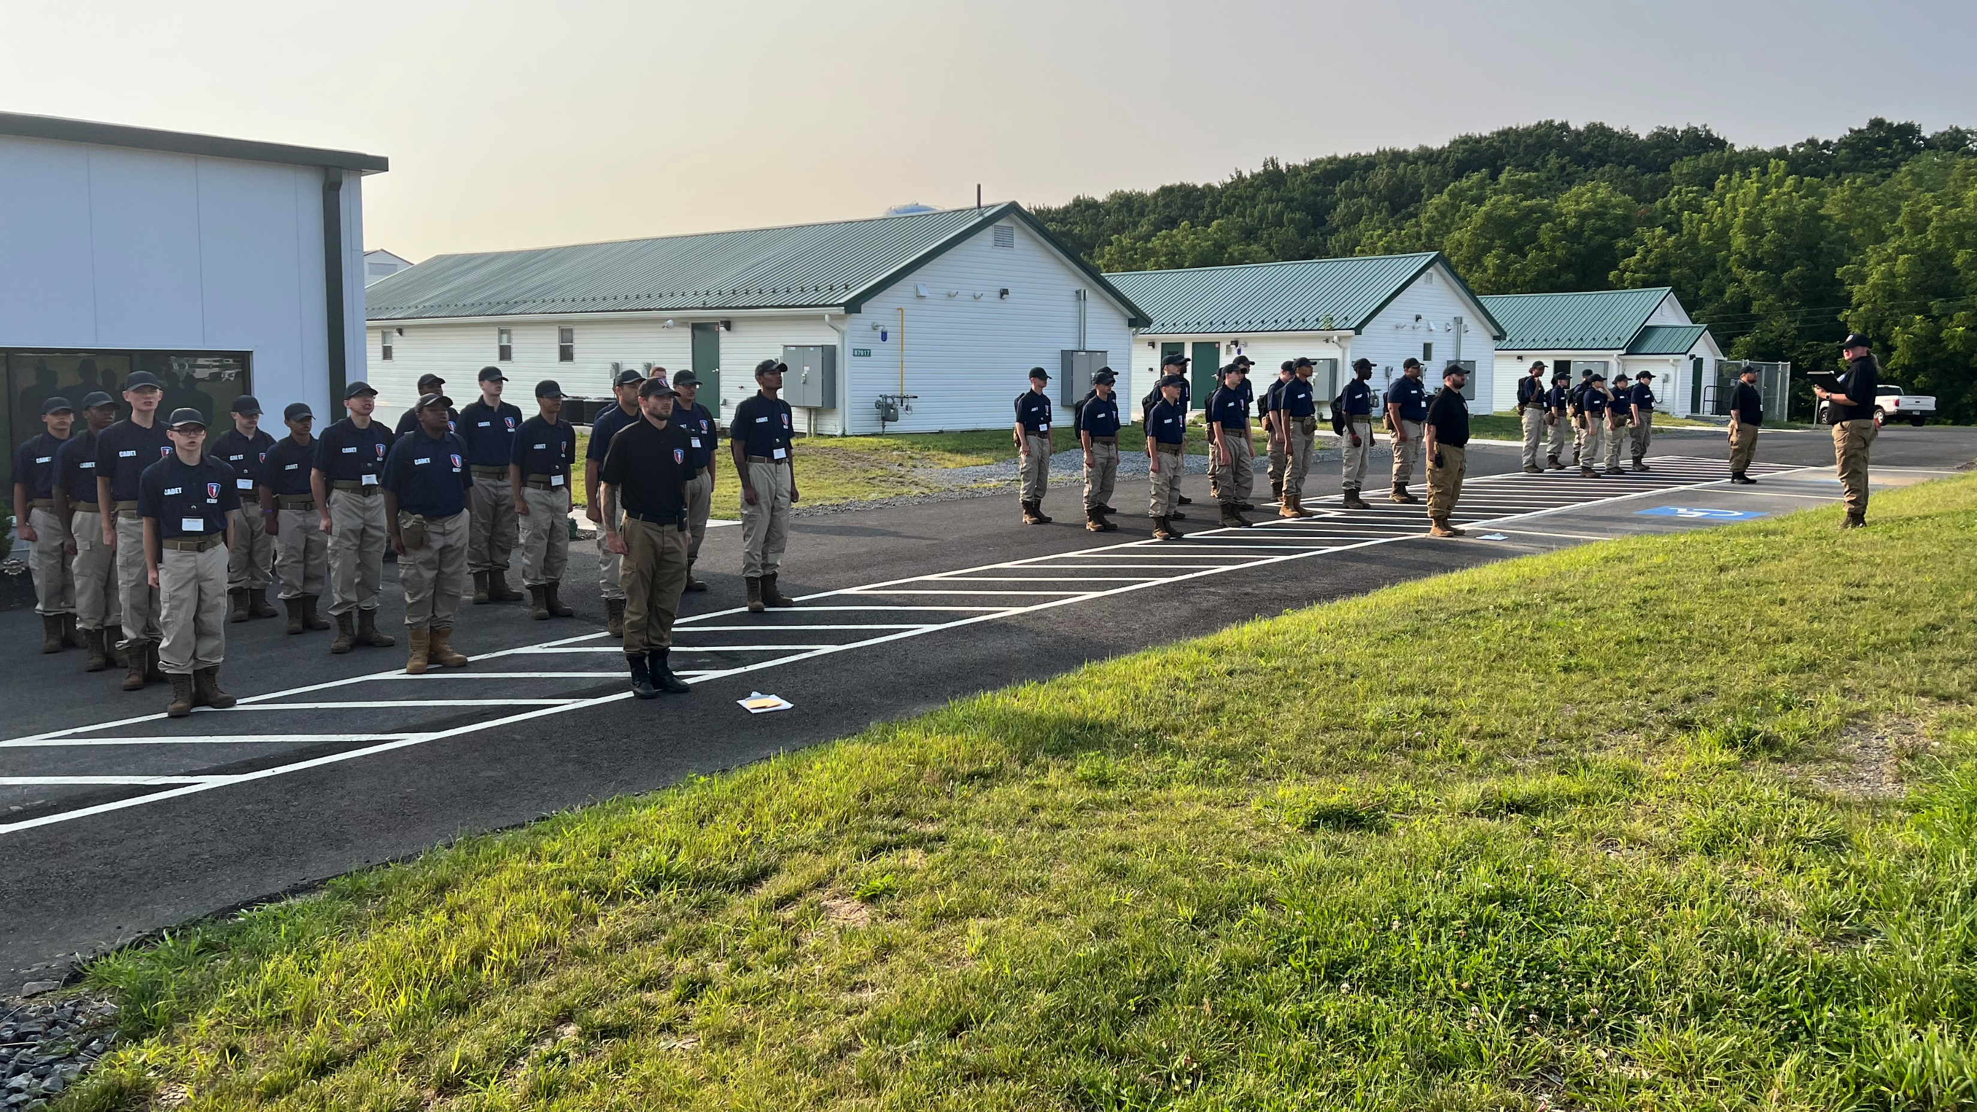
Keystone State Challenge Academy
Located at Fort Indiantown Gap, PA
A military-style leadership academy for 16–18-year-old youth who are struggling in their current educational placement to achieve self-discipline, education, and the skills necessary to succeed.
FREE to all qualified applicants-
Funded by Federal and State budgets.
Students remain on current school’s roster resulting in no loss of subsidy.
22-week residential program with 2 classes per year (January and July).

Slide 2

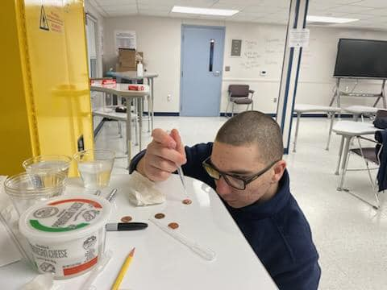
Keystone State Challenge Academy
Located at Fort Indiantown Gap, PA
8 Core Components to focus on all aspects of the youth’s life starting with education.
Academic Excellence
All Cadets attend 20 weeks of academic classes preparing them for:
Testing for the General Educational Development Diploma (GED)
-or-
Credit recovery to return to their home school district
Taught by CAIU teachers certified in English, Math, Science, Social Studies, & Special Education

Slide 3
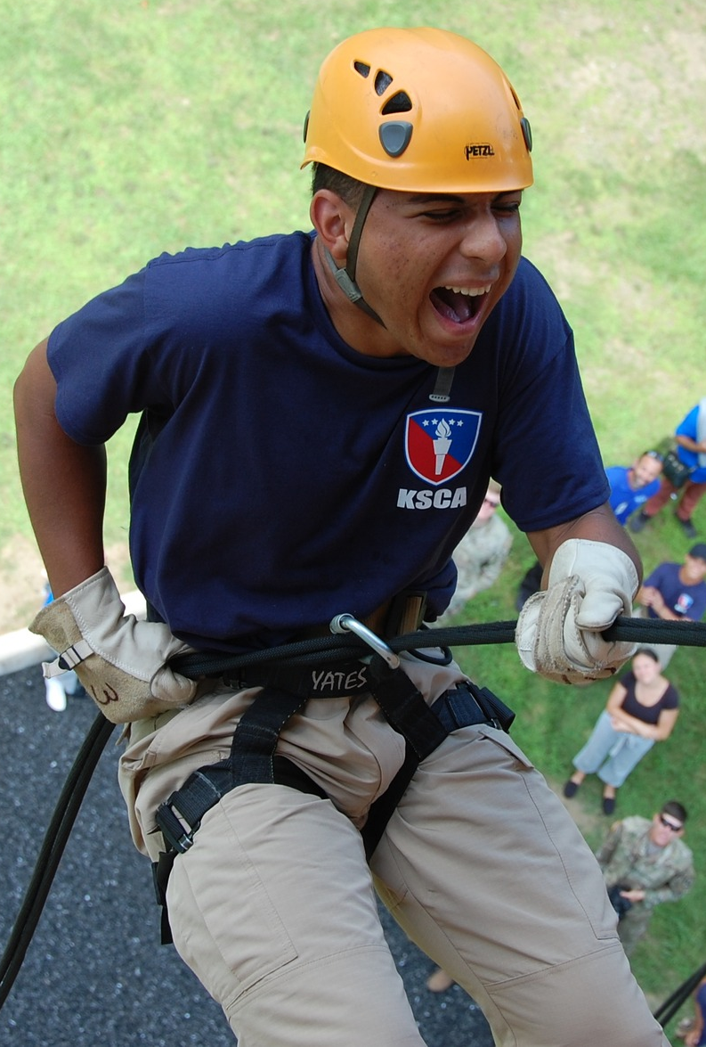
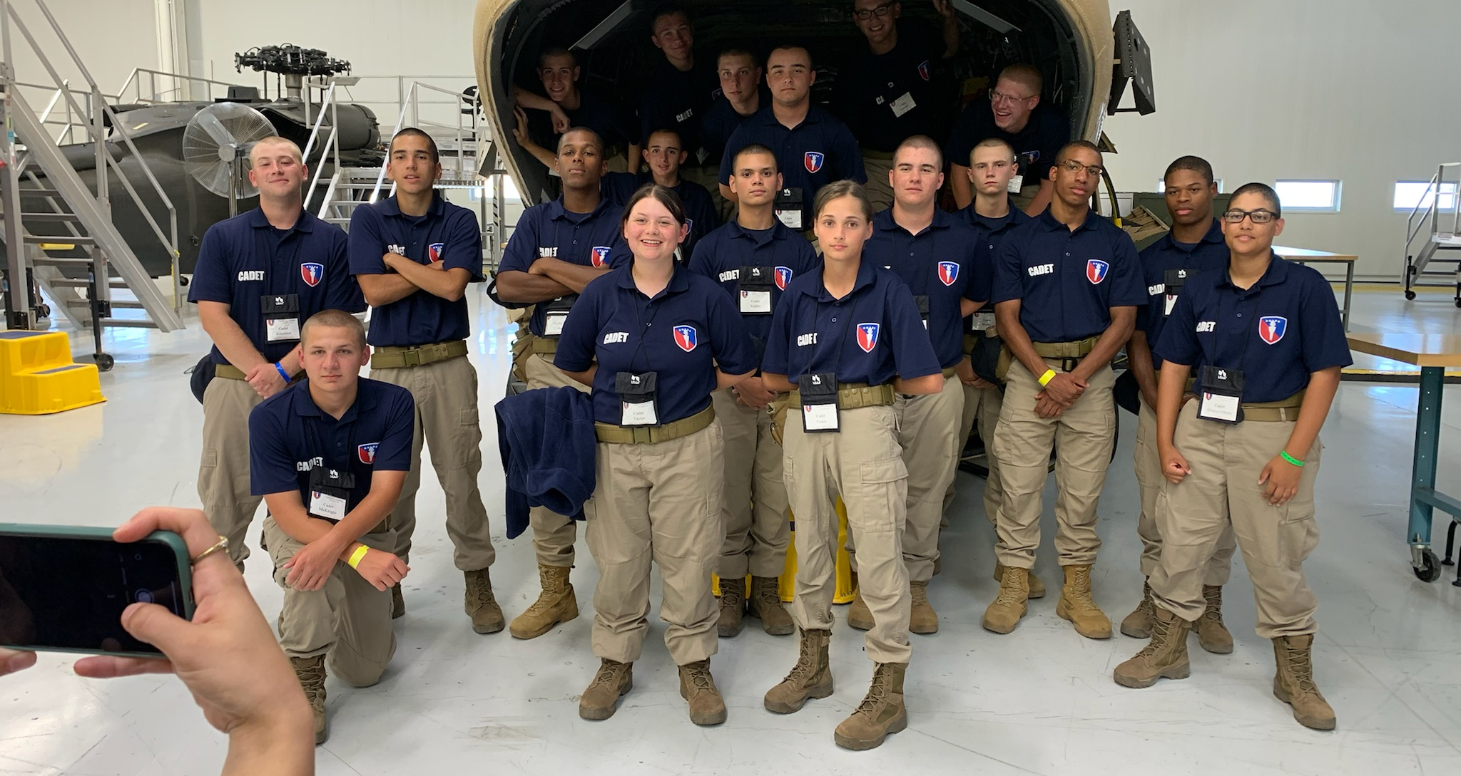
Keystone State Challenge Academy
Located at Fort Indiantown Gap, PA
Other Core Components that Benefit the Youth’s Total Well-Being:
Physical Fitness
Daily physical fitness activities and standards that work towards improvement of a timed one-mile run, sit-ups, and push ups
Health and Hygiene
Classes on hygiene, nutrition, substance abuse prevention, human sexuality, family planning, and communicable diseases.
Responsible Citizenship
Instruction on the structure and processes of the US Government along with individual rights and responsibilities.
Life Coping Skills
Classes designed to increase the Cadet’s self-awareness, self-discipline, and independent living skills.
Service to the Community
Cadets will volunteer to a minimum of 40 hours as a group or individual for community service and conservation projects.
Job Skills
Exploration of and preparation for possible career options.

Slide 4
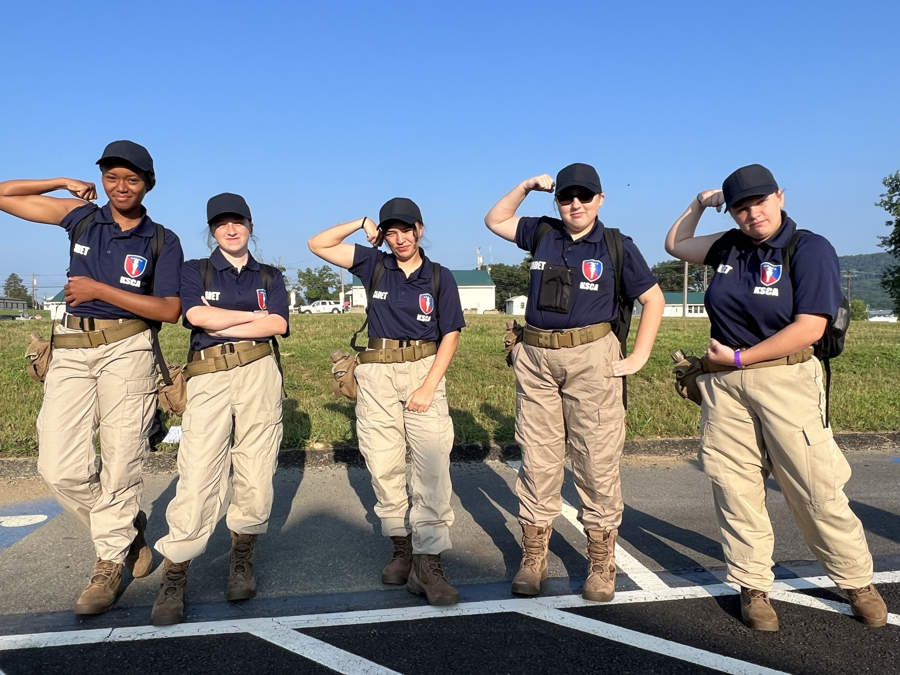
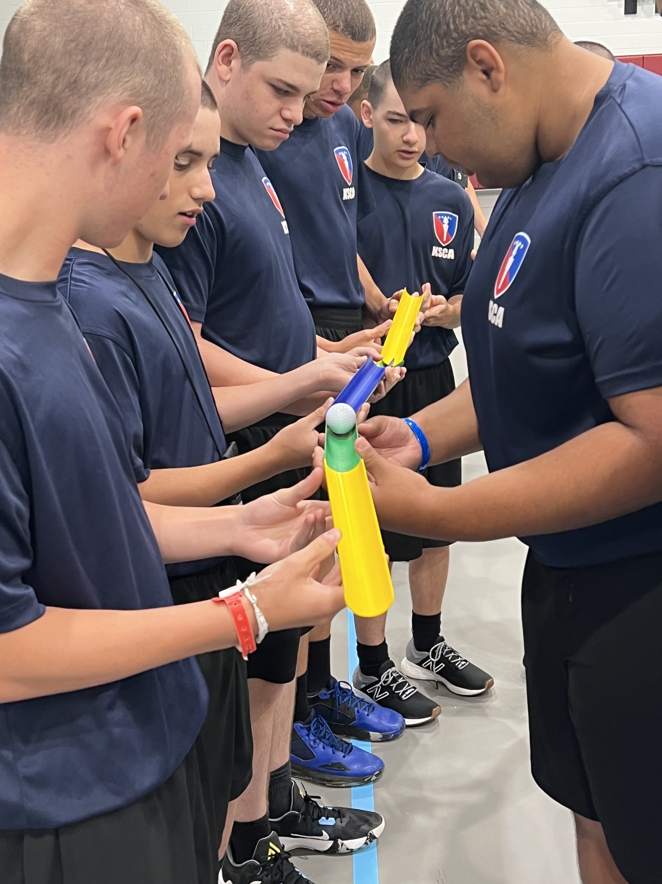
Keystone State Challenge Academy
Located at Fort Indiantown Gap, PA
Partnering with the School of Record to Consider Youth that Meet the Following:
Drug Free
Be free (or willing to be free) from use of illegal drugs, alcohol, and tobacco products.
Voluntary
Voluntarily participating in the program with parent/legal guardian approval (cannot be forced)
Age
Between the age of 16-18 at the start of the class.
At-Risk Youth
Struggling in school academically or socially putting them at risk of not graduating.
Capable
Be physically and mentally capable of participating (with reasonable accommodations)
Criminal Record
Not be under indictment for or ever convicted of a felony.
Citizen
A citizen or lawful permanent resident of the United States.

