Slide 1
Drug Awareness
for Families

Slide 2

Hello!
PISD Secondary Counselors welcome you
Clark, Mattei, Southard, LHS, PHS

Slide 3
PISD Secondary Counselors
Kathy Stone - PHS (A-Di)
Kayla Walling - PHS (Dj-Le)
Savannah Rubio - PHS (Lf-Re)
Denise Moore - PHS (Rf-Z)
Jill Clayton - LHS (A-K)
Raquel Pastrana Rodriguez - LHS (L-Z)

Slide 4
Secondary Counselors cont.
Rebecca Duncan - Clark (A-L)
Matthew Magruder - Clark (M-Z)
Michael Brinkley - Mattei (A-L)
Sylvia Newhouse - Mattei (M-Z)
Amanda Douglas - Southard (A-L)
Quinton Kent - Southard (M-Z)

Slide 5
Drugs put the word “less” next to hope.
Anonymous

Slide 6
Drug Use among Secondary Students
What are the statistics?

Slide 7
Definition of a Drug
A drug is any substance other than food which changes the way the body or mind functions.
It can center the bloodstream through a variety of routes (smoking, swallowing, snorting, injecting, suppositories)
The brain is the organ that is most sensitive to drugs due to the amount of bloodflow that it receives.

Slide 8
6 out of 10 parents
Say that they are not concerned about their children’s possible use or abuse of alcohol or other drugs
Bureau of Justice Statistics

Slide 9
General Teen Drug Use Statistics in the U.S.
1 in 8 teens report abusing an illicit drug in the past year
86% of teens know someone who drinks, smokes or abuses drugs during school
50% of teens report misusing drugs at least one time
62% of teens have abused alcohol by their senior year in high school
43% of college students use 1 or more illegal drugs
Bureau of Justice Statistics, 2021

Slide 10
General Use Stats cont.
In 2019, there were 4,777 overdose deaths among teenagers
2.08 million teens reported drug use in the last month
8.7% of teens in 8th grade report using illicit drugs in the last month
21.3% of 8th graders have tried an illegal drug at least once
46.6% of all teens report that by grade 12 they have used illegal drugs
11.2% of all overdose deaths were individuals between 15 - 24 years of age Bureau of Justice Statistics, 2021

Slide 11
Is teen substance use normal?
From mood swings to rebellion, many types of challenging behavior are normal during the teen years, but experimenting with substance use isn’t one of them. A variety of common teen experiences can become an excuse or reason for substance use. Understanding why some teens drink or use substances is a valuable step toward keeping them healthy and safe.

Slide 12
Reasons for Use
Fitting in
Feelings of being an outsider and longing to be included and liked by others. Some teens see substance use as an easy path to making friends, fitting in or being accepted with the “right” crowd.
What parents can do:
Get to know your kid’s friends and their parents, and talk with those parents about their approach to supervision and their stance on substance use.
Encourage your teen to use your home for socializing. Give them a private space if possible but keep an eye on them.
Assure your child that they can call you to be picked up whenever needed, no questions asked.
Talk about their need for acceptance and to fit in. Explain that real friends will give them space to be themselves and won’t make them do anything they’re uncomfortable with.

Slide 13
Reasons for Use cont.
Socializing
Some teens use drugs and alcohol to overcome insecurities, let their guard down and feel socially confident. In addition to more obvious risks, this can lead teens to feel like substance use is necessary to achieve a certain level of interaction.
What parents can do:
Find activities for your teen to socialize in a healthy, safe and supervised environment.
If your child is socializing at someone else’s home, know where they will be. Call the parents in advance to verify the occasion, location and that there will be supervision.
Communicate your expectations and rules for when your teen goes out with friends, and include regular check-ins.
Model healthy behaviors. Find opportunities to socialize and connect in environments that don’t include alcohol or other substances.

Slide 14
Reasons for Use cont.
Life transitions
Periods of transition in teens’ lives - like moving, divorce, puberty, changing schools, an illness or death in the family - can become a time of upheaval, leading some to attempt to find solace in substances.
What parents can do:
Ramp up the monitoring and communication during and after transitions.
Encourage an open dialogue with your teen about their experiences.
Set aside regular one-on-one time with your teen to bond and have fun together.

Slide 15
Reasons for Use cont.
Emotional and psychological pain
Whether it’s the pressure of everyday teen drama or the emotional toll of family problems, some teens use substances to dull the very real pain in their lives. Loneliness, low self-esteem, depression, anxiety disorder and other mental health issues are commonly associated with teen substance use.
What parents can do:
Offer empathy and compassion. Let your child know you understand. Acknowledge that everyone struggles sometimes.
Remind your child that you are there for support and guidance - and that it’s important to you that she or he is healthy, happy and makes safe choices.
Model healthy coping skills. Show your kids how to learn from mistakes and disappointments.
If your child is suffering, reassure them that you will seek out appropriate professional help and then do just that.
Notes:
Speaking with your student’s campus counselor can help in finding resources for appropriate professional help.

Slide 16
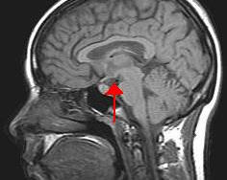
You can also split your content
Why does it matter?
Teens’ brains are still underdeveloped
Earlier development of the back of the brain/later development of front of brain
Less than optimal planning and judgment
More risky, impulsive behaviors
Minimal consideration of negative consequences
Consequences to the brain can be more disastrous

Slide 17
Most abused drugs by secondary students
Alcohol
Alcohol availability within the home and its common societal acceptance make it the most common substance being abused.
Marijuana
Due to its legalization in some states and its use medically, many people believe that it is not harmful.
A
M
Abuse of prescription painkillers is a significant problem, especially when someone they know has chronic pain and has these pills on hand.
Rx Drugs
Many teens think they are inhaling harmless water vapor, but research tells a different story.
Vaping / Nicotine
P
V
Notes:
1) While the legal drinking age is 21 in the US, around 36% of 8th, 10th, and 12th graders report using alcohol in 2021. Decreased ability to pay attention, stunted brain development, and memory troubles comes with other devastating effects.
2) Marijuana - seems to be more common and often used openly. Many people, both teens and adults, believe that marijuana is not harmful, but it can have negative effects, including cannabis use disorder and it can serve as a gateway to other substances.
3) Prescription Pills - prescription drug misuse is considered the fastest-growing drug problem in the US. Two drugs commonly abused by teens are Adderall and Ritalin - known as study drugs - used to boost academic performance. They help young people focus and stay awake for longer hours in order to study.
4) Vaping / Nicotine - The Monitoring the Future survey from the National Institute of Drug Abuse is an annual survey of over 42,000 8th, 10th and 12th graders, The 2019 survey shows vaping nicotine and especially marijuana have increased significantly. In fact, there has been a more than 50% increase in the number of 10th and 12th graders reporting that they vape marijuana.

Slide 18
In two or three columns
Alcohol
Warning signs
Changes in mood
Academic or behavioral problems in school
Changing groups of friends
Low energy level
Less interest in activities or care in appearance
Slurred speech
Problems concentrating
Concerns
More adolescents use alcohol than tobacco or marijuana
Increases the risk of physical and sexual assault
Interferes with brain development
Impairs judgment
Significant factor in the deaths of people younger than age 21.
Impact on teens
In 2021, 5.9 million youth (12-20) reported drinking alcohol beyond “just a few sips” in the past month
In 2021, 3.2 million youth (12-20) reported binge drinking at least once in the past month
Girls are now drinking more than boys
Notes:
2021 survey from the National Institutes of Health

Slide 19
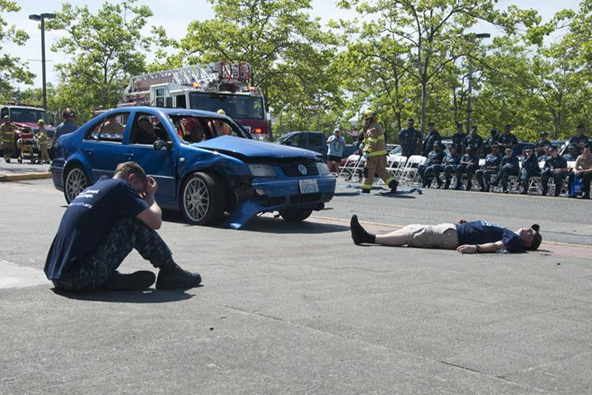
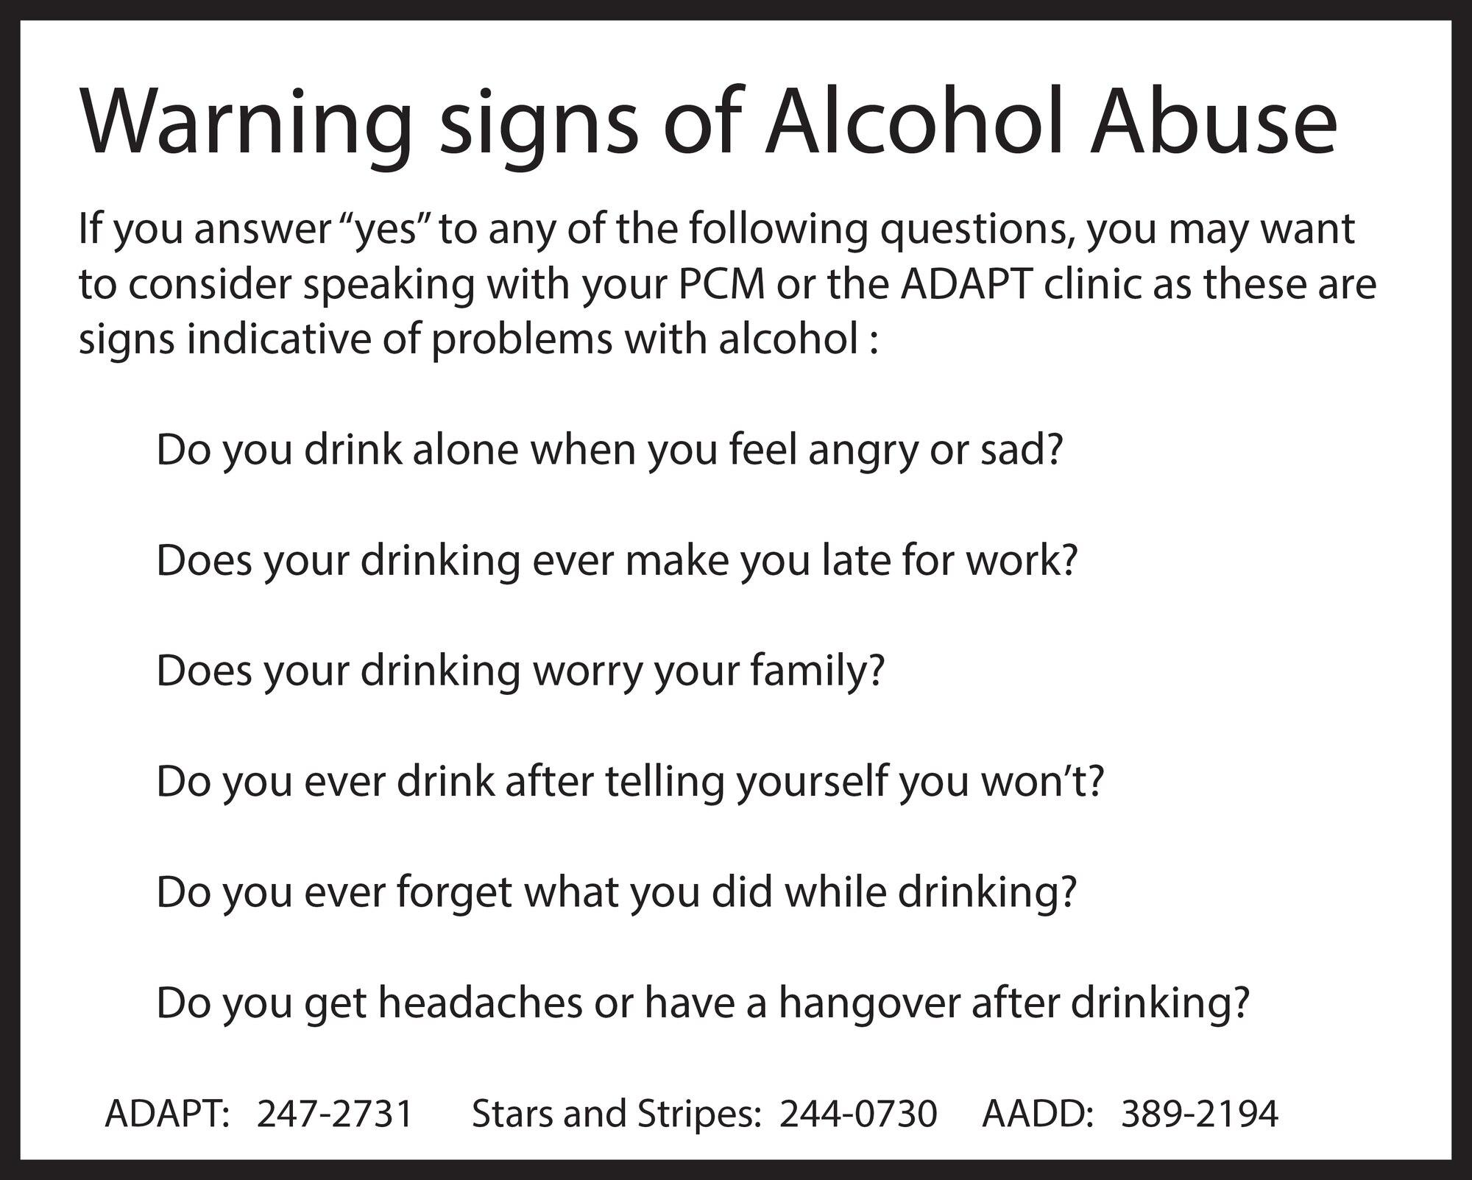
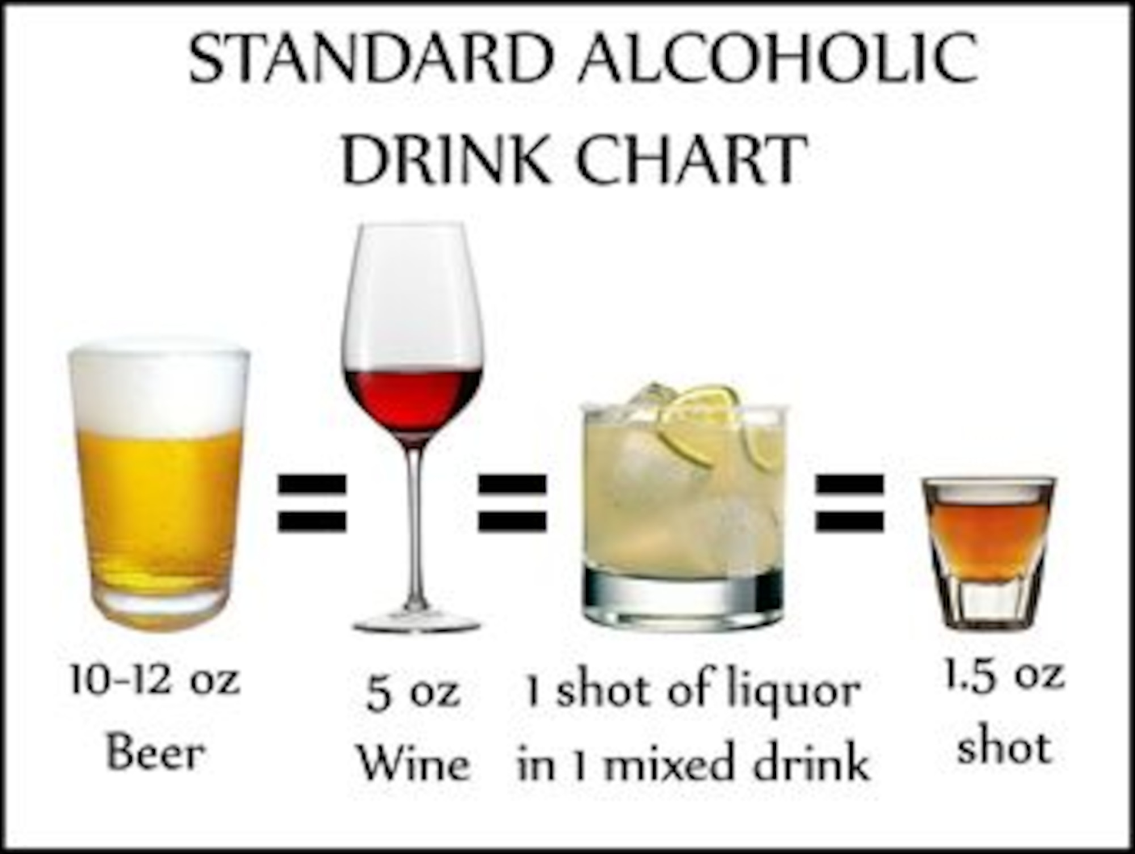

Notes:
Surveys measure drinks according to the chart above. So when students are asked about amount it is based on these indicators.
Warning signs - questions for an individual to ask themselves to see if there is a problem.
Abuse of alcohol can lead not only to injury to the abuser, but to others around them - drinking and driving / legal issues, etc.

Slide 20
In two or three columns
Marijuana
Combination use
Often used through vaping, which adds to the problem - survey in 2019 showed that 8% of 8th graders, 19% of 10th graders and 22% of 12th graders -are using this method
Cannabis product exposures (edible products) are on the rise for all age children
Concerns
Increased risk of mental health issues such as depression and social anxiety.
Association between marijuana and schizophrenia is stronger in people who start using at an earlier age and use more frequently
Marketing of products is often attractive to young people
Impact on teens
In 2019, 37% of US high school students reported use in the past month
Compared with teens who don’t use, users are more likely to quit high school or not get a college degree
Since 2000, Oregon University study finds use has increased by about 245%
Notes:
2019 - Centers for Disease Control and Prevention

Slide 21
In two or three columns
Marijuana / Delta -9 THC
Definition
Delta 9 THC is the naturally occurring cannabinoid component of marijuana that causes the high in the user
Cannabis plants containing greater than 0.3% Delta THC are classified as marijuana
Plants wil less than 0.3% are classified as hemp
Concerns
Marijuana grown today has high levels (10% - 30%) of Delta 9 THC - this is a very different plant than what was grown in the past
Due to the increased percentages, the high that users experience is much “higher” than in the past
Impact on teens
People who start using cannabis in their teens are more likely to experience memory and learning difficulties
Researchers have found that exposure to Delta ( THC heightens sensitivity to fear and anxiety causing stimuli
Notes:
2019 - Centers for Disease Control and Prevention

Slide 22
Purchasing Power
Obtaining products
Many products that contain Delta-9 can be readily obtained by teens. Locations such as vape shops and gas stations sell these products. By law, people under the age of 21 in Texas should not be able to make these purchases. So, how are so many young people getting their hands on these products?
An example (JUUL e-cigarettes and compatible pods):
Physical retail locations - the most common way is through a physical retail location. Nearly 74% of youth said that they obtained JUUL at a store or retail outlet.
Social sources - just over half (52%) reported that they received JUUL from a social source, such as a friend or family member.
Online - 6% reported that they received the product through an online transaction. Among those who attempted an online transaction, 89% were successful.
Notes:
Youth who had used Juul in the past 30 dates reported that they got the product in 1 or more of these ways. (Truth Initiative.org)
Sometimes adults have the idea that these types of products are being bought in secret from a “drug dealer,” when in fact, they can be readliy purchased at your conrner convenience store.

Slide 23
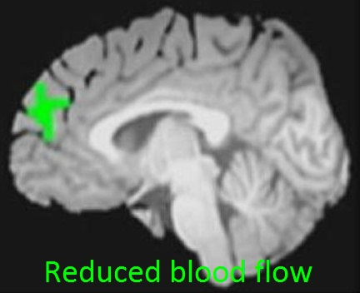
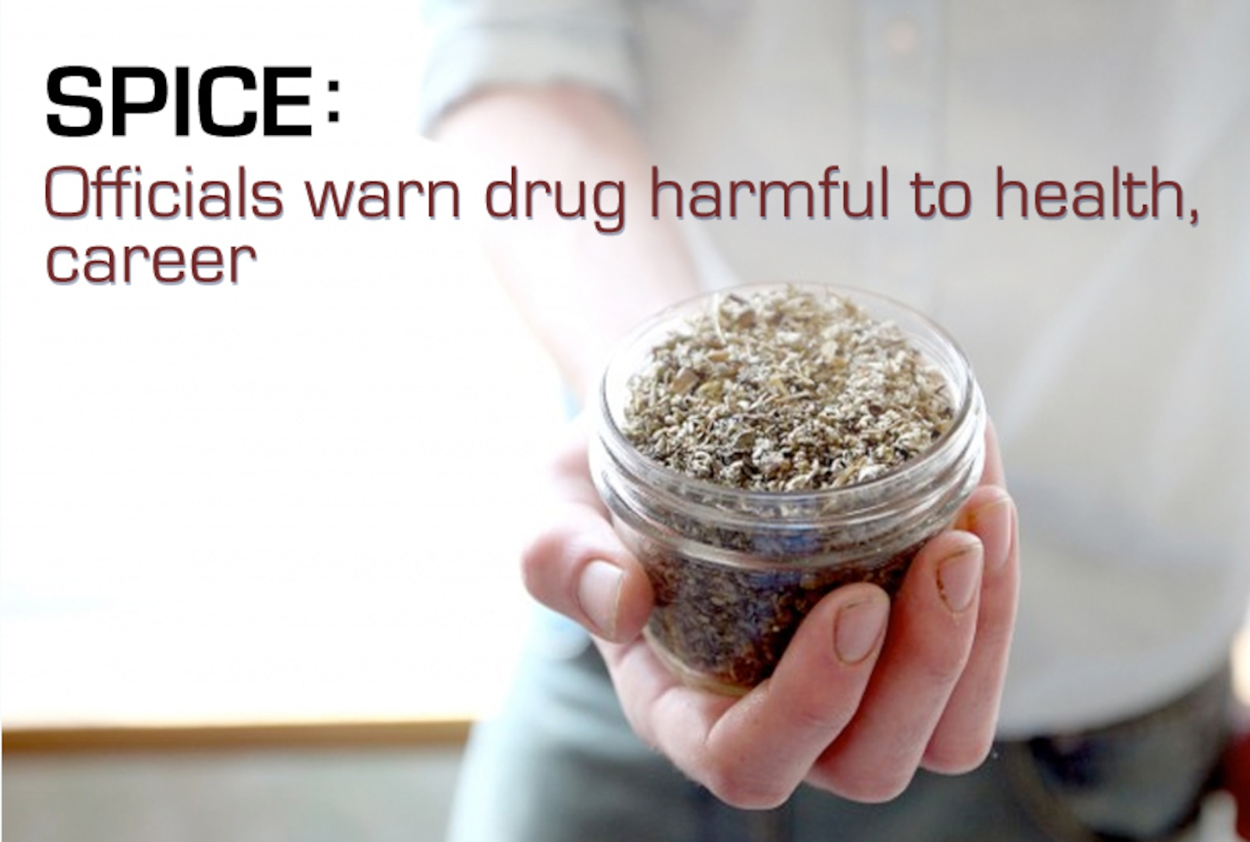
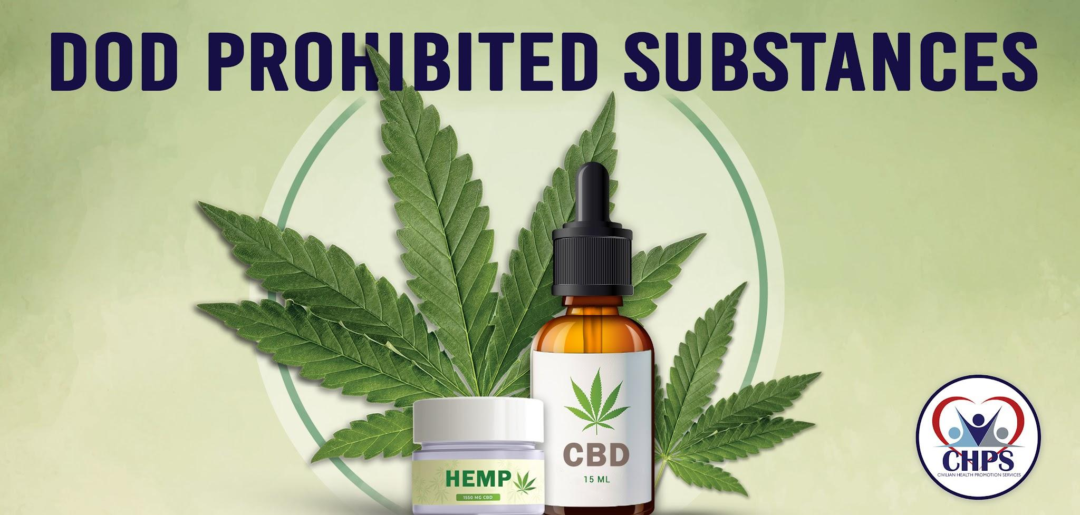
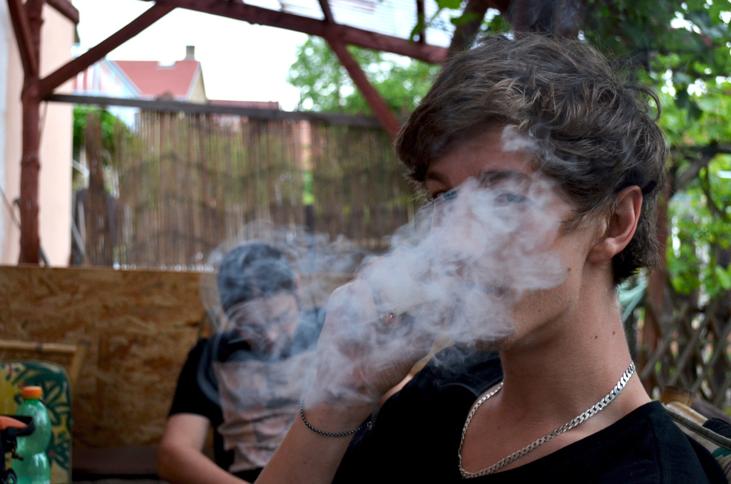
Notes:
Spice = synthetic marijuana / can also be known as K2 / often sold as “herbal incense” or “potpourri” / abuse can lead to long-lasting health effects even after the user quits using the substances.
Marijuana can cause functional impairment in cognitive abilities / use of the drug is associated with a thinning of the prefrontal cortex of the brain
DOD (Department of Defense) employees are subject to prosecution for the consumption or possession of prohibitied substances (in any form).
Marijuana can also be consumed through vaping - which doubles the problems.

Slide 24
In two or three columns
Rx Drugs
Abused Drugs
Opioids - synthetic forms, including fentanyl, are now the most common drugs involved in drug overdose deaths in US
Depressants - block out problems for a short while
Stimulants - sometimes abused as study drugs by students that feel they are under academic pressure
Concerns
Fastest-growing drug problem in the US
Can be easier to access than street drugs, but can also be bought and sold
Over the counter meds can be a problem as well
With repeated use tolerance develops as well as physical dependence
Impact on teens
90% of addictions start in the teenage years
Common misperception is that these pills are safer or less harmful
17.8% of teens surveyed said they have taken a Rx drug without a doctor’s prescription
Girls tend to abuse to stay alert or lose weight
Boys tend to abuse to get high
Notes:
Survey from Substance Abuse and Mental Health Services Administration (SAMHSA)

Slide 25
In two or three columns
Fentanyl
Fentanyl facts
Fentanyl is an opioid that is prescribed for chronic, severe pain
2 types - pharmaceutical and illegally made
Most cases of overdose are linked to illegally made fentanyl
50X stronger than heroin / 100X stronger than morphine
Concerns
Often added to other drugs because of its extreme potency, which makes drugs cheaper, more powerful, addictive & dangerous
Liquid & powder forms
Powder form mixed with other drugs and made into pills
Liquid form can be found in nasal sprays, eye drops and dropped onto paper or small candies
Impact
Over 150 people die every day from overdoses related to synthetic opioid like fentanyl
Only way to detect it is with fentanyl test strips - cannot see it, taste it or smell it
Illicit drugs do not come with an ingredients list - many contain deadly doses of fentanyl
Notes:
Survey from Substance Abuse and Mental Health Services Administration (SAMHSA)
Centers for Didease Control and Prevention
Forever 15 Project - Hays County Texas and Hays CISD

Slide 26
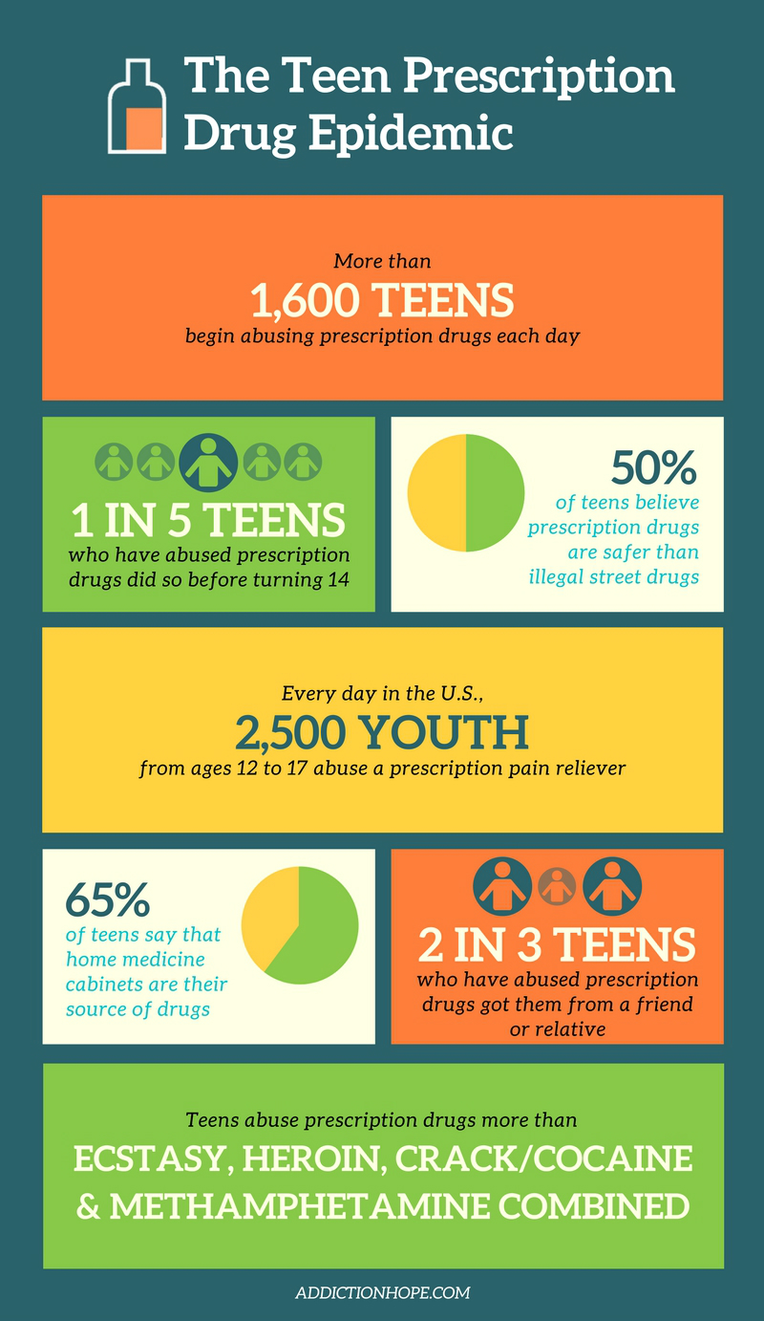
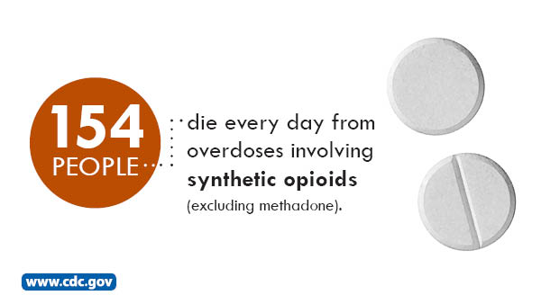
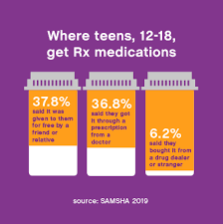
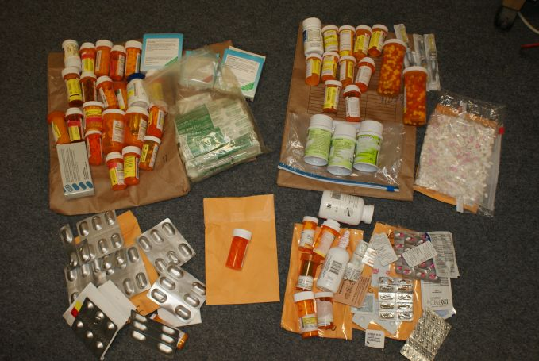
Notes:
Drugs found in a young person’s locker at school. Used to sell to other students.
Where teens, 12-18, get RX meds: 37.8% said it was given to them for free by a friend or relative / 36.8% said they got it through a prescription from a doctor / 6.2% said they bought it from a drug dealer or stranger.
The Teen Prescription Drug Epidemic - more than 1600 teens begin abusing prescription drugs each day / 1 in 5 teens who have abused prescription drugs did so before turning 14 / 50% of teens believe prescription drugs are safer than illegal street drugs / every day in the U.S., 2500 youth from ages 12 to 17 abuse a prescription pain reliever / 65% of teens say that home medicine cabinets are their source of drugs / 2 in 3 teens who have abused prescription drugs got them from a friend or relative / teens abuse prescription drugs more than ecstasy, heroin, crack/cocaine and methamphetamine combined - addictionhope.com

Slide 27
In two or three columns
Vaping / Nicotine
Harmful Chemicals
The aerosol created when vaping contains harmful ingredients:
Nicotine
Ultrafine particles
Flavorings
Volatile organic compounds (benzene - car exhaust)
Heavy metals (nickel, tin, lead)
Concerns
Structurally changes the developing brain
Increases risk of addiction to other drugs
Affects attention, learning, mood, impulse control
Increased blood pressure, respiration, heart rate
Increases risk of developing diabetes
Impact on teens
Well tolerated; lowers aversion to high doses later in life (nicotine)
Enhances acquisition of cocaine, meth and alcohol
Brain is more sensitive to the rewarding effects which causes quicker addiction
Teens tend to have fewer withdrawal symptoms
Notes:
Teens who vaped in the past year have 2x higher odds of having tobacco use disorder.
Teens who used e-cigarettes but never marijuana have 2-4x higher odds of marijuana use.
Nicotine exposure alters brain and increased vulnerability to other substance use.

Slide 28
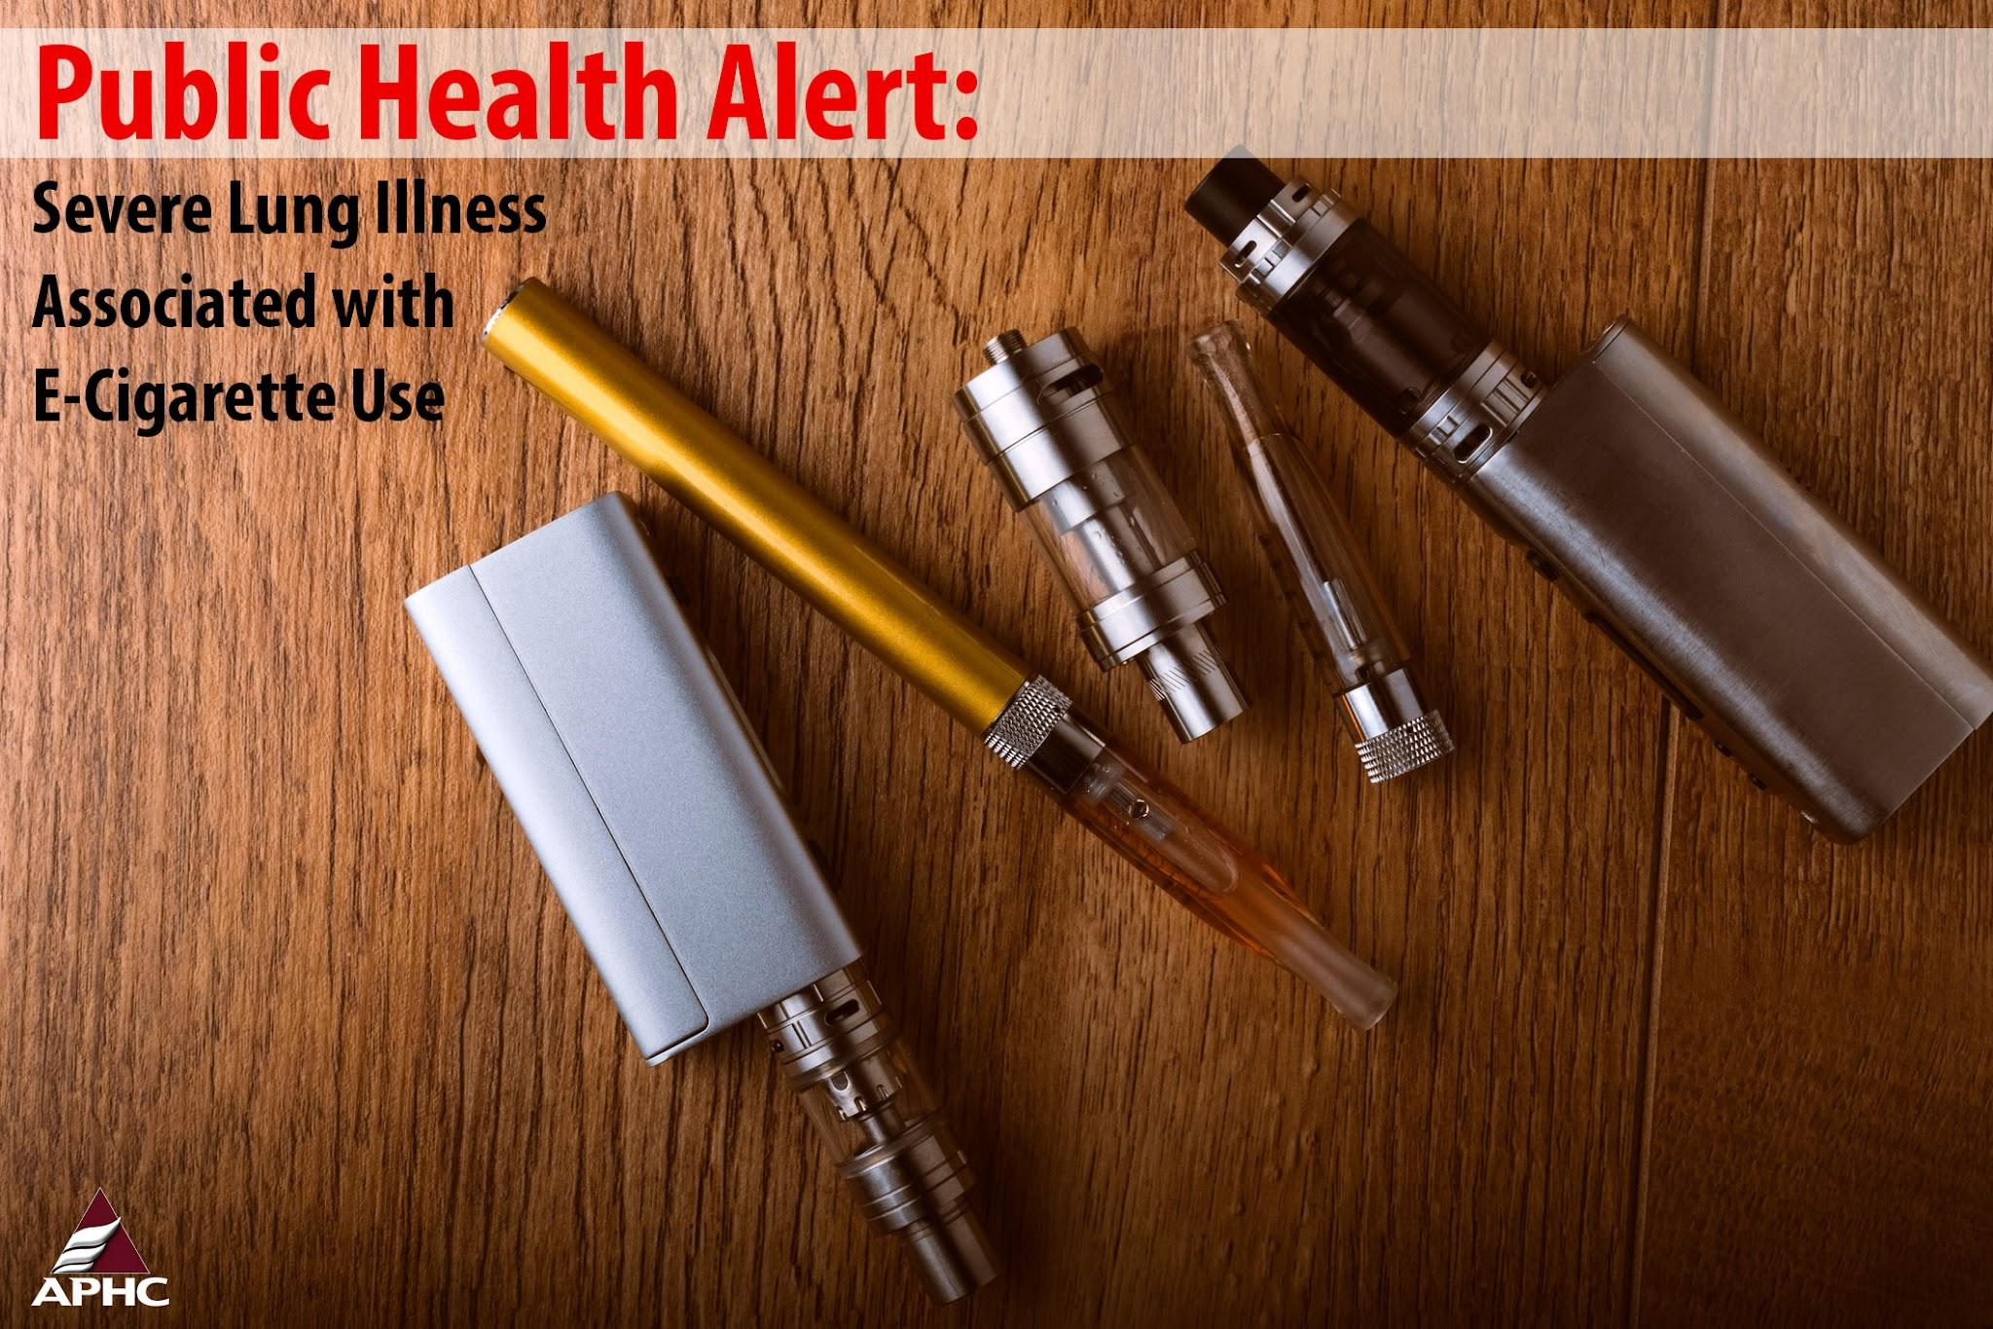
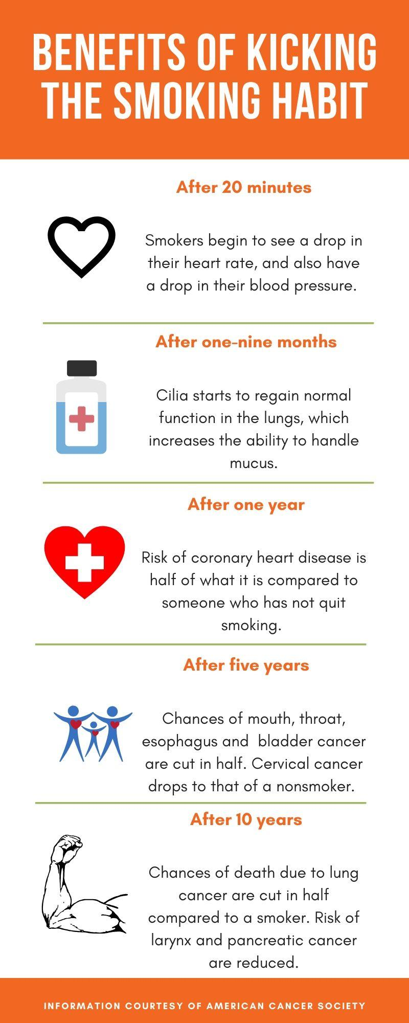
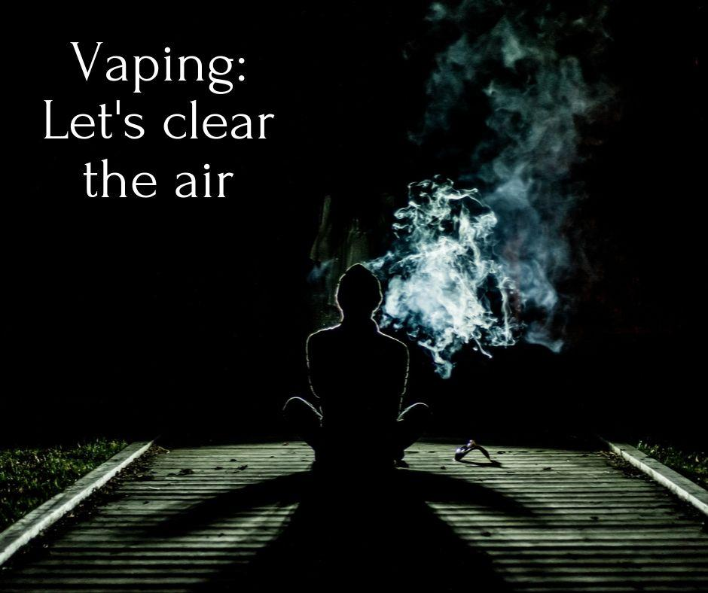
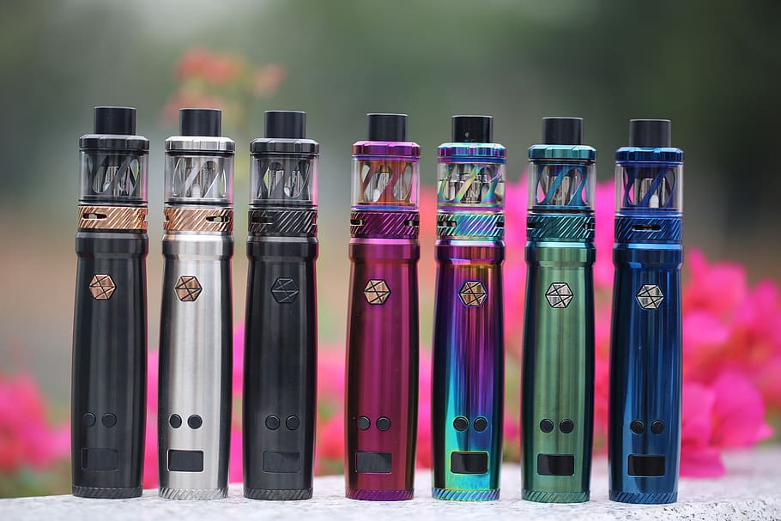

Slide 29

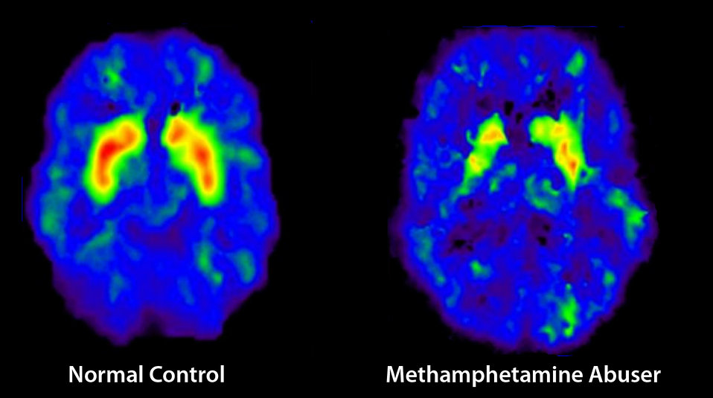

Slide 30
Let’s review some concepts
Help, don’t punish
Health
Focus on health and safety, not punishment.
Addiction
Addiction is serious, yet despite that, 95% of youth with nicotine addiction get no help.
Help
Get professional help if needed. Sometimes it takes another helper to work together with families.
Counseling
Consider counseling. Most often there are underlying reasons for substance abuse.
Modeling
If a teen is surrounded by others who have healthy coping strategies, they will often not turn to substances for help in coping.
Support
Text messaging (Truth Initiative)
Help & Hope by Text at drugfree.org

Slide 31
Thanks!
ANY QUESTIONS?
Please reach out to your student’s
campus counselor for additional
Information and resources.

Slide 32
Credits
Special thanks to all the people who made and released these awesome resources for free:
Presentation template by SlidesCarnival
Photographs by Unsplash

