Slide 1

WELCOME
Marian Catholic
Spartan Athletics
Parent Awareness
Presentation
Winter Season 2023-24

Slide 2
PLEASE NOTE that this presentation replaces the traditional sports Parent Awareness Meetings to begin each season. The presentation will familiarize you with Marian policy and reminders, as well as address any questions. It’s very important that the contents of this presentation be discussed with and understood by your student athletes.

Slide 3
ADMINISTRATION welcomes you…
Vince Krydynski, President (708) 755-7565
Mary Ann West, Principal (708) 755-7565
Kevin Kelly, Athletic Director (708) 996-4640
Mike Taylor, Associate AD (708) 996-4647

Slide 4

QUESTIONS beyond this PP will often be covered by visiting the Marian Catholic web site at www.marianchs.com. This includes important upcoming dates, sports schedules and e-mails/contacts for head coaches of programs. Marian also has its own Twitter and Facebook pages.

Slide 5
Through enrollment at Marian Catholic, you have acknowledged that you have read and understand the forms on the Marian web site ATHLETICS page that refer to concussion information/protocol and Impact Program, IHSA Performance Enhancing Testing Policy, Return to Learn / Return to Play policies and Athletic Insurance/Medical Consent policies.
The documents may be found HERE: 23-24 Parent Concussion Notice Form.pdf and it’s recommended that you PRINT and RETAIN a copy of the information.

Slide 6

ATHLETIC
TRAINING
Marian Catholic has a relationship with Kaitlyn Miller as its resource for Athletic Training. Trainers are typically on campus during most sports events and practices. It’s important to be in contact with trainers for injury management, avoiding injuries and rehabilitation. Our trainers can also facilitate an appointment with doctors in a more efficient manner than many general practitioners. Please consult Marian’s ATHLETICS web page for more information and resources.
Kaitlyn Miller: trainerkaitlyn@marianchs.com
Keith Miller: trainerkeith@marianchs.com

Slide 7

CONCESSIONS,
SPORTS RECOGNITION
Marian Catholic is fortunate to have Bonnie Pressler serve as coordinator for Marian’s Valerie Middleton memorial concession stands and Sports Awards recognition nights. She will try to make a concession stand available for many sporting events.
In some cases, we will seek parental help for concessions or admission gates (football, cheerleading, women’s volleyball, men’s/women’s basketball). Please look for a separate correspondence with worker schedules. If you are unable to fulfill a responsibility, please be sure that you trade or seek help from another parent in order to help staff all events.

Slide 8


Sports souvenir posters of Athletes
Photographer Bob Skelly will offer Individual Sports posters to Marian Athletes. Posters are 16 x 20 framed, matted and ready to hang for $150 each (payment to Marian Catholic High School).
For more information, please contact Bob Skelly at bobskellyphoto@aol.com

Slide 9

SUPERVISION
Marian Catholic wants to ensure that student-athletes are under the care of adult supervision at all times. If athletes have a later practice on a school day, they will be required to leave the building or move to the Leadership Center by 2:45 p.m. Waiting for practices in hallways or common areas is not permitted.
At the conclusion of practices or games, coaches will always be sure students have adult supervision until rides arrive. Parents should be aware of practice schedules so that student-athletes are picked up in a timely fashion.
At NO TIME, should a student be in the weight room or an athletic facility without staff approval and supervision.

Slide 10
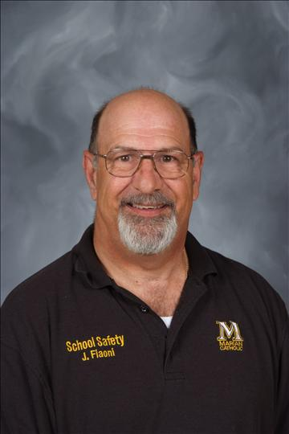

CAMPUS
SECURITY
Mr. Joe Fiaoni (pictured) coordinates Security at Marian. Safety and security are a priority, so it’s vital to adhere to the following guidelines.
Never open an outside door for a non-Marian student or coach.
(all visitors should be directed to Main Office entrance or a coach)
Never prop an outside door open with an object.
Do not leave school (classroom area) access open after 2:45 p.m.
Secure personal items in supervised classrooms or LOCKED lockers.
Drive slowly and safely when operating a vehicle on campus.
Doors/gates locked and lights turned off at conclusion of activities.
Do not begin any activity without adult supervision.
Avoid damage, danger for others when working out in hallways.
Report any unfamiliar visitors, unusual activity to an adult.
NOTE that trainers, after-school officers, maintenance and many adults will always be equipped with radios during after-school activities.

Slide 11

RESPONSIBILITY
OF ATHLETES
Being an athlete means higher visibility in the school environment, and consequently, a great sense of responsibility.
GRADES: Students must maintain academic eligibility in order to participate in athletics. Weekly grades checks are conducted and results distributed to coaches. Parents have the same ability to stay current with grades through PowerSchool.
Students not maintaining eligibility standards (discussed in Student Handbook) will be subject to ineligible status for a one-week period (Monday through Sunday). Athletes are required to attend an after-school study session during this period. Athletes may attend practices while ineligible, provided they do not conflict with the after-school study session (Athlete must have signed confirmation of study session attendance).
The best policy is to stay on top of academics at the start of each semester.

Slide 12
RESPONSIBILITY
OF ATHLETES
Being an athlete means higher visibility in the school environment, and consequently, a great sense of responsibility.
STUDENT OATH: Detailed in the Student Handbook, each Marian Catholic student is required to sign off on a Student Oath to begin each year. This includes a commitment to being drug- and alcohol-free.
Marian parents have encouraged a program that includes random drug testing for all students, to occur at least once a year.
In addition to a commitment to keeping bodies and minds at peak performance, student athletes are expected to adhere to these policies to avoid penalties and loss of time on a team.

Slide 13
RESPONSIBILITY
OF ATHLETES
Being an athlete means higher visibility in the school environment, and consequently, a great sense of responsibility.
DRESS EXPECTATIONS: While each sport will have specific expectations for practice gear and dress code, the rule of thumb is that student-athletes will practice in school-issued apparel or school colors in most cases.
Rules regarding items like earrings, head gear, etc. should be the same as during the school day anytime a student-athlete is on campus or representing the school (on busses, during competition or at schools of opponents).

Slide 14
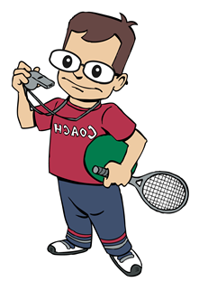
RESPONSIBILITY
OF FAMILIES
Team chemistry and path to a level of success are dependent on the consistent commitment of all team participants.
COMMITMENT: All Marian athletic teams and many clubs/activities require participation during weekends and scheduled school breaks and holidays. Except in cases of family emergencies or illness, participants are expected to be present at all tryout sessions, practices and games/matches or scheduled activities.
In cases where a student must be absent, a decreased level of participation should be expected upon return. In all cases, parents and student-athletes should be diligent in expressing schedule conflicts well in advance.

Slide 15
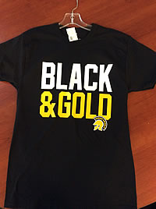
RESPONSIBILITY
OF PARENTS
Marian Catholic seeks an ownership with parents of athletes, including communication and sharing of goals.
COMMON GOALS: Marian Catholic has the same goals as parents in terms of development, Christian values, sportsmanship and success. Please discuss this presentation with your sons/daughters.
COMMUNICATION: Please consult the Marian website, coach
e-mails and send-home materials to stay up to date with teams.
ISSUES: We know issues arise. Please never put your sons/daughters, family or Marian Catholic in an embarrassing situation. Issues should be addressed in the following order: Athlete to coach, parent to coach, parent/athlete to administrator (only if no resolution through first two methods). This order priority helps develop students with leadership responsibility.

Slide 16
RESPONSIBILITY
OF PARENTS
Marian Catholic seeks an ownership with parents of athletes, including communication and sharing of goals.
PRACTICES: In the majority of cases, Marian Catholic practices are not open to parents and fans. Please respect this policy and support student-athletes from a distance.
COURTESY: Please note that many parking spaces near the West Gym entrance are RESERVED spaces. Students and parents should not park in these marked spots at any time. Also, please be aware that faculty needs access to these spaces throughout the day and night and drivers SHOULD NOT block entry or access to spaces at any time. Vehicles should NEVER travel or be parked on the Stadium ambulance area or non-paved areas of Marian Catholic.

Slide 17
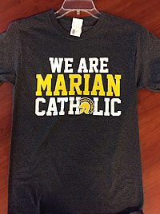
COMMON GOAL:
SPORTSMANSHIP
Pride comes from knowing all of our words and actions represent family, community and Marian Catholic High School.
In conjunction with the Illinois High School Association and East Suburban Catholic Conference, sportsmanship is a priority at Marian Catholic.
The bar is set high for student-athletes and coaches as we wear the Black and Gold in interscholastic competition and in dealing with opponents, tournaments and registered officials.
There is also an expectation that fans and parents represent us to the best of their abilities. We look forward to enthusiastic, positive support for all student athletes, while encouraging all to heed the IHSA’s advise and SPORT A WINNING ATTITUDE! Thanks in advance for your cooperation and emphasis on Sportsmanship values.

Slide 18
SPORTS
PHYSICALS
It is MANDATORY that each student-athlete have a current PHYSICAL on file before trying out for any Spartan Athletic team. IHSA/IESA Physical forms are available for download on the Athletics home page on the Marian Web Site. A doctor-generated physical form is acceptable as well.
It would be wise for any prospective student-athlete to take advantage of $20 physicals offered in school during spring Finals Week of each year. These physicals will be good for the entire following school year.
ALL-SCHOOL PHYSICAL
Thursday,
May 23, 2024
7 a.m.

Slide 19
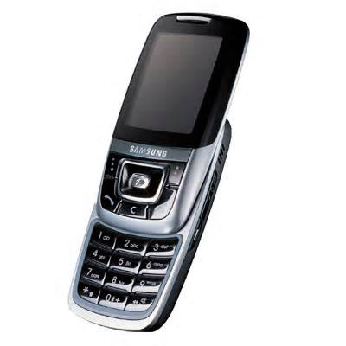
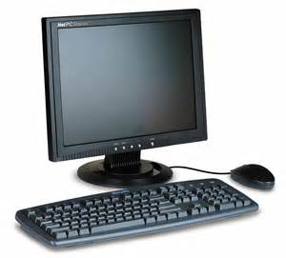
COMMUNICATION!
The road to any successful season will be accomplished by good communication among staff, coaches, parents and athletes.
The Marian Catholic main office is open until 3:30 p.m. on school days and all coaches should have voicemails. Many coaches will develop their own phone trees and electronic communication systems.
Often the most efficient means of reaching a coach during the day will be through e-mail. Direct communication through athletes and coaches teaches responsibility and is often most effective.

Slide 20



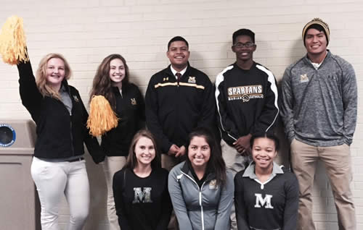
SPARTAN PARTNERS
Illinois High School Association
www.ihsa.org
East Suburban Catholic Conference
www.eastsuburbancc.com
Marian Catholic Spartan Shop
www.marianchs.com/Spartan-shop.php

Slide 21
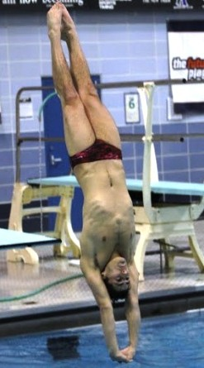
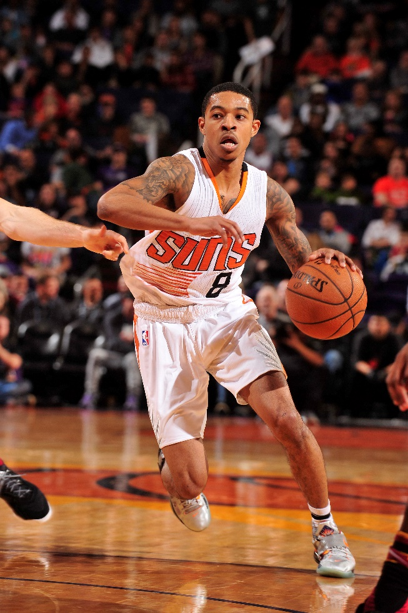
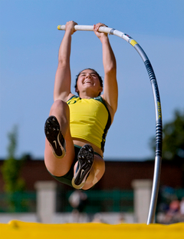
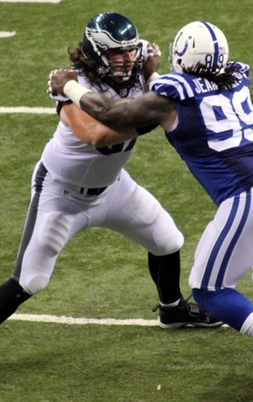
Thanks and enjoy the journey!
FROM LEFT:
Joey Cifelli ‘15
Tyler Ulis ‘14
Melissa Gergel ’07
Dennis Kelly ‘08
We are… MARIAN CATHOLIC!

