Slide 1
ENHANCING YOUR MAPS WITH THE
FRAME OF REFERENCE
September 28, 2016
Leah Moak
Joy Sievers

Slide 2

DON’T LET THE
FRAME OF REFERENCE SCARE YOU!

Slide 3
Today’s Goals
Understand WHY we should use the Frame of Reference
Determine the difference between a Frame question and a Map question
Learn the three different Frames of Reference
Apply the Frames of Reference to a Podcast
Discuss how the Frames can be implemented in your classroom

Slide 4
College and Career Readiness
Reading Anchor Standards
And
The Frame of Reference
Read closely to determine what the text says explicitly and make logical inferences from it; cite specific textual evidence when writing or speaking to support conclusions from the text
Assess how point of view or purpose shapes the content of the text
Determine central ideas or themes of a text and analyze their development; summarize the key details and ideas

Slide 5
WEBB’S DEPTH OF KNOWLEDGE

Slide 6

ADDING THE FRAME OF REFERENCE
Can be used with ANY map.
Gives students an opportunity to THINK ABOUT THEIR THINKING.
Encourages greater REFLECTIVE THINKING.
Increases the RIGOR of any map.

Slide 7
Question Sort

Slide 8
Map Questions
Vs.
Frame Questions

Slide 9
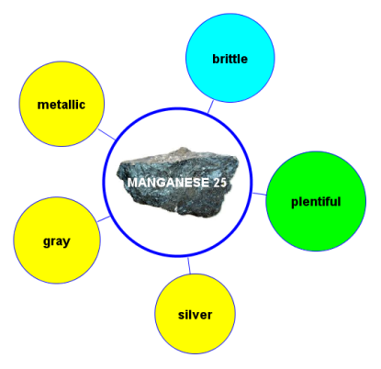
MAP QUESTIONS:
What is Manganese?
What are the properties of Manganese 25?
How would you describe Manganese 25?

Slide 10
FRAME QUESTIONS:
How do you know these are the
characteristics of Manganese 25?
Does a specific point of view influence the descriptors that you used?
What conclusions can you draw about these properties? Why would it be important to know about the properties of Manganese 25?

Slide 11
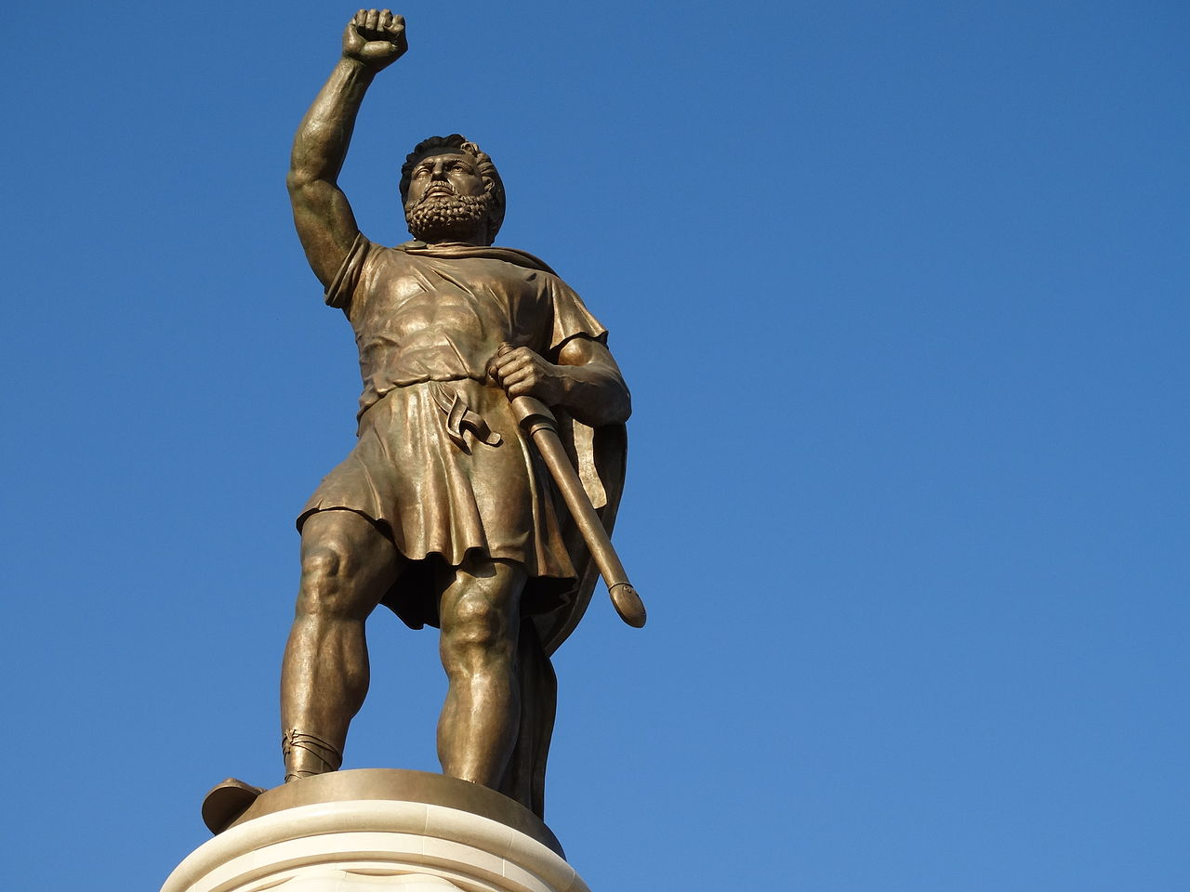
Map Questions:
Who was Alexander the Great?
How would you describe Alexander the Great?
When did Alexander the Great rule?

Slide 12
FRAME QUESTIONS:
How do you know these are the
characteristics of Alexander the
Great?
Does a specific point of view influence the descriptors that you used?
What conclusions can you draw about his character?

Slide 13
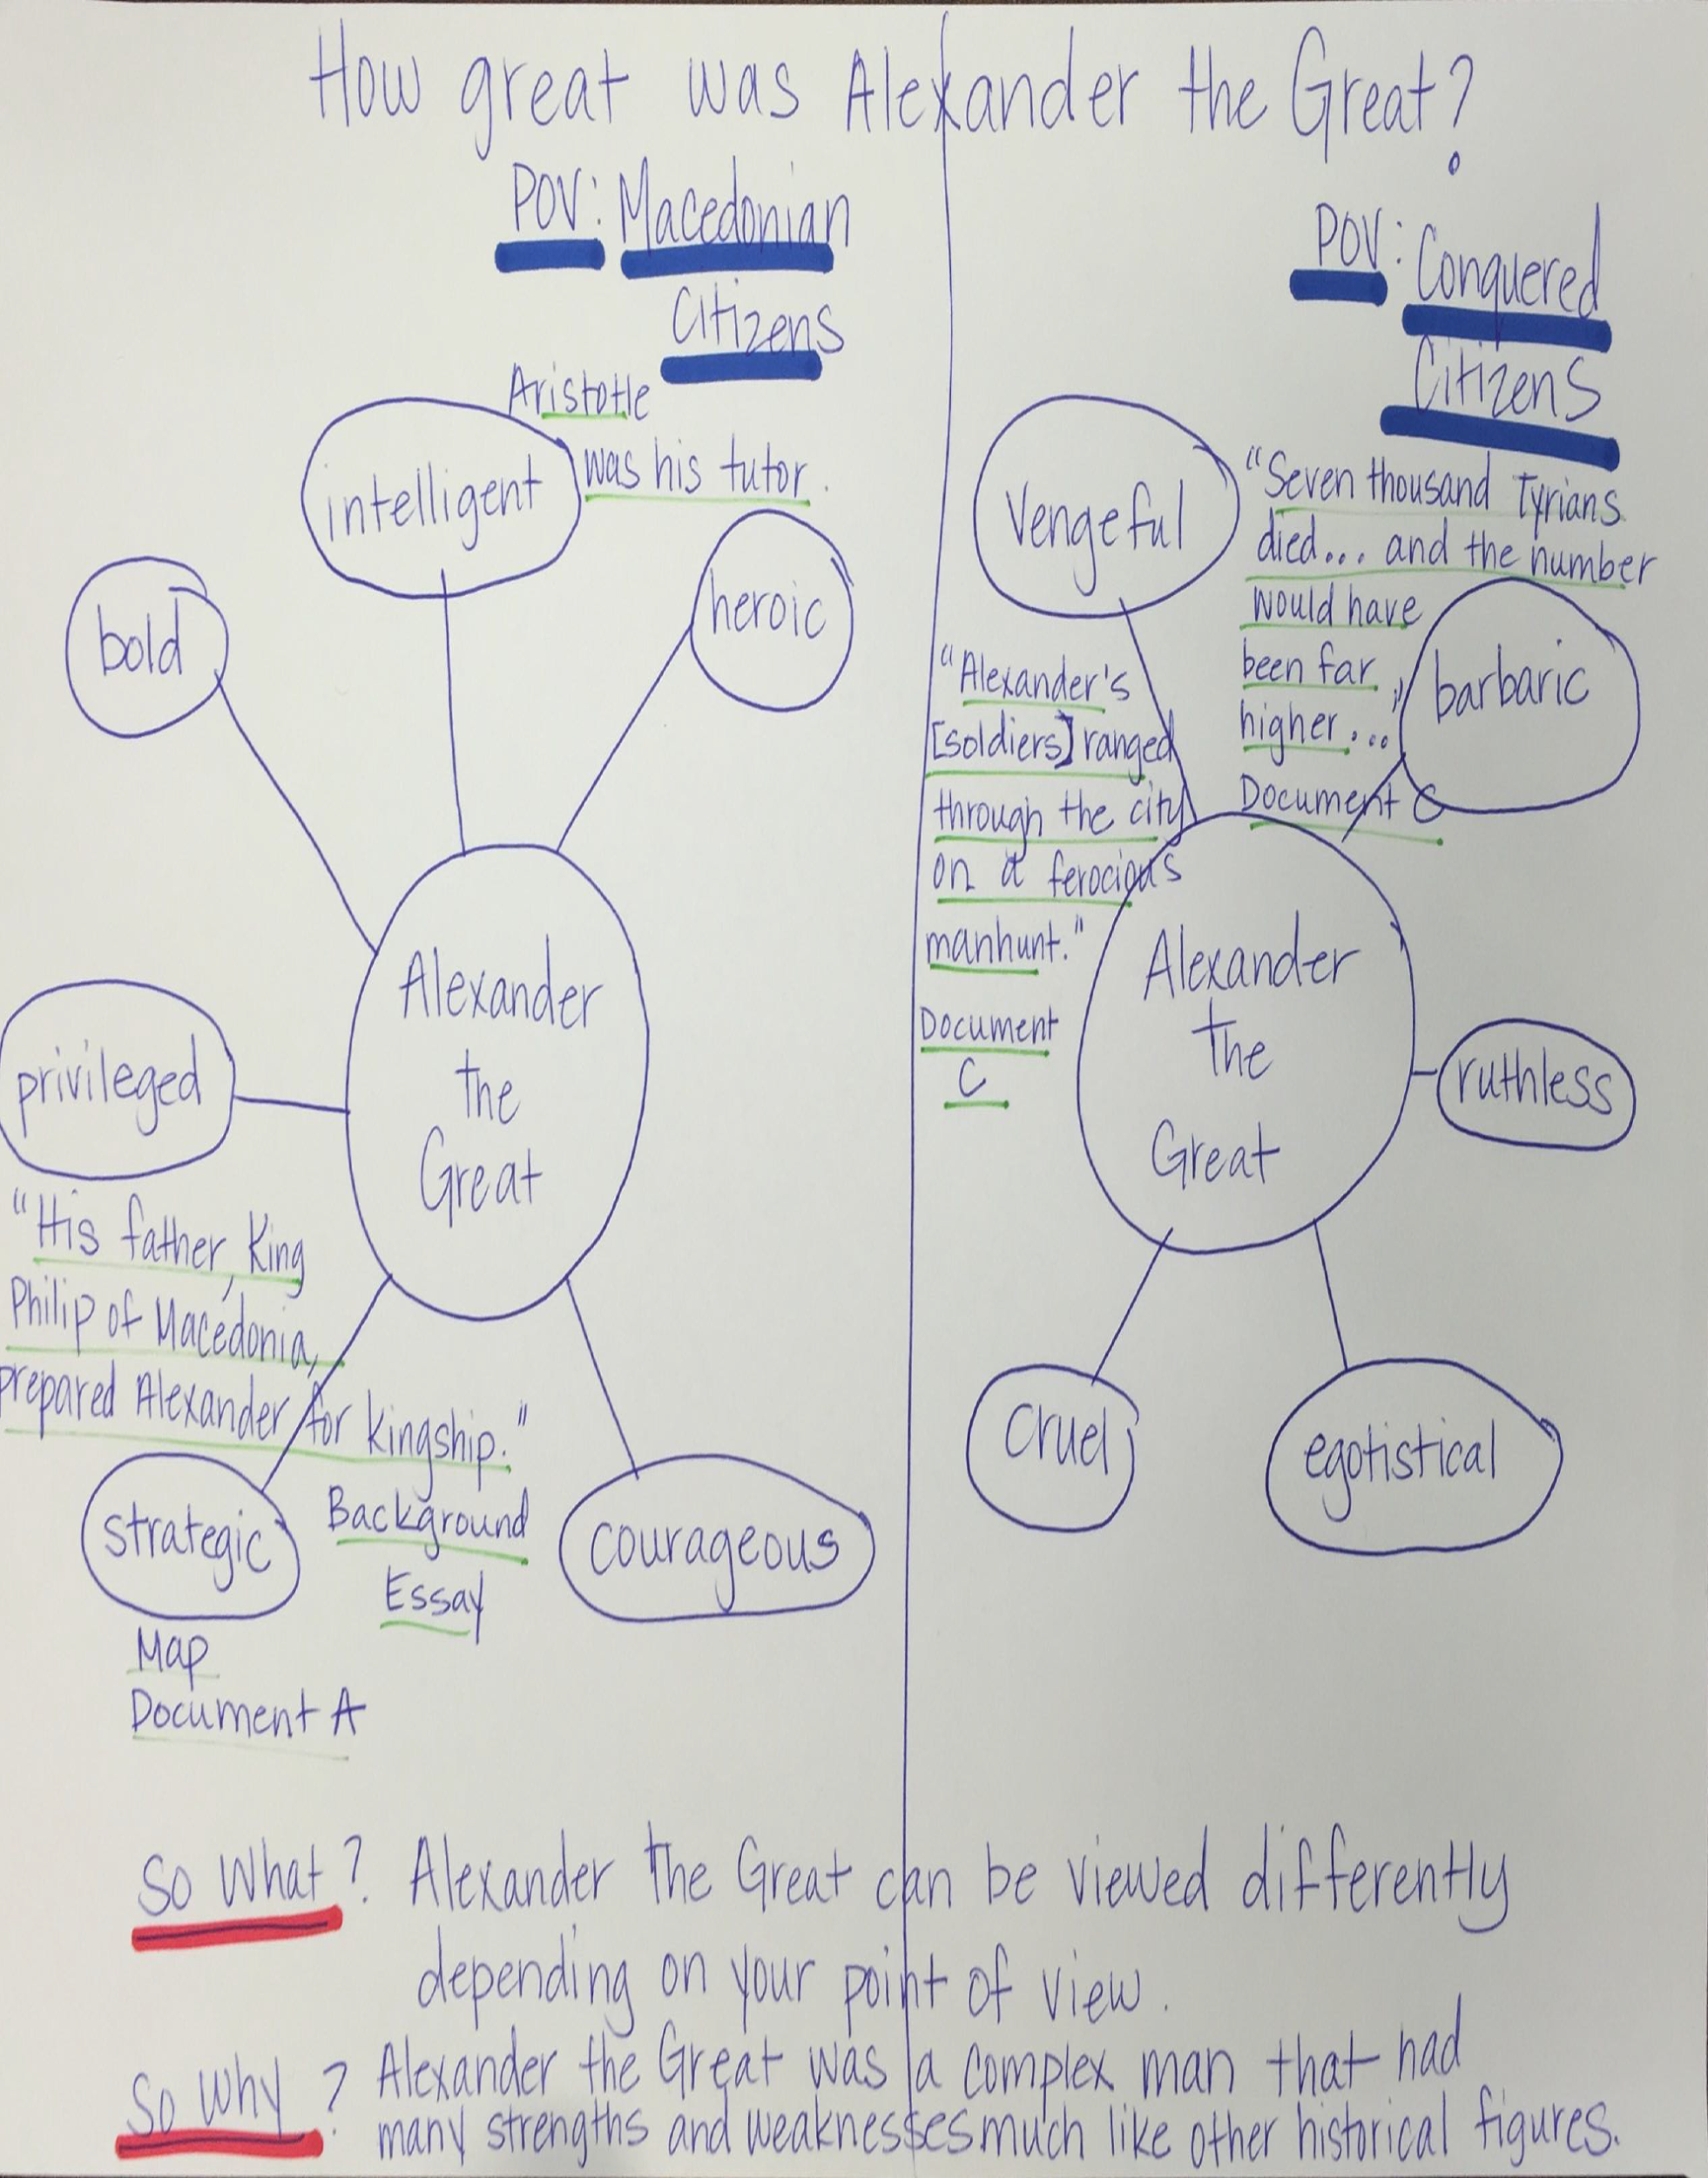

Slide 14
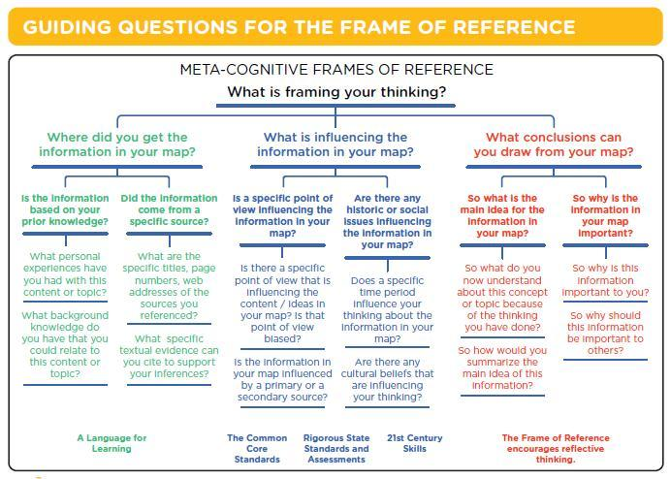
THE FRAME OF REFERENCE
Notes:
Passed out extra frames.
This should be one of you major follow-ups. Then go through each branch one by one. Higher level as you go. You can do followups in 3. Second branch is more about perspective. Sometimes assign before or think about a point of view
Influencing – post 9/11 or east coast or west coast
Third: so what: what do you understand about the content
So why: should I care
When I think like a matematician

Slide 15



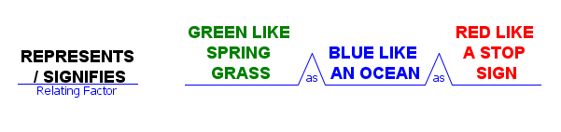

THE USE OF COLOR IN THE FRAME OF REFERENCE
the beginning of ideas, of connections.
How we know something usually “springs” from our prior knowledge, experience or a specific source.
a depth of thought.
Analyzing what influences our thinking requires thinking “below the surface.”
a signal to stop and reflect.
Summarizing our thinking and the use of that knowledge in the “real world” requires reflective thinking.

Slide 16
The Green Frame
Use a Circle Map for Note Taking

Slide 17
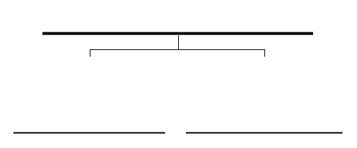
WHERE DID YOU GET THE INFORMATION IN YOUR MAP?
IS THE INFORMATION BASED ON YOUR PRIOR KNOWLEDGE?
DID THE INFORMATION COME FROM A SPECIFIC SOURCE?

Slide 18
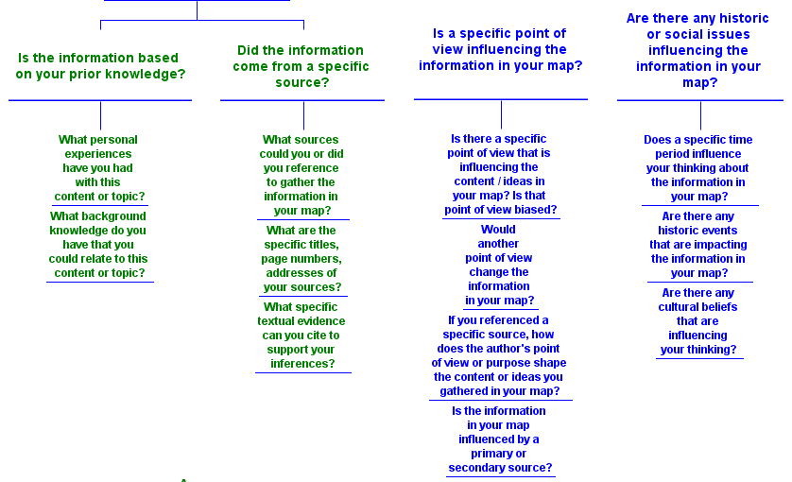
Standards
Recall information from experiences or gather information from print and digital sources.
Notes:
Adds credibility and use a variety of sources.

Slide 19
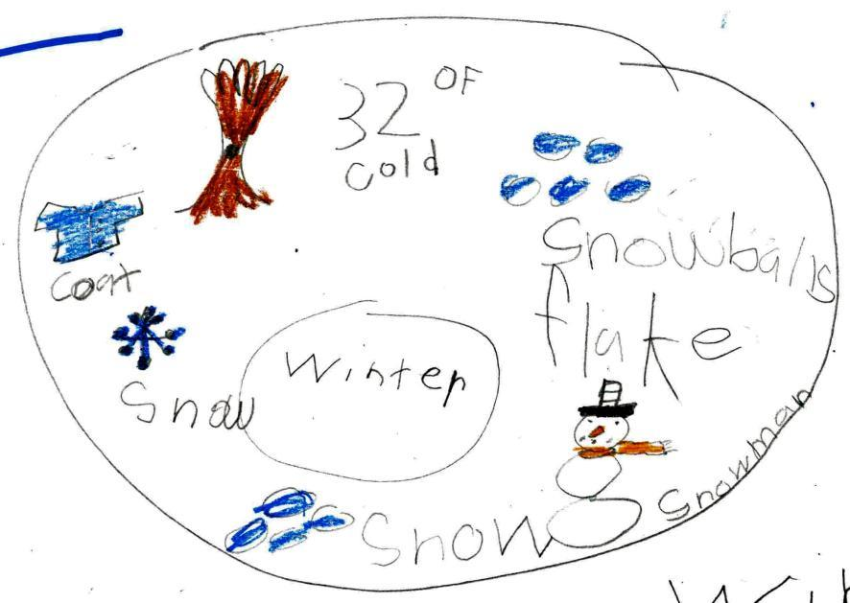
Playing in the snow is fun.
I love the cold weather.
I live in VA and we have a long winter.

Slide 20
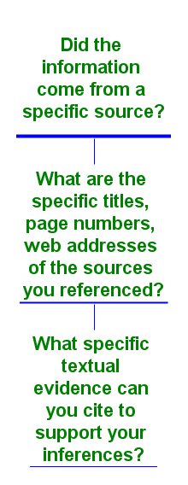
Standards
Ask and answer questions to demonstrate understanding of a text, referring explicitly to the text as the basis for the answers.
Quote accurately from a text when explaining what the text says explicitly and when drawing inferences from the text.
Assess the credibility of each source.

Slide 21
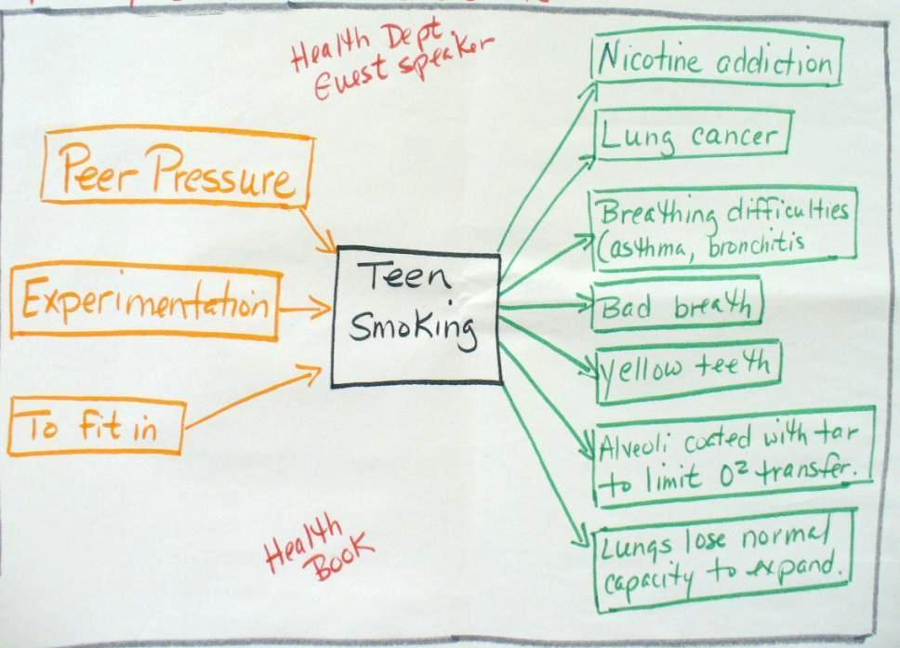
Health Department Guest Speaker
www.teensmoking.us/content/teen-smoking-statistics.html
www.familyfirstaid.org/teen-smoking.html

Slide 22
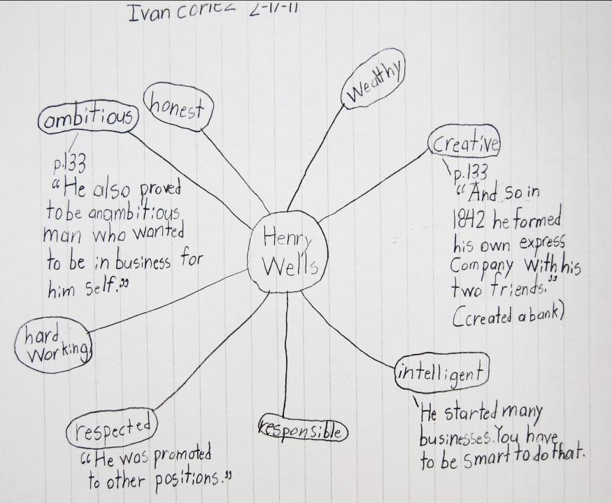
What evidence from the text supports your descriptors?

Slide 23
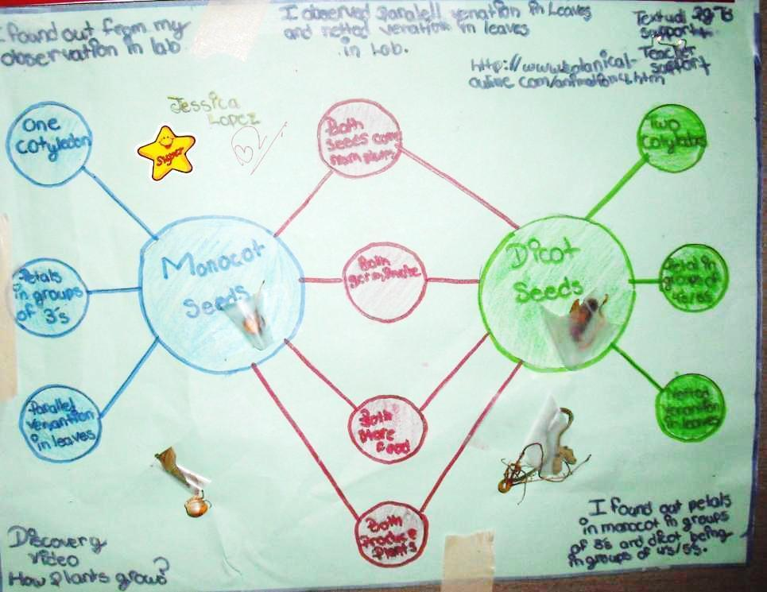
I found out from my observations in the lab.
Discovery Video: How Plants Grow

Slide 24


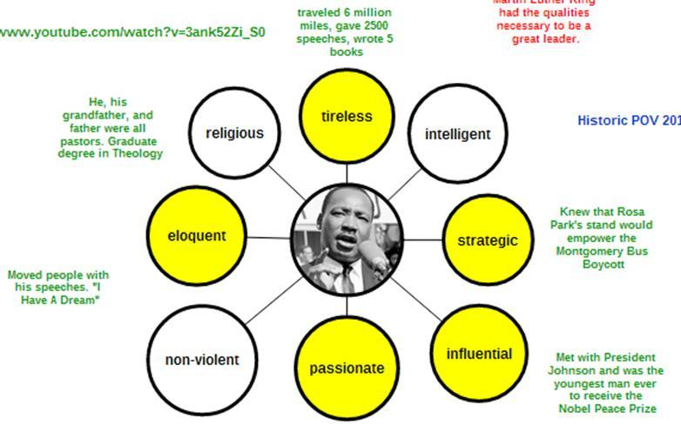

Traveled 6 million miles, gave 2,500 speeches, wrote 5 books
He, his grandfather and father were all pastors. Graduate degree in Theology
Knew that Rosa Park’s stand would empower the Montgomery Bus Boycott
Moved people with his speeches. “I Have A Dream”
Met with President Johnson and was the youngest man ever to receive the Nobel Peace Prize
http://youtube.com/watch?v=3ank527Zi_SO
Notes:
Add textual evidence for each of the adjectives based on the video you watch.

Slide 25
Green Frame Reflection
Sharing Our Understandings

Slide 26
The Blue Frame
Use a Thinking Map for Note Taking

Slide 27
WHAT IS INFLUENCING THE INFORMATION IN YOUR MAP?
IS A SPECIFIC POINT OF VIEW INFLUENCING THE INFORMATION IN YOUR MAP?
ARE THERE ANY HISTORIC OR SOCIAL ISSUES INFLUENCING THE INFORMATION IN YOUR MAP?

Slide 28
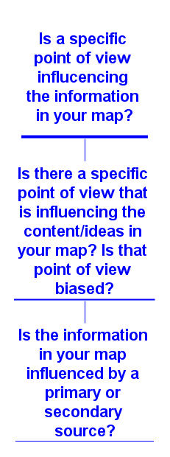
Standards
Distinguish their own point of view from that of the author of a text.
Analyze multiple accounts of the same event or topic, noting important similarities and differences in the point of view they represent.

Slide 29
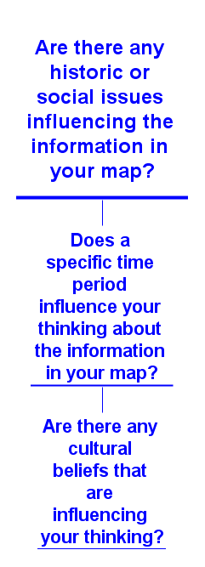
Standards
Compare and contrast the treatment of similar themes and topics in stories, myths, and traditional literature from different cultures.

Slide 30
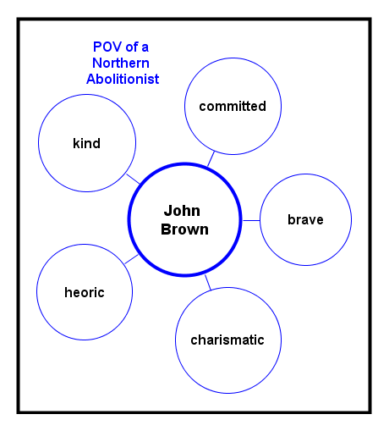
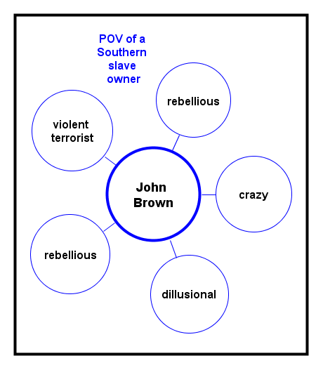

Slide 31
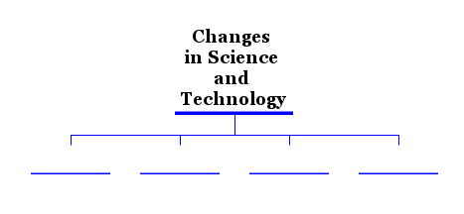
Between 1918-1970

Slide 32
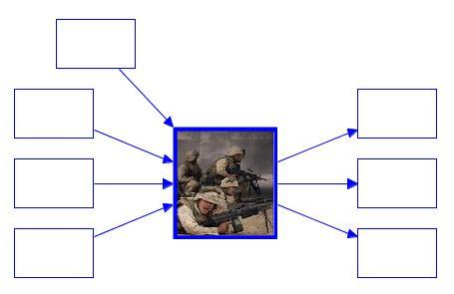
POV – American Soldier?
POV – Soldier from Iraq?
The War in Iraq

Slide 33
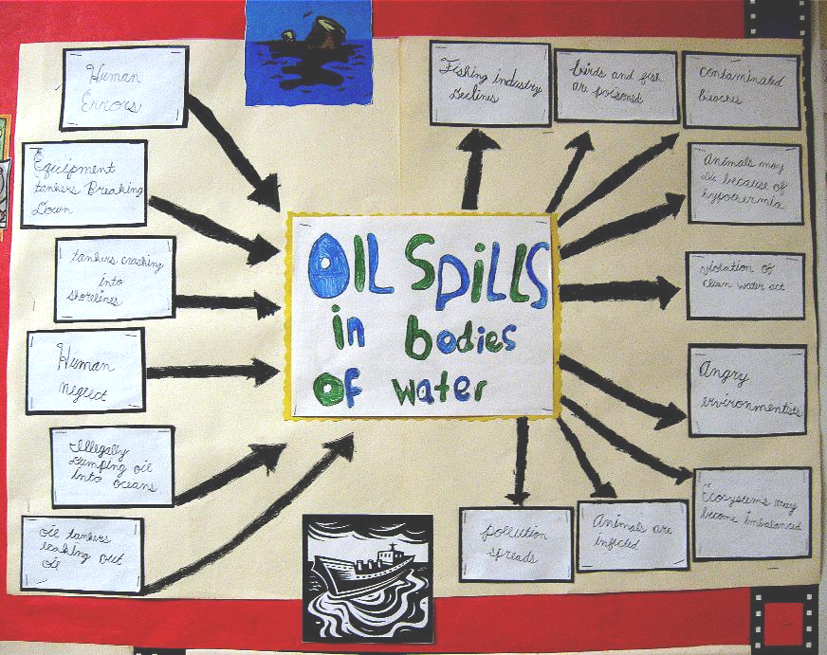
Researcher
&
Media
Environmentalist &
Economist

Slide 34
Traveled 6 million miles, gave 2,500 speeches, wrote 5 books
Historic POV 2011
He, his grandfather and father were all pastors. Graduate degree in Theology
Knew that Rosa Park’s stand would empower the Montgomery Bus Boycott
Moved people with his speeches. “I Have A Dream”
Met with President Johnson and was the youngest man ever to receive the Nobel Peace Prize
http://youtube.com/watch?v=3ank527Zi_SO
Notes:
Add textual evidence for each of the adjectives based on the video you watch.

Slide 35
Blue Frame Reflection
Sharing Our Understandings

Slide 36
The Red Frame
Use a Thinking Map for Note Taking

Slide 37
WHAT CONCLUSIONS CAN YOU DRAW FROM THE INFORMATION IN YOUR MAP?
SO WHAT IS THE MAIN IDEA FOR THE INFORMATION IN YOUR MAP?
SO WHY IS THE INFORMATION IN YOUR MAP IMPORTANT?

Slide 38
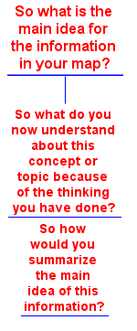
Standards
Determine two or more main ideas of a text and explain how they are supported by key details; summarize the text.

Slide 39
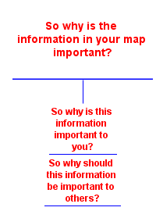
COLLEGE AND CAREER READINESS STANDARDS CONNECTIONS:
“Write a variety of text types for different purposes to examine a topic and convey ideas and information clearly with:…
Sense of closure
Concluding statement,
Logical conclusion”
Notes:
Takes you back to your world. It also brings you back to your green frame.

Slide 40
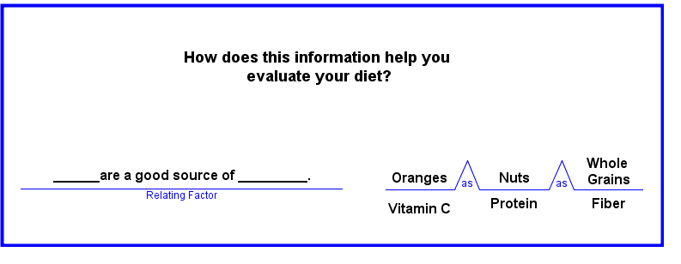
Foods provide our bodies with specific kinds of nutrition.
Knowing the nutritional value of the foods you eat is important to a balanced and healthy diet.

Slide 41
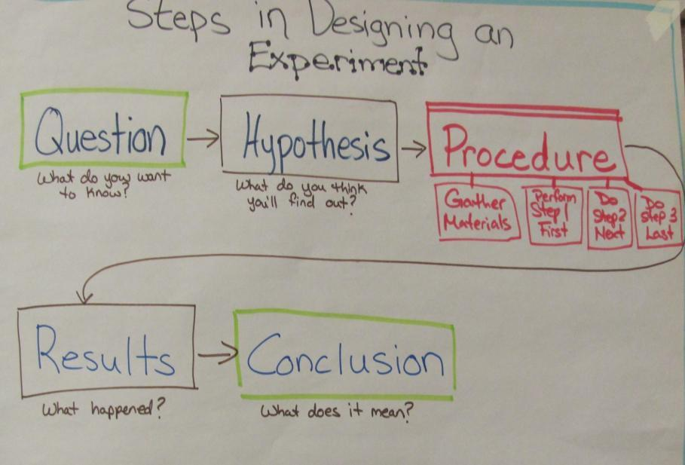
The question should be addressed in the conclusion.
The hypothesis should be checked against the results.
I need to know that scientists think logically when they solve a problem.
Notes:
I need to know that scientist think logically when they solve a problem. That is in steps. I also know that the steps are related – like the question should be answered in my conclusion and my results should let me know if my hypothesis is right or not.

Slide 42
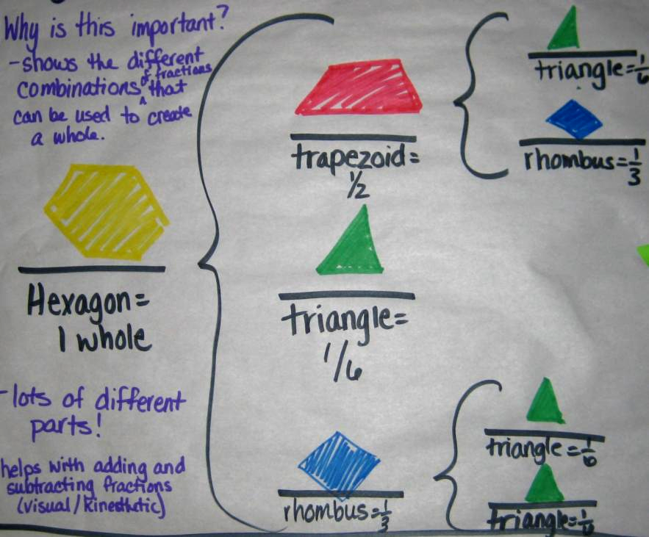
This shows the different combinations of fractions that can be used to create a whole.
-lots of different parts! -helps with adding and subtracting fractions – I can see the combinations and can make them with the manipulatives.

Slide 43
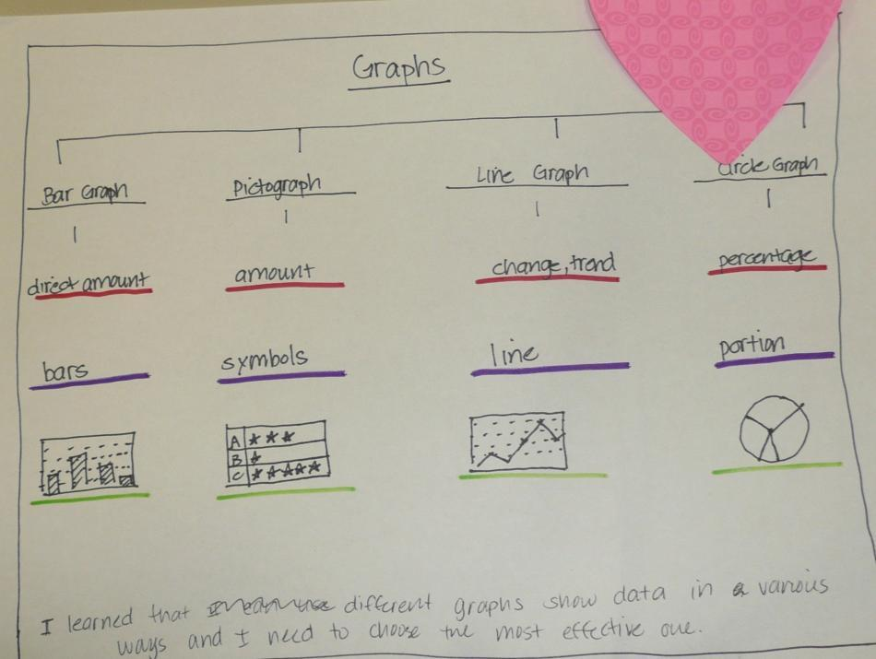
I learned that different graphs show data in various ways and I need to choose the most effective one.

Slide 44
MLK had the qualities necessary to be a great leader.
Traveled 6 million miles, gave 2,500 speeches, wrote 5 books
Historic POV 2011
He, his grandfather and father were all pastors. Graduate degree in Theology
Knew that Rosa Park’s stand would empower the Montgomery Bus Boycott
Moved people with his speeches. “I Have A Dream”
MLK’s leadership abilities and his commitment to mankind changed the world.
Met with President Johnson and was the youngest man ever to receive the Nobel Peace Prize
http://youtube.com/watch?v=3ank527Zi_SO
Notes:
Add textual evidence for each of the adjectives based on the video you watch.

Slide 45
Red Frame Reflection
Sharing Our Understandings

Slide 46
2nd Sort of Questions

Slide 47
YOUR TURN!
Applying the Frames
to a
Podcast

Slide 48
How would you define Normandy School District? Support your thinking with evidence.

Slide 49
What could be the results of leaving the Normandy District from the point of view of a Normandy student?

Slide 50
What could be the results of leaving the Normandy District from the point of view of the community?

Slide 51
With the two maps side by side, add a “So What?” and a “So Why?”

Slide 52
More Practice
Incorporating ALL Frames
FEARS ACTIVITY
Notes:
ONLY if we have time

Slide 53
Reflections
How does using a Frame of Reference enhance a Thinking Map?
What is the difference between a Frame question and a Map question?
When would you use the Frame of Reference?
How do you plan on implementing the Frames of Reference in your classroom?
QUESTIONS????

