Slide 1
The Parents’ Guide to Google Classroom
ADA Compliant Version

Slide 2
What is Google Classroom?
Think of Google Classroom (GC) as your child’s digital link to learning. Teachers use GC to share assignments, homework, newsletters, and much more with students AND parents!

Slide 3
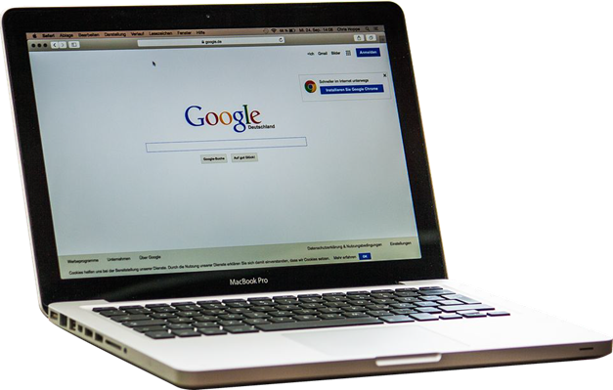
Getting Started
Your child was provided with a secure login and password that is unique to them.
Check with his/her teacher to obtain this private information or ask them to add you as a parent via email!

Slide 4

Getting Started - Step 1
Click on the Google Chrome browser icon.

Slide 5
Getting Started - Step 2
Type
www.google.com
into your web address bar.

Slide 6
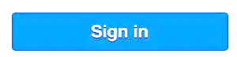
Getting Started - Step 3
Click on Sign In in the upper right hand corner of the browser window.

Slide 7
Getting Started - Step 4
Type in your child’s Google Email address & click “next.”

Slide 8
Getting Started - Step 5
Type in your Password & click “next.”

Slide 9
Now you’ll see-
that you are signed in to your Google Apps for Education account!

Slide 10

Google Suite
Click on the 9 squares (Waffle/Rubik’s Cube) icon in the top right hand corner to see the Google Suite of Products!

Slide 11























Google Icons to Recognize:
Chrome
Docs
Drive
Slides
Sheets
Forms
Calendar
Gmail
Photos
Maps
Keep
Classroom
Meet
Hangouts
Sites
Contacts
Cloud
Cloud
Search
YouTube
News
Vault
My Account
Groups

Slide 12
Navigating Classroom-1
Click on the waffle button
and then the Google Classroom
icon.

Slide 13
Navigating Classroom -2
Click on the class you wish to view.

Slide 14
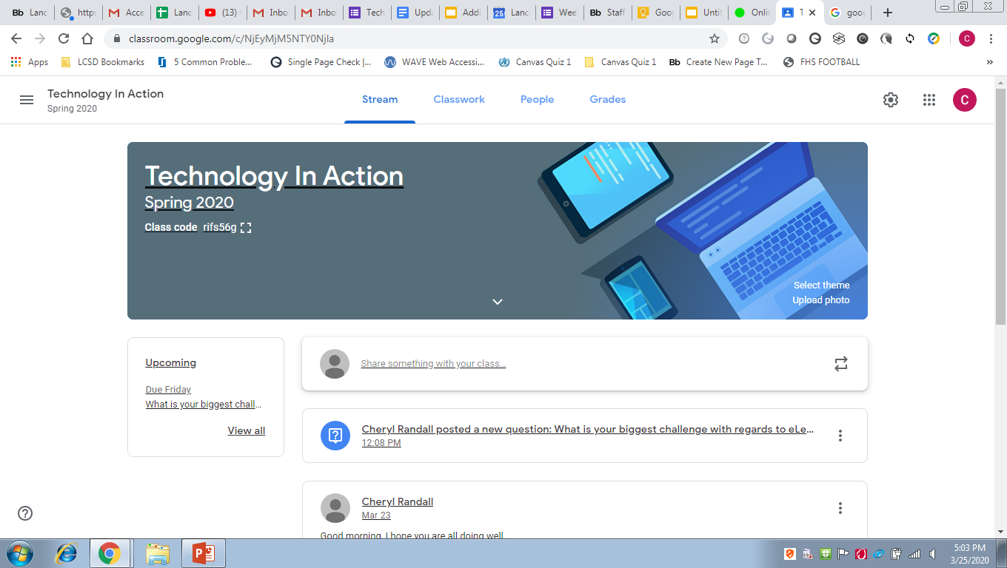
Navigating Classroom -3
Stream Page Key:
= Menu of Classes
Stream = Announcements Page
Classwork = Assignments
People = Teacher and Classmates
= App Directory
Your Image = Your Account
Upcoming = Upcoming Assignments
Updates from your teacher will appear in the center of the screen.

Slide 15

Navigating Classroom -4
Classwork Page Key:
View your work = See Your Grades
Google Calendar = See Due Dates
Class Drive Folder = View Your Files
All Topics = Choose Class Topics
Center Titles= Topic Headings
= Assignment Title
Date on the Right Side = Assignment Due Date
Assigned, Turned In, or Graded = Assignment Status
Attached Files or Links will be listed below the Assignment.
View Assignment = Displays the Assignment

Slide 16

Access Anywhere
Android
Iphone
Tablet
Desktop

Slide 17
Google Apps
allow you to edit Google assignments from any device that is connected to the internet!

Slide 18
Questions?
Email: eLearning@lancasterschools.org

