Slide 1



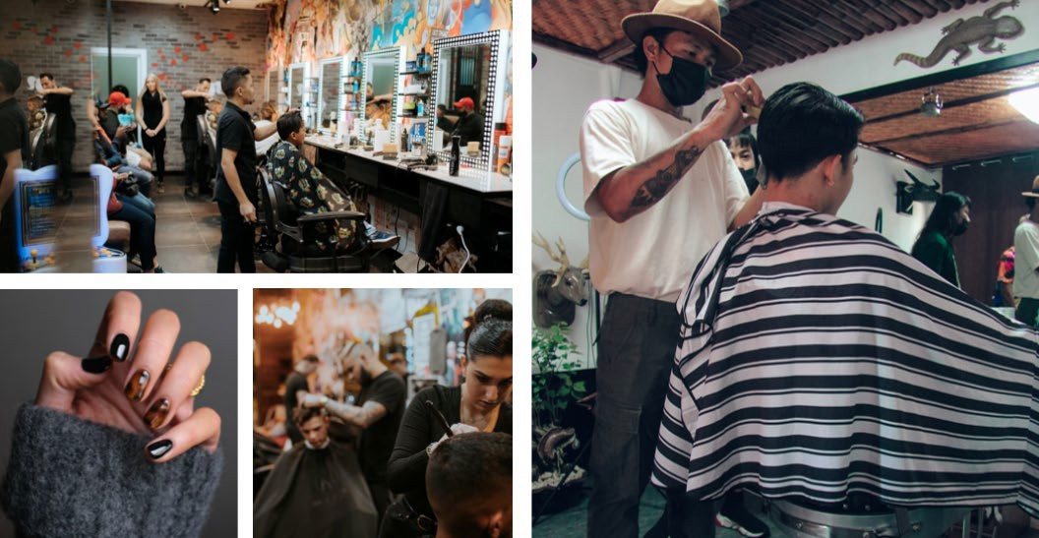

Human Services Career Cluster
The Human Services Career Cluster focuses on preparing individuals for employment in career pathways that relate to families and human needs such as counseling and mental health services, family and community services, personal care services, and consumer services.
Cosmetology and Personal Care Services
Regional Program of Study
The Cosmetology and Personal Care Services regional program of study introduces CTE learners to knowledge and skills related to providing beauty and personal care services. CTE concentrators may learn about or practice managing personal care facilities and coordinating or supervising personal service workers.
Secondary Courses for High School Credit
Level 1
Principles of Cosmetology Design and Color Theory
Work-Based Learning and Expanded Learning Opportunities
Exploration Activities | Work-Based Learning Activities
Participate in TIVA or SkillsUSA | Job shadow a cosmetologist Work part-time at a salon, spa, or barbershop
Level 2
Introduction to Cosmetology
Level 3
Cosmetology I/Lab
Level 4
Cosmetology II/Lab
Industry-Based Certifications
*Requirements for License:
High School Diploma/Background check
PSJA Academy
Cosmetology Operator License
Postsecondary Opportunities
Certificate/License
Certified Aesthetic Laser Operator
Cosmetologist
Certified Spa Supervisor
Nail Technician/Specialist and Manicurist
Associates Degrees
Cosmetology/Cosmetologist, General
Aesthetician/Esthetician and Skin Care Specialist
Salon/Beauty Salon Management/Manager
Cosmetology, Barber/Styling, and Nail Instructor
Aligned Occupations
Occupations | Median Wage | Annual Openings | % Growth
First-Line Supervisors of Personal Service Workers | $36,941 | 1,634 | 24%
Barbers | $28,267 | 348 | 14%
Hairdressers, Hairstylists, and Cosmetologists | $21,507 | 3,489 | 22%
Manicurists and Pedicurists | $21,715 | 418 | 45%
Shampooers | $18,720 | 139 | 24%
Skincare Specialists | $26,437 | 637 | 22%
Successful completion of the Cosmetology and Personal Care Services regional program of study will fulfill requirements of the Public Service endorsement. Revised – August 2022

Slide 2

Cosmetology and Personal Care Services Course Information
Level 1
COURSE NAME | SERVICE ID | PREREQUISITES | COREQUISITES
Principles of Cosmetology Design and Color Theory | 13025050 (1 credit) | None | None
Level 2
COURSE NAME | SERVICE ID | PREREQUISITES | COREQUISITES
Introduction to Cosmetology | 13025100 (1 credit) | None | None
Level 3
COURSE NAME | SERVICE ID | PREREQUISITES | COREQUISITES
Cosmetology I/Lab | 13025200 (2 credits) | None | None
Level 4
COURSE NAME | SERVICE ID | PREREQUISITES | COREQUISITES
Cosmetology II/Lab | 13025310 (3 credits) | Cosmetology I | None
FOR ADDITIONAL INFORMATION ON THE HUMAN SERVICES CAREER CLUSTER,
PLEASE CONTACT: PSJA ISD CTE Coordinator: Maria Davila maria.davila@psjaisd.us
https://tea.texas.gov/cte
Pharr-San Juan-Alamo ISD does not discriminate on the basis of race, color, national origin, sex, disability or age in its programs or activities and provides equal access to the Boy Scouts and other designated youth groups. The following person has been designated to handle inquiries regarding the nondiscrimination policies: Pharr-San
Juan-Alamo ISD Administration Building, 601 E Kelly Ave. Pharr, TX 78577 956-354-2000
Further nondiscrimination information can be found at Notification of Nondiscrimination in Career and Technical Education Programs.

