Slide 1
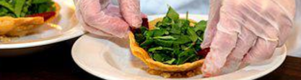

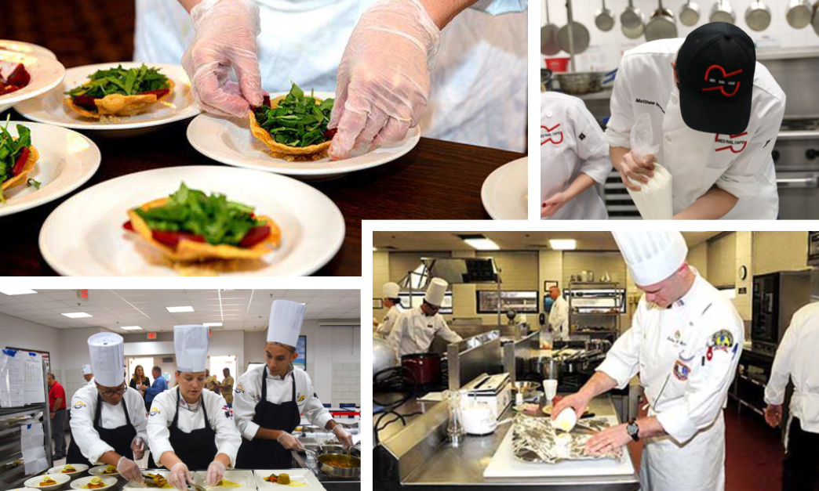

Culinary Arts
Statewide Program of Study
Hospitality and Tourism Career Cluster
The Hospitality and Tourism Career Cluster focuses on the management, marketing, and operations of restaurants and other food/beverage services, lodging, attractions, recreation events, and travel-related services. Students acquire knowledge and skills focusing on communication, time management, and customer service that meet industry standards. Students will explore the history of the hospitality and tourism industry and examine characteristics needed for success.
The Culinary Arts program of study introduces CTE learners to occupations and educational opportunities related to the planning, directing, or coordinating activities of a food and beverage organization or department. This program of study also explores opportunities involved in directing and participating in the preparation and cooking of food.
Secondary Courses for High School Credit
Level 1
Introduction to Culinary Arts
Level 2
Culinary Arts
Level 3
Advanced Culinary Arts
Level 4
Food Science
Practicum in Culinary Arts
Work-Based Learning and
Expanded Learning Opportunities
Exploration Activities | Work-Based Learning Activities
Participate in Family, Career, and Community Leaders of America, SkillsUSA, American Culinary Federation, or the Texas Restaurant Association | Plan a catering event or work for a catering company Participate in a cooking course Work in a restaurant
Industry-Based Certifications
Culinary Meat Selection & Cookery Certification
Food Safety & Science Certification
PSJA Academy
Level I College Certificate Available:
Commercial Baking Certificate
Postsecondary Opportunities
Associates Degrees
Hotel and Restaurant Management
Restaurant Culinary and Catering Management
Hospitality Administration/ Management, General
Culinary Arts/ Chef Training
Bachelor’s Degrees
Hotel and Restaurant Management
Food Service Systems Administration/ Management
Hospitality Administration/ Management, General
Culinary Science and Food Service Management
Master’s, Doctoral, and Professional Degrees
Hotel and Restaurant Management
Food Service Systems Administration/ Management
Hospitality Administration/ Management, General
Business Administration Management, General
Aligned Occupations
Occupations | Median Wage | Annual Openings | % Growth
Food and Beverage Managers | $55,619 | 1,561 | 28%
Chef and Head Cooks | $43,285 | 1,366 | 25%
Food Science Technicians | $34,382 | 236 | 11%
Successful completion of the Culinary Arts program of study will fulfill requirements of the Business and Industry endorsement. Revised – August 2022

Slide 2

Culinary Arts
Course Information
Level 1
COURSE NAME | SERVICE ID | PREREQUISITES | COREQUISITES
Introduction to Culinary Arts | 13022550 (1 credit) | None | None
Level 2
COURSE NAME | SERVICE ID | PREREQUISITES | COREQUISITES
Culinary Arts | N1302268 (1 credit) | None | None
Level 3
COURSE NAME | SERVICE ID | PREREQUISITES | COREQUISITES
Advanced Culinary Arts | 13022650 (2 credits) | Culinary Arts | None
Level 4
COURSE NAME | SERVICE ID | PREREQUISITES | COREQUISITES
Food Science | 13023000 (1 credit) | 3 units of Science, including Chemistry and Biology | None
Practicum in Culinary Arts | 13022700 (2 credits) | Culinary Arts | None
FOR ADDITIONAL INFORMATION ON THE HOSPITALITY AND TOURISM CAREER CLUSTER,
PLEASE CONTACT: PSJA ISD CTE Coordinator: Astrid Bonilla-Lazo astrid.lazo@psjaisd.us
https://tea.texas.gov/cte
Pharr-San Juan-Alamo ISD does not discriminate on the basis of race, color, national origin, sex, disability or age in its programs or activities and provides equal access to the Boy Scouts and other designated youth groups. The following person has been designated to handle inquiries regarding the nondiscrimination policies: Pharr-San Juan-Alamo ISD Administration Building, 601 E Kelly Ave. Pharr, TX 78577 956-354-2000
Further nondiscrimination information can be found at Notification of Nondiscrimination in Career and Technical Education Programs.

