Slide 1


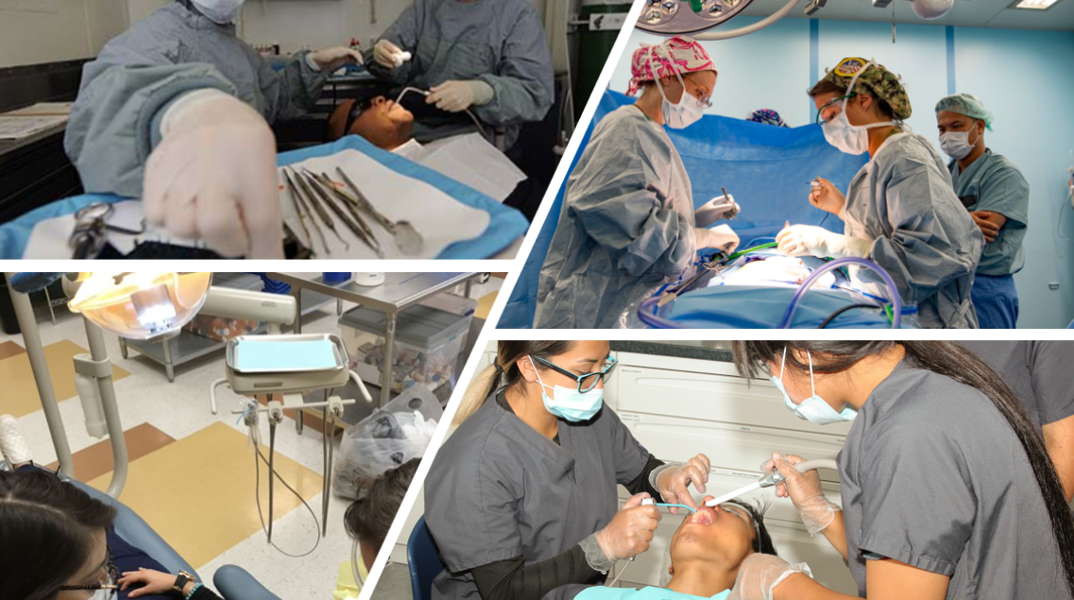

Healthcare Therapeutic
Statewide Program of Study
Health Science Career Cluster
The Health Science Career Cluster focuses on planning, managing, and providing therapeutic services, diagnostics services, health informatics, support services, and biotechnology research and development. To pursue a career in the health science industry, students should learn to reason, think critically, make decisions, solve problems, communicate effectively, and work well with others.
The Healthcare Therapeutic program of study introduces students to occupations and educational opportunities related to diagnosing and treating acute, episodic, or chronic illness independently or as part of a healthcare team. This program of study also includes an introduction to the opportunities associated with providing treatment and counsel to patients as well as rehabilitative programs that help build or restore daily living skills to persons with disabilities or developmental delays.
Secondary Courses for High School Credit
Level 1
Principles of Health Science
Level 2
Medical Terminology
Level 3
Health Science Theory/Health Science Clinical
Level 4
Pharmacology
Practicum in Health Science
Work-Based Learning and
Expanded Learning Opportunities
Exploration Activities | Work-Based Learning Activities
Participate in SkillsUSA or Health Occupation Students of America | Volunteer at a community wellness center, hospital, assisted living, or nursing home
Industry-Based Certifications
* Requirements for License/Certification
Certified Dental Assistant-Fingerprinting; SS#; HS Diploma
Emergency Medical Technician – Basic Fingerprinting; High School Diploma
Certified EKG Technician- Fingerprinting, High School Diploma
Certified Nurse Aide (CNA)- Social Security
ECG Technician – Fingerprinting, High School Diploma
Nationally Registered Certified EKG Technician- Fingerprinting, High School Diploma
Pharmacy Technician – High School Diploma
Phlebotomy Technician – SS#, High School Diploma
Postsecondary Opportunities
Associates Degrees
Dental Hygienist
Medical/Clinical Assistant
Bachelor’s Degrees
Dental Hygienist
Master’s, Doctoral, and Professional Degrees
Dentist
Physician Assistant
Family and General Practitioners
Pharmacist
Certified Ophthalmic Technician*
Certified Surgical Technologist*
Licensed Dental Hygienist*
Orthopedic Technologist*
*IBC sunsetting 8/31/24
Aligned Occupations
Occupations | Median Wage | Annual Openings | % Growth
Medical Assistants | $29,598 | 8,862 | 30%
Surgical Technologists | $45,032 | 1,150 | 20%
Dental Hygienists | $73,507 | 1,353 | 38%
Physicians and Surgeons | $213,071 | 1,151 | 30%
Successful completion of the Healthcare Therapeutic program of study will fulfill requirements of a Public Service endorsement or STEM endorsement if the math and science requirements are met. Revised – August 2022

Slide 2


Healthcare Therapeutic
Course Information
Level 1
COURSE NAME | SERVICE ID | PREREQUISITES | COREQUISITES
Principles of Health Science | 13020200 (1 credit) | None | None
Level 2
COURSE NAME | SERVICE ID | PREREQUISITES | COREQUISITES
Medical Terminology | 13020300 (1 credit) | None | None
Level 3
COURSE NAME | SERVICE ID | PREREQUISITES | COREQUISITES
Health Science Theory | 13020400 (1 credit) | Biology | None
COURSE NAME | SERVICE ID | PREREQUISITES | COREQUISITES
Pharmacology | 13020950 (1 credit) | Biology and Chemistry | None
Practicum in Health Science | 13020500 (2 credits) | Health Science Theory and Biology | None
FOR ADDITIONAL INFORMATION ON THE ARTS, AUDIO/VIDEO TECHNOLOGY, AND COMMUNICATIONS CAREER CLUSTER, PLEASE CONTACT: PSJA ISD CTE Coordinator: Maria Davila maria.davila@psjaisd.us
https://tea.texas.gov/cte
Pharr-San Juan-Alamo ISD does not discriminate on the basis of race, color, national origin, sex, disability or age in its programs or activities and provides equal access to the Boy Scouts and other designated youth groups. The following person has been designated to handle inquiries regarding the nondiscrimination policies: Pharr-San Juan-Alamo ISD Administration Building, 601 E Kelly Ave. Pharr, TX 78577 956-354-2000
Further nondiscrimination information can be found at Notification of Nondiscrimination in Career and Technical Education Programs.

