Slide 1
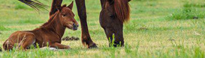

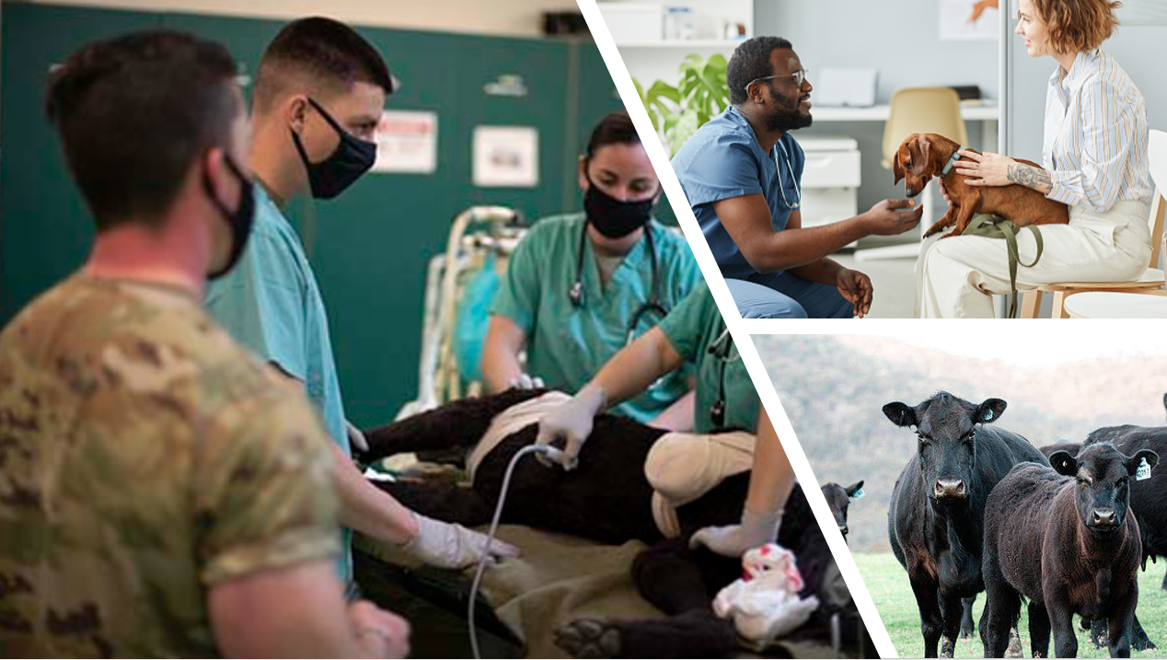

Animal Science
Statewide Program of Study
Agriculture, Food, and Natural Resources Career Cluster
The Agriculture, Food, and Natural Resources (AFNR) Career Cluster focuses on the essential elements of life food, water, land, and air. This career cluster includes a diverse spectrum of occupations, ranging from farmer, rancher, and veterinarian to geologist, land conservationist, and florist. It also includes non-traditional agricultural occupations like wind energy, solar energy, and oil and gas production.
The Animal Science program of study focuses on the science, research, and business of animals and other living organisms. It teaches CTE learners how to apply biology and life science to real-world life processes of animals and wildlife, either in laboratories or in the field, which could include a veterinary office, a farm or ranch, or any outdoor area harboring animal life. Students may also research and analyze the growth and destruction of species and research or diagnose diseases and injuries of animals.
Secondary Courses for High School Credit
Level 1
Principles of Agriculture, Food, and Natural Resources
Level 2
Small Animal Management
Equine Science
Level 3
Livestock Production
Level 4
Advanced Animal Science
Work-Based Learning and
Expanded Learning Opportunities
Exploration Activities | Work-Based Learning Activities
Participate in Texas FFA | Compete in an Agri-Science Fair 4H Volunteer at a local farm or with a veterinarian Participate in an FFA supervised agriculture experience
Industry-Based Certifications
Elanco Fundamentals of Animal Science Certification
PSJA Academy
AgriLife Veterinary Assistant Certificate
Postsecondary Opportunities
Associates Degrees
Food Science and Technology
Veterinary Studies
Biotechnology Laboratory Technician
Biology Technician
Bachelor’s Degrees
Animal Sciences
Agriculture
Biology
Zoology/ Animal Biology
Master’s, Doctoral, and Professional Degrees
Genetics
Veterinary Medicine
Biological and Physical Sciences
Biological and Biomedical Sciences
Aligned Occupations
Occupations | Median Wage | Annual Openings | % Growth
Animal Breeders | $39,139 | 28 | 9%
Animal Scientists | $57,533 | 22 | 12%
Medical Scientists | $63,898 | 435 | 27%
Veterinarians | $93,496 | 294 | 24%
Zoologists and Wildlife Biologists | $67,309 | 45 | 32%
Successful completion of the Animal Science program of study will fulfill requirements of a Business and Industry endorsement or STEM endorsement if the math and science requirements are met. Revised – August 2022

Slide 2

Animal Science
Course Information
Level 1
COURSE NAME | SERVICE ID | PREREQUISITES | COREQUISITES
Principles of Agriculture, Food, and Natural Resources | 13000200 (1 credit) | None | None
Level 2
COURSE NAME | SERVICE ID | PREREQUISITES | COREQUISITES
Small Animal Management | 13000400 (0.5 credit)
Equine Science | 13000500 (0.5 credit) | None | None
Level 3
COURSE NAME | SERVICE ID | PREREQUISITES | COREQUISITES
Livestock Production | 13000300 (1 credit) | None | None
Level 4
COURSE NAME | SERVICE ID | PREREQUISITES | COREQUISITES
Advanced Animal Science | 13000700 (1 credit) | Biology and Chemistry or Integrated Physics and Chemistry (IPC); Algebra I and Geometry; and either Small Animal Management, Equine Science, or Livestock Production | None
FOR ADDITIONAL INFORMATION ON THE AGRICULTURE, FOOD, AND NATURAL RESOURCE CAREER CLUSTER,
PLEASE CONTACT: PSJA ISD CTE Coordinator: David Gonzalez david.gonzalez@psjaisd.us
https://tea.texas.gov/cte
Pharr-San Juan-Alamo ISD does not discriminate on the basis of race, color, national origin, sex, disability or age in its programs or activities and provides equal access to the Boy Scouts and other designated youth groups. The following person has been designated to handle inquiries regarding the nondiscrimination policies: Pharr-San Juan-Alamo ISD Administration Building, 601 E Kelly Ave. Pharr, TX 78577 956-354-2000
Further nondiscrimination information can be found at Notification of Nondiscrimination in Career and Technical Education Programs.

