Slide 1
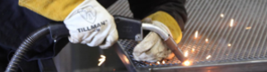

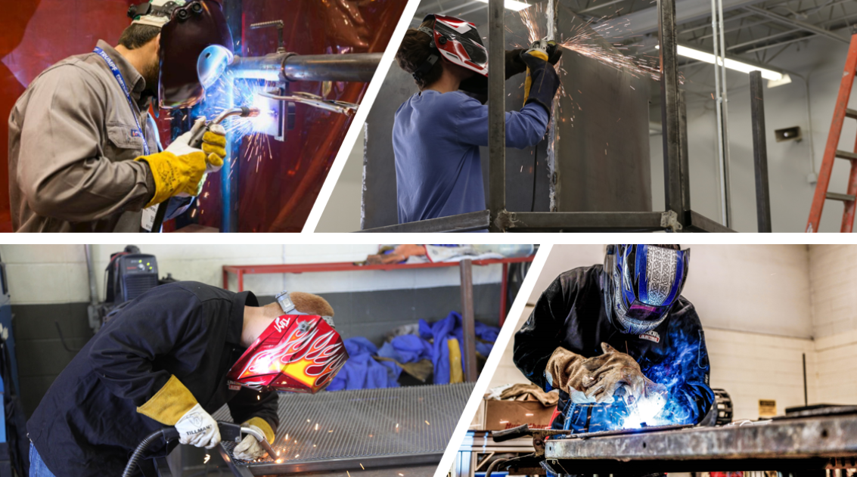

Welding
Statewide Program of Study
Manufacturing Career Cluster
The Manufacturing Career Cluster focuses on planning, managing, and performing the processing of materials into intermediate or final products and related professional and technical support activities such as production planning and control, maintenance, and manufacturing/process engineering.
The Welding program of study focuses on the development and use of automatic and computer-controlled machines, tools, and robots that perform work on metal or plastic. CTE learners will learn how to modify parts to make or repair machine tools or maintain individual machines, and how to use hand-welding or flame-cutting equipment.
Secondary Courses for High School Credit
Level 1
Introduction to Welding
Level 2
Welding I
Level 3
Welding II
Level 4
Practicum in Manufacturing
Work-Based Learning and
Expanded Learning Opportunities
Exploration Activities | Work-Based Learning Activities
Participate and compete in SkillsUSA Job shadow a machinist | Work in a local business or industry apprenticeship Join the American Welding Society
Industry-Based Certifications
AWS D1.1 Structural Steel
AWS D9.1 Sheet Metal Welding
PSJA Academy
Level I College Certificate Available:
Structural Welding and Combination Welding Certificate
Postsecondary Opportunities
Associates Degrees
Certified Welder or Welder Inspector
Machine Shop Technology/Assistant
Operations Management and Supervision
Occupational Safety and Health Technology/Technician
Bachelor’s Degrees
Welding Engineering Technology/Technician
Biomedical Technology/Technician
Operations Management and Supervision
Environmental Health
Master’s, Doctoral, and Professional Degrees
Welding Engineering Technology/Technician
Occupational Health and Industrial Hygiene
Operations Management and Supervision
Environmental Health
OSHA 30 Hour General*
*IBC sunsetting 8/31/24
Aligned Occupations
Occupations | Median Wage | Annual Openings | % Growth
Welders, Cutters, Solderers, and Brazers | $41,350 | 6,171 | 9%
Welding Soldering and Brazing Machine Setters, Operators and Tenders | $40,040 | 280 | 9%
Successful completion of the Welding program of study will fulfill requirements of the Business and Industry endorsement. Revised – August 2022

Slide 2

Welding
Course Information
Level 1
COURSE NAME | SERVICE ID | PREREQUISITES | COREQUISITES
Introduction to Welding | 13032250 (1 credit) | None | None
Level 2
COURSE NAME | SERVICE ID | PREREQUISITES | COREQUISITES
Welding I | 13032300 (2 credits) | None | None
Level 3
COURSE NAME | SERVICE ID | PREREQUISITES | COREQUISITES
Welding II | 13032400 (2 credits) | Welding I | None
Level 4
COURSE NAME | SERVICE ID | PREREQUISITES | COREQUISITES
Practicum in Manufacturing | 13033000 (2 credits) | None | None
FOR ADDITIONAL INFORMATION ON THE MANUFACTURING CAREER CLUSTER,
PLEASE CONTACT: PSJA ISD CTE Coordinator: David Gonzalez david.gonzalez@psjaisd.us
https://tea.texas.gov/cte
Pharr-San Juan-Alamo ISD does not discriminate on the basis of race, color, national origin, sex, disability or age in its programs or activities and provides equal access to the Boy Scouts and other designated youth groups. The following person has been designated to handle inquiries regarding the nondiscrimination policies: Pharr-San Juan-Alamo ISD Administration Building, 601 E Kelly Ave. Pharr, TX 78577 956-354-2000
Further nondiscrimination information can be found at Notification of Nondiscrimination in Career and Technical Education Programs.

