Slide 1
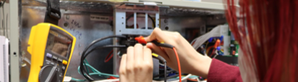

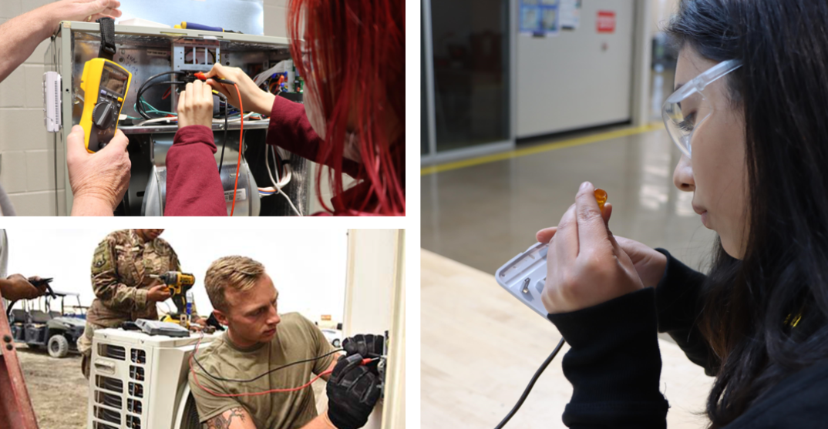

HVAC and Sheet Metal
Statewide Program of Study
Architecture and Construction Career Cluster
The Architecture and Construction Career Cluster focuses on designing, planning, managing, building, and maintaining the built environment. Principles of Architecture provides an overview to the various fields of architecture, interior design, and construction management.
The HVAC and Sheet Metal program of study explores the occupations and educational opportunities associated with installing, serving, or repairing heating and air conditioning systems and also the fabrication, assembly, installation, and repair of sheet metal products and equipment, such as ducts, control boxes, drainpipes, and furnace casings. This program of study may also include exploration into preparing cost estimates for certain construction projects involving heating and air conditioning and sheet metal.
Secondary Courses for High School Credit
Level 1
Principles of Construction
Level 2
Heating, Ventilation Air Conditioning (HVAC) and Refrigeration Technology l
Level 3
Heating, Ventilation Air Conditioning (HVAC) and Refrigeration Technology II
Level 4
Practicum in Construction Technology
Work-Based Learning and
Expanded Learning Opportunities
Exploration Activities | Work-Based Learning Activities
Shadow an HVAC worker or cost estimator Participate in SkillsUSA | Intern with an HVAC and/or sheet metal company
Industry-Based Certifications
NCCER Core
PSJA Academy
Level I College Certificate Available:
Heating, Ventilation, Air Conditioning and Refrigeration Technology Certificate
Postsecondary Opportunities
Associates Degrees
Business Administration and Management, General
Mechanical Engineering
Heating, Ventilation, Air Conditioning and Refrigeration Engineering Technology/ Technician
Business/ Commerce, General
Bachelor’s Degrees
Business Administration and Management
Mechanical Engineering
Construction Engineering Technology/ Technician
Business/ Commerce, General
Master’s, Doctoral, and Professional Degrees
Business Administration and Management
Mechanical Engineering
Construction Engineering
Business/Commerce, General
Aligned Occupations
Occupations | Median Wage | Annual Openings | % Growth
Heating, Air Conditioning, and Refrigeration Mechanics | $41,808 | 3,356 | 26%
Sheet Metal Workers | $37,419 | 1,479 | 17%
Cost Estimators | $63,939 | 2,239 | 21%
Successful completion of the HVAC and Sheet Metal program of study will fulfill requirements of the Business and Industry endorsement. Revised – August 2022

Slide 2

HVAC and Sheet Metal
Course Information
Level 1
COURSE NAME | SERVICE ID | PREREQUISITES | COREQUISITES
Principles of Construction | 13004220 (1 credit) | None | None
Level 2
COURSE NAME | SERVICE ID | PREREQUISITES | COREQUISITES
Heating, Ventilation, and Air Conditioning (HVAC) and Refrigeration Technology l | 13005800 (1 credit) | None | None
Level 3
COURSE NAME | SERVICE ID | PREREQUISITES | COREQUISITES
Heating, Ventilation, and Air Conditioning (HVAC) and Refrigeration Technology II | 13005900 (2 credits) | Heating, Ventilation, and Air Conditioning (HVAC) and Refrigeration Technology l | None
Level 4
COURSE NAME | SERVICE ID | PREREQUISITES | COREQUISITES
Practicum in Construction Technology | 13005250 (2 credits) | Heating, Ventilation Air Conditioning (HVAC) and Refrigeration Technology II | None
FOR ADDITIONAL INFORMATION ON THE ARCHITECTURE AND CONSTRUCTION CAREER CLUSTER,
PLEASE CONTACT: PSJA ISD CTE Coordinator: Belinda Vargas belinda.vargas@psjaisd.us
https://tea.texas.gov/cte
Pharr-San Juan-Alamo ISD does not discriminate on the basis of race, color, national origin, sex, disability or age in its programs or activities and provides equal access to the Boy Scouts and other designated youth groups. The following person has been designated to handle inquiries regarding the nondiscrimination policies: Pharr-San Juan-Alamo ISD Administration Building, 601 E Kelly Ave. Pharr, TX 78577 956-354-2000
Further nondiscrimination information can be found at Notification of Nondiscrimination in Career and Technical Education Programs.

