Slide 1
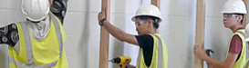

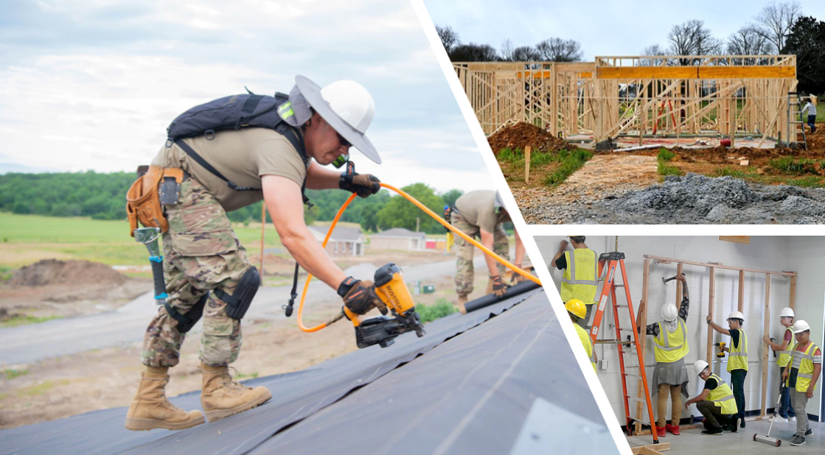

Carpentry
Statewide Program of Study
Architecture and Construction Career Cluster
The Architecture and Construction Career Cluster focuses on designing, planning, managing, building, and maintaining the built environment. Principles of Architecture provides an overview to the various fields of architecture, interior design, and construction management.
The Carpentry program of study explores the occupations and educational opportunities related to constructing, installing, or repairing structures and fixtures made of wood, such as concrete forms (including frameworks, partitions, joists, studding, rafters, and stairways). This program of study may also include exploration into installing, dismantling, or moving machinery and heavy equipment according to layout plans, blueprints, or other drawings.
Secondary Courses for High School Credit
Level 1
Principles of Construction
Level 2
Construction Technology I
Level 3
Construction Technology II
Level 4
Practicum in Construction Technology
Work-Based Learning and
Expanded Learning Opportunities
Exploration Activities | Work-Based Learning Activities
Shadow a carpenter or millwright Participate in SkillsUSA | Obtain an NCCER certification in Millwright Level 1 or Carpentry Level 1
Industry-Based Certifications
PSJA Academy
NCCER Core
Postsecondary Opportunities
Associates Degrees
Carpentry/Carpenter
Industrial Mechanics and Maintenance Technology
Bachelor’s Degrees
Construction Science
Master’s, Doctoral, and Professional Degrees
Construction Management
Aligned Occupations
Occupations | Median Wage | Annual Openings | % Growth
Carpenters | $35,922 | 5,031 | 26%
Cost Estimators | $63,939 | 2,239 | 21%
Successful completion of the Carpentry program of study will fulfill requirements of the Business and Industry endorsement. Revised – August 2022

Slide 2

Carpentry
Course Information
Level 1
COURSE NAME | SERVICE ID | PREREQUISITES | COREQUISITES
Principles of Construction | 13004220 (1 credit) | None | None
Level 2
COURSE NAME | SERVICE ID | PREREQUISITES | COREQUISITES
Construction Technology I | 13005100 (2 credits) | None | None
Level 3
COURSE NAME | SERVICE ID | PREREQUISITES | COREQUISITES
Construction Technology II | 13005200 (2 credits) | Construction Technology I | None
Level 4
COURSE NAME | SERVICE ID | PREREQUISITES | COREQUISITES
Practicum in Construction Technology | 13005250 (2 credits) | Construction Technology ll | None
FOR ADDITIONAL INFORMATION ON THE ARCHITECTURE AND CONSTRUCTION CAREER CLUSTER,
PLEASE CONTACT: PSJA ISD CTE Coordinator: Belinda Vargas belinda.vargas@psjaisd.us
https://tea.texas.gov/cte
Pharr-San Juan-Alamo ISD does not discriminate on the basis of race, color, national origin, sex, disability or age in its programs or activities and provides equal access to the Boy Scouts and other designated youth groups. The following person has been designated to handle inquiries regarding the nondiscrimination policies: Pharr-San Juan-Alamo ISD Administration Building, 601 E Kelly Ave. Pharr, TX 78577 956-354-2000
Further nondiscrimination information can be found at Notification of Nondiscrimination in Career and Technical Education Programs.

