Slide 1
ESBOCES CTE Programs
THE STUDENTS YOU SEND
&
THE PLACES THEY CAN GO

Slide 2
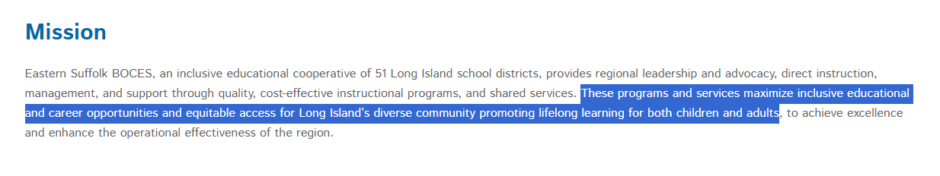
Purpose of Analysis and Reporting

Slide 3
Purpose of Analysis and Reporting
Internally
Understand students we serve in our CTE programs
Review and align program implementation to DEI initiatives
Understand industries our programs serve (and what students may encounter when they enter the workforce)
Externally
Provide accountability to component districts
Create opportunity for component districts to consider practices for identifying student interests and granting access to programs
Provide employment and earnings information

Slide 4
Goals for Analysis and Reporting
Increase access to programs, particularly for members of marginalized communities and along non-traditional career paths
Increase employment opportunities, particularly for members of marginalized communities and along non-traditional career paths
Diversify local workforce

Slide 5
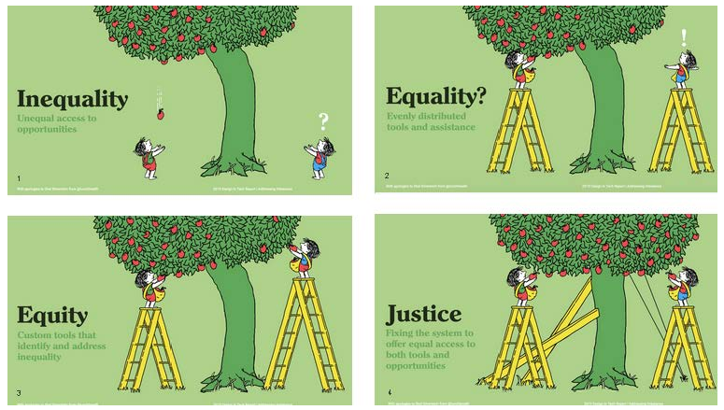
Goals for Analysis and Reporting

Slide 6
Population Parameters
Students enrolled in CTE programs
2021-22 school year
Internal data retrieved from SMS
External (district) data retrieved from SIRS Warehouse (Level 1)

Slide 7
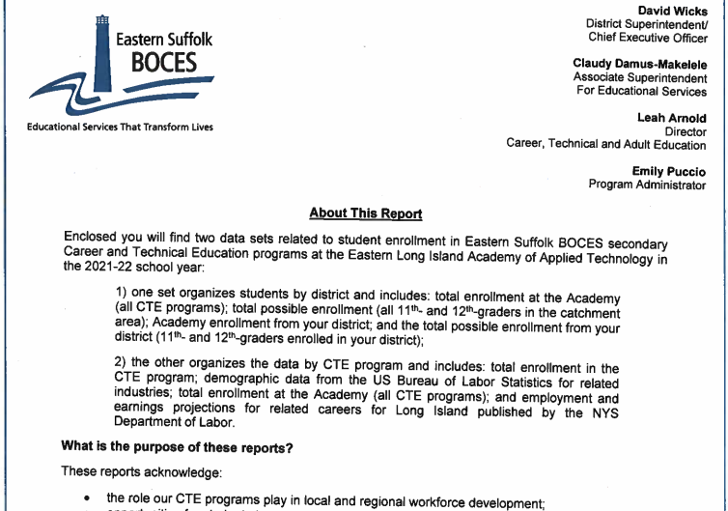
In Your Folder
About This Report document

Slide 8
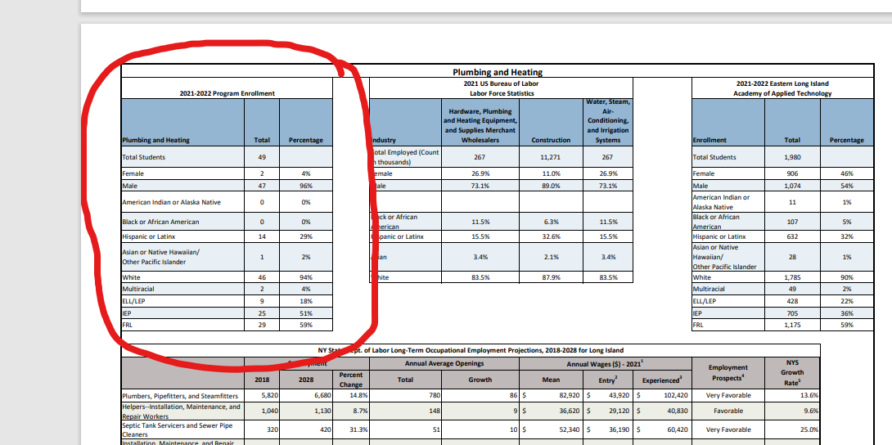
In Your Folder
Student population data by program

Slide 9
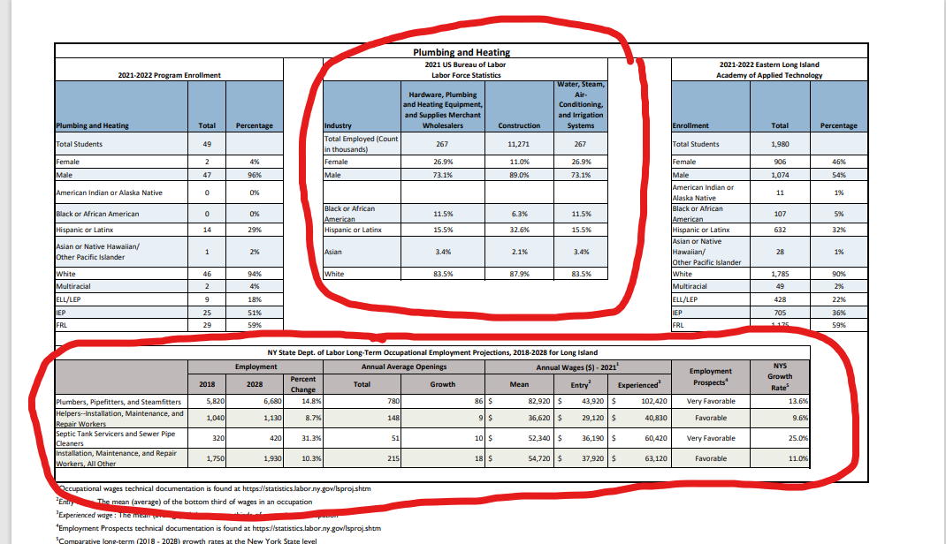
In Your Folder
Corresponding workforce
data

Slide 10
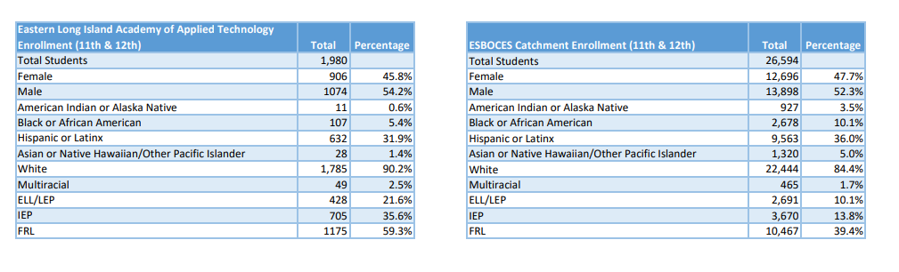
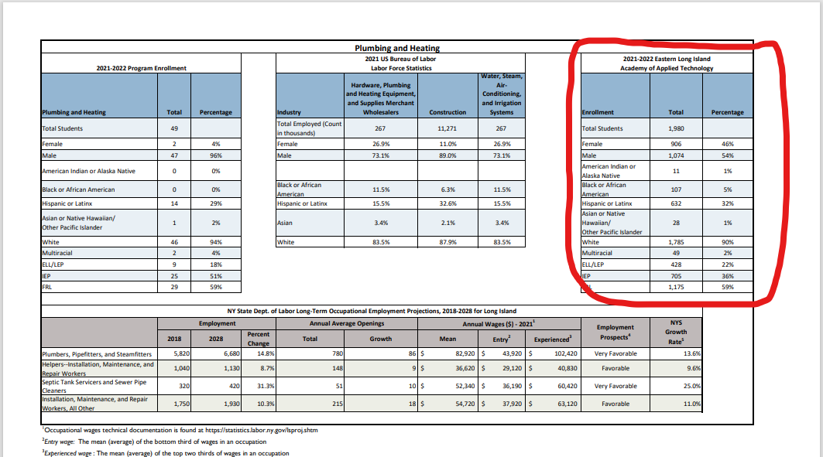
In Your Folder
Student population data for the Academy and region

Slide 11
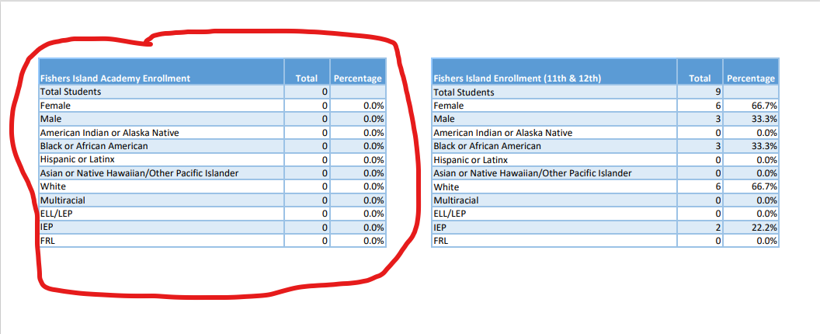
In Your Folder
Academy student population data for your district

Slide 12
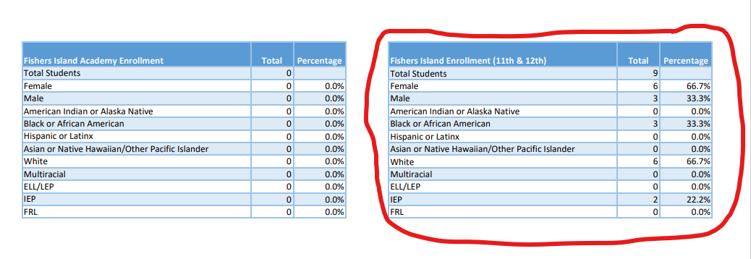
In Your Folder
Corresponding data for all district 11th- and 12th-graders

Slide 13
In Your Folder
Ability to crosswalk data multi-directionally:
  Region
  District/school
  Academy Program
  Industry
  State

Slide 14
Sharing Data
Internally
  Shared Decision Making Teams
  Program Approval/Self-Study Teams
  Cluster Meetings
  District Contact Meetings
Externally
  Curriculum Council
  District Contact Meetings

Slide 15
For Discussion
  What questions or feedback do you have?
  What are other avenues for sharing this information that you would find valuable?
  What supports would you find helpful for utilizing this data to meet goals?
      Increase access to programs, particularly for marginalized communities
      Diversify local workforce
      Create opportunities for traditional and non-traditional career pathways
  What other information would you like to see included in future reporting?

Slide 16
Moving Forward
Perspective Shifts
  Advance career opportunities along non-traditional career paths
  Advance career opportunities for historically marginalized student populations
  Utilize CTE programs to improve graduation outcomes
Action Steps
  Assess processes for identifying student career interests
  Develop implementation model for student career plans
  Analyze internal requisites for applying to CTE programs
  Present to faculty, staff and/or students on any of these topics
  Contact: Emily Puccio or Leah Arnold, 631-244-4099

