Slide 1


K-5 Report Card Changes
Begin full-screen slideshow and turn on audio for narrated walkthrough or click through the slides on your own for self-paced learning.
August 2020
Curriculum and Instruction

Slide 2
Objectives
Update the K-5 report card to reflect the 2020 Colorado Academic Standards (CAS) Grade Level Expectations (GLE) for all subject areas including English Language Arts, Mathematics, Science, and Social Studies.
Add GLEs for Music, Theatre/Dance (when applicable), and Visual Arts.

Slide 3
Rationale
As part of District 11’s implementation of the 2020 CAS, the GLEs appearing on the report card need to reflect what students are learning. This change represents an updating of standards language and not a significant shift in grading practices.

Slide 4
Summary of Changes
Subject | Overall degree of change | Description of changes
English Language Arts | Moderate | Several new GLEs Additions or deletions from several GLEs Update to language of many GLEs
Mathematics | Moderate | No new GLEs Change to language and “clustering” for many GLEs
Music | High | GLE previously not included on report card
Science | Moderate | Several new GLEs Many GLEs received updated language and also changed grade levels
Social Studies | Moderate | Several new GLEs Change in student knowledge and skills to meet GLE
Visual Arts | High | GLE previously not included on report card

Slide 5
English Language Arts
Details | Our new K-5 reading, writing, and communicating GLEs in the D11 report card are the GLEs in the 2020 Colorado Academic Standards. The verbiage has moderate changes. Relative to our previous report card GLEs, all new report card GLEs represent either only a language shift or are more comprehensive and rigorous than the previous GLE.
Learn more | Consult the 2020 Colorado Academic Standards for Reading, Writing, and Communicating: Grades Pre-K - 2 Grades 3-5 Consult a spreadsheet of side-by-side comparisons between new and previous report card GLEs. Consult with Mykel Donnelly, K-12 Literacy and Language Arts Facilitator, or Natasha North, K-12 Literacy Specialist, or Christy Feldman, K-6 Literacy Specialist.
Next steps | Make plans for how you will monitor and document student progress on all ELA evidence outcomes under each new report card GLE.

Slide 6
Mathematics
Details | Our new K-5 math GLEs in the D11 report card are the GLEs in the 2020 Colorado Academic Standards for math, usually with identical verbiage. These statements originally appeared in the 2010 Common Core State Standards (CCSS) as “cluster” descriptions of groups of closely related math standards, and this is effectively the role they serve for the math evidence outcomes in the 2020 Colorado Academic Standards. Relative to our previous report card GLEs, all new report card GLEs represent either only a language shift or a more detailed sub-aspect of some previous GLE.
Learn more | Consult the 2020 Colorado Academic Standards for Mathematics: Grades Pre-K – 2 Grades 3 – 5 Consult a spreadsheet of side-by-side comparisons between new and previous report card GLEs. Consult with Dave Sawtelle, K-12 Mathematics Facilitator, or Phillip Hutcherson, K-8 Math TOSA.
Next steps | Consult “at-a-glance” documents of evidence outcomes under each new report card GLE: PDF Make plans for how you will monitor and document student progress on all math evidence outcomes under each new report card GLE.

Slide 7
Performing Arts (Music/Theatre)
Details | Our new K-5 music GLEs in the D11 report card are the GLEs in the 2020 Colorado Academic Standards. The verbiage has significant changes. Relative to our previous report card GLEs, Music and Theatre now includes more detailed language.
Learn more | Consult the 2020 Colorado Academic Music Standards and 2020 Colorado Academic Theatre Standards Consult with Laurilea McDaniel, K-12 Visual and Performing Arts Facilitator
Next steps | Make plans for how you will monitor and document student progress on all music and theatre evidence outcomes under each new report card GLE.

Slide 8
Science
Details | Many of the disciplinary core ideas (i.e. content such as Astronomy, Geology) have switched grade levels with the general pattern of content moving down a grade level. New GLEs regarding waves and wave technology Integration of engineering and the design cycle Adapted from Next Generation Science Standards
Learn more | 2020 Colorado Academic Standards Next Generation Science Standards STEM Teaching Tools Spreadsheet showing changes in science GLEs from 2009 to 2020 Contact Darian Founds, Science Facilitator, at darian.founds@d11.org
Next steps | Make plans for how you will monitor and document student progress on all music and theatre evidence outcomes under each new report card GLE. Development of learning blueprints for K-8 science Professional learning opportunities for K-5 science standards literacy and Carolina Building Blocks of Science 3D

Slide 9
Social Studies
Details | Our new K-5 social studies GLEs in the D11 report card are the GLEs in the 2020 Colorado Academic Standards. The verbiage has moderate changes and there are several new GLEs.. Relative to our previous report card GLEs, there was a change in student knowledge and skills to meet the GLE.
Learn more | Consult the 2020 Colorado Academic Standards for Social Studies. Consult a spreadsheet of side-by-side comparisons between new and previous report card GLEs. Mykel Donnelly, K-12 Literacy and Language Arts Facilitator and Social Studies Coordinator.
Next steps | Make plans for how you will monitor and document student progress on all social studies evidence outcomes under each new report card GLE.

Slide 10
Visual Arts
Details | Our new K-5 visual arts GLEs in the D11 report card are the GLEs in the 2020 Colorado Academic Standards. The verbiage has significant changes. Relative to our previous report card GLEs, Visual Arts now includes more detailed language.
Learn more | Consult the 2020 Colorado Academic Visual Arts Standards. Consult with Laurilea McDaniel, K-12 Visual and Performing Arts Facilitator
Next steps | Make plans for how you will monitor and document student progress on all visual arts evidence outcomes under each new report card GLE.

Slide 11
More Information
For a detailed breakdown of the changes to each GLE in every subject area, CLICK HERE
Looking at the 2020 tab on each subject area’s worksheet, the degree of change relative to the 2009 GLE is color-coded as shown below.
Green – minor change such as updating language
Yellow – moderate change such as addition or removal of knowledge and/or skills
Red – significant change such as a completely new GLE

Slide 12
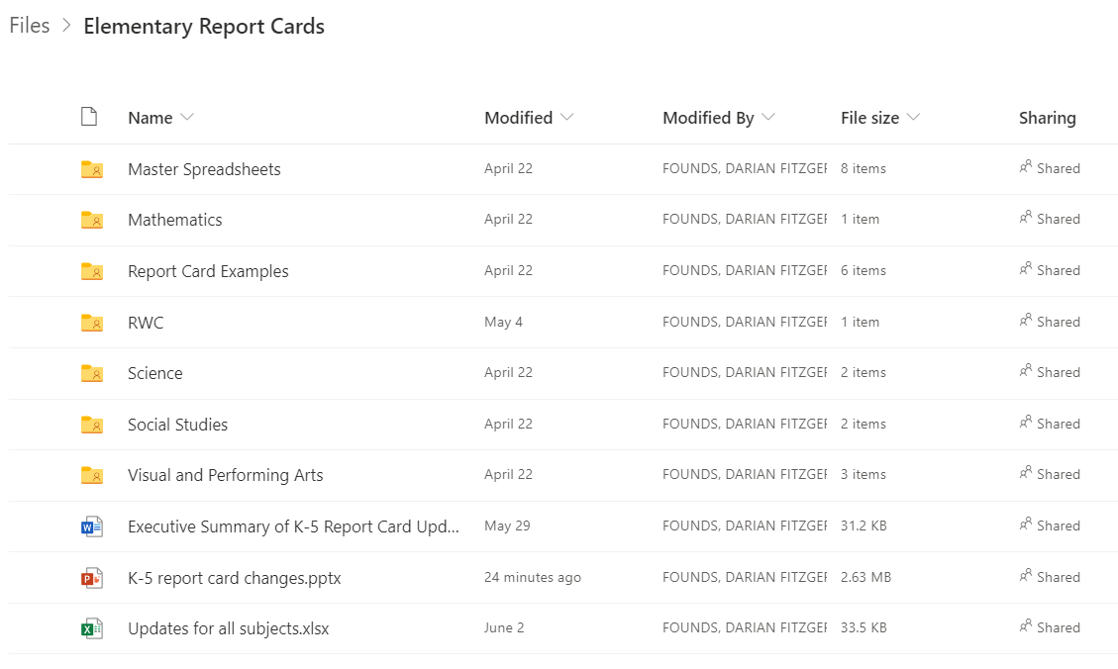
More Information

Slide 13
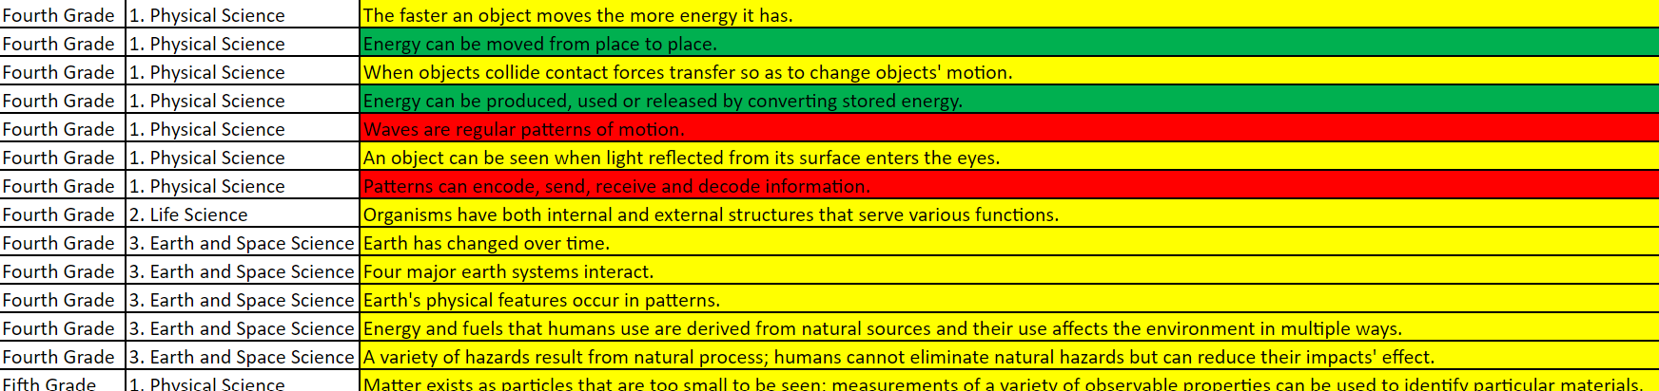
Example

Slide 14
Learn More
Standards Literacy 101 - CLICK HERE
Professional learning regarding standards-based grading practices – COMING Fall 2020

Slide 15
Contacts
Karol Gates, Director of Curriculum and Instruction (karol.gates@d11org)
Dave Sawtelle, Mathematics Facilitator (david.sawtelle@d11.org)
Mykel Donnelly, Literacy and Language Arts Facilitator/Social Studies Coordinator (mykel.donnelly@d11.org)
Laurilea McDaniel, Visual and Performing Arts Facilitator (laurilea.mcdaniel@d11.org)
Darian Founds, Science and Health Facilitator (darian.founds@d11.org)

