Slide 1
The Diploma Programme

Slide 2
What you need to know about the IB and the
Diploma Programme

Slide 3
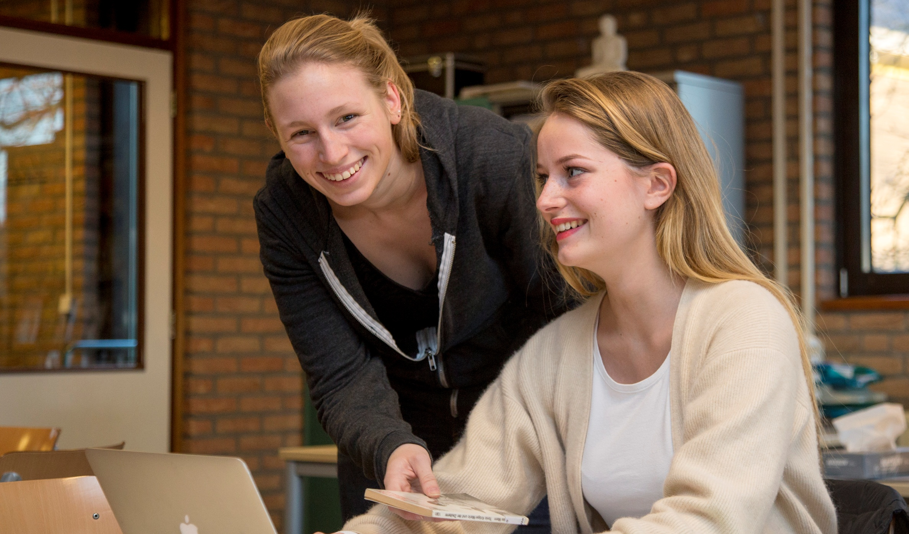
So what exactly is the International Baccalaureate?
“... The International Baccalaureate (IB) is motivated by its mission to create a better world through education”

Slide 4

-
...The International Baccalaureate aims to develop inquiring, knowledgeable and caring young people who help to create a better and more peaceful world through intercultural understanding and respect...

Slide 5
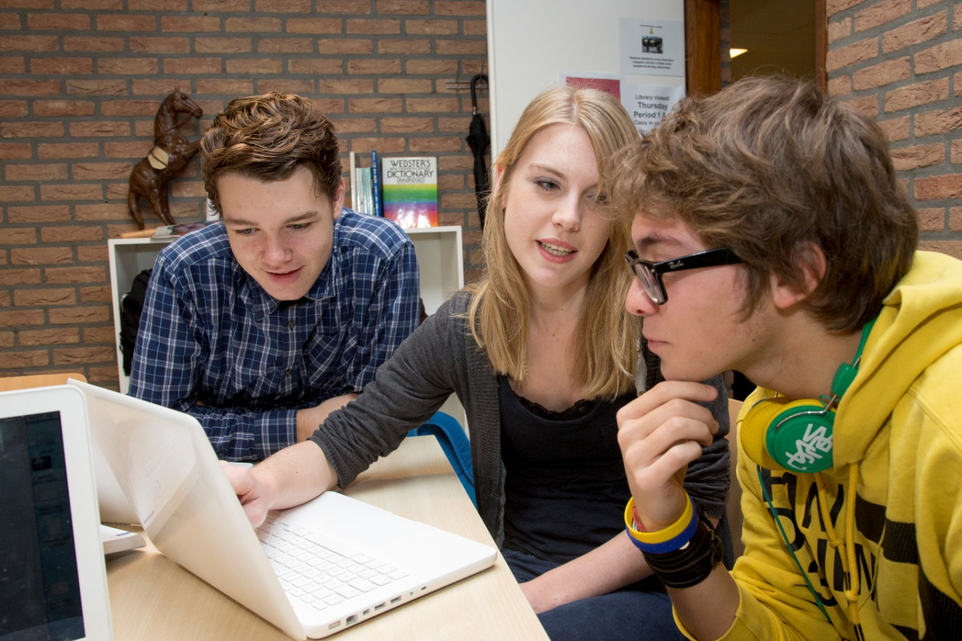
...Our programmes encourage students across the world to become active, compassionate and lifelong learners who understand that other people, with their differences, can also be right....

Slide 6

IB learner profile
The IB learner profile is the IB mission statement translated into a set of learning outcomes for the 21st century
As IB learners we strive to be:
  inquirers
  knowledgeable
  thinkers
  communicators
  principled
  open-minded
  caring
  risk-takers
  balanced
  reflective

Slide 7
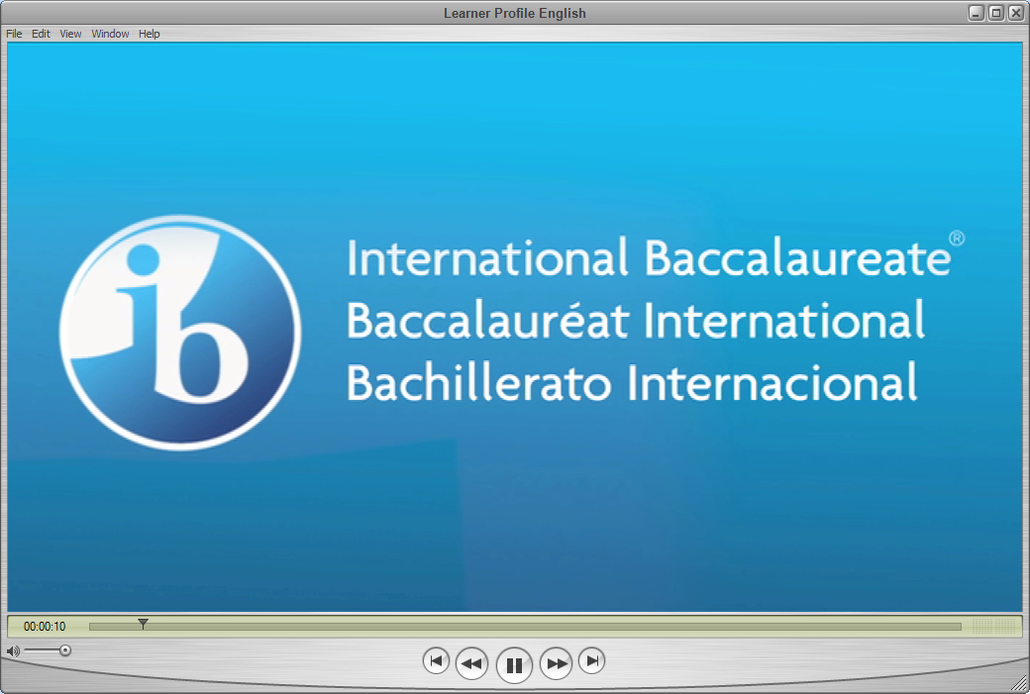
The IB learner profile
Notes:
Video – IB Learner Profile
Note to the presenter: the video titled ‘Learner Profile English.avi’ must be stored in the same folder as this presentation!

Slide 8
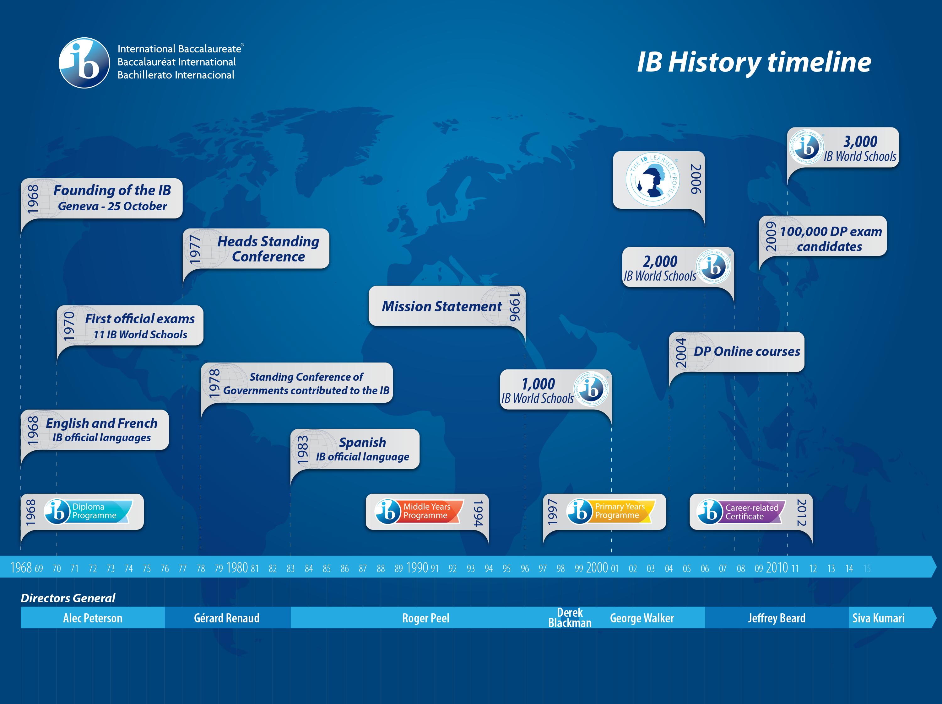
Notes:
Founded in 1968 in Geneva, Switzerland we currently work with...

Slide 9
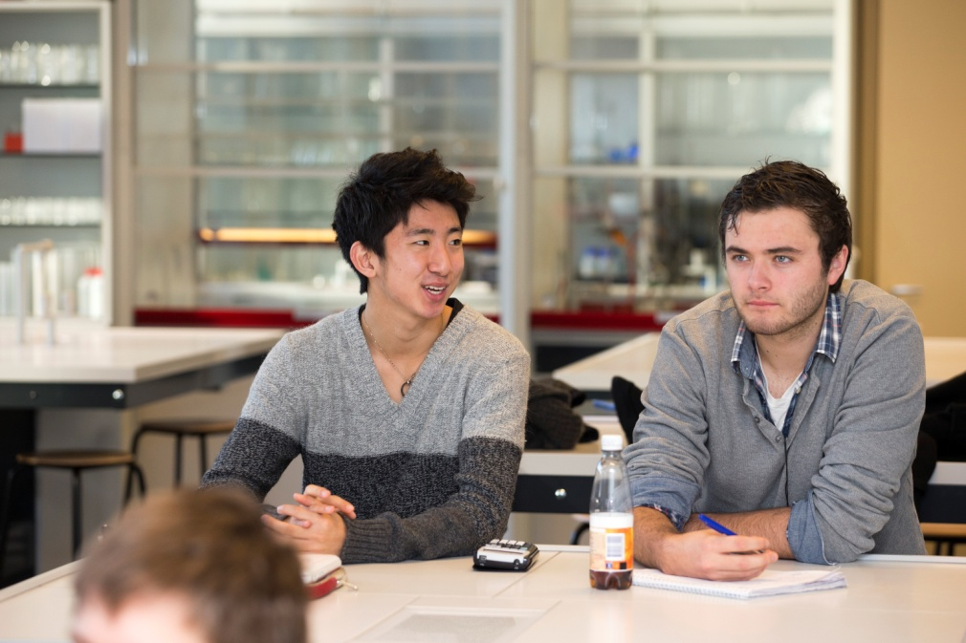
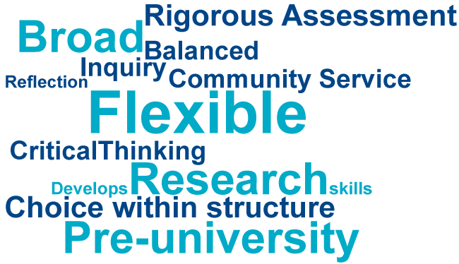
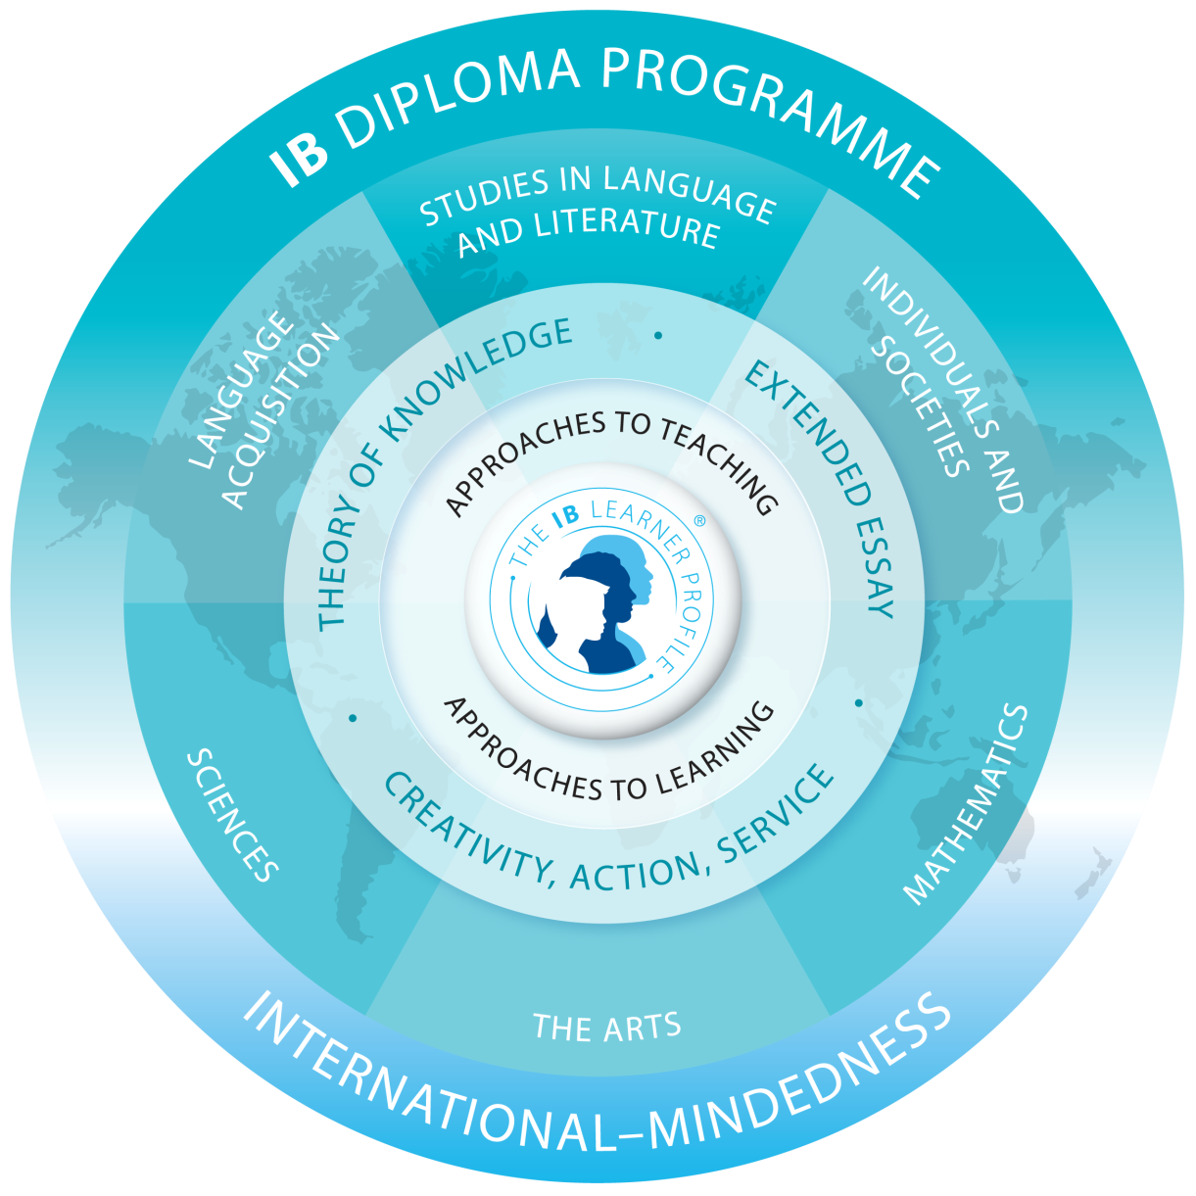
Notes:
Over half a million graduates since 1970
Available in English, French, Spanish with examinations in May and November each year
Diploma students take six subjects plus they write a 4,000 word extended essay, complete a course in theory of knowledge, and complete a number of creativity, action and service projects
The diploma is well recognized by the world’s leading universities
Alternatively, students can opt to take individual certificates in one or more subjects
Many IB schools teach the Diploma Programme along-side national programmes
The DP courses online project allows students to study a variety of Diploma subjects with other students from around the world led by an IB teacher and distance learning online

Slide 10
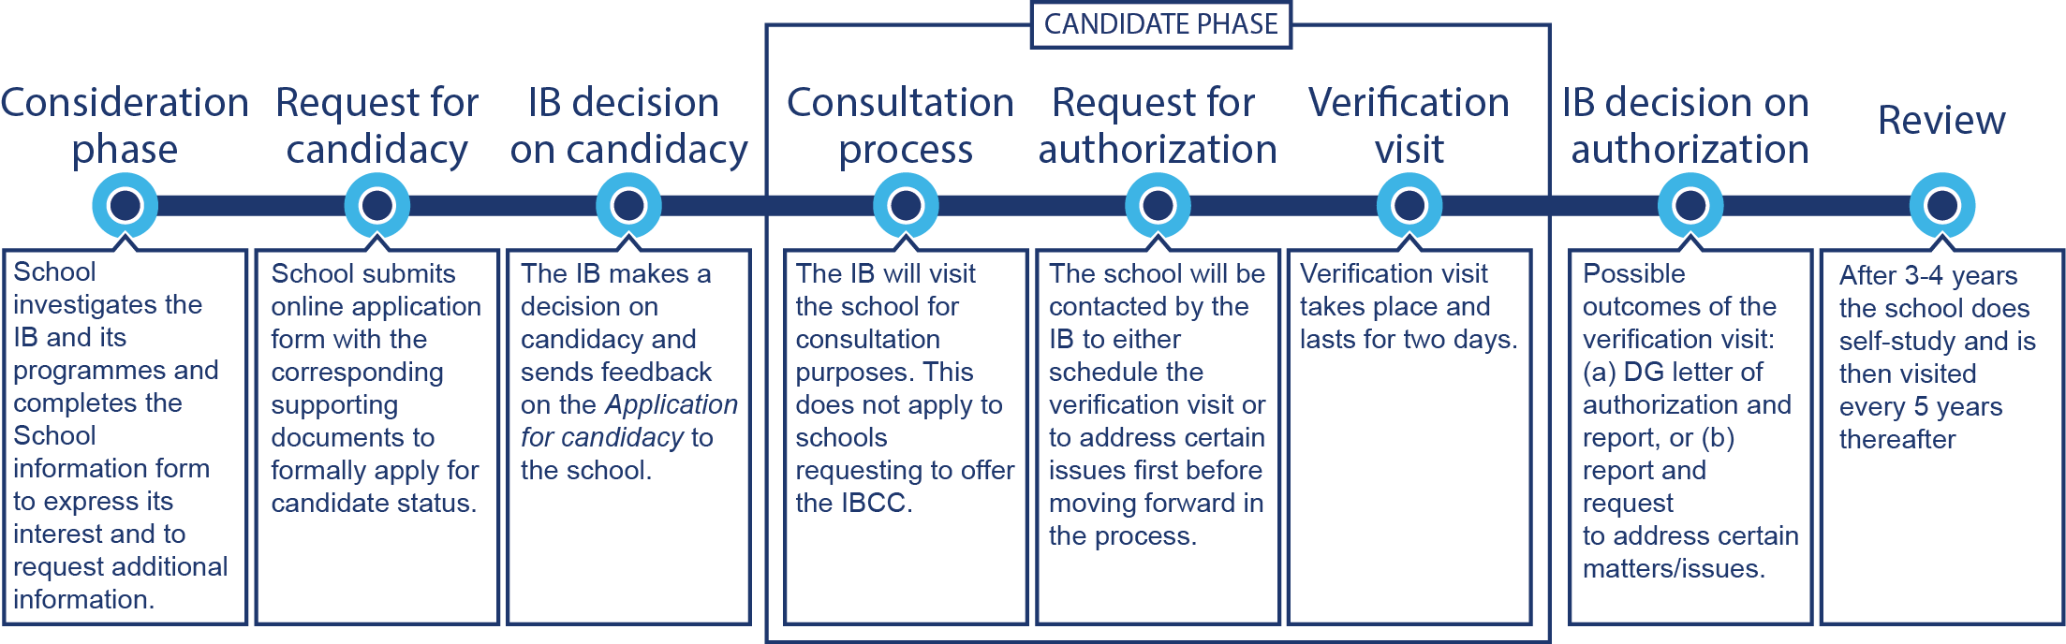
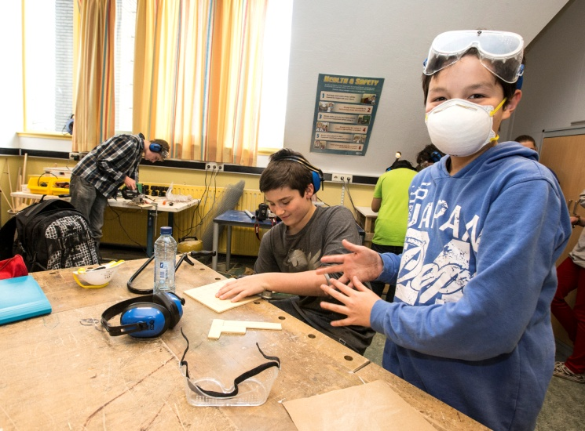
How is a school authorized and reviewed?

Slide 11
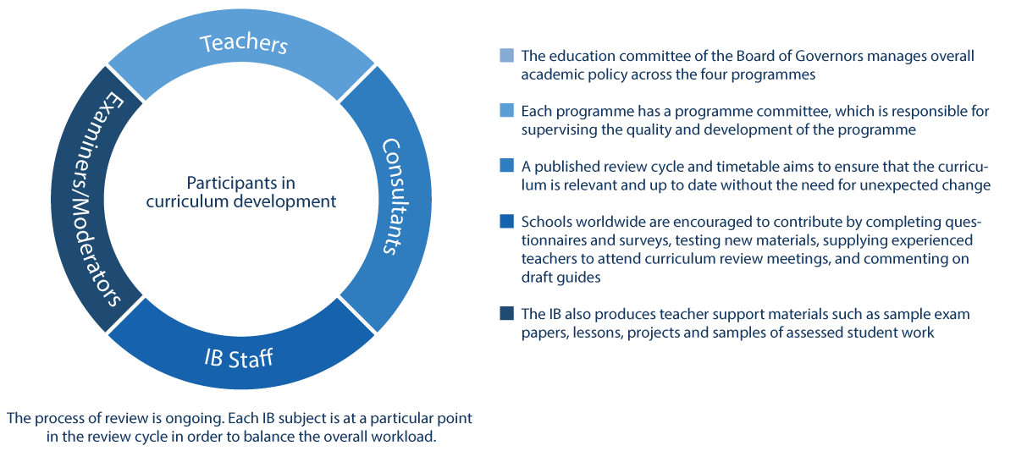
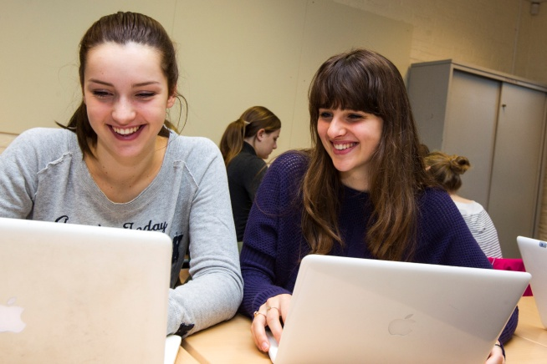
How the IB develops its curriculum

