Slide 1
The Middle Years Programme

Slide 2
What you need to know about the IB...

Slide 3
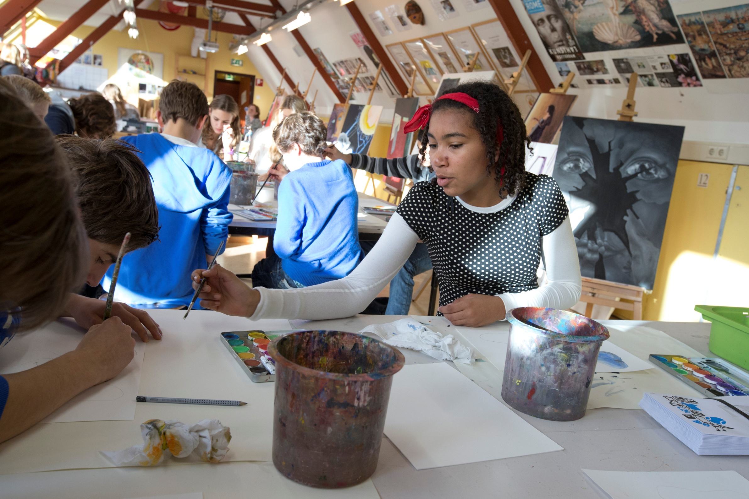
So what exactly is the International Baccalaureate?
“... The International Baccalaureate (IB) is motivated by its mission to create a better world through education”

Slide 4
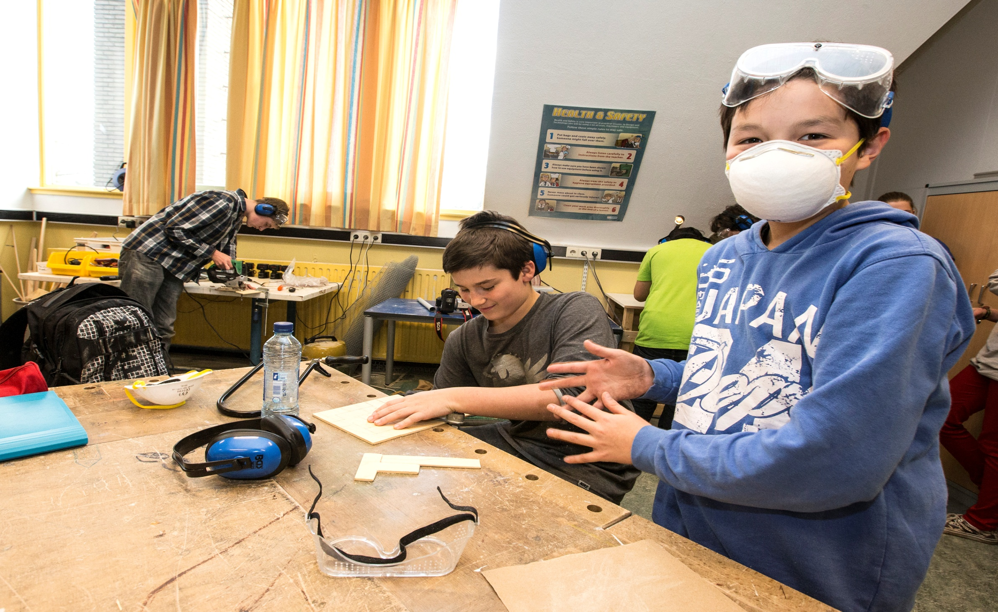
...The International Baccalaureate aims to develop inquiring, knowledgeable and caring young people who help to create a better and more peaceful world through intercultural understanding and respect...

Slide 5
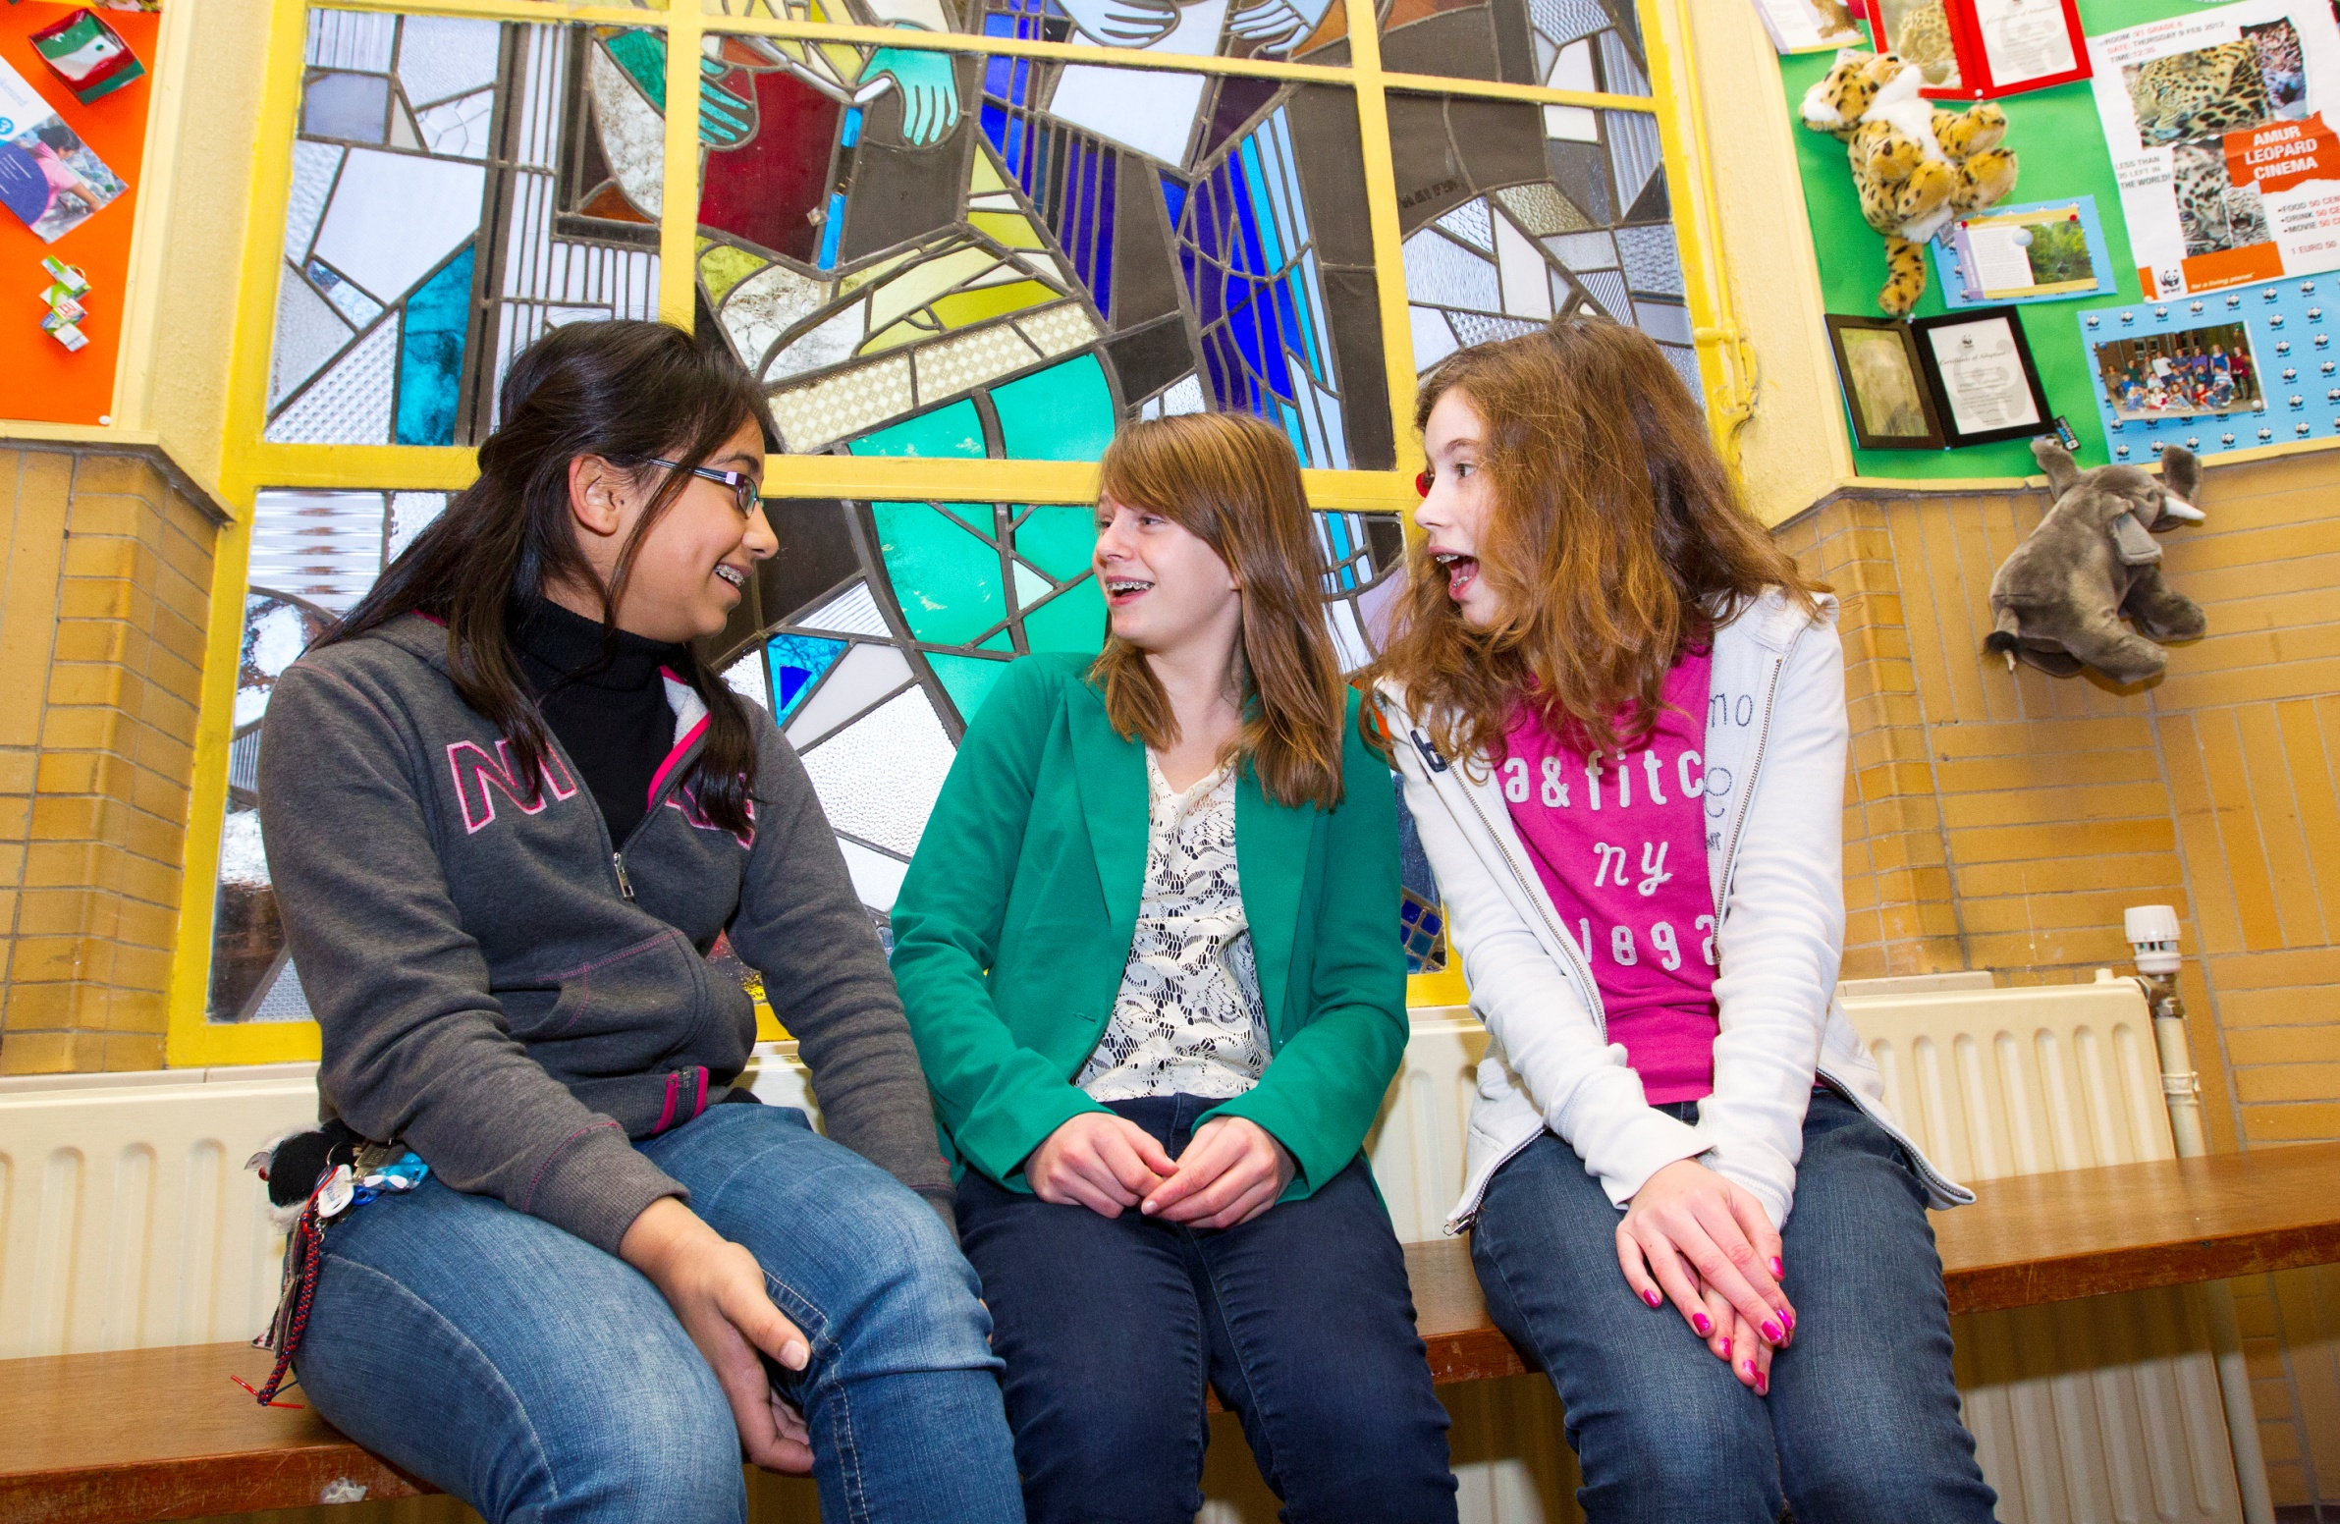
...Our programmes encourage students across the world to become active, compassionate and lifelong learners who understand that other people, with their differences, can also be right....

Slide 6
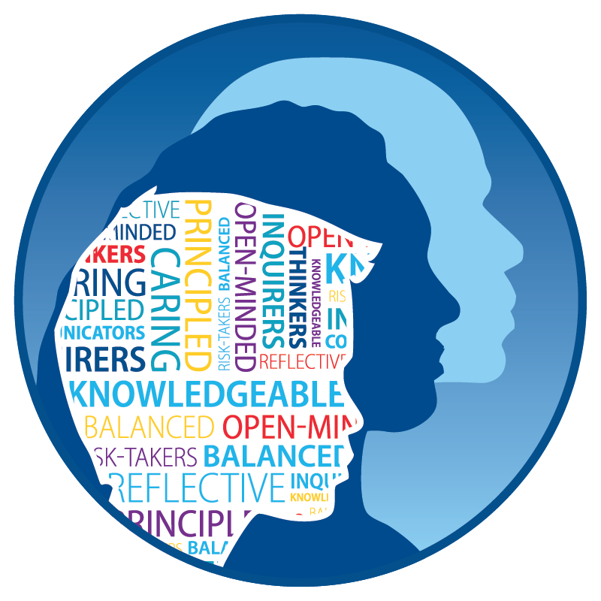
IB learner profile
The IB learner profile is the IB mission statement translated into a set of learning outcomes for the 21st century
As IB learners we strive to be:
  inquirers
  knowledgeable
  thinkers
  communicators
  principled
  open-minded
  caring
  risk-takers
  balanced
  reflective

Slide 7
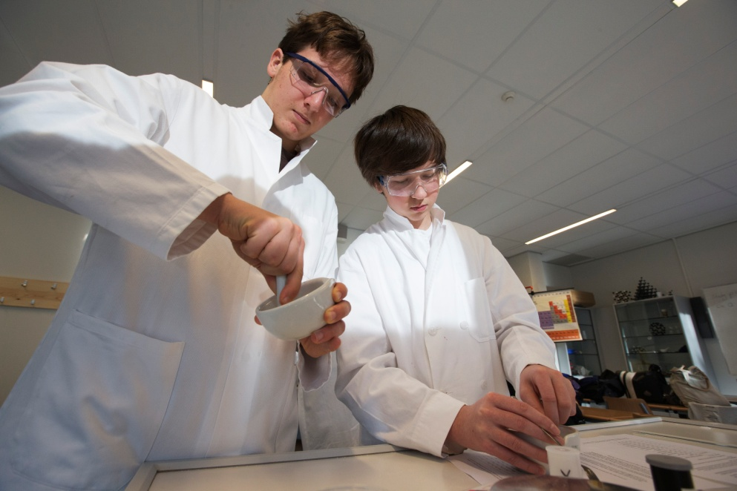
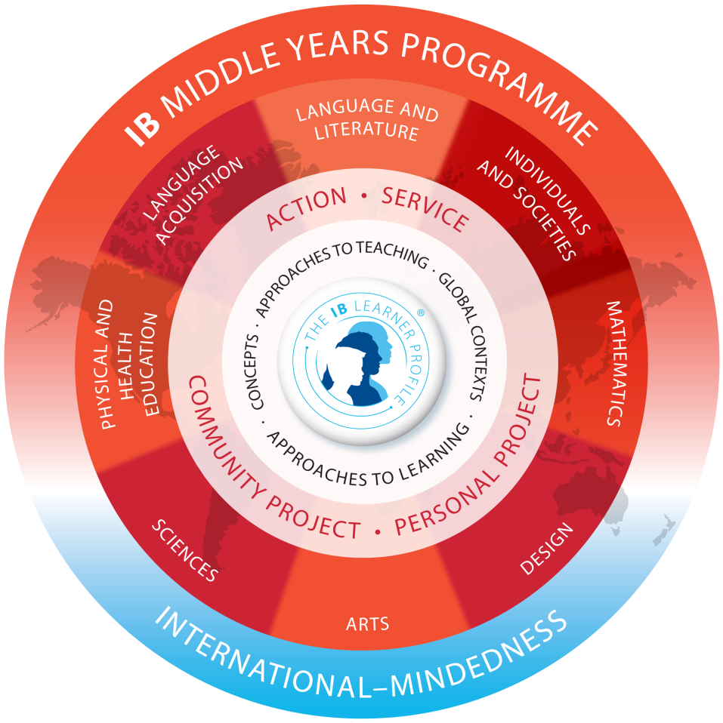
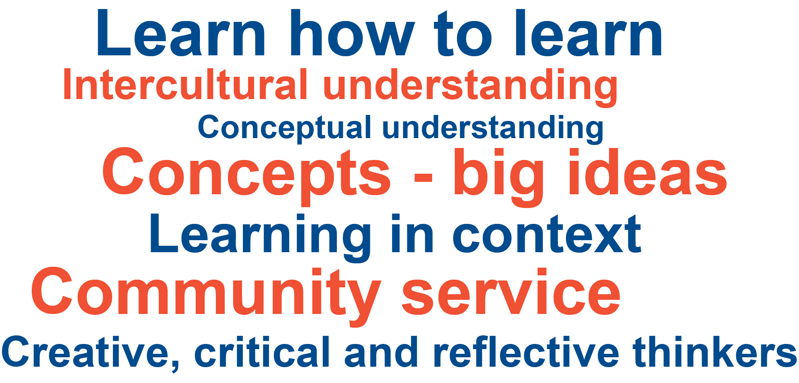
Notes:
Supported in English, French, Spanish and Chinese but can be taught in other languages
The new MYP offers: greater flexibility for schools to combine the MYP with the requirements of national and state educational systems AND closer alignment across the IB continuum, offering an ideal preparation for students going on to study the IB Diploma Programme or the IB Career-related Certificate.
Student study is supported by a minimum of 50 hours of instruction per subject group in each academic year. In years 4 and 5, students have the option to take courses from six of the eight subject groups, which provides greater flexibility.
MYP projects provide students the opportunity to demonstrate what they have learned in the MYP. In schools that include MYP years 5, all students must complete the personal project. In programmes that include MYP years 4 or 5, schools may offer students the opportunity to do both the community project and the personal project. In schools that include MYP year 3 or 4, students must complete the community project. Schools can opt to have the IB validate their internal assessment and an MYP certificate can be obtained. T
Teaching and learning in context. Students learn best when their learning experiences have context and are connected to their lives and the world that they have experienced. Using global contexts, MYP students explore human identity, global challenges and what it means to be internationally-minded.
Conceptual understanding. Concepts are big ideas that have relevance within specific disciplines and across subject areas. MYP students use concepts as a vehicle to inquire into issues and ideas of personal, local and global significance and examine knowledge holistically.

Slide 8
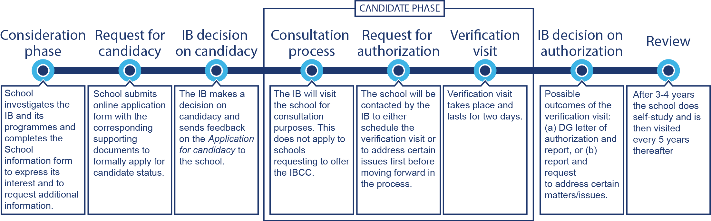

How is a school authorized and reviewed?

Slide 9
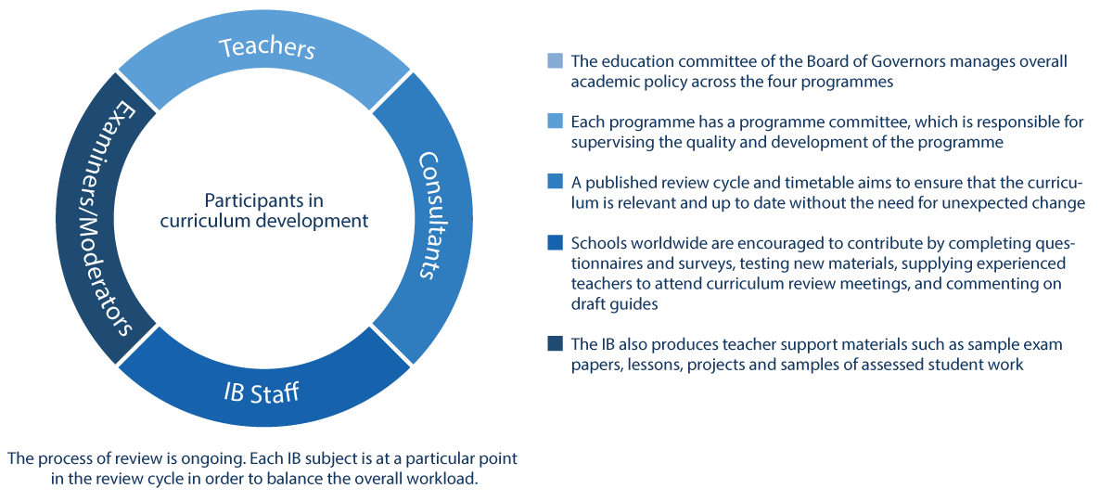
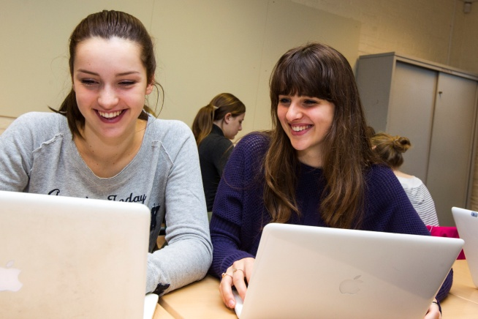
How the IB develops it’s curriculum

