Slide 1
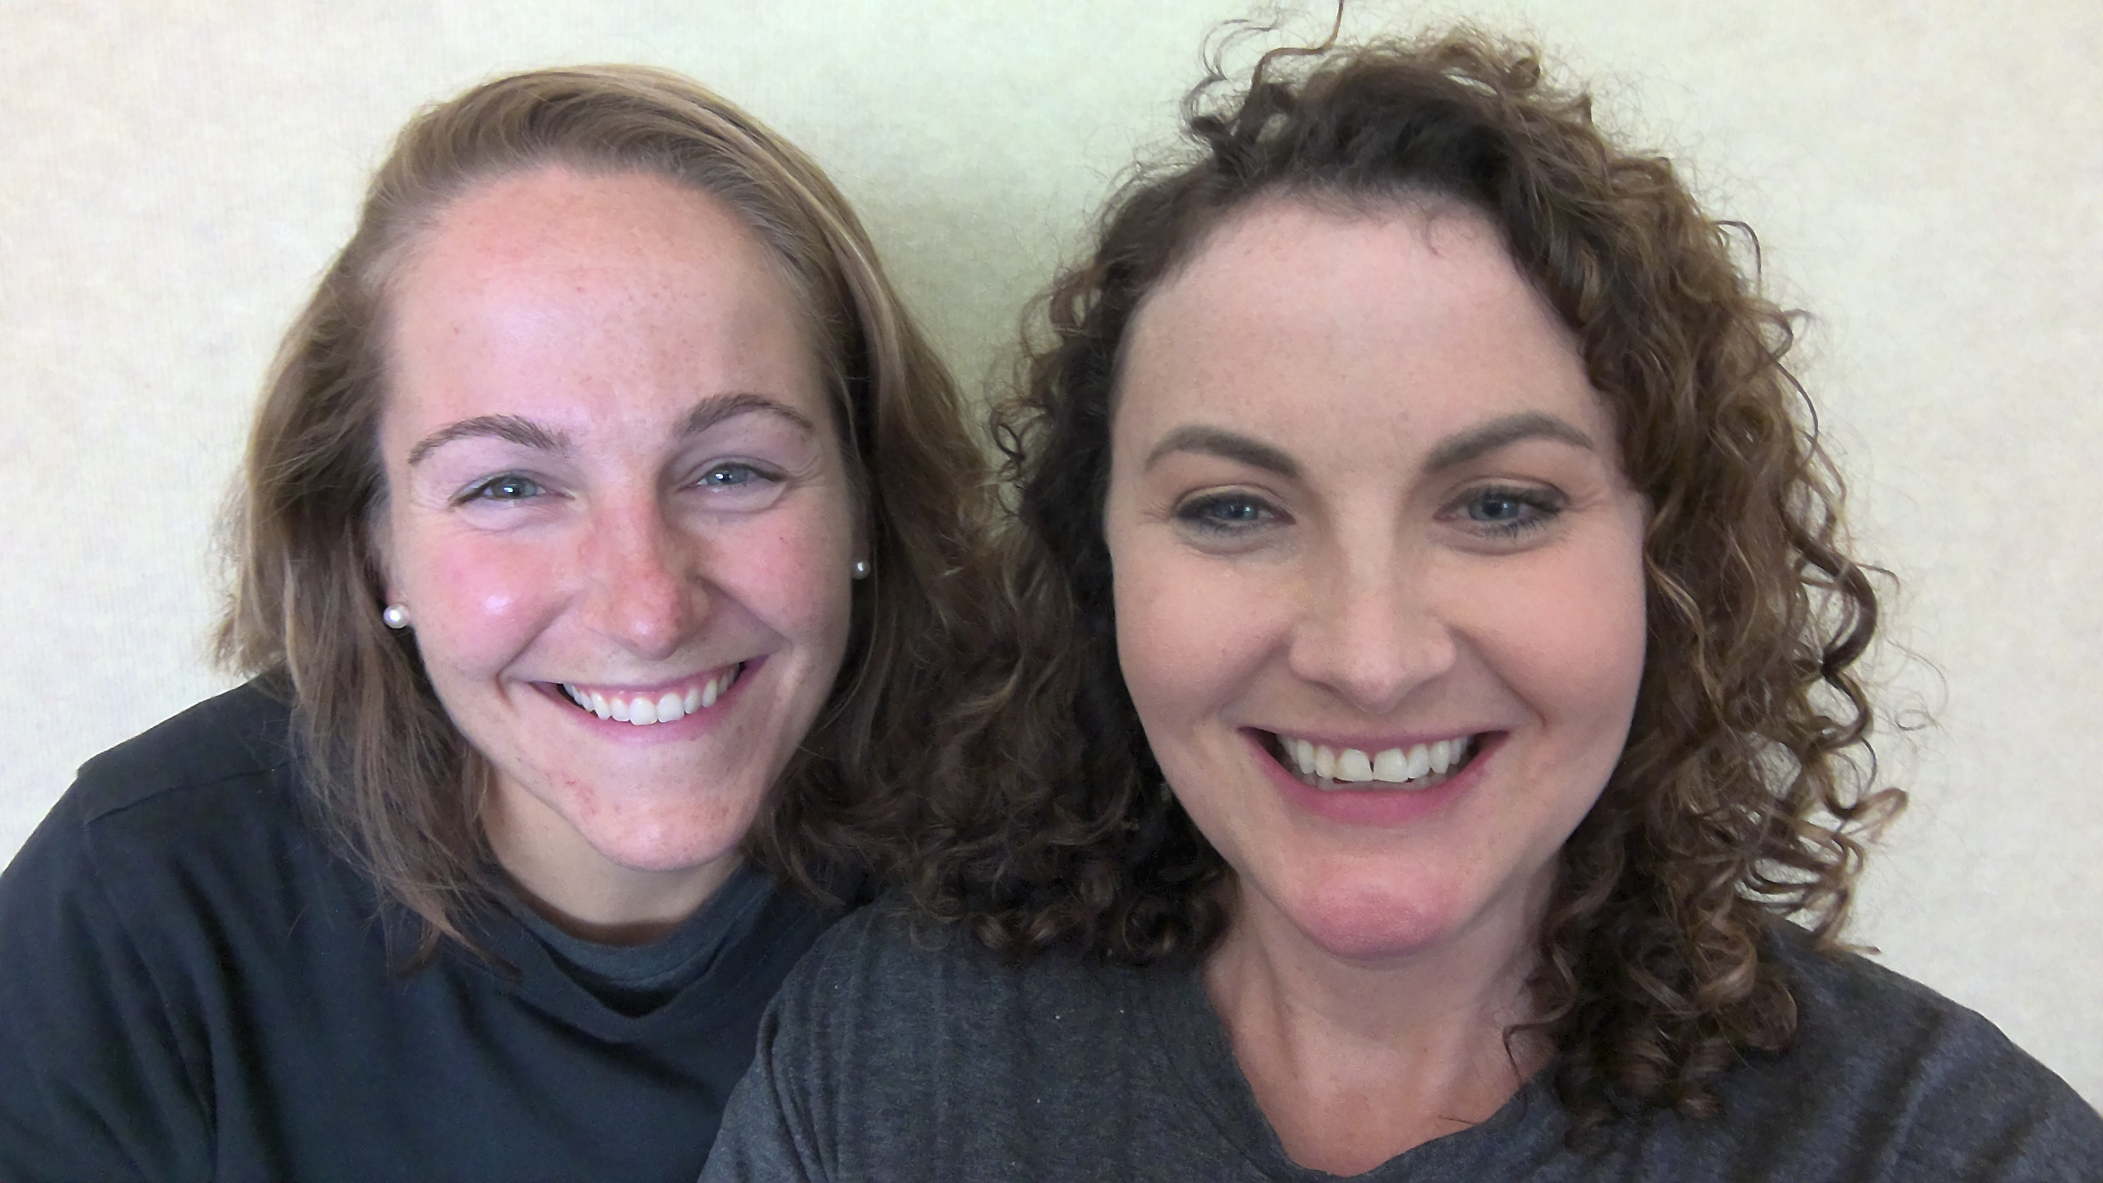

4th Grade
Virtual Curriculum Night
2023-2024

Slide 2



Thank you, community!
In 2022, the LWSD community approved three levies:
Educational Programs & Operations Levy – provides continued funding for staff, opportunities for early learning, filling the gap between what the state funds and what our students need.*
School Technology & Capital Projects Levy - provides continued funding for student computers, classroom technology and building updates.*
2022 Building Excellence Levy -
provides funding for additions at Finn Hill, Kirkland and Redmond middle schools; rebuilding and enlarging Rockwell Elementary, additional high school capacity on the eastside and westside, acquisition of property for future schools.
*These levies need to be renewed by voters every four years.

Slide 3

JME
Title 1 school
John Muir Elementary is a Title I School. This means that we receive Federal funding to supplement existing programs in support of student progress toward the state’s challenging academic standards. These funds can be used for parent and family engagement, staff professional development, curricular tools, and other resources.

Slide 4

Title I Parent and Family Rights
You have the right to…
Participate in the planning and decision-making processes pertaining to Title I
Receive communication and translation services in your home language
Request teacher and paraeducator qualifications
Receive information about curriculum and assessments
If you feel that our school is not meeting the requirements for Title I, you have the right to file a citizen complaint.

Slide 5
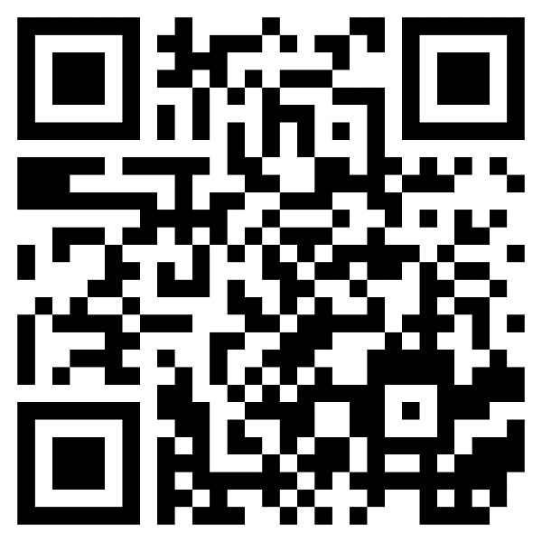
Title I Parent-Family Engagement
Your voice is important in guiding our Title I Program. If you have not already done so, please complete the short survey on Parent Square (Scan QR Code) to share ideas and availability.

Slide 6


Slide 7

4th Grade Philosophy
Practice
Praise
Reteach

Slide 8
Positive Behavioral Intervention Systems
PBIS
Gotcha Tickets
Respectuful
On task
Appropriate
Responsible
JME R.O.A.R.
ROAR Awards

Slide 9

Social & Emotional Learning
Purposeful People
Second Step
With classroom teacher
With school counselor

Slide 10

Reading
Wonders
Essential Question
Comprehension Strategy
Comprehension Skill
Vocabulary Strategy
Genre
Shared Read
Anthology
Phonics

Slide 11

Writing
District Units
Informational
Opinion
Narrative

Slide 12

Math
Illustrative
Factors & Multiples
Fractions
Fraction Operations
Place Value
Measurement
Multiplication & Division
Angles
Shapes

Slide 13
Technology
Class Link
Lexia
Dreambox
Edutyping

Slide 14

Science
Amplify
Waves, Energy & Information
Energy Conversions
Vision & Light
Earth’s Features

Slide 15

Social Studies
Washington Our Home
Civics
Economics
Geography
History

Slide 16

Art
Deep Space Sparkle
Deep Space Sparkle
Art Docent
JME National Heritage Month Alignment

Slide 17

Health
Letter will be sent home
King County FLASH
Family
Self-Esteem
Gender Roles
Friendship
Decision Making
Puberty
Reproductive Systems

Slide 18
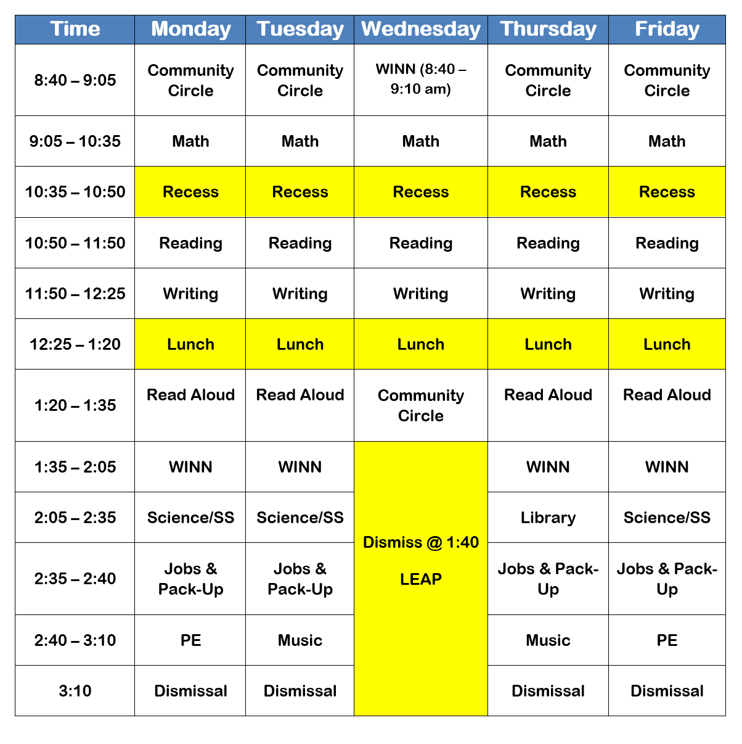
Ms. Plese
Weekly Schedules

Slide 19
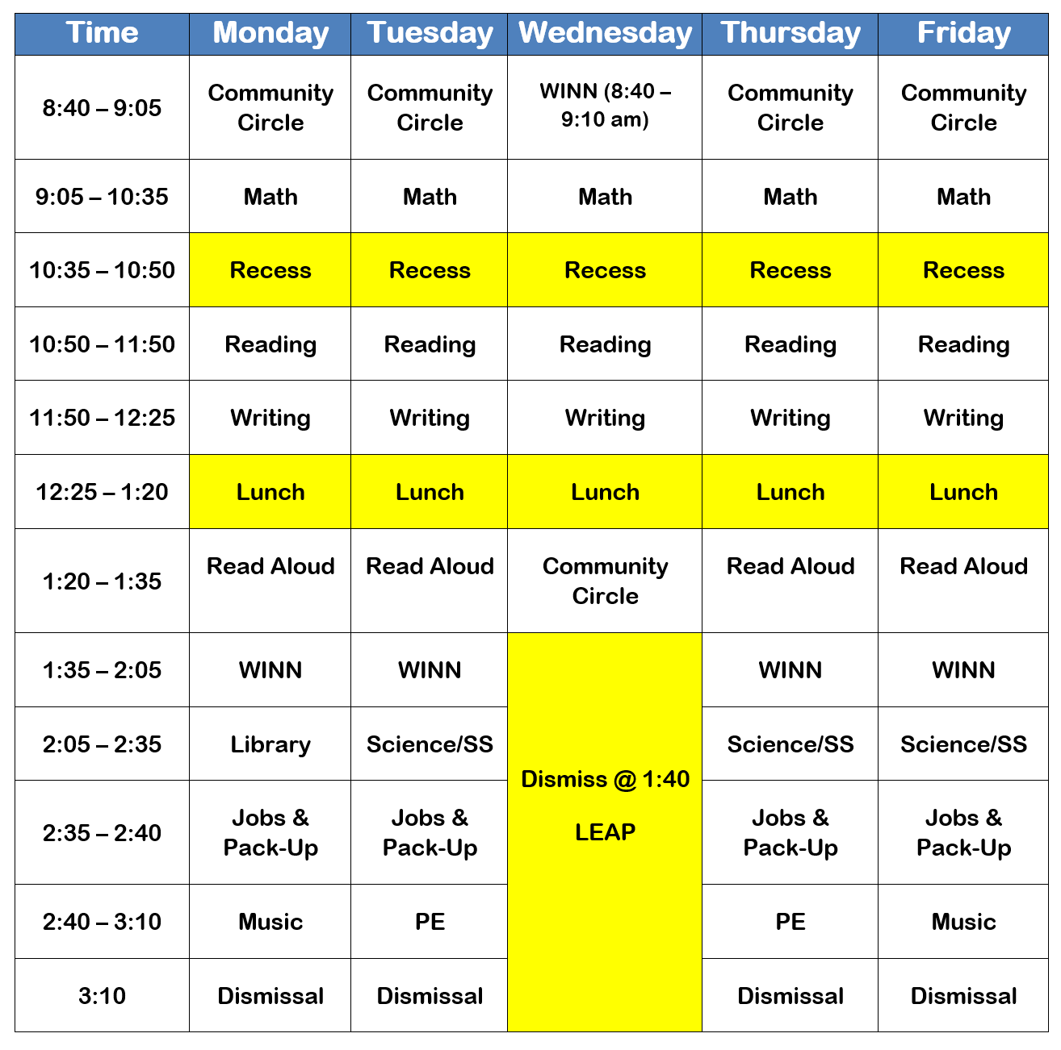
Mrs. Morison
Weekly Schedules

Slide 20
Optional
Homework
Independent Reading
Lexia
Dreambox
EduTyping
Check Newsletter
Math Family support

Slide 21


Communication
Weekly Newsletter
Parent Square
Parent Square
Past week learning
Upcoming events
Important announcements
24 hour turn around time
Notify Office
Note

Slide 22
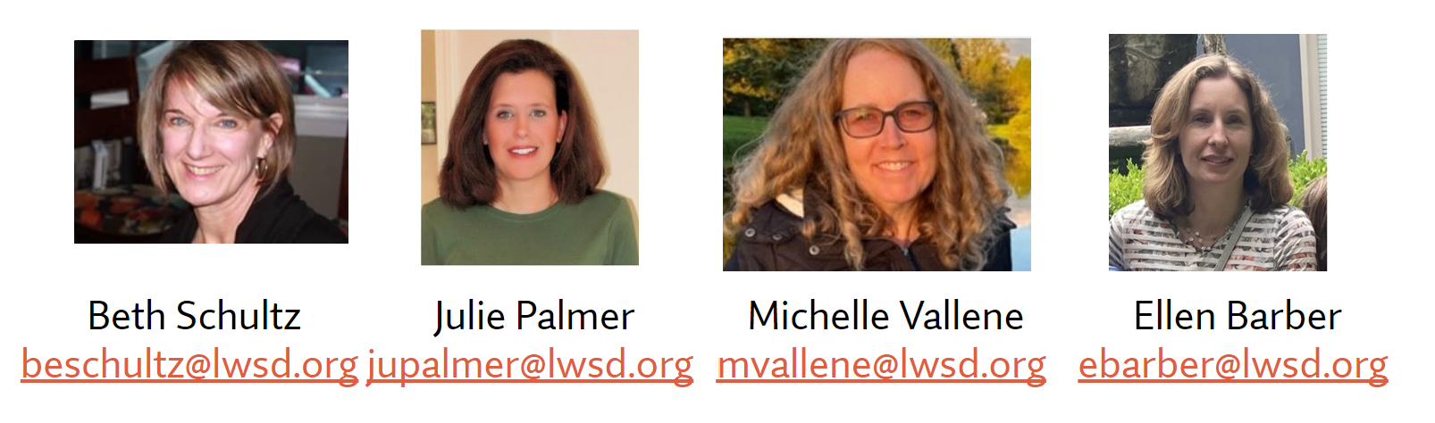
Safety Net
Purpose
Support students in partnership with general education teachers in literacy so they can meet or exceed grade level standards
Safety Net instruction never replaces core instruction with their teacher, it serves as extra instruction for students who qualify

Slide 23
Who is Served?
Measurement- Fastbridge
Student not meeting standard
Parents will be contacted if student qualifies
Groups begin when testing is completed

Slide 24
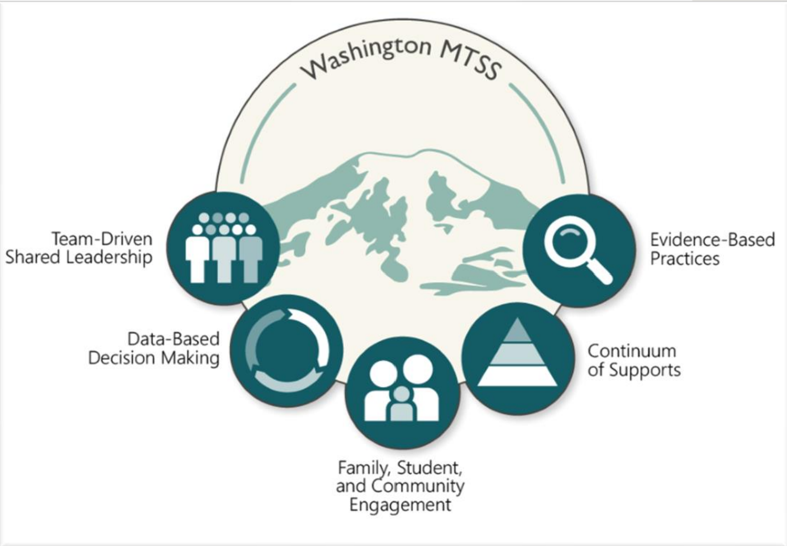
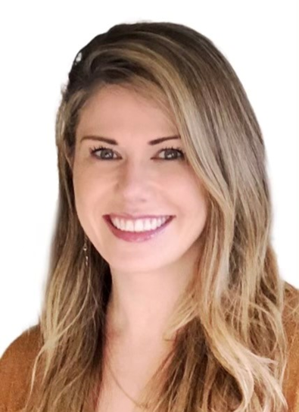
MTSS Coach
Former safety net teacher
MTSS Leadership
MTSS stands for Multi-Tiered System of Support, coach partners with teachers to ensure appropriate student supports are in place so that each learner feels a sense of belonging, makes measurable growth, and feels successful

Slide 25
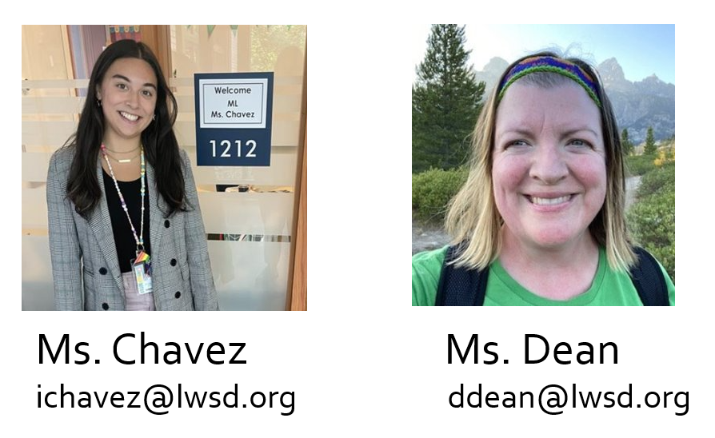
Multilingual Learner (ML) Program
We provide English instruction and support to multilingual students in all grades – focusing on listening, speaking, reading, and writing.
The type and level of English support is determined by students' WIDA test scores and other assessments given by classroom and intervention teachers.

Slide 26


