Slide 1

How is My SAE Graded?
What’s new with SAE?
What is required?
How do I get an ‘A’?

Slide 2
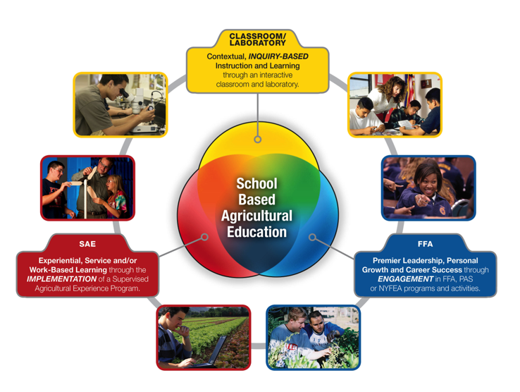
Supervised Agricultural Experience
SAE is one of the three essential components of all agriculture education programs.

Slide 3
Killingly SAE Requirements
The SAE project counts for 25% of the agriculture class grade beginning in the second quarter of the student’s freshman year.
Each student should document a minimum of 25 hours per academic quarter.
All SAE’s require students to…
  Set SMART goals
  Keep Accurate Records
  Learn new skills
  Reflect on your learning
Depending on the SAE project, other records and state paperwork may be required; an Agriculture Teacher will help determine what is required.

Slide 4
Types of SAEs
Placement (Unpaid Volunteer); serving your community at a registered non-profit agency, school or town facility.
Placement (Paid); working as paid employee at a farm or other agriculture-related business.
Entrepreneurship; developing a business that produces agricultural goods for sale or provides an agricultural-related service.
Research; developing a research project that uses the scientific method to investigate an agriculture-related question.
Improvement; developing a project that improves your own home or community.
Exploratory; seeking opportunities to explore agriculture related careers and programs.

Slide 5
Your SAE Project is Graded.
A Quality SAE Project focuses on the student as a LEARNER. The student…
  Sets challenging and realistic goals
  Continually develops and practices new skills
  Takes advantage of opportunities to learn and grow
  Communicates with teachers and workplace mentors
  Maintains accurate and detailed records
  Meets the hourly requirements
  Keeps all required paperwork and goals current
  Documents the project (photographs, portfolios, etc.)
  Demonstrates the ability to reflect on their learning

Slide 6
Your Online SAE Record Book
When a teacher grades your SAE; they will use your online SAE Recordbook, Ag Experience Tracker website www.theaet.com
When information is missing from your online Record Book, it is very difficult to grade your SAE and you may get a lower grade than you deserve!
Your SAE Record Book should include…
  Completed SAE Plan and Annual Review
  Time (Hours and Minutes) recorded in your journal
  Income and Expenses related to your project
  Pictures or other evidence

Slide 7
Keep Accurate Records!
You will be given time in class to update your online records; but it is your responsibility to make sure your records are current.
Be sure to include enough detail so that what you are learning and accomplishing is documented in your journal.

Slide 8
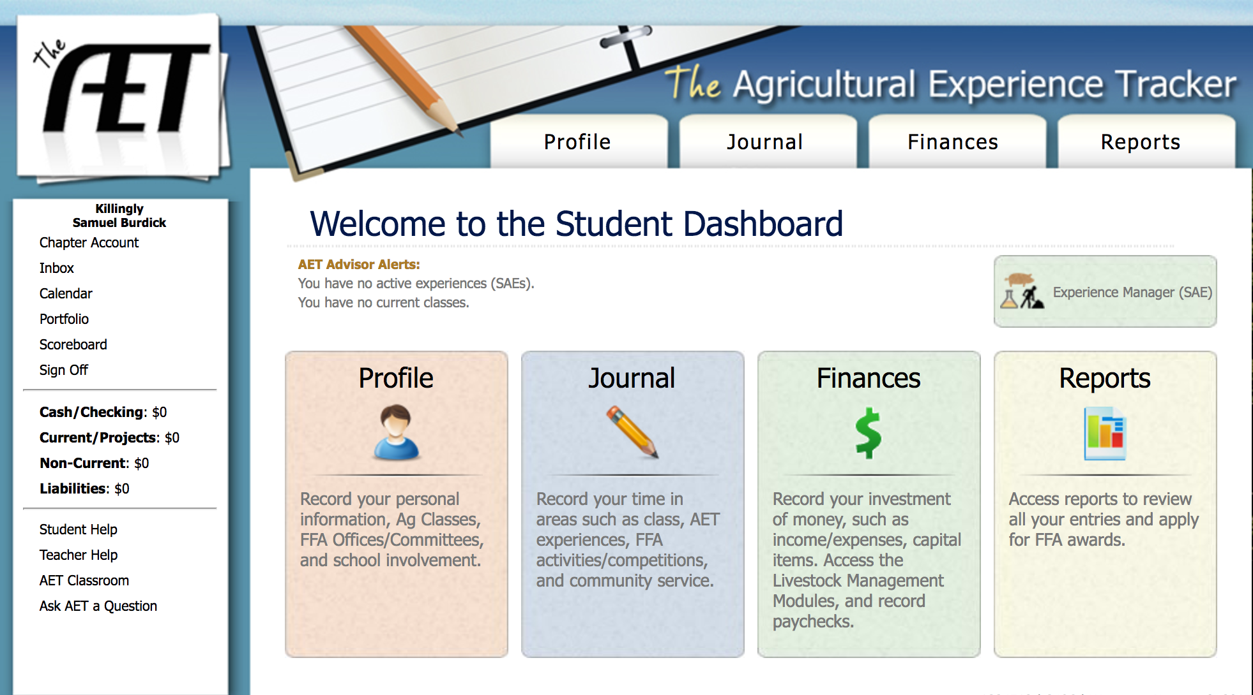
This is your home screen – always click on ‘full site’

Slide 9
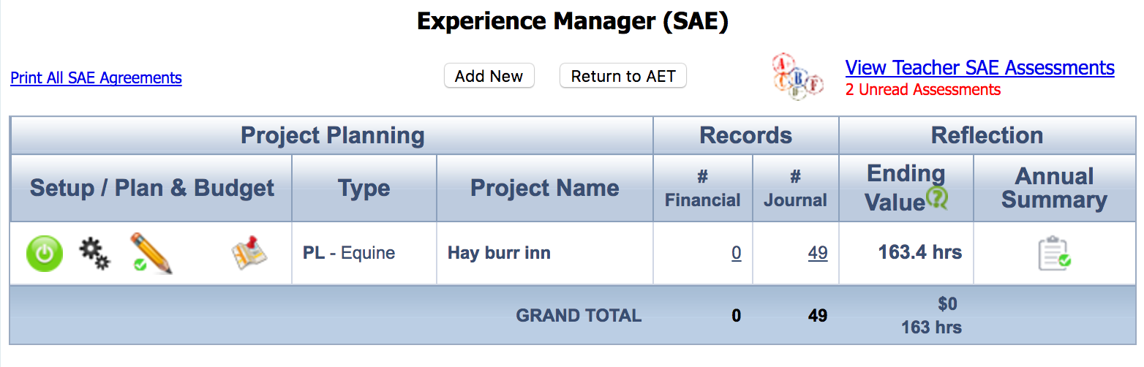
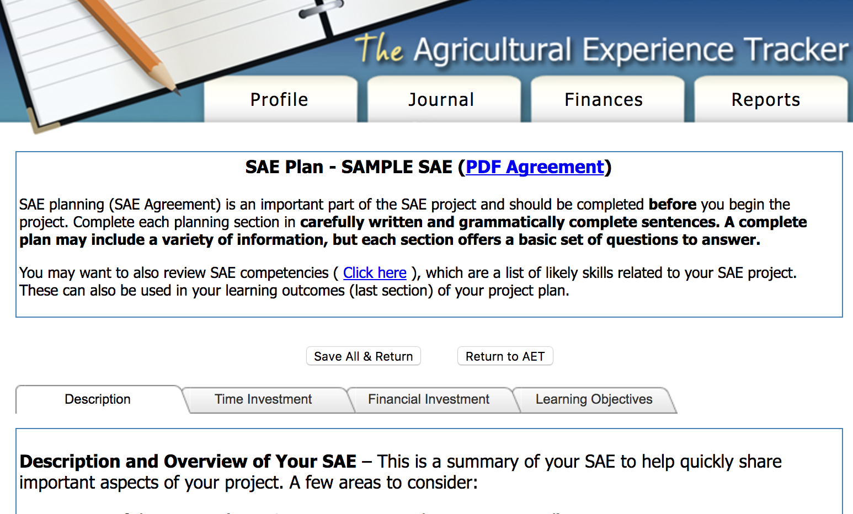
Your SAE Plan
SAE Plan
  Description
  Time
  Finances
  Learning Objectives

Slide 10
Quality SAE projects are built through setting goals and working towards those Goals.
Goals are a way to keep us focused and give all our actions purpose and direction.
People who set goals and continue to work toward them set higher standards and are more likely to achieve them!

Slide 11




What is a SMART Goal?
S = Specific
M = Measurable
A = Attainable
R = Realistic
T = Timely or Tractable

Slide 12
SMART Goals Setting Tips
Use only positive statements.
Say “I will…” instead of “I want…”
Make sure you have all the information you need.
Focus on actions rather than outcomes.
Don’t be afraid to fail.
Respect yourself – you are all capable of great things.

Slide 13
SAE Progress Report and Evaluation
You will fill it out at the end of each quarter
  Record the number of hours worked.
  Reflect and Summarize what you have learned and accomplished.
  Complete the Evaluation Rubric
Your teacher will review your record book and the rubric to determine your grade.

Slide 14
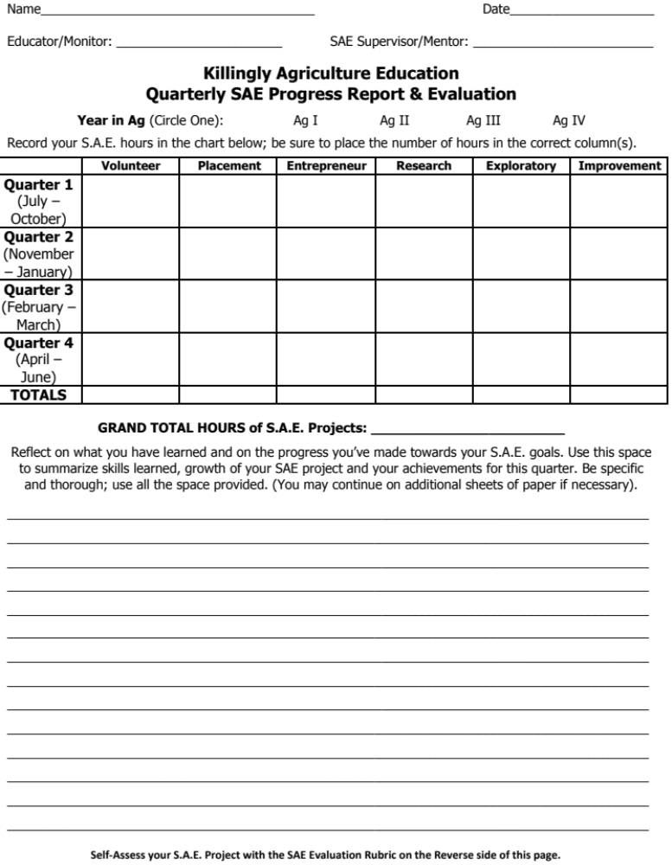
Record your total hours for each quarter in the correct column.
This section is to summarize your SAE for the quarter and to reflect on your skills learned.

Slide 15
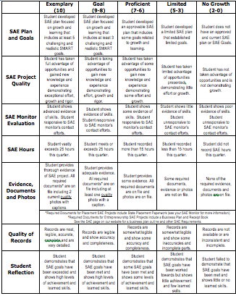
Evaluation of Your Project
No matter what kind of SAE Project you have, your SAE will be evaluated using the same Rubric.

Slide 16
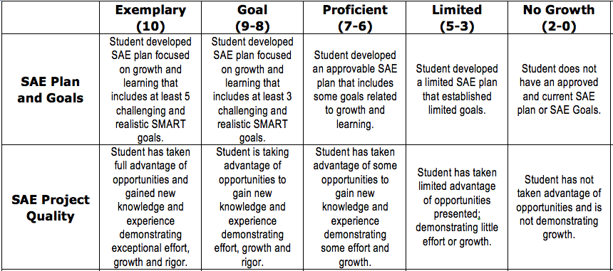
How do I get an ‘A’?
Write 5 SMART Goals!
Focus on learning new things!

Slide 17
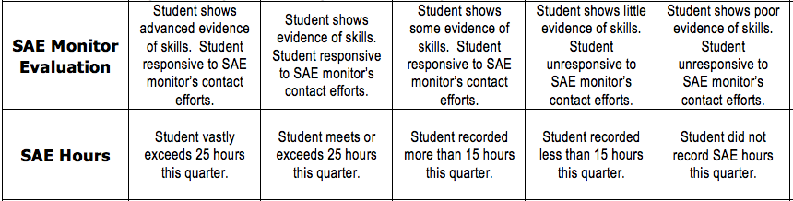
Be sure to set up an SAE Visit once or twice each year. These usually happen in the Summer!
Plan ahead so that you can devote more than 25 hours to your SAE each quarter.

Slide 18
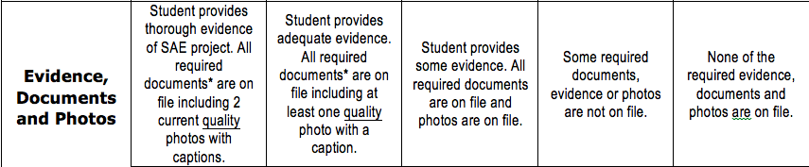
Take at least two high quality photos of your project!
High quality photos are well lit, include the students face and show the student practicing a skill.
  Placement SAE’s sometimes require paperwork from the state. Your Ag Teacher will provide it.
  Entrepreneurship SAE’s require a business plan.

Slide 19
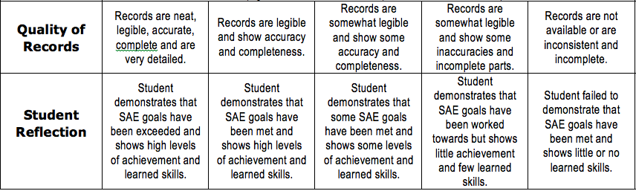
Keep clear and organized records.
Take the time to explain what you’ve learned and your progress towards your goals in your reflection.

Slide 20

An SAE project is required for each Ag Student!
Our goal is to support you so that you can graduate ready for college and/or the workforce.
A quality SAE project helps you get there!

