Slide 1

HHCA Class of 2025
Junior College Planning Meeting
Sept 25 and 26, 2023
Welcome Megan Robbins
Director of Guidance
Dual Enrollment Sara Cain, TCL
Nancy Reading &
Zach Evans, USCB
Megan Robbins, HHCA
The Next 20 Months Mary Delle Robinson
College & Career Advisor

Slide 2
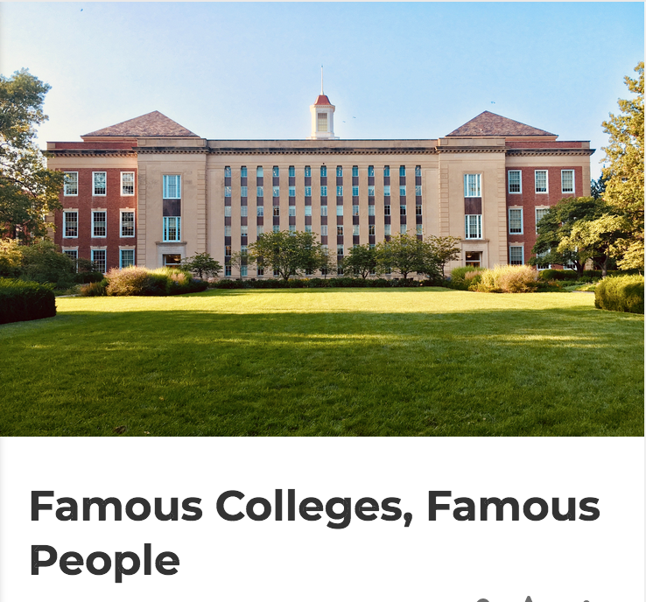

Let’s play a game of Kahoot
Notes:
51% Life + Palmetto Fellows

Slide 3
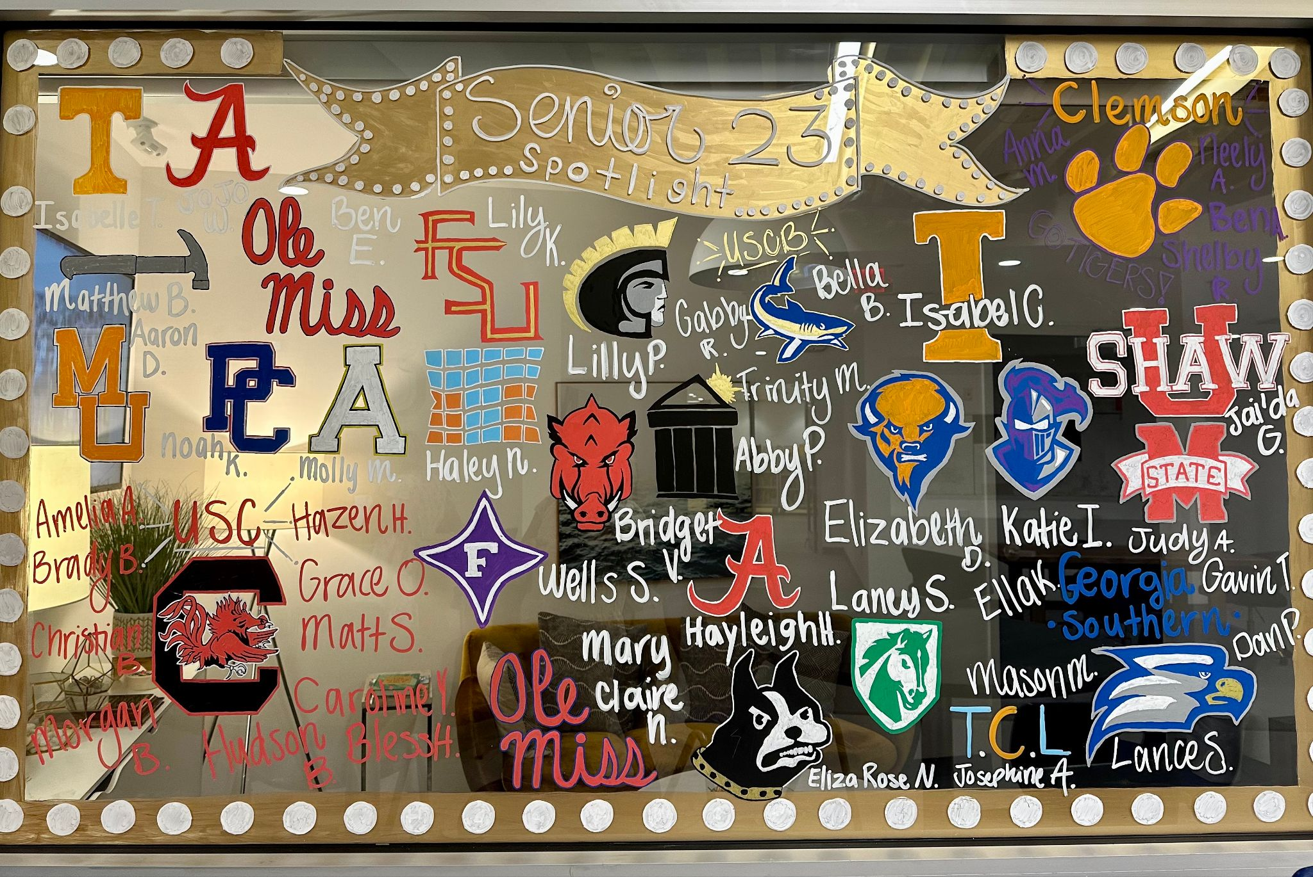
Class of 2023 Reflection
45 Seniors
98% 2/4-year college
163 Acceptances to 60 colleges
21 Different Colleges
13 Attending OOS
4 Palmetto Fellows
4 College Athletes
42% Life Scholars
Clemson 79%
USC 100%
$3.8 million in scholarships and merit aid
Notes:
51% Life + Palmetto Fellows

Slide 4


Palmetto Bowl
South Carolina vs. Clemson
University of South Carolina - 21
100% Accepted
82% Full Acceptance
13% Pathway/Gateway
5% Deferred
0% WL
Avg Test - 1148 / 24
GPA - 4.17
11 Gamecocks!
Clemson - 17
79% Accepted
42% Full Acceptance
42% Bridge
28% Deferred
24% WL
Avg Test - 1230 / 26
GPA - 4.61
4 Tigers!
Notes:
USC 52%, Clemson 24%

Slide 5
Class of 2025
60 juniors preparing to launch from the nest in 20 months
Plan and pray!
Prov 16:9 ~ “A man’s mind plans his way, but the Lord directs his steps.”
Important items of note within this presentation are marked with a red arrow!

Slide 6
Post High School Options
4-year university away from home (96%)
Small / Regional Colleges (like USCB!)
  Start small, save money, transfer later
Technical Colleges / Trade Schools
  2-yr degree options; associates degrees
  Skill certifications
Military (enlist, ROTC, etc.)
  Serve your country, specialized skills training, leadership, pays for college
Work - Full or part-time &/or online classes

Slide 7
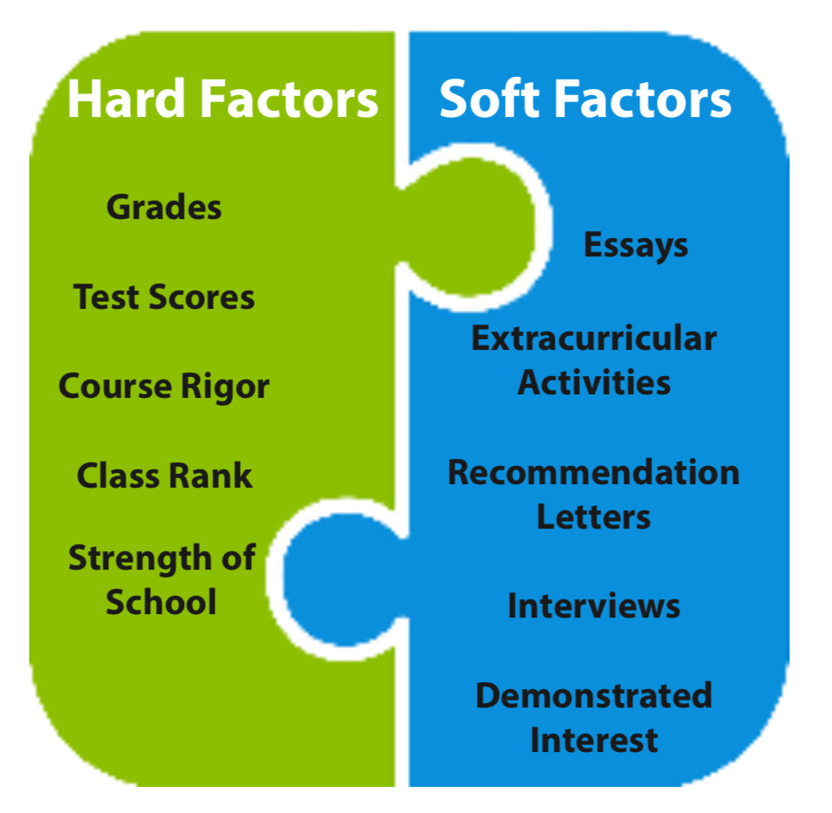
What Colleges Consider
Seek personality and voice; tell a story!
Transcript: grades, course selections
Passionate involvement in meaningful activities.
Did the student keep progressing?
HHCA does not rank, except on final transcripts
Who knows you best?
“…a student’s academic performance in high school is the clearest indicator of potential success at Clemson…”
Do you know us? Visit campus, see reps at lunch, college fairs
“What will this student bring to our campus?”

Slide 8
The College Application:
Tell a Story with a Theme
Personal / Family info
Academics
  Transcript - Courses taken and grades
  Honors (5)
SAT/ACT - Optional but often helpful (use strategy), esp for scholarships

Slide 9
The College Application:
Tell a Story with a Theme
Activities (10) - What’s important outside of school
  Clubs
  Athletics
  Work
  Service
  Leadership
College Essay - Tell a story that weaves in your values, personality, passions, goals, theme
Letters of Recommendation - Who knows you well?

Slide 10
The Transcript
MOST IMPORTANT part of college application
  First impression
  Best indicator of success
All courses, final grades, GPA (W/U)
Rigor of courses
Updated in SCOIR in January, June and August
Posted to SCOIR MyDrive
Sent officially to each college by HHCA

Slide 11
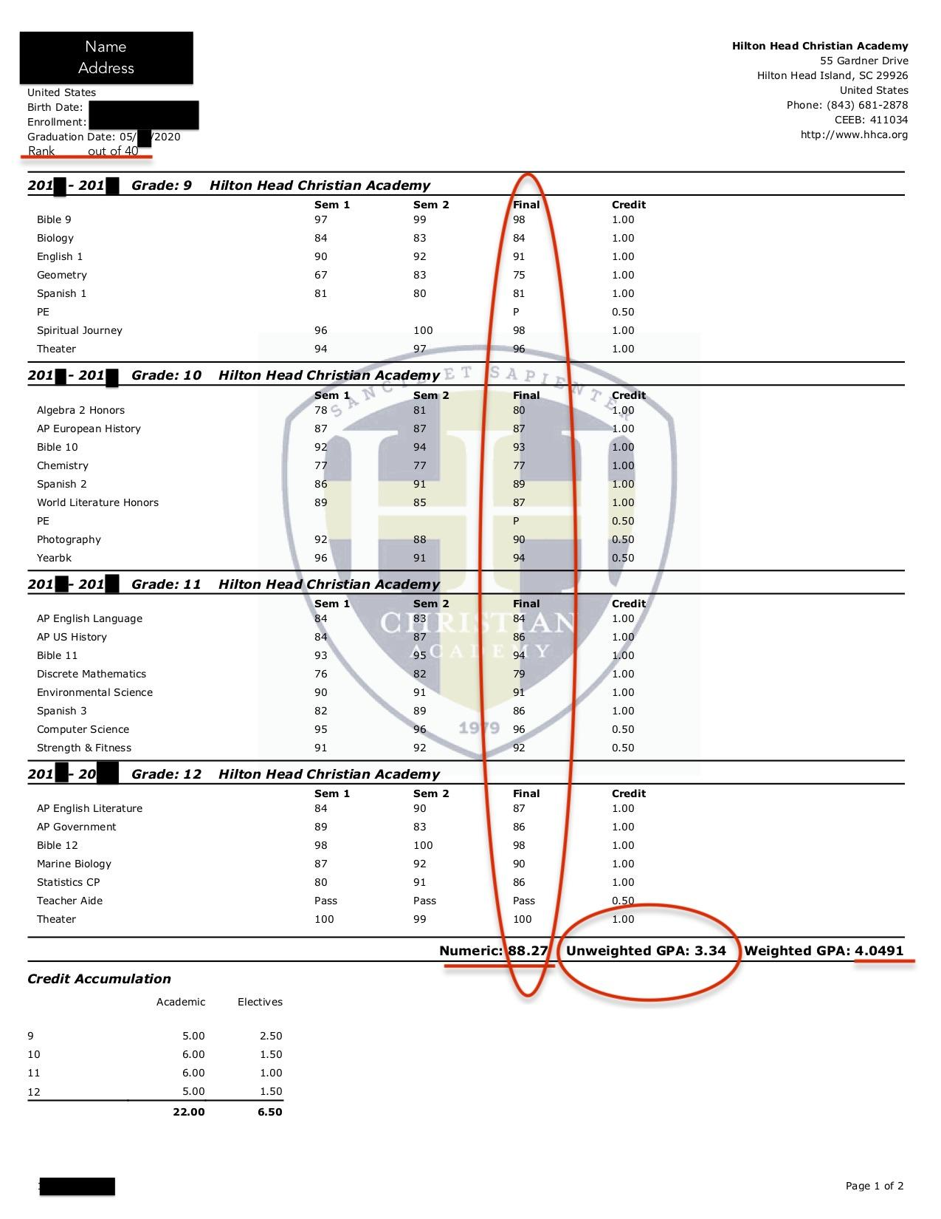
The Transcript
9
10
11
12
Notes:
Certain opportunities and limitations are available at certain GPA levels. Many large and elite colleges will only consider you for admission at a 3.5 or above. 2.5 is the lower end for most 4-year institutions. 2.0 is the bare minimum and only for very few colleges/technical schools and the military...

Slide 12
Graduation Credit Requirements
4 English ▸ 2+ World Language
4 Math ▸ 1 Tech/Computer Science
4 Sciences ▸ 1 Physical Education
(Bio, Chem, Physics)
4 Bible ▸ 1 Fine Arts
3+ Social Science 24 Total Credits
(US History, Gov/Econ)
+ Electives, Internship, Dual Enrollment, DwD, Teacher’s Aide, etc. Colleges like to see productive use of time.
Notes:
So what is our goal over the next 4 years? It’s to graduate students. Here are the graduation credit requirements

Slide 13
College Fit
Most important aspect of college decision
Factors: academic match, size, location, programs/majors, affordability, football program, grad rate, alumni network, job placement rate, etc.
Create balanced list
  Likely (1-2), Level (2-4), Reach/Unpredictable (2-4)
  View scattergrams on SCOIR
70% of students get into 1 of top 3 colleges
College Visits - Reps @ HHCA, college fairs,
group tours, family tours

Slide 14
Career Center offerings
Internship/Co-Op opportunities
Career Match
Academic Match
Financial Match
Institutional Scholarships - Merit / Need based
SC Scholarships
Federal Grants
Likely / Level / Reach
Scattergrams
Offers Major
Six Keys
to
College Fit
Learning Supports/Tutoring
Medical Facility
Mental Health Services
Student Support
Personal Match
Clubs/Activities
Campus Size
Location
Student Housing
Student Outcomes
4 or 6 Year Graduation Rates
Employment Rates
Graduate School Acceptance Rates

Slide 15
SCOIR – College Planning Tool
www.scoir.com
Let’s take a quick tour
  Comparisons
  Scattergrams - Academic Fit
Student Portal
  College & career exploration
  College application manager
Parent Portal (Join today!)
  Follow your student
  Suggest colleges
  Explore financial aid

Slide 16
HHCA College Resource Page
www.hhca.org/college
  Resources for college exploration and application support
Let’s take a quick tour

Slide 17
23-24 HHCA College Prep Series
www.hhca.org/collegeprep
  Dates of college prep events from Sept - Dec
  Highlights:
    Oct 18 - Little Known Secrets of Paying for College Workshop
    Oct 18 - USCB College Fair (5:30-7:30)
    Oct 28/29 - SAT Prep 12-4pm
    Nov 6 - USC Bus Tour
Let’s take a quick look…

Slide 18
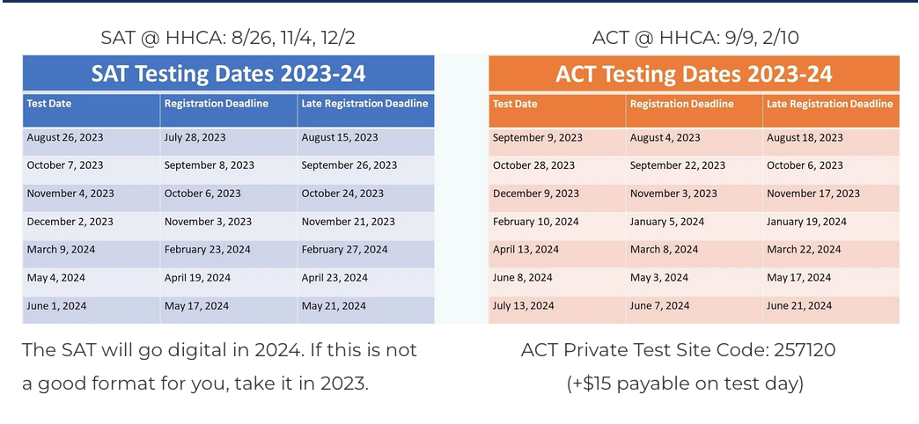
SAT/ACT Dates
Register:
www.collegeboard.org
www.act.org

Slide 19


SAT/ACT Prep

Slide 20
SAT/ACT Prep
Connect PSAT/SAT with Khan Academy for free test prep
Request tutor list from Mrs. Robinson

Slide 21
Financial Aid Basics
HHCA Financial Aid Workshops:
  Oct 18 - Little Known Secrets of Paying for College (HHCA Cafe @7pm)
  FAFSA Workshop (TBD)
FAFSA – Free Application for Federal Student Aid; Opens Dec 2023, but usually opens Oct 1
Loan – must pay back
Grant- free money
CSS Profile – Selective, private schools; more comprehensive
12 Tips for Financing College from “The Price You Pay for College” by Ron Lieber

Slide 22
Financial Aid Basics
COA = Cost of Attendance ($29-33K for USC, CofC, Clemson)
EFC = Expected Family Contribution
SAI = Student Aid Index
Net Price Calculator (NPC) – search on the college website (required) … COA - EFC = NP
Palmetto Calculator on www.getsmartsc.com
SCOIR

Slide 23
Financing College
Financial Aid Award Packages
  Combo of loans, grants, work study, etc.
Scholarships
  High season February - April
  Set realistic expectations (local, fit criteria, etc.)
  HHCA Scholarship Database (updated throughout the year!)
Other ways to pay for college
  ROTC/Service Academy (during college...road to officer)
  Military (enlist, then college paid by GI Bill later)
  Work

Slide 24
SC Scholarships
Life - $20K ($5K for 4 years)
  Meet 2 of 3 criteria below:
    Top 30% (~ 17; ask for rank)
    1100 / 24
    3.0+ UGPA
Palmetto Fellows - $29.5K ($6.75K (1) / $7.5K (2-4))
  Top 6% + 1200 OR 1400/32
  4.0+ GPA
Hope - $2.8K+ 1st year only
  3.0 GPA
  30 hours + 3.0 = convert to LIFE

Slide 25
SC Scholarships
STEM Enhancement
  + $2.5K/yr (years 2-4)
  14 hrs math/ science credits as freshman
  LIFE = 5K, 7.5K, 7.5K, 7.5K = $27.5K
  Palmetto = 6.75K, 10K, 10K, 10K = $36.75K
8 semesters - Clock starts when classes begin (even if just one class)

Slide 26
Athletes – College Sports
Careful decision … Fit comes first
Register with NCAA Initial Eligibility Clearinghouse or see NAIA
D1/D2 - www.ncaa.org (eligibility requirements, approved HHCA courses, and initiate application - $100) … D3 doesn’t use Clearinghouse
Complete recruitment forms on college websites
Email coaches w/link to your HUDL highlights & schedule
Involve your high school or club coach
Notes:
For any athletes ….start this now.

Slide 27
College Planning Timeline – Fall
Refer now to Rising Junior Top Ten List
Coming this spring: Rising Senior Top Ten List
Coming next fall: Senior Top Ten+ List

Slide 28
College Planning Timeline – Fall
If new: Join SCOIR (email Mrs. Robinson for invitation)
If new: Join Class of 2025 Guidance Group Message:
Text “@hhca2025” to 81010
Set academic goals
  Check Transcript (in SCOIR)
  Dual enrollment for spring? Next year?
Take PSAT Oct 10 – use results to prepare …
  Take SAT /ACT in Nov/Dec; March/May
  SAT Prep @ HHCA Oct 28/29, 12-4pm (see previous slide)
  After Algebra 2
Engage in clubs, sports, leadership, service

Slide 29
College Planning Timeline – Fall
Attend HHCA college rep visits on campus
  USCB College Fair Wed 10/18, 5:30-7:30
  Ask questions
SCOIR - Explore!
  Take Principles U Career Assessment
  Explore Colleges & Careers
Develop college list
    Research programs in SCOIR, etc.
    Family / Friend recommendations
    College Tours – plan during school breaks
Develop Activities List/Resume in Google Doc

Slide 30
College Planning Timeline – Winter
Continue Fall List
Meet w/Mrs. Robinson individually (Nov - Mar)
Tweak college list
Register for SAT / ACT (Dec - March)
  Accommodations? Work on ASAP
Prep for SAT using Khan Academy
Consider Junior Seminar spring semester
Research Summer Opportunities
  College Camps, Internships

Slide 31
College Planning Timeline – Spring
Take first SAT / ACT if not already (March/May)
Junior Seminar / Junior English Class
  Resume development
  College Essay Workshop
Winter and Spring Break College Tours
Letters of Recommendation – decide who and ask properly and politely

Slide 32
College Planning Timeline– Summer
LORs requested > resume > brag survey
Work on essay/personal statement
Be Productive!
  Work
  Attend summer camp on college campus
  Seek summer internship in field of interest

Slide 33
College Planning Timeline– Summer
Visit more college campuses / take official tours
Note admissions deadlines for colleges in SCOIR; create spreadsheet to track
Meet with Mrs. R before school starts or shortly after to align on plans
Submit one (easy) application (> Aug 1) before school starts

Slide 34
Parent Support
Guide life balance
Safe space (still a kid!)
Limit college talk to a certain time each week
Engage re: school, social, strengths, growth areas
Teach life skills (phone conversations, appointment setting, etc.)
Schedule Junior Meeting (Nov-Mar, after PSAT results)
Guide goal-setting
Support college app process - Check in, keep on track

Slide 35
Parent Support
SAT/ACT registration (Nov/Dec @ HHCA > Alg 2)
College Tours/Fairs – Schedule/encourage, USCB Fair Oct 18
Financial Aid / Scholarships - FAFSA, assist (next year)
View MyHHCA / SCOIR / HHCA News / hhca.org/guidance, hhca.org/college, hhca.org/collegeprep
Join Class of 2025 Group Message: Text “@hhca2025” to 81010

Slide 36

It’s all about Balance
Balance = Work hard / Play hard / Serve others / Rest well
Considerations
  Cumulative workload / stress
  Outside activities
  Family priorities
  Sleep
  Keep a written schedule/agenda
  Choose wisely...can’t do it all

Slide 37
Questions?

Slide 38
US Guidance Team
Megan Robbins - Director of Guidance
Mary Delle Robinson – College & Career Advisor
Erin Caprielian – Registrar
Mission: to equip students with the tools and confidence to know their identities in Christ and use their gifts and skills to change the world for God’s glory.
“For I know the plans I have for you,” declares the LORD, “plans to prosper you and not harm you, plans to give you hope and a future.” ~ Jeremiah 29:11

