Slide 1

Colorado Springs School District 11
Facilities
Mike Willis: Senior Director of Facilities
James Warren: Assistant Director of Facilities
Brian Kelly: Operations & Maintenance Manager
Mark Miller: Custodial Foreman & Inspector

Slide 2
Facilities Maintenance & Operations
Building Manager Responsibilities
Work Order Process
Vandalism and Insurance Claims
Reimbursable Work
Audio/Visual Equipment Work
Utility and Equipment Outage Scheduling

Slide 3
Building Manager Responsibilities
  Spends 80-90 percent of their time maintaining facilities
    Includes operational testing (e.g. fire drills), landscaping designated areas, operating and maintaining building equipment with basic repairs, room painting, minor plumbing, floor cleaning and resurfacing, oversight of general building cleanliness, and normal weather clean-up
    Call Facilities for more complex repairs and support

Slide 4
Building Manager Responsibilities
Partners with Maintenance Shops on behalf of the School staff
Provides direct support to schools for work as assigned
  Includes support to after school activities, rentals, building access for vendors, and other support
Communicates with Maintenance Shops Foremen and technicians for repairs, support schedules, self-help projects, and reimbursable support requests
Tracks work orders and provides status updates to School Staff

Slide 5
Building Manager Responsibilities
Provides foul weather support
  Includes shoveling snow in designated areas, ice removal, mopping and keeping hallways dry
  Keep students, staff, and visitors away from areas deemed unsafe due to water, snow, or ice accumulation
Plan the building management team’s schedule
  Must ensure adequate staffing to meet school operational needs

Slide 6
Regular Work Orders
Regular Work Orders repair and/or replace building components and infrastructure systems
Includes:
  Maintenance/repairs beyond building manager capability
  Self-Help requests must be approved by Director of Facilities
    Similar to reimbursable work agreements
  Environmental and safety requests
  Pest control
  Additional custodial support

Slide 7
Work Order Process
Facility support begins with a work order
  Normally submitted by the Building Manager
Work orders are detailed; state the 5 W’s
  Don’t forget the room number; it’s required!
Only one Work Order per request
  Duplicates will slow down support and wastes resources
  Main shop will coordinate additional support as needed

Slide 8
Emergency Work Orders
An Emergencies is defined as an event that poses an unacceptable risk to life or limb, damage building(s), and/or your mission
  Call first! Work Order Desk (719-477-6000) Timely notification often reduces damage, engages facilities staff
    After hours, call District Security (719-520-2287)
  Place a work order when practical
  Emergency ends when risk is mitigated
    Final repairs and clean up may occur later

Slide 9
Vandalism and Insurance Claims
First call Security Department, then Facilities Department
  After hours, Security will contact Facilities
If the building is secure, support may be provided the next day
BM’s should paint over graffiti before calling Shops for support
Shops will assist with widespread areas and by power washing unpainted brick, sidewalks, and similar surfaces
Facilities will coordinate with Risk Management for additional support, if needed

Slide 10
Reimbursable Work Agreements
Formal agreement for support between schools and Facilities
Provides schools with option to obtain higher level of services than Facilities has resources to provide
Requests for maintenance ahead of schedule, such as carpet replacement and painting ahead of maintenance schedule
Requests for non-standard equipment, such as split units A/C to single offices, unique playground equipment, and modern fixtures not resourced through a Capital Program project, etc.
Currently re-working process to better support academics

Slide 11
Reimbursable Work Agreements
Ask for detailed estimates only when you are serious
  Opportunity cost is less hours to maintain your school
Two “free” estimates per school per year for unfunded requests
  Additional requests will be estimated on a reimbursable basis
  Ballpark estimates will be provided without funding
Executed via formal agreements with a defined scope of work, cost, and schedule
  May only be changed by agreement of the Budget Authority and Director of Facilities

Slide 12
Audio/Visual Equipment Work
Requests to add, move, or modify display screens, projectors, mounted TV monitors, speakers, cameras, telephones, and other A/V equipment will be placed with the IT Department
  Call the IT Help Desk at 520-2211 or enter online using the “Happy Fox” IT work order system
IT will enter work order to seek Facilities support when needed
A/V requests directly from schools will be declined

Slide 13
Utility and Equipment Outage Scheduling
Utility and equipment outages will be coordinated with all stakeholders at least two weeks in advance
  Equipment outage include major teaching stations, swimming pools, gyms, cafeterias, auditoriums, and other building equipment and systems that do not have significant redundancy to support teaching, athletics, and rental needs
  Does not include bona fide emergencies which require immediate attention
Notes:
Outage Schedule will be sent to all stakeholders when updated, including Principals, BMs, Athletic Directors, FNS, Security, and others as appropriate

Slide 14
Fire Safety and Building Egress Requirements
Fire extinguishers
Annual training required for all building staff on extinguisher locations, proper use, and maintenance
  Should be inspected for serviceability monthly (BMs)
  Don’t be afraid to ask how to operate! Could save ……
Don’t block cabinets or hangars
  Fire code requires 3-ft clear zone to front and sides of all extinguishers

Slide 15
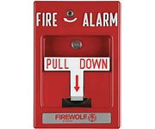
Fire Safety and Building Egress Requirements
Emergency Fire Pull Stations
Same requirement as the clearance of fire extinguishers
  Fire code requires a 3-ft clear zone on front and sides
  Must have easy and direct access to all fire pull stations

Slide 16
Fire Safety and Building Egress Requirements
Egress Safety - when and how to manage fire doors
Fire Doors reduce the speed a fire may spread
Fire rated doors cannot be altered in any way
  i.e. No sanding, painting, drilling, etc
  All alterations voids fire rating…replacement is costly
  Fire doors must remain closed at all times in non-sprinklered building/area of school
    Exception: rooms/areas with secondary egress

Slide 17
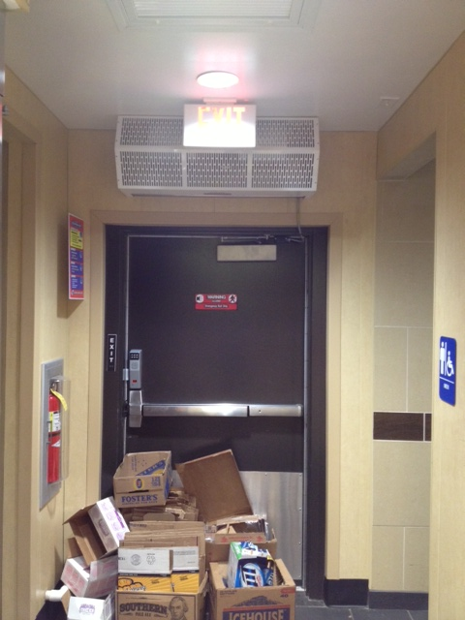
Fire Safety and Building Egress Requirements
Never block or store things near fire doors – a clear path of egress is critical to both occupants and fire teams
Exit Lights (e.g. frog eyes, EXIT lights, and combo lights) must be tested by Building Managers monthly

Slide 18
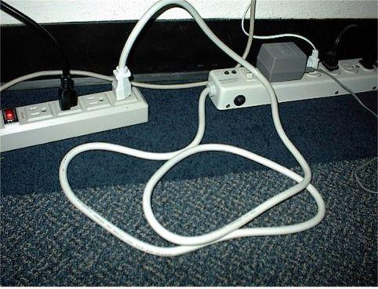
Other Fire Safety
Do not permanently use extension cords
Never daisy chained power strips and/or extension cords
                May cause fires due to wires overheating
Concerns: request help on a work order

Slide 19
Other Fire Safety
Electrical, mechanical, and boiler rooms are not storage rooms
Storing flammable items in these areas is a fire code violation
Violations during CSFD inspections can result in fines and even a court summons

Slide 20
Questions?

