Slide 1
Marine Option
NROTC
(Naval Reserve Officer Training Corps)
4 Year Scholarship Program

Slide 2
INTRO
What is the Reserve Officer Training Corps?
  A source to obtain a commissioning as a Marine Corps Officer (other sources are the US Naval Academy, Platoon Leaders Course, and Officer Candidates Course)
The difference between an enlisted Marine and a Marine Officer
  Officers are trained to be the leaders and supervisors of enlisted personnel. They develop the orders and policies, and enlisted Marines carry it out. It is on the Officer to properly lead and take care of those Marines in his/her charge.
Why does NAVAL ROTC have Navy AND Marine Corps?
  The Navy and Marine Corps are separate services within the Department of the Navy. And, just as the US Naval Academy produces both Navy and Marine Corps Officers, NROTC trains both Navy and Marine option midshipmen. Your application and selection for NROTC “Marine option” means that your scholarship is with the Marine Corps, and that is who you will commission with upon graduating from college.

Slide 3
NROTC Mission
To educate and train highly qualified
young men and women for careers
as commissioned officers in the
United States Marine Corps.

Slide 4
The Benefits
Pays full tuition, lab fees, books, and uniforms!
Provides leadership opportunities
Structured academic environment
Provides a monthly stipend ($250-$400)
Some universities will help with room and board
Up to $180,000

Slide 5
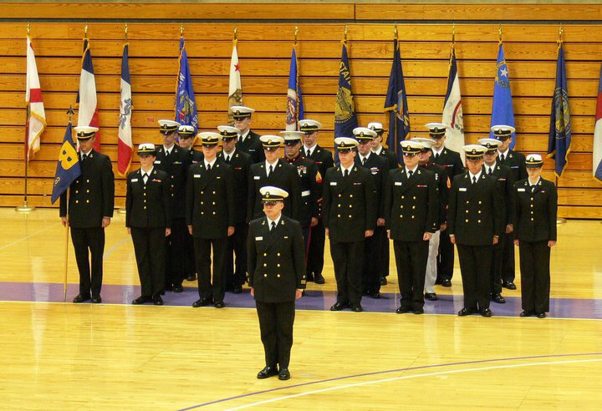
LIFE AS A MIDSHIPMAN
All Midshipmen do some training together, but there is separate training and separate classes for Navy and Marine option midshipmen.
Upper-class Midshipmen hold the billets of Battalion Commander, Company Commanders, First Sergeants, Battalion Staff, Platoon Commanders
Underclass Midshipmen hold the billets of squad leader, fire team leader, general population
Typical Weekly Schedule:
  Four college courses per semester
    One NROTC class (1.25 hours) twice per week on top of normal college courses
  NROTC lab twice per week (2 hours per lab)
    Drill, annual training, student Company Commander time
  Physical training twice per week
  Wear uniform on Thursdays
  Weekend events occur two or three times per semester
NROTC classes include:
  Basic military knowledge
  Drill
  Battle studies
  Leadership
  History of war
  OCS preparation
Notes:
You have a lot more responsibility than your average college student
Study groups and tutors are provided

Slide 6
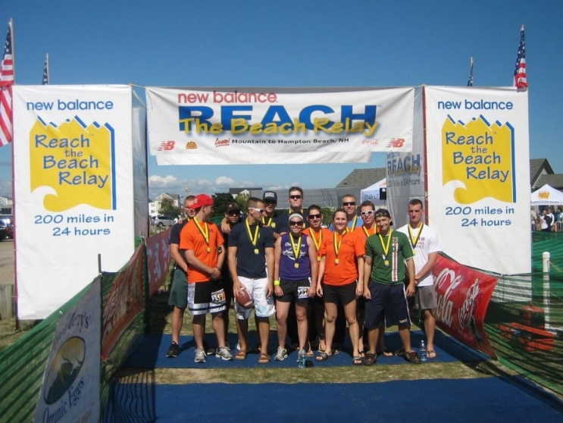
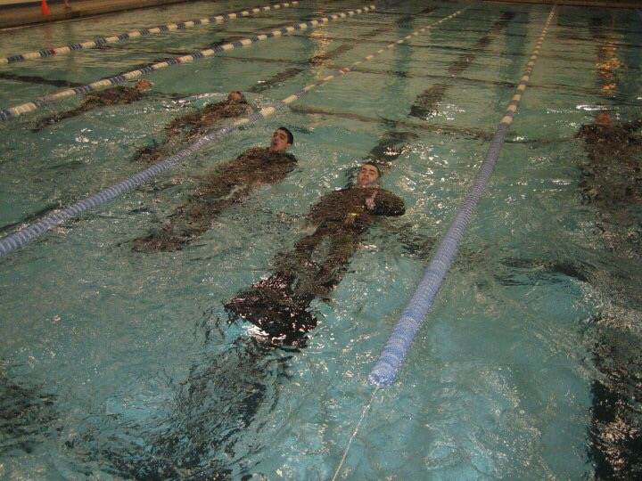
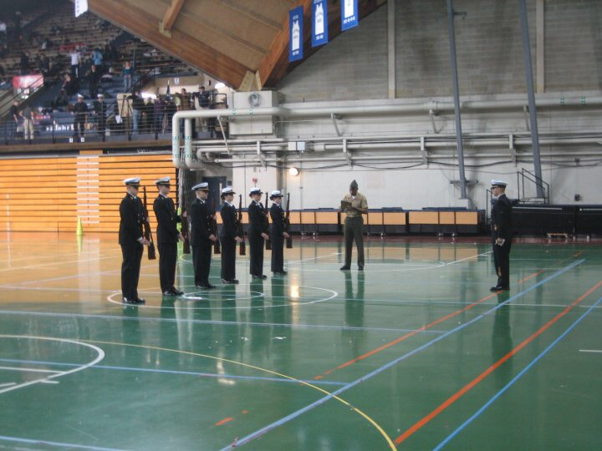
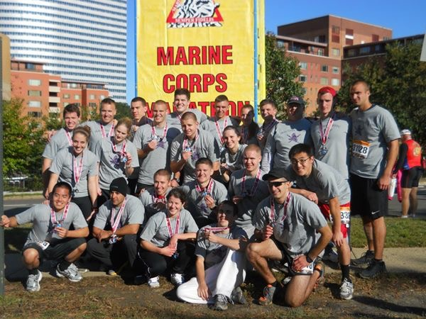
LIFE AS A MIDSHIPMAN
Other annual events:
  Field Exercises (one weekend per semester)- These are for Marine option Midshipmen, and Navy option Midshipmen who would like to go, to execute what they have been learning in the classroom
  Birthday Ball
  Military Excellence Competitions- competing against other NROTC units in drill, color guard, PT events
  Camaraderie events
  Color Guard events- football games, parades, etc.
4. The “typical” college life
Students can pick any major
Students can participate in varsity sports while they are in the program, and it is actually encouraged
Students can live on or off campus (NROTC cannot direct that)
Even if a student gets college credit from classes in high school, they need to be taking enough credits each semester in college to be a full-time student
Maintain a 2.0 GPA

Slide 7
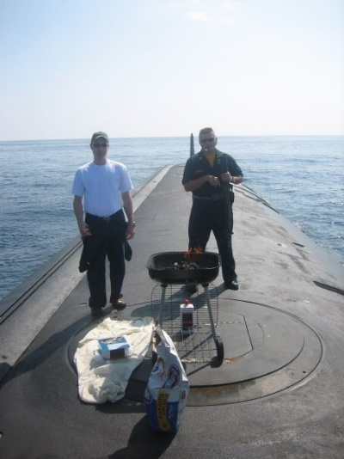
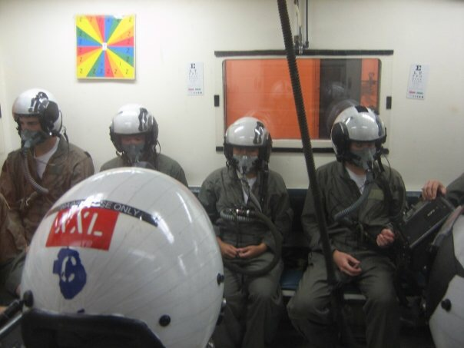
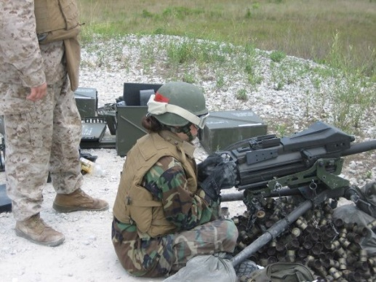
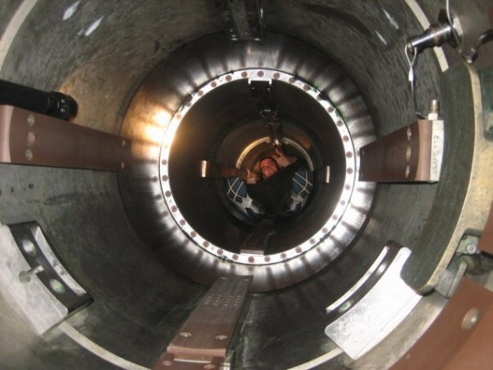
SUMMER TRAINING
1. NROTC Indoctrination Program: Summer before freshman year, in Great Lakes, IL; 3 weeks long
2. Career Orientation and Training for Midshipmen (CORTRAMID): Summer after freshman year; 4 weeks long
  To provide a broad-scoped view of the Navy and Marine Corps
  All training is conducted with other NROTC students in your grade from around the country
  Aviation Week (get to fly), Surface Warfare Week (including underway on a ship), Submarine Week (including underway on a submarine)
  Marine Week
    Weapons live-fire training
    O-Course, Rappel tower
    Urban warfare
    Road marches
    Small-unit tactics, patrols, ambushes, etc.
Notes:
Emphasize that yea, they may be losing some of what they thought was going to be a fun summer break at home, but they’re getting to do things that their peers will never get to do in their entire lives
Some of my best friends today are other midshipmen who I met through this program

Slide 8
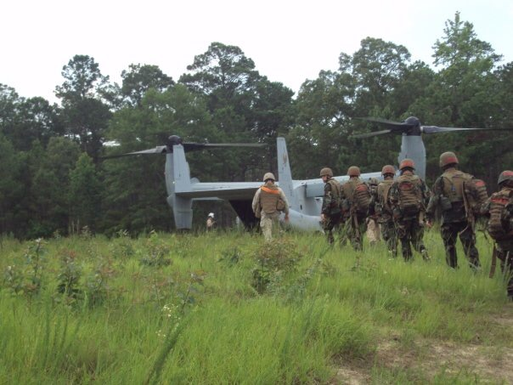
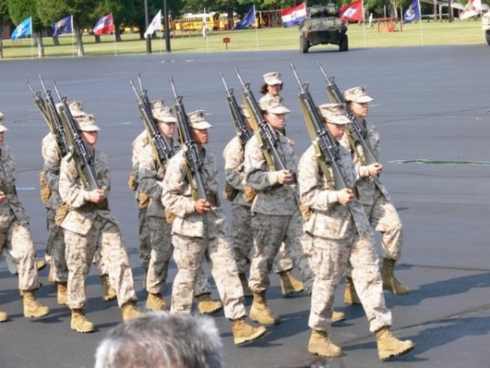
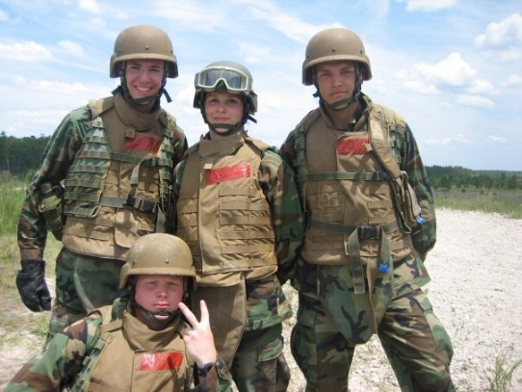
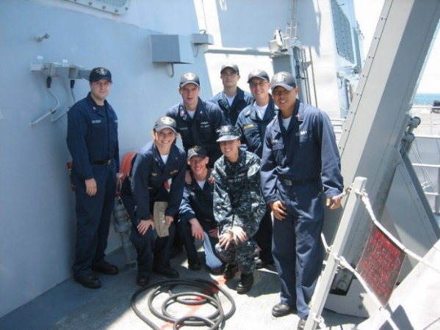
SUMMER TRAINING
Mountain Warfare Training Camp: Summer after sophomore year; 10 days at Marine Corps Mountain Warfare Training Center, Bridgeport, CA
  Marine-specific training
  Mountain survival skills and field craft
  Small-unit tactics and movement through mountainous terrain between 6k and 12k feet elev.
  Demonstration of learned skills through tactical leadership situations
Officer Candidates School (OCS): Summer after junior year; 6 weeks long in Quantico, VA
  you must pass this in order to get your commission
  Marine Corps is the only branch that requires ALL of its officers to go through OCS (except USNA midshipmen)
  Evaluated on Academics, Physical Fitness, and Leadership
Notes:
Emphasize that yea, they may be losing some of what they thought was going to be a fun summer break at home, but they’re getting to do things that their peers will never get to do in their entire lives
Some of my best friends today are other midshipmen who I met through this program
1. Academics: Weapons, Military Subjects, Tactics, Compass Course, Drill, Land navigation, Leadership, History
2.Physical training: Physical Fitness Test, Combat Readiness Test, Obstacle Course, Endurance Course
3. Leadership: Leadership Readiness Course, Small-Unit Leadership Evaluations, Command Evaluation

Slide 9
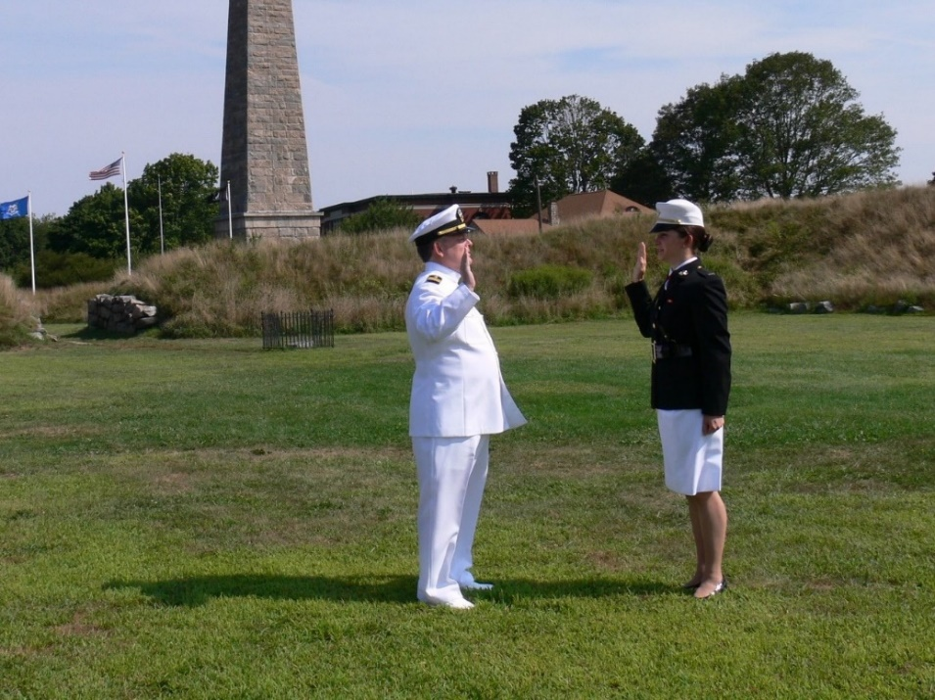
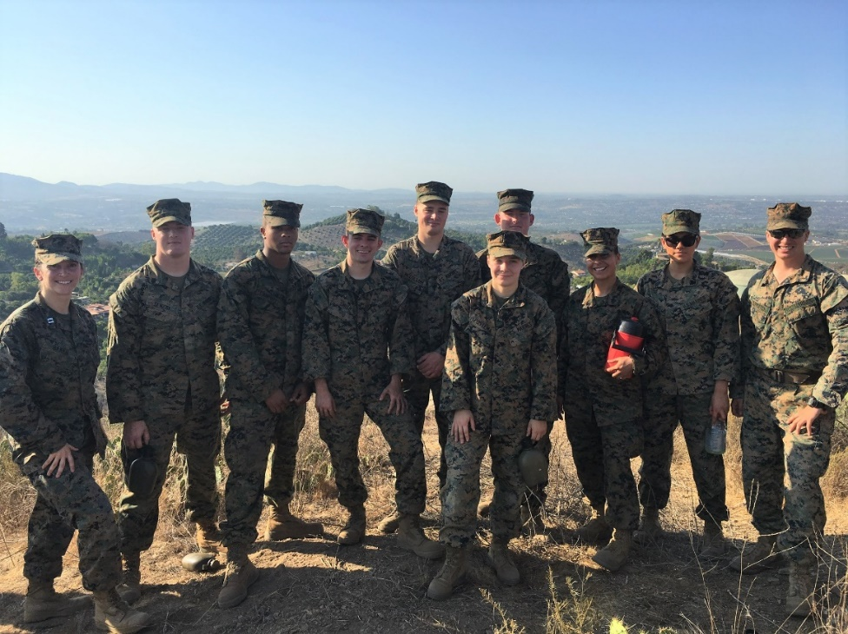
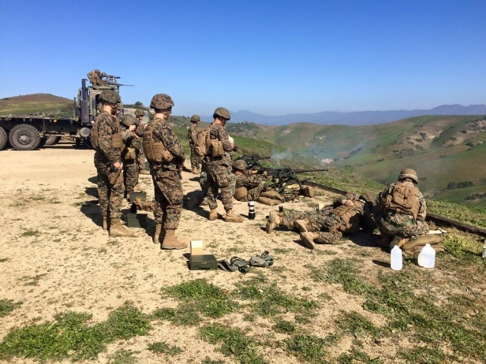
COMMISSIONING
This happens on the same day that you graduate.
Afterwards, you’ll receive your report date to The Basic School in Quantico, VA.
THE MOST REWARDING PART: LEADING MARINES

Slide 10
Eligibility Requirements
U. S. Citizen
17-23 years of age
Be physically qualified by USMC standards
Must graduate High School.
Minimum of 1000 SAT (critical reading and math combined) or 22 ACT (composite), or a minimum of 74 on the Armed Services Aptitude Battery Test (ASVAB). *SAT scores must be from the same test
Pursuing enrollment at participating NROTC college or university.* we know that the students may not have acceptance letters by the application due dates

Slide 11
PFT Scores
Must receive a score of at least 200
Max set of crunches in two minutes
Max set of pull-ups
3-mile run
Event | Male Min | Male Max | Female Min | Female Max
Pull-ups | 4 | 20 | 1 | 7
Crunches | 70 | 105 | 50 | 100
3 mile run | 27:40 | 18:00 | 30:50 | 21:00
Notes:
Females would have to do 34 push ups to get the same points that they would get if they did one pull-up

Slide 12










Well Known Participating Schools
  UC Berkeley
  Stanford
  U of San Diego
  UC Davis
  MIT
  UCLA
  Florida State
  USC
  Pennsylvania
  Virginia
  Notre Dame
  Texas
  Florida
  Harvard
  Oregon St
  Colorado
  Washington
  Cornell
  Penn State
  Duke
70 + colleges and universities in total that host an NROTC program
  *One of the top three schools choices must include a school where you would qualify for in-state tuition unless you live in Texas, Alaska, Montana, Hawaii, Guam or overseas.

Slide 13
Obligation
Upon graduation you will be commissioned as a second lieutenant in the USMC.
You will be required to fulfill four years of active duty service in the USMC upon graduation.
Flight training guarantees require additional active duty obligated time.

Slide 14
How To Apply
Go to https://www.nrotc.navy.mil and complete the online application. Once fully complete, ensure you click “submit.”
Take the SAT or ACT
Apply to any of the eligible NROTC colleges or universities. To look at which schools offer NROTC programs go to https://www.nrotc.navy.mil/colleges.cfm

Slide 15
Application Package
Complete the Application Package
  Transcripts
  Three teacher evaluations (Counselor, English and Coach/Other)
  Two Marine officer interviews
  Physical Fitness Test results
  SAT/ACT/ASVAB scores
  Students interested in aviation will pursue that through their NROTC unit (we cannot direct that)

Slide 16
Selection Boards
Two Marine Option NROTC Boards:
Early Board: 17-21 October 2022
  Packages due to the Executive Officer NLT 23 September 2022
Regular Board: 23-27 January 2023
  Packages due to the Executive Officer NLT 15 January 2023
Notes:
Confirm this matches the Annual Plan

Slide 17
Selection Criteria
SAT/ACT/ASVAB Scores
Class Standing
Cumulative GPA
Athletics and extracurricular activities
Student Government/Leadership
Community service/employment
Two Marine officer interview results
Three teacher evaluations’ comments
Two essay questions

Slide 18
Last Year’s Winners
Recruiting Station Sacramento
Statistics
14 recipients within the last two years
SAT (Math/Reading): 1238
Un-weighted GPA: 3.76
PFT: 255
Community Service hours: 278
Standing in class: Within top 30%
2 Eagle Scouts
Colleges/Universities
University of San Diego (2)
Oregon State University
University of California, Berkeley
University of California at Los Angeles (2)
University of San Diego (3)
Embry-Riddle Aeronautical University (2)
Virginia Military Institute
San Diego State University
University of California, Davis
Notes:
Looking for the all-around individual, not just the high scholar or pro athlete

Slide 19
  Capt Rachel C. Baker
  Executive Officer
  Office: (916) 928-2602 / Cell: 916-204-2790
  Rachel.baker@marines.usmc.mil
Staff Sergeant Boyd
(916) 390-7496
Cody.boyd@marines.usmc.mil
More information can be found at:
https://www.nrotc.navy.mil

Slide 20
Questions?

