Slide 1

School Climate
SEPTEMBER 2022
prepared by Ellis Ott, Ph.D., Research & Accountability Department

Slide 2
U.S. Dept. of Education
School Climate Surveys (EDSCLS)
SY 20-25 Strategic Plan:
  Core Values –
    Embody respect for the diversity and dignity of all
    Provide a safe learning environment
    Engage with students, family, staff, and community to support student success
  Strategic Goals
    Student Success: Increase academic achievement and social emotional well-being for all students

Slide 3
U.S. Dept. of Education
School Climate Surveys (EDSCLS)
Suite of surveys for students (grades 5-12), parents, and staff
Reliable, nationally-validated
Completion time 10-20 minutes (47 to 83 items)
Majority of survey items provide a positive statement with 4 response options – 2 positive, 2 negative (from Strongly Disagree to Strongly Agree)
Administered every Spring, 2017 to 2022

Slide 4
ED School Climate Surveys
3 domains with 13 subdomain topical areas
Engagement
Safety
Environment

Slide 5
Engagement Domain
Strong relationships between students, teachers, families, and schools and strong connections between schools and the broader community.
Topics: Cultural and linguistic competence, Relationships, and School participation

Slide 6
Engagement examples
Teachers understand my problems (students)
At this school, my child feels he/she belongs (parents)
Staff do a good job helping parents to support their children’s learning at home (staff)

Slide 7
Safety Domain
Emotional and physical safety are fundamental characteristics of high-quality schools; in these schools, students feel a sense of belonging and are free to focus on learning
Topics: Emotional safety, Physical safety, Bullying, Substance Abuse, and Emergency readiness/management

Slide 8
Safety examples
I feel safe going to and from this school (students)
My child is safe at this school (parents)
People at this school care about me as a person (staff)

Slide 9
Environment Domain
Appropriate facilities, well-managed classrooms, available school-based health supports, and a clear, fair disciplinary policy
Topics: Physical and Instructional environment, physical and mental health, and discipline

Slide 10
Environment examples
My teachers expect me to do my best all the time (students)
My child’s teachers make themselves available to me (parents)
Discipline is fair (staff)

Slide 11
Benchmarks
In Fall of 2017, benchmarked scale scores were completed to provide perception levels by domain and topic
Four levels of perception: Very Positive, Positive, Negative, and Very Negative
Provided results are percent positive/very positive (positive rate)

Slide 12
School climate results
Publically Available Data Dashboard to review School Climate results:
https://public.tableau.com/app/profile/k12northstar
Comparison and Filtering options available (example: school, race/ethnicity)
Some information suppressed to protect confidentiality

Slide 13
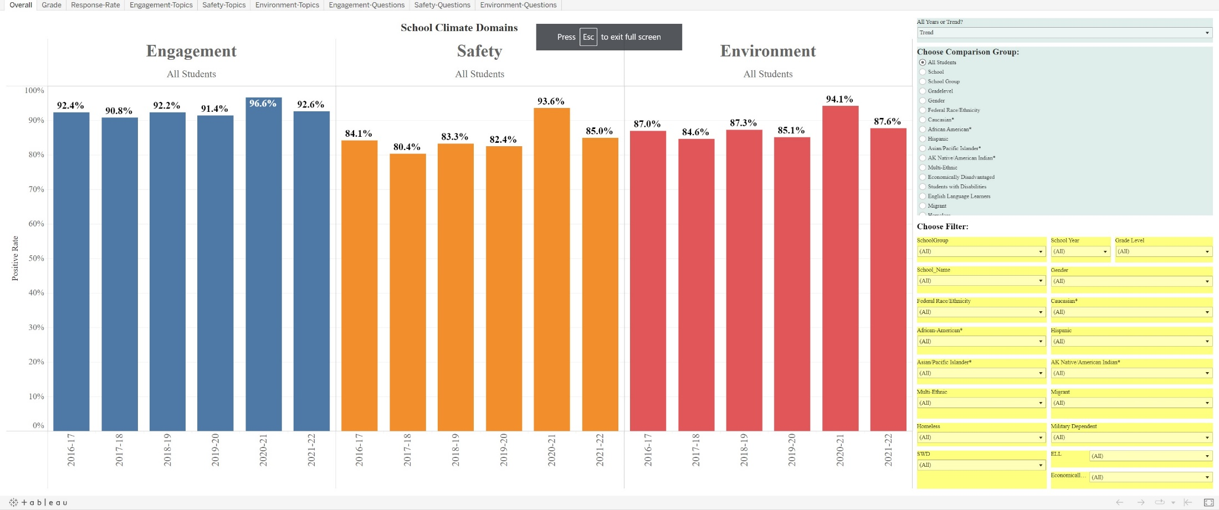
Example screen: Students
Publically Available Dashboard to review School Climate results for each survey group:
https://public.tableau.com/profile/k12northstar#!/

Slide 14
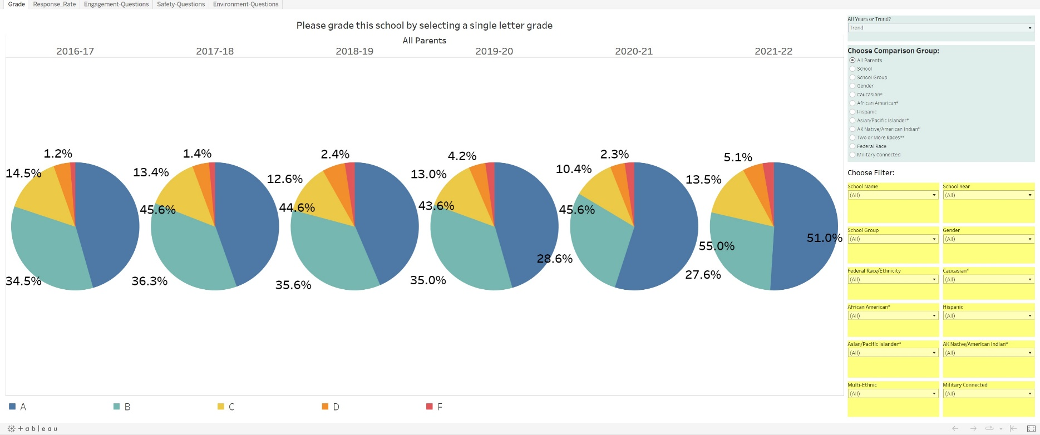
Example screen: Parents

Slide 15
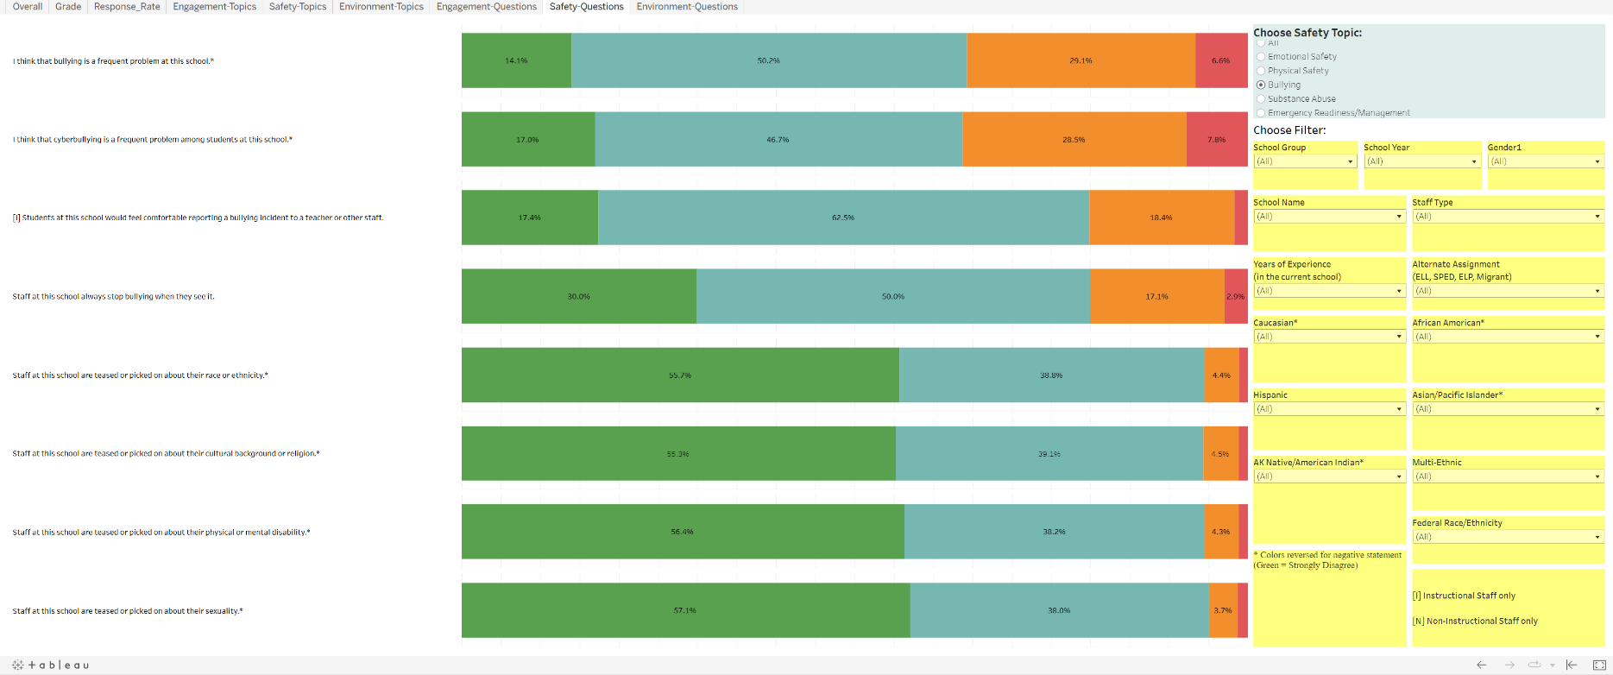
Example screen: Staff

Slide 16
Conclusion
2022 Student response rate of 54% vs 40% 2021
2022 Parent response rate of 16% vs 24% 2021
2022 Staff response rate of 55% vs 67% 2021

Slide 17
Conclusion
Greater than 3/4 positive rate for students and staff in Engagement, Safety, and Environment
Schools given grade point average of 2.86, 3.17, and 3.19 by students, staff, and parents in 2022
Student positive rate above benchmark in all domains (below benchmark for staff)

Slide 18
Conclusion
Perception gaps for all student demographic groups were no more than ‘small’
African American student group had lowest positive rate than all other demographic groups for all 3 domains
Administration of EDSCLS every Spring

Slide 19
EDSCLS resources
Web address – https://safesupportivelearning.ed.gov
  School Climate Resource package which includes:
  Quick guide on making improvements
  School Climate Improvement Reference Manual
  School Climate Improvement Action Guides
  School Climate Interpretation Resources
  Online Modules

Slide 20
Questions?
Comments?
THANK YOU
Fairbanks North Star Borough School District
Ellis Ott, Ph.D.
Phone: 907-452-2000 x. 11364
E-mail: ellis.ott@k12northstar.org

