Slide 1

School Climate
SEPTEMBER 2021
prepared by Ellis Ott, Ph.D., Research & Accountability Department

Slide 2
U.S. Dept. of Education
School Climate Surveys (EDSCLS)
SY 20-25 Strategic Plan:
  Core Values –
    Embody respect for the diversity and dignity of all
    Provide a safe learning environment
    Engage with students, family, staff, and community to support student success
  Strategic Goals
    Student Success: Increase academic achievement and social emotional well-being for all students

Slide 3
U.S. Dept. of Education
School Climate Surveys (EDSCLS)
Suite of surveys for students (grades 5-12), parents, and staff
Reliable, nationally-validated
Completion time 10-20 minutes (47 to 83 items)
Majority of survey items provide a positive statement with 4 response options – 2 positive, 2 negative (from Strongly Disagree to Strongly Agree)
Administered every Spring, 2017 to 2021

Slide 4
ED School Climate Surveys
2021 Student response rate of 40% vs 62% in 2020
2021 Parent response rate of 24% vs 16% in 2020
2021 Staff response rate of 67% vs 54% in 2020

Slide 5
ED School Climate Surveys
3 domains with 13 subdomain topical areas
Engagement
Safety
Environment

Slide 6
Engagement Domain
Engagement includes several components of “school connectedness,” such as the amount of effort students expend in the work of learning, their sense of belonging, and their emotional involvement with the school
Topics: Cultural and linguistic competence, Relationships, and School participation

Slide 7
Safety Domain
Emotional and physical safety are fundamental characteristics of high-quality schools; in these schools, students feel a sense of belonging and are free to focus on learning
Topics: Emotional safety, Physical safety, Bullying, Substance Abuse, and Emergency readiness/management

Slide 8
Environment Domain
Positive school environments are characterized by appropriate and well-maintained facilities; well managed classrooms with high levels of engagement, rigor, productivity, and inclusion; a range of available school-based health supports; clear, fair disciplinary policies; and explicit policies and procedures governing various school practices
Topics: Physical and Instructional environment, physical and mental health, and discipline

Slide 9
Benchmarks
In Fall of 2017, benchmarked scale scores were completed to provide perception levels by domain and topic
Four levels of perception: Very Positive, Positive, Negative, and Very Negative
Provided results are percent positive/very positive (positive rate)

Slide 10
School climate results
Publically Available Data Dashboard to review School Climate results:
https://public.tableau.com/profile/k12northstar#!/
Comparison and Filtering options available (example: school, race/ethnicity)
Some information suppressed to protect confidentiality

Slide 11
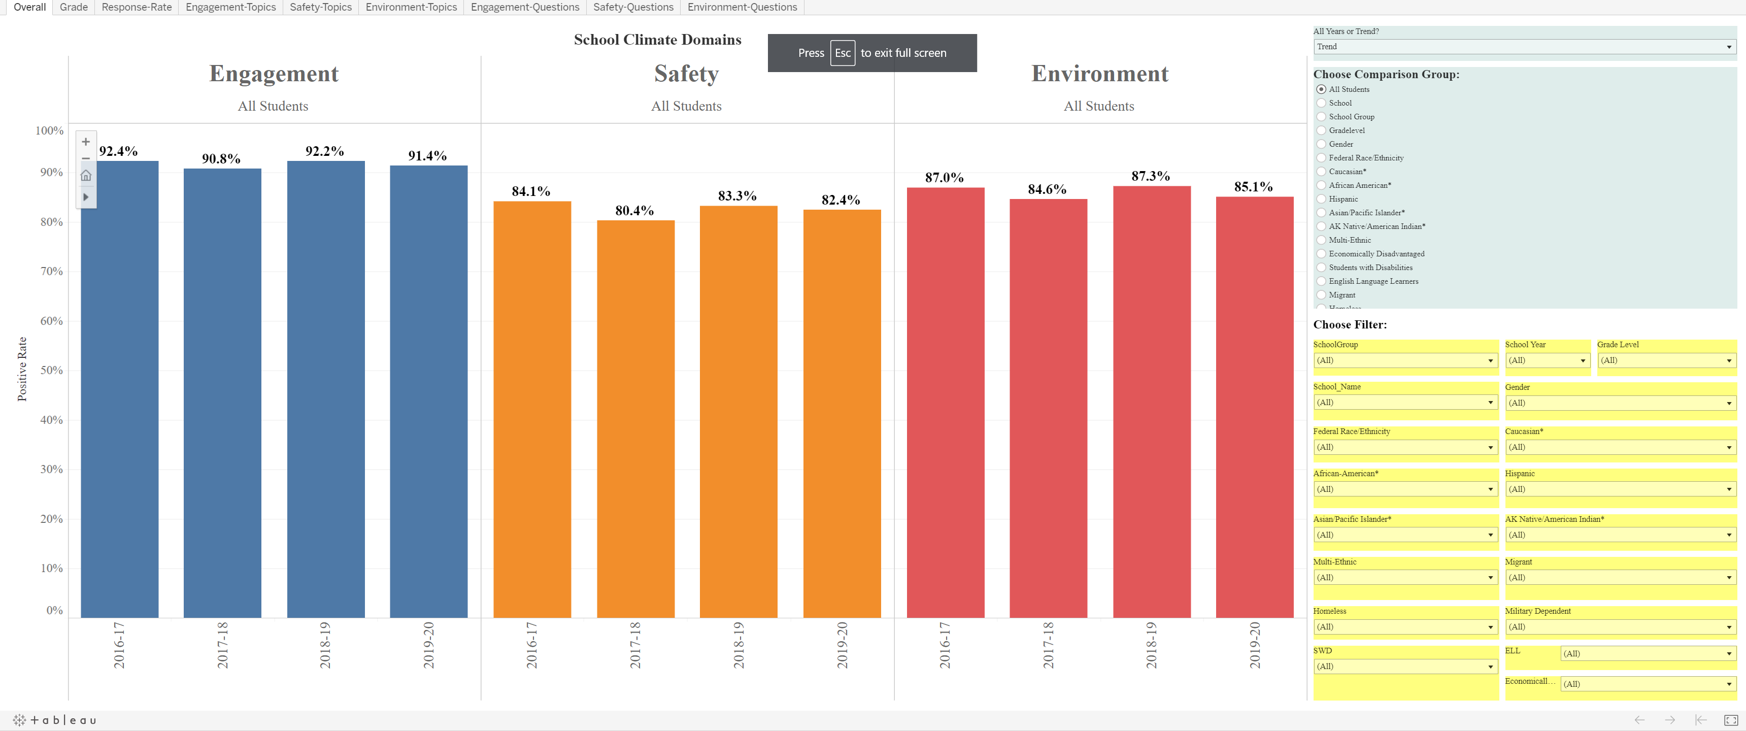
Example screen: Students
Publically Available Dashboard to review School Climate results for each survey group:
https://public.tableau.com/profile/k12northstar#!/

Slide 12
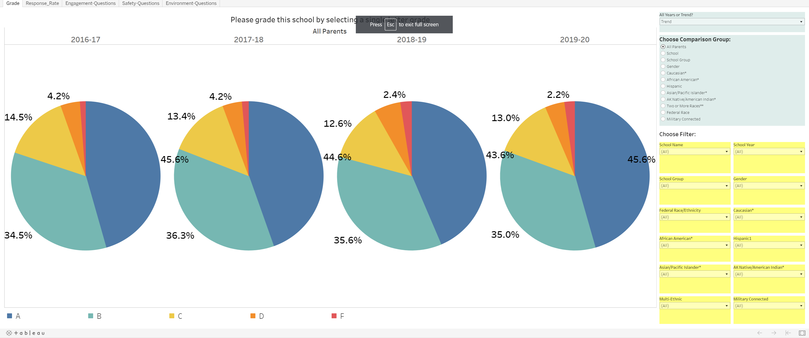
Example screen: Parents

Slide 13
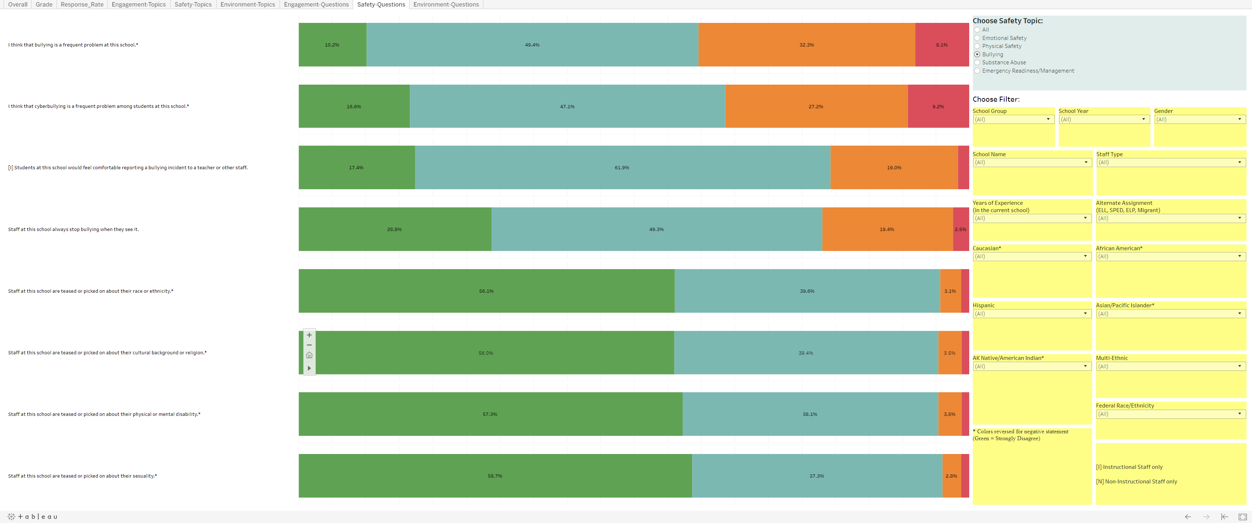
Example screen: Staff

Slide 14
Conclusion
Interpret survey results with caution:
Schools in “remote” learning for the first half of 2020-2021
Optional in-person in second half of 2020-2021
Survey questions may be answered differently in remote learning vs. in-person

Slide 15
Conclusion
Highest survey response rate in 5 years for staff and parents
2,000+ parent survey responses
High positive rate for students and staff in Engagement, Safety, and Environment
Schools given grade point average of 3.10, 3.18, and 3.30 by students, staff, and parents in 2021

Slide 16
EDSCLS resources
Web address – https://safesupportivelearning.ed.gov
  School Climate Resource package which includes:
  Quick guide on making improvements
  School Climate Improvement Reference Manual
  School Climate Improvement Action Guides
  School Climate Interpretation Resources
  Online Modules

Slide 17
Questions?
Comments?
THANK YOU
Fairbanks North Star Borough School District
Ellis Ott, Ph.D.
Phone: 907-452-2000 x. 11364
E-mail: ellis.ott@k12northstar.org

