Slide 1

School Climate
August 2019
prepared by Ellis Ott, Ph.D., Research & Accountability Department

Slide 2
U.S. Dept. of Education
School Climate Surveys (EDSCLS)
Suite of surveys for students (grades 5-12), parents, and staff
Reliable, nationally-validated
Completion time 10-20 minutes (47 to 83 items)
Majority of survey items provide a positive statement with 4 response options – 2 positive, 2 negative (from Strongly Disagree to Strongly Agree)
Administered in Spring 2017, 2018, and 2019

Slide 3
ED School Climate Surveys
2019 Student response rate of 70% vs 61% and 51% in previous years
2019 Parent response rate of 12% vs 21% and 11% in previous years
2019 Staff response rate of 46% vs 54% and 36% in previous years

Slide 4
ED School Climate Surveys
3 domains with 13 subdomain topical areas
Engagement
Safety
Environment

Slide 5
Engagement Domain
Engagement includes several components of “school connectedness,” such as the amount of effort students expend in the work of learning, their sense of belonging, and their emotional involvement with the school
Topics: Cultural and linguistic competence, Relationships, and School participation

Slide 6
Safety Domain
Emotional and physical safety are fundamental characteristics of high-quality schools; in these schools, students feel a sense of belonging and are free to focus on learning
Topics: Emotional safety, Physical safety, Bullying, Substance Abuse, and Emergency readiness/management

Slide 7
Environment Domain
Positive school environments are characterized by appropriate and well-maintained facilities; well managed classrooms with high levels of engagement, rigor, productivity, and inclusion; a range of available school-based health supports; clear, fair disciplinary policies; and explicit policies and procedures governing various school practices
Topics: Physical and Instructional environment, physical and mental health, and discipline

Slide 8
Benchmarks
In Fall of 2017, benchmarked scale scores were completed to provide perception levels by domain and topic
Four levels of perception: Very Positive, Positive, Negative, and Very Negative
Provided results are percent positive/very positive

Slide 9
School climate results
Publically Available Dashboard to review School Climate results:
https://public.tableau.com/profile/k12northstar#!/
Comparison and Filtering options available (example: school, race/ethnicity)
Some information suppressed to protect confidentiality

Slide 10
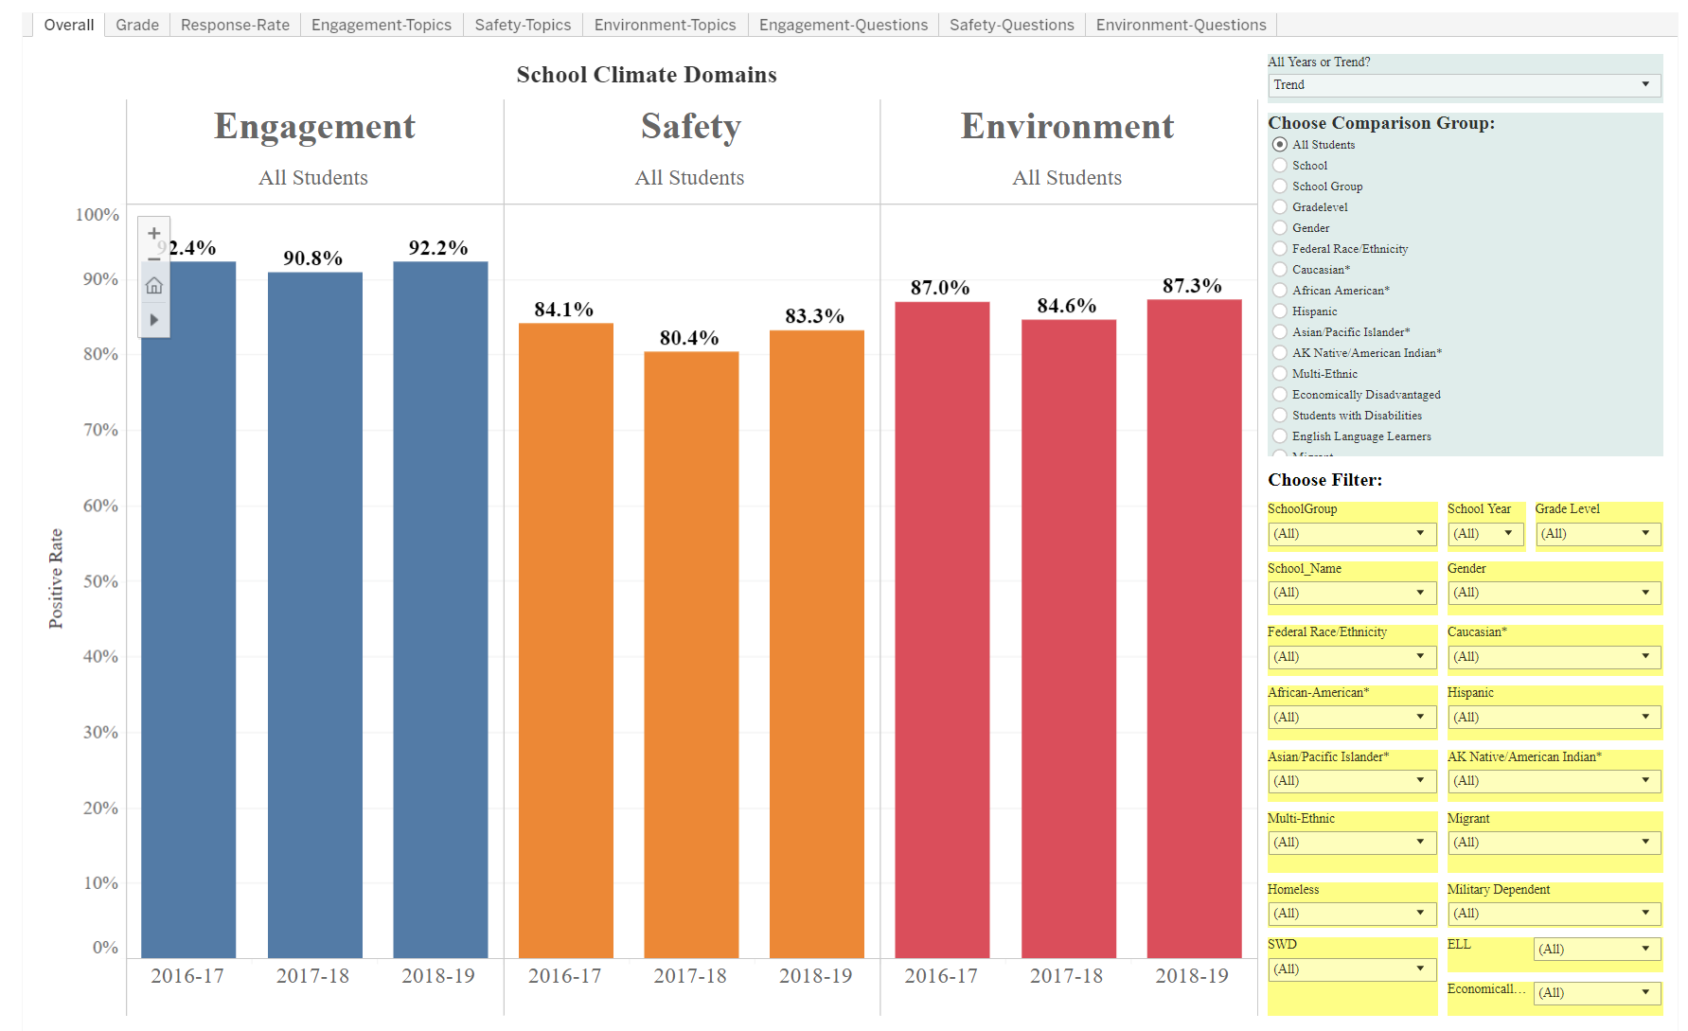
Example screen: Students
Publically Available Dashboard to review School Climate results for each survey group:
https://public.tableau.com/profile/k12northstar#!/

Slide 11
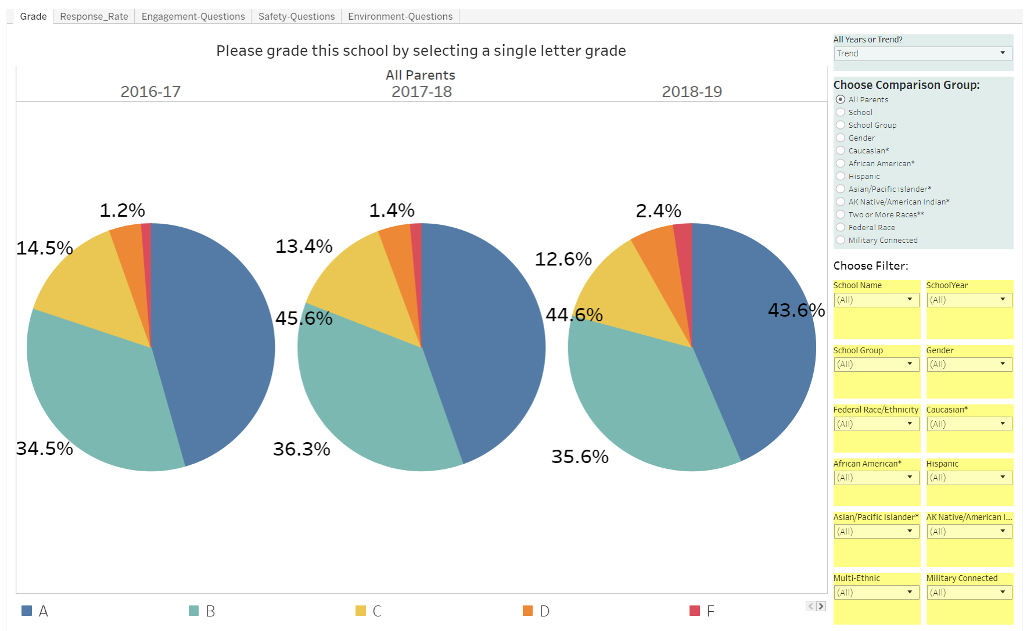
Example screen: Parents

Slide 12
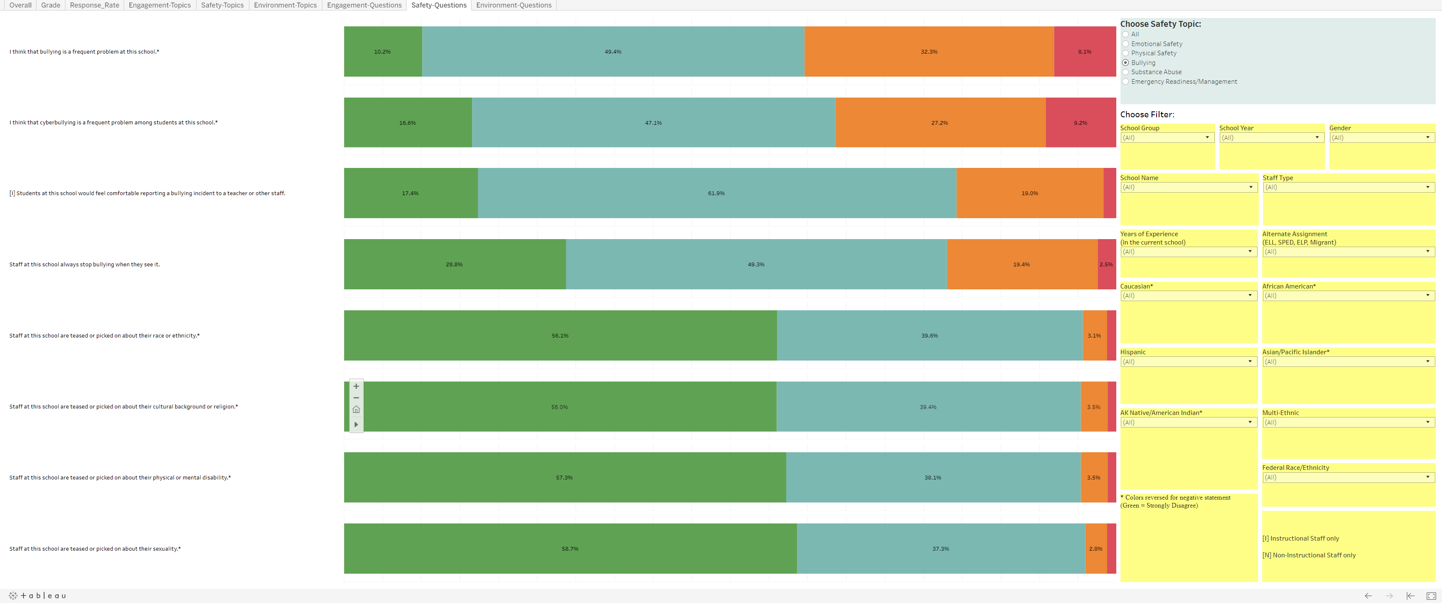
Example screen: Staff

Slide 13
Conclusion
All groups tended to agree with positive statements about their school
Greater than 3/4 of students and staff indicated a “positive” or “very positive” school climate in Engagement, Safety, and Environment
Schools given grade point average of 2.83, 3.06, and 3.12 by students, staff, and parents in 2019
Some increase in % positive/very positive for each domain between 2018 and 2019

Slide 14
Conclusion
Perception gaps by race/ethnicity, gender, economic status, disability, English language, and Military dependence were either very small or small for all groups
Some schools and groups with typically lower test performance, showed higher school climate results
Administration of EDSCLS every Spring

Slide 15
EDSCLS resources
Web address – https://safesupportivelearning.ed.gov
  School Climate Resource package which includes:
  Quick guide on making improvements
  School Climate Improvement Reference Manual
  School Climate Improvement Action Guides
  School Climate Interpretation Resources
  Online Modules

Slide 16
Questions?
Comments?
THANK YOU
Fairbanks North Star Borough School District
Ellis Ott, Ph.D.
Phone: 907-452-2000 x. 11364
E-mail: ellis.ott@k12northstar.org

