Slide 1
School Climate
August 2017
prepared by Ellis Ott, Ph.D., Research & Accountability Department

Slide 2
U.S. Dept. of EDucation
School Climate Surveys (EDSCLS)
Suite of surveys for students (grades 5-12), parents, instructional staff, and non-instructional staff
Reliable, nationally-validated
Completion time 20-30 minutes (43 to 103 items)
Survey items provide a positive statement with 4 response options – 2 positive, 2 negative (from Strongly Disagree to Strongly Agree)
Replaced three misaligned surveys: Senior Survey, Parent Opinion Poll, Secondary School Climate
Administered in Spring 2017

Slide 3
ED School Climate Surveys
Response rates of 51% and 11% for students and parents
Response rates of 41% and 28% for instructional and non-instructional staff
Initial process had issues with server overload → addressed with Survey Monkey version of EDSCLS

Slide 4
ED School Climate Surveys
3 domains with 13 subdomain topical areas
Engagement
Safety
Environment

Slide 5
ENGAGEMent Domain
Engagement includes several components of “school connectedness,” such as the amount of effort students expend in the work of learning, their sense of belonging, and their emotional involvement with the school

Slide 6
ENGAGEMent TOPICS
3 subdomain topical areas
Cultural and linguistic competence
Relationships
School participation

Slide 7
Safety Domain
Emotional and physical safety are fundamental characteristics of high-quality schools; in these schools, students feel a sense of belonging and are free to focus on learning

Slide 8
SAFETY topics
5 subdomain topical areas
Emotional safety
Physical safety
Bullying/cyberbullying
Substance abuse
Emergency readiness/management

Slide 9
environment Domain
Positive school environments are characterized by appropriate and well-maintained facilities; well managed classrooms with high levels of engagement, rigor, productivity, and inclusion; a range of available school-based health supports; clear, fair disciplinary policies; and explicit policies and procedures governing various school practices

Slide 10
environment Topics
5 subdomain topical areas
Physical environment
Instructional environment
Physical health
Mental Health
Discipline

Slide 11
SCALE SCORES?
Scale scores provided for domains and topics
Scores range from 100 to 500
Scores at 300 or higher considered “positive”
Under 300 → “negative”
100 to 199 → tend to “Strongly Disagree”
200 to 299 → tend to “Disagree”
300 to 399 → tend to “Agree”
400 to 500 → tend to “Strongly Agree”

Slide 12
School climate results
Publically Available Dashboard to review School Climate results for each survey group:
https://public.tableau.com/profile/k12northstar#!/
Filtering available for School, School Group, Grade Level, Race/Ethnicity, Gender, and Military Dependent
Some information suppressed to protect confidentiality (example: if group is less than 5 individuals)

Slide 13
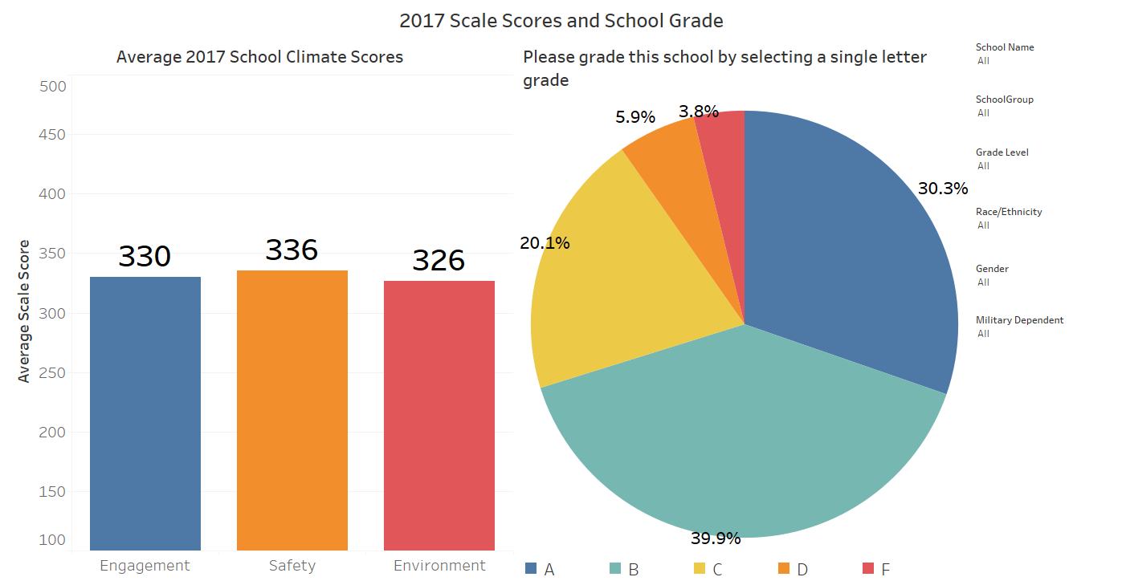
Example screen: Students
Publically Available Dashboard to review School Climate results for each survey group:
https://public.tableau.com/profile/k12northstar#!/

Slide 14
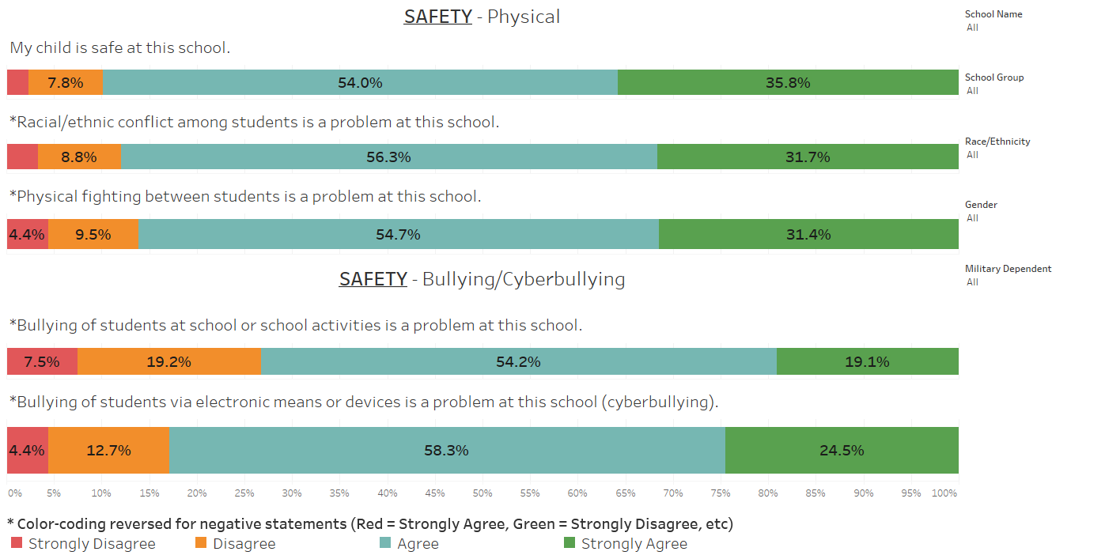
Example screen: PARENTS

Slide 15
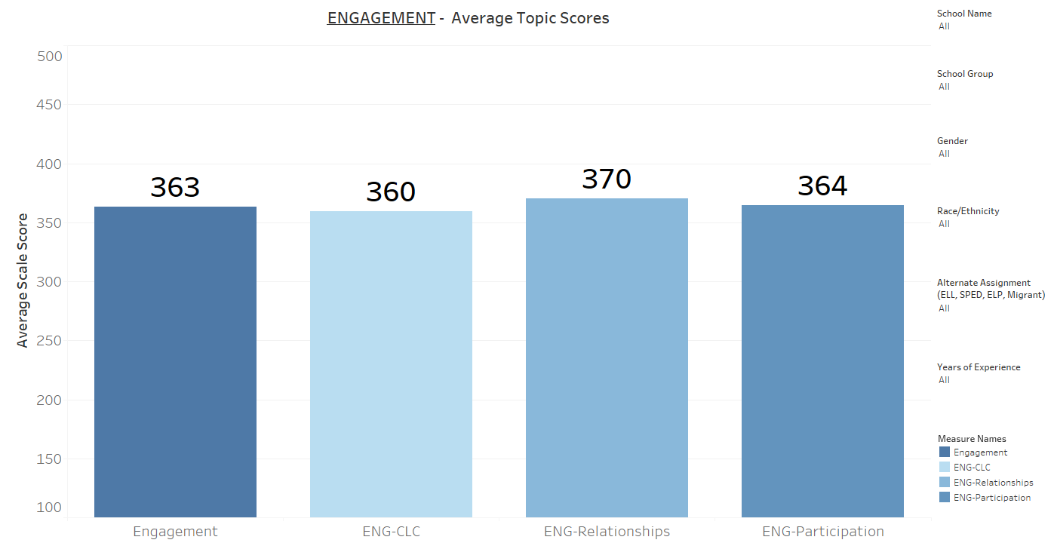
Example screen: instructional staff

Slide 16
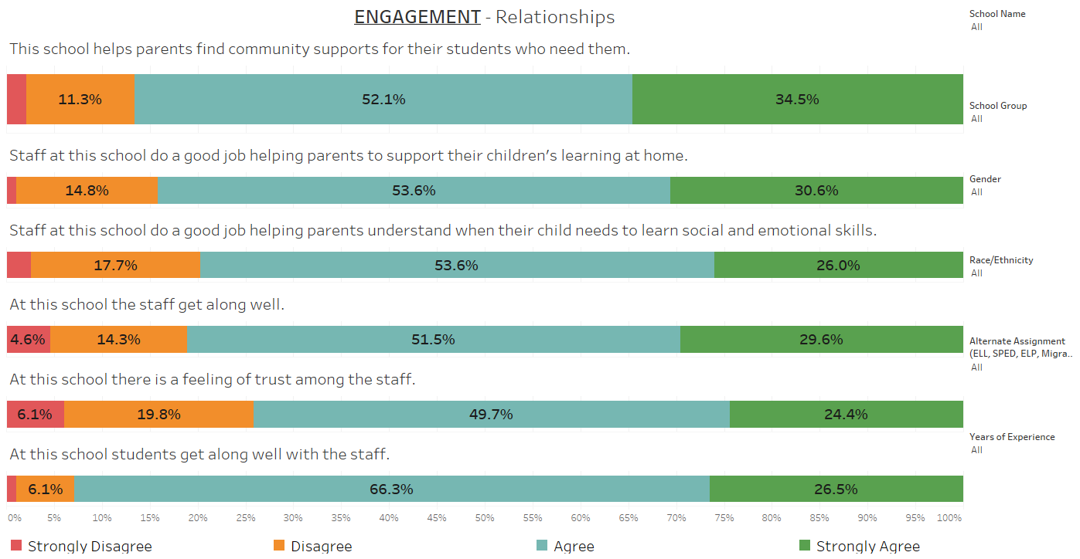
Example screen: Non-instructional staff

Slide 17
conclusion
All groups tended to agree with positive statements about their school
Greater than 2/3 of students and staff indicated a “positive” school climate in Engagement, Safety, and Environment (scale score of 300 or higher)
Schools given grade point average of 3.19 and 2.87 by parents and students
District performance above national average on scale scores for all domains and survey groups

Slide 18
conclusion
Perception gaps by race/ethnicity, gender, economic status, disability, English language, and Military dependence were either very small or small for all groups
Some schools and groups with typically lower test performance, showed higher school climate results
Administration of EDSCLS highly recommended every year in the Spring

Slide 19
EDSCLS resources
Web address – https://safesupportivelearning.ed.gov
  School Climate Resource package which includes:
  Quick guide on making improvements
  School Climate Improvement Reference Manual
  School Climate Improvement Action Guides
  School Climate Interpretation Resources
  Online Modules

Slide 20
Questions?
Comments?
THANK YOU
Fairbanks North Star Borough School District
Ellis Ott, Ph.D.
Phone: 907-452-2000 x. 11364
E-mail: ellis.ott@k12northstar.org

