Slide 1
ED School climate surveys
Presented by Ellis M. Ott, Ph.D.
Fairbanks North Star Borough School District
Fairbanks, Alaska
2017 NCES STATS-DC Data Conference

Slide 2
Our school district
About 14,000 students, 35 schools
Drop-out rate 4.1%, Graduation rate ~74%
Free/reduced price lunch 37%
Special education services 17%
English language learner 3%
Compiled from local school district data

Slide 3
Our school district
Caucasian Only | 59%
African American Only | 5%
Hispanic | 9%
Asian/Pacific Islander Only | 4%
AK Native/American Indian Only | 9%
Two or more Races Non-Hispanic | 16%
Enrollment and Ethnicity Report Oct 1, 2016 – available at https://www.k12northstar.org/Page/6267

Slide 4
introduction
offered participation in EDSCLS for spring 2017
review of items and previous surveys
decision to administer edscls to entire district

Slide 5
Why edscls?
  1. Edscls could replace 3 surveys
      Senior survey
      Parent opinion poll (every other year)
      School climate (secondary students & staff)
      All administered at different times of the year

Slide 6
Why edscls?
  2. Edscls - Suite of surveys with more overlap
      Common theme with 3 domains: engagement, safety, environment
      Domain and topic interpretation as opposed to only item level –
          get “bigger picture”
      Could be administered at same time

Slide 7
Why edscls?
  3. National caliber
      Nationally-validated
      Reliable
      Possibility of national comparison data

Slide 8
Why edscls?
  More comprehensive set of items
  Item wording allowed “passive” parental approval
  No financial cost to district
  Lots of resources for guidance on interpretation and response to results for improving school climate

Slide 9
ED School Climate Surveys
Surveys administered in feb/mar 2017
Early issues with server → switched to survey monkey
Response rates of 51% & 11% for students and parents
Response rates of 41% & 28% for instructional staff and non-instructional staff
Results to be presented to school board in mid august – will recommend administration every year
Dashboard of results created with tableau

Slide 10
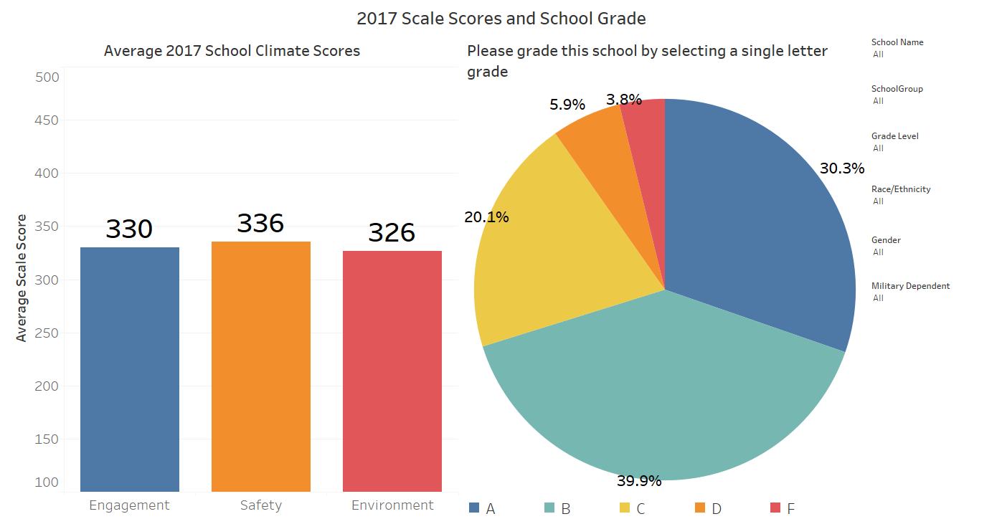
Example: dashboard screen

Slide 11
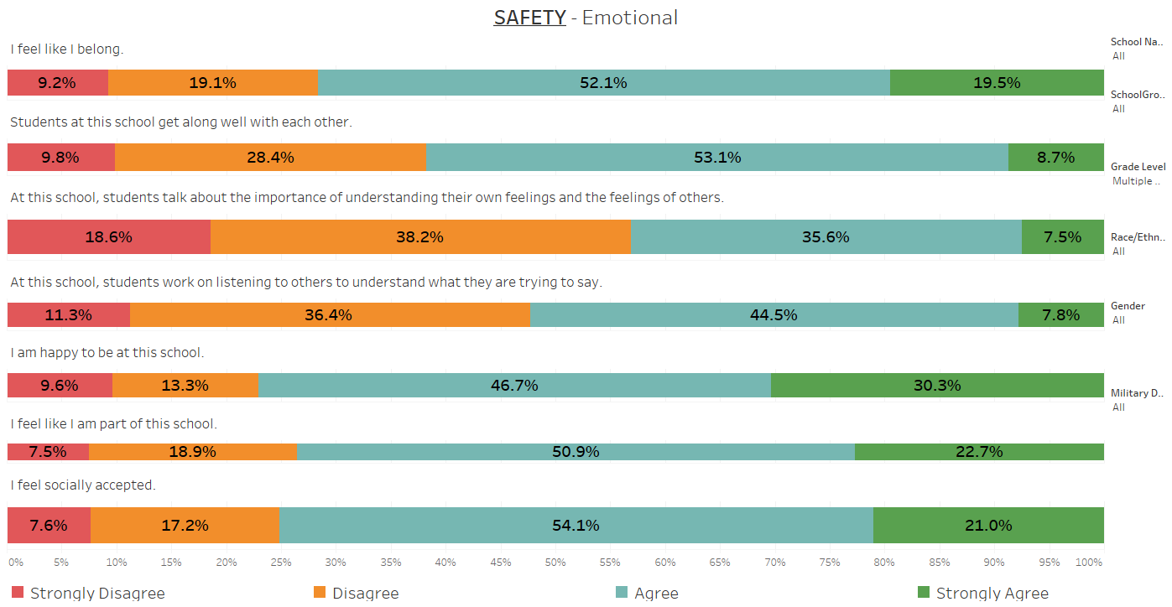
Example: dashboard screen

Slide 12
Questions?
Comments?
THANK YOU
Fairbanks North Star Borough School District
Ellis Ott, Ph.D.
Phone: 907-452-2000 x. 11364
E-mail: ellis.ott@k12northstar.org

