Slide 1
The USE of two or more races in reporting
Presented by Ellis M. Ott, Ph.D.
Fairbanks North Star Borough School District
Fairbanks, Alaska
2016 NCES STATS-DC Data Conference — July 13

Slide 2
Our school district
About 14,000 students, 35 schools
Drop-out rate 4-6%, Graduation rate 70%
Free/reduced price lunch 36%
Special education services 16%
English Language Learner 3%

Slide 3
Collection of race and ethnicity

Slide 4
TIMELINE
Office of Management and Budget revises Policy Directive No. 15 on race and ethnic standards in 1997
US Dept. of Education releases guidance in 2007
SEA/LEA Implementation required in 2010-2011
Per Federal Register Notice October 30, 1997
https://www.whitehouse.gov/omb/fedreg_1997standards

Slide 5
Policy directive no.15:
Race and ethnic standards
SIX Minimum Categories for Data on Race and Ethnicity:
American Indian or Alaska Native
Asian
Black or African American
Hispanic or Latino
Native Hawaiian or Other Pacific Islander
Caucasian
Per Federal Register Notice October 30, 1997
https://www.whitehouse.gov/omb/fedreg_1997standards

Slide 6
Reporting of race and ethnicity

Slide 7
Reporting Process
Single field reported :
1) One race identified → one race is reported
2) More than one race → “Two or More Races”
If student selects “Hispanic or Latino” → Hispanic (regardless of race(s) identified)
Thus, each race category is treated as mutually exclusive

Slide 8
Examples: Collection and Report
Caucasian
☑ African American
Hispanic or Latino Student reported as Two or More Races
☑ Asian Not Asian nor African American
American Indian
Alaska Native
Hawaiian/Pacific Islander
Caucasian
African American
☑ Hispanic or Latino Student reported as Hispanic or Latino
☑ Asian Not Asian nor Alaska Native
American Indian Nor Two or More Races
☑ Alaska Native
Hawaiian/Pacific Islander

Slide 10
Retrieved from State Report Cards https://education.alaska.gov/ReportCard/

Slide 11
Retrieved from Common Core of Data - https://nces.ed.gov/ccd/ccddata.asp

Slide 13
Census Data analysis
2.9 million, or 0.9% of U.S. population were American Indian and Alaska Native alone according to 2010 Census
5.2 million, or 1.7% of U.S. population were American Indian and Alaska Native alone or in combination with one or more other races
According to Census, two-or-more races group projected to increase in the future
The American Indian and Alaska Native Population: 2010 (2010 Census Briefs)

Slide 14
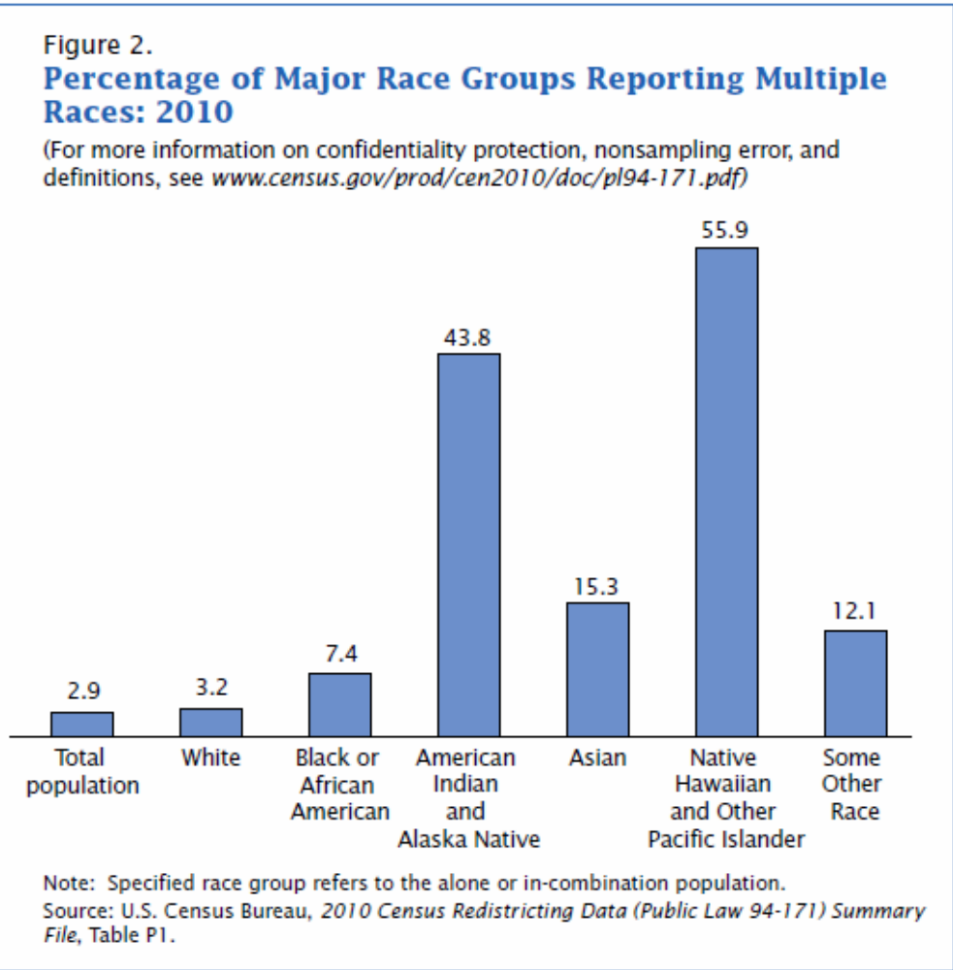

Slide 15
Fairbanks Graduation Rate 2007 to 2015
Alaska Native/American Indian
(include multi-racial or not)

Slide 16
Enrollment/Ethnicity Oct 1, 2015
 | Federal Reporting
 | Number | Percent
District Total | 13,765 | 100%
Caucasian | 8,227 | 59.8%
African-American | 653 | 4.7%
Hispanic | 1,161 | 8.4%
Asian/Pacific Islander | 478 | 3.5%
AK Native/American Indian | 1,250 | 9.1%
Two or More Races | 1,996 | 14.5%
INCLUDE Multi-Racial/Ethnic
Number | Percent
13,765 | 100%
10,515 | 76.4%
1,396 | 10.1%
1,161 | 8.4%
1,074 | 7.8%
2,497 | 18.1%
2,621 | 19.0%

Slide 17
Enrollment/Ethnicity Oct 1, 2015
# of Races/Ethnicities | Number | Percent
Two | 2,248 | 85.8%
Three | 331 | 14.6%
Four | 39 | 1.7%
Five | 3 | 0.1%
Two or More | 2,621 | 100%
Breakdown of # of races/ethnicities

Slide 18
Students with Exactly 2 Races/Ethnicities
 | Caucasian | African-American | Hispanic | Asian | AK Native | Am.Indian | Hawaiian/Pac.Isl. | Total
Caucasian | - | 386 | 376 | 265 | 661 | 173 | 80 | 1941
African-American | 386 | - | 52 | 26 | 57 | 19 | 11 | 551
Hispanic | 376 | 52 | - | 13 | 26 | 7 | 10 | 484
Asian | 265 | 26 | 13 | - | 4 | 5 | 21 | 334
AK Native | 661 | 57 | 26 | 4 | - | 48 | 8 | 804
American Indian | 173 | 19 | 7 | 5 | 48 | - | 0 | 252
Hawaiian/Pac.Isl. | 80 | 11 | 10 | 21 | 8 | 0 | - | 130
Total | 1941 | 551 | 484 | 334 | 804 | 252 | 130 | 2248

Slide 19
Students with Exactly 2 Races/Ethnicities (percentages)
 | Caucasian | African-American | Hispanic | Asian | AK Native | Am.Indian | Hawaiian/Pac.Isl. | Total
Caucasian | - | 70.0% | 77.7% | 79.3% | 82.2% | 68.7% | 61.5% | 86.3%
African-American | 19.9% | - | 10.7% | 7.8% | 7.1% | 7.5% | 8.5% | 24.5%
Hispanic | 19.4% | 9.4% | - | 3.9% | 3.2% | 2.8% | 7.7% | 21.5%
Asian | 13.7% | 4.7% | 2.7% | - | 0.5% | 5.0% | 16.2% | 14.9%
AK Native | 34.1% | 10.3% | 5.4% | 1.2% | - | 2.0% | 6.2% | 35.8%
American Indian | 8.9% | 3.4% | 1.4% | 1.5% | 6.0% | - | 0% | 11.2%
Hawaiian/Pac.Isl. | 4.1% | 2.0% | 2.1% | 6.3% | 1.0% | 0% | - | 5.8%
Total | 100% | 100% | 100% | 100% | 100% | 100% | 100% | 100%

Slide 20
Projections using K-6 Figures
Two-or-More Race % may increase for additional 3-4 years
K-6 data may approximate K-12 percentages in next few years
 | Percent Multi-Racial or Hispanic
 | 2015-2016 (K-12) | 2015-2016 (K-6)
District-wide | 22.9% | 24.8%
Caucasian | 21.8% | 23.9%
African-American | 53.3% | 56.8%
Asian/Pacific Islander | 55.5% | 58.2%
AK Native/American Indian | 50.0% | 54.9%

Slide 21
ESSA LAW
New ESSA law intended to give States more flexibility
Will States be given flexibility to no longer treat races as mutually exclusive in reporting?
In time, more and more students will be “two or more races” → this issue will be compounded

Slide 22
Exclusion of Multi-Racial/Ethnic Students
(in Federal reporting)
1. Hides important information
2. Changes outcomes
3. Can be Misleading for Stakeholders

Slide 23
Inclusion of Multi-Racial/Ethnic Students
1. Accurately represents all of student’s race(s)/ethnicity(ies)
2. Respects diversity of student background
3. Aligns program activity with reporting

Slide 24
What next?
Contact legislators to emphasize importance of state flexibility in ESSA law
Does Office of Management and Budget have plans to Revise Policy Directive No.15, which is now almost 20 years old?
    If there are committees, how does a person join?
    Will there be an opportunity for public comment on this issue
What can be done to participate in change?

Slide 25
Questions?
Comments?
THANK YOU
Fairbanks North Star Borough School District
Ellis Ott, Ph.D.
Phone: 907-452-2000 x. 11364
E-mail: ellis.ott@k12northstar.org

