Slide 1
Transparency in an Early Warning System
Presented by Ellis M. Ott, Ph.D.
Fairbanks North Star Borough School District
Fairbanks, Alaska
2016 NCES STATS-DC Data Conference — July 13

Slide 2
Our school district
About 14,000 students, 35 schools
Drop-out rate 4-6%, Graduation rate 70%
Free/reduced price lunch 36%
Special education services 16%
Limited English proficient 3%

Slide 3
Our school district
Caucasian | 60%
African American | 5%
Hispanic | 8%
Asian/Pacific Islander | 4%
AK Native/American Indian | 11%
Two or more Races | 12%

Slide 4
ATTENDANCE MATTERS
Alternative programs excluded from the analysis due to fundamentally different attendance information; Some data compiled over 8 years (05-06 to 13-14)

Slide 5
ATTENDANCE AND GPA MATTERS
Alternative programs excluded from the analysis due to fundamentally different attendance information; Some data compiled over 8 years (05-06 to 13-14)

Slide 6
Initial RISK using attendance and GPA
 | GPA | <1.0 F | 1.0-1.99 D | 2.0-2.99 C | 3.0-3.99 B | 4.0+ A
ATTENDANCE RATE | Less than 70%*
 | 70% - 80%*
 | 80% - 90%*
 | More than 90%*
* For elementary students, the cut-offs are 85%, 90%, and 92%

Slide 7
Early Warning System
Information on Attendance and Grades combined with:
Retention
Former dropout
Credits vs Grade Level
State/District Assessments
Out-of-school suspensions
To determine High, Medium, and Low Risk for Dropout

Slide 8
FACTS for High Risk Students:
Almost 2/3 of dropouts are High Risk students,
despite being only 11% of All students
27 times more likely to dropout than Low Risk student
Only about 12% graduate if High Risk continues

Slide 9
FACTS for High Risk Students:
Less than 8% meet standards in Math
Average GPA is 1 letter grade lower than their peers
High Risk in Elementary → High Risk in Secondary
(over 50%)
Dropout rate can be cut in HALF with interventions

Slide 10
Dropout rates by Risk
 |  |  | Risk level |  |  | Total
 |  |  | LOW | MED | HIGH
Dropout | NO | % of Non-Drops | 71% | 19% | 10% | 100%
 |  | Count | 21245 | 5703 | 2992 | 29940
 | YES | Count | 181 | 271 | 804 | 1256
 |  | % of DROPS | 14% | 22% | 64% | 100%
 |  | DROPOUT RATE | 0.8% | 4.5% | 21.2% | 4%
Total |  | Count | 21426 | 5974 | 3796 | 31196
 |  | % of TOTAL | 69% | 19% | 11% | 100%
Aggregated across 5 years (10-11 to 14-15)

Slide 11
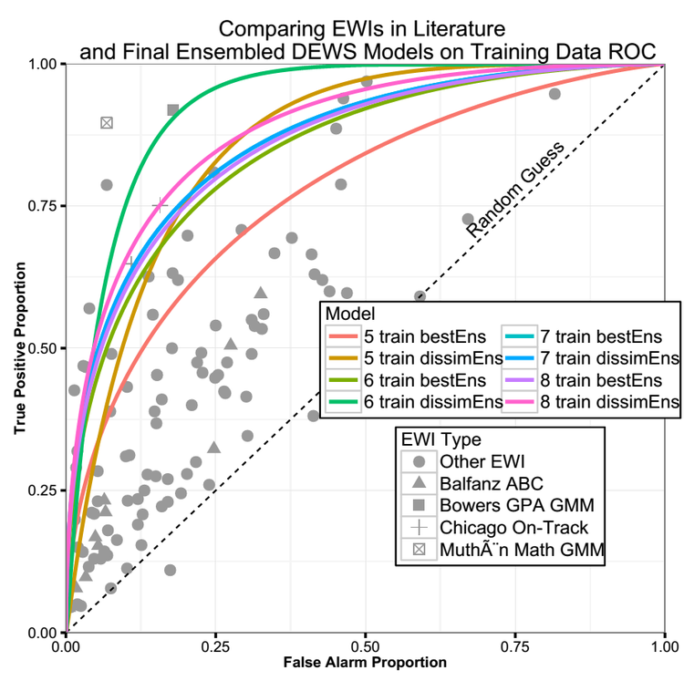
High + Med Risk
High Risk Only
(Jared Knowles, 2015 – Of Needles and Haystacks…)

Slide 12
Graduation rates by Risk
Notes:
Found similar results with false alarm and true positive rates with predicting non-graduation (a single year of high risk is considered high risk, all years must be low risk to be considered low risk, all others are medium risk)

Slide 13
Dropout Rate by Groups and Risk:
Student with Disability Dropout Rate = 7.4%
Students without Disability Dropout Rate = 3.7%
High Risk Dropout Rate:
SWD = 21.3% non-SWD = 21.1%
Economic Disadvantage = 22% Non-ED = 20%
Limited English Proficient = 16% Non-LEP = 21.5%
Caucasian = 20.9%
African-American = 17.8%
Hispanic = 19.6%
Asian/PI = 20%
AK Native/American Indian = 23%

Slide 14
Dropout Rates by Service
Interventions with High Risk students lead to:
Comparison group (No intervention) = 21.1%
Treatment group (Intervention) = 10.8%
“24+ contacts” group = 7%
Early Warning System is a GAME CHANGER
Used Propensity Score Matching for analysis

Slide 15
Grades 7-12 Dropout Rates 05 to 15

Slide 16
School Input on Early Warning Systems
28 administrators, counselors, support staff, and teachers
21 schools
Asked 6 questions: School, Role, Staff involved, interventions used, challenges, suggestions, final thoughts

Slide 17
School Input Summary
Primary staff involved are counselors & prevention/intervention specialists
Interventions provided include counseling, parental contact, 1-1 contact with staff, and referral to various district programs
Challenges sited were parental involvement, attendance, and time & Resources
School-based referral process suggested to improve model
Other additional comments were requesting for more support and professional development

Slide 18
outreach
Presentations to various stakeholders to build support:
  Local school board
  Parental advisory committees
  All principals meeting
(future presentation to all federal programs staff upcoming)

Slide 19
What next?
Preventing dropout is a “return on investment” – one less dropout means the school district receives one additional base student allocation funding
Analysis showed that a program using new counselors to serve High risk students could “pay itself back”
School board expressed interest in renewing the graduation success program
Biggest hurdle to overcome? budget

Slide 20
Questions?
Comments?
THANK YOU
Fairbanks North Star Borough School District
Ellis Ott, Ph.D.
Phone: 907-452-2000 x. 11364
E-mail: ellis.ott@k12northstar.org

