Slide 1
Student Assessment Results
2014-2015

Slide 2
Alaska Measures of Progress (AMP)
Spring 2015
Dashboard prepared by Ellis Ott, Ph.D., Research & Accountability Department

Slide 3
What is AMP?
New assessment in 2015 for students in grades 3-10
Aligned to the new, more challenging Alaska ELA and Math standards
Computer-based, with technology enhanced items
Performance levels are not comparable to the proficiency levels of the Standards Based Assessments (SBAs)

Slide 4
Level 4
Student demonstrates knowledge & skills of complex grade level content
Meets
Standards
Level 3
Student demonstrates knowledge & skills of current grade level content
Level 2
Student may have gaps in knowledge & skills but is capable of most grade-level content
Partially Meets Standards
Student may have significant gaps in knowledge and skills. Parents/guardians and teachers are encouraged to examine other academic information and discuss possible reasons that a student’s score is in Level 1.
Level 1
Notes:
The AMP scores are divided into four levels, with four being the highest level. Students with scores in levels 3 and 4 meet the standards; students with scores in levels 1 and 2 partially meet the standards.
There are significant differences between a student that has just barely made it into level 2 and a student who is almost level 3. Teachers and parents are encouraged to look at other classroom evidence of student understanding along with the overall AMP score to determine which skills the student needs re-teaching or extra support in.

Slide 5
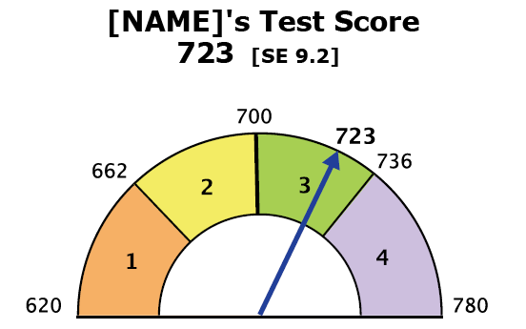

Student Report
AMP Meter
Level 3 & 4 : Meets Standards
Level 1 & 2: Partially Meets Standards
Notes:
The most prominent feature on the AMP student report is the AMP meter. The arrow on large meter shows the student’s overall score and achievement level. The lowest obtainable score on amp for all grades is 620 and the highest score is 780. 700 is the lowest score for range 3 in all grades. The cut scores between levels 1 and 2 and 3 and 4 vary by grade and content area.

Slide 6
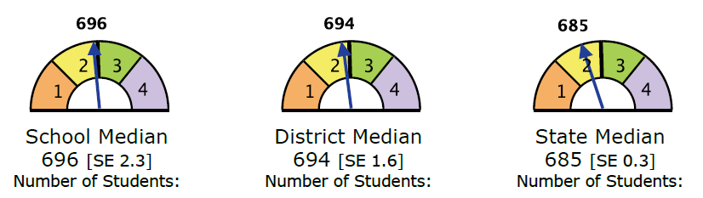
Student Report
AMP Meters: School, District, State
Allows comparison of student’s achievement level to median achievement level of students in the same grade in the school, district, and state.
Notes:
The three smaller meters show the median score in that content area and grade level for the school, district and state. The median is used instead of the mean (or average) in order to avoid one very high or low score skewing the comparison.
These meters allow students, their families, and teachers to check a student’s overall achievement against students of the same grade in their school, their district and their state.

Slide 7
2014-2015
Fairbanks North Star Borough School District
2014-2015
AMP = Alaska Measures of Progress; Big 4 is an unweighted average of Anchorage, Juneau, Kenai and Mat-Su
Dashboard prepared by Ellis Ott, Ph.D., Research & Accountability
Notes:
Results competitive with “big 4” – note was made that we have had a history of higher performance than Big4 – sometimes results are higher, and sometimes results are lower than the big 4 – that’s why I use the term “competitive”

Slide 8
2014-2015
Fairbanks North Star Borough School District
AMP Summary 2015
2014-2015
AMP = Alaska Measures of Progress; Big 4 is an unweighted average of Anchorage, Juneau, Kenai and Mat-Su
Dashboard prepared by Ellis Ott, Ph.D., Research & Accountability

Slide 9
2014-2015
Fairbanks North Star Borough School District
AMP Summary 2015
2014-2015
AMP = Alaska Measures of Progress
Dashboard prepared by Ellis Ott, Ph.D., Research & Accountability
Notes:
Between 80% group and 95% group – size of gaps are small for 3-6 ELA, medium for 7-10 ELA and 3-6 Math, and large for 7-10 Math

Slide 10
2014-2015
Fairbanks North Star Borough School District
AMP Summary 2015
2014-2015
AMP = Alaska Measures of Progress
Dashboard prepared by Ellis Ott, Ph.D., Research & Accountability

Slide 11
2014-2015
Fairbanks North Star Borough School District
AMP Summary 2015
2014-2015
AMP = Alaska Measures of Progress
Dashboard prepared by Ellis Ott, Ph.D., Research & Accountability
Notes:
Fairly Small Gaps with Hispanic, Asian/PI, Two or More Races → Small Gaps with Females, African American and Elementary Alaska Native/American Indian → Medium gaps for Economic Disadvantage, Caucasian, and Secondary Alaska Native/American Indian → Large gaps for LEP and SWD

Slide 12
2014-2015
Fairbanks North Star Borough School District
AMP Summary 2015
2014-2015
AMP = Alaska Measures of Progress
Dashboard prepared by Ellis Ott, Ph.D., Research & Accountability
Notes:
Multi-racial/ethnic students included in results for every race/ethnicity identified – “only” results provided in Appendix of report

Slide 13
2014-2015
Fairbanks North Star Borough School District
AMP Summary 2015
2014-2015
AMP = Alaska Measures of Progress
Dashboard prepared by Ellis Ott, Ph.D., Research & Accountability

Slide 14
2014-2015
Fairbanks North Star Borough School District
AMP Summary 2015
2014-2015
AMP = Alaska Measures of Progress
Dashboard prepared by Ellis Ott, Ph.D., Research & Accountability

Slide 15
TerraNova
February 2015
Dashboard prepared by Ellis Ott, Ph.D., Research & Accountability Department

Slide 16
2014-2015
Fairbanks North Star Borough School District
2014-2015
Dashboard prepared by Ellis Ott, Ph.D., Research & Accountability

Slide 17
2014-2015
Fairbanks North Star Borough School District
2014-2015
Dashboard prepared by Ellis Ott, Ph.D., Research & Accountability

Slide 18
Fairbanks North Star Borough School District
Alaska School Performance Index (ASPI)
Growth scores in AMP unavailable due to 1st year
ASPI “frozen” in 2014-15
All schools received same rating as in 2013-14
In 13-14 District schools averaged 85.43 points, which would be a 4 rating
About 98% of district students were enrolled in 3-5 star rated schools
NOTE: ASPI score for schools includes measures of achievement, growth, and attendance rates (9-12 schools also include graduation rates, participation in WorkKeys, and performance on SAT, ACT, and WorkKeys)

