Slide 1
It's Time to Spend Your
American Rescue Plan –
Homeless Children and Youth Funds
September 28, 2023
Integrated Student Support and Programs Office
California Department of Education

Slide 2
Acronyms – Just a Reminder
American Rescue Plan – Homeless Children and Youth (ARP-HCY)
California Department of Education (CDE)
County Office of Education (COE)
Education for Homeless Children and Youth (EHCY)
Elementary and Secondary School Emergency Relief Fund (ESSER)
Homeless Education Technical Assistance Centers (HETACs)
Local Educational Agency (LEA)
U.S. Department of Education (ED)

Slide 3
A Quick Overview
The CDE allocation of the ARP-HCY was $98 million and was dispersed in two separate ways – ARP-HCY I and ARP-HCY II
ARP-HCY funds may be used for pre-award costs dating back to March 13, 2020, when the national emergency was declared
All ARP-HCY funds are to be expended and/or obligated by September 30, 2024

Slide 4
ARP-HCY I Funds
One-hundred and twenty LEAs that received an EHCY grant received ARP-HCY I funds
  Funding results of ARP-HCY I funds are available at https://www.cde.ca.gov/fg/fo/r8/aprhcy21results.asp
  LEAs that receive ARP-HCY I funds have separate reporting and expenditure timelines. Please refer to the grant award notification (GAN) for specific information

Slide 5
ARP-HCY I Summer 2023 Report
Funds | Total Allocation | Spent | Unspent | Percentage Spent
ARP-HCY I | $18,507,981 | $9,440,922 | $9,067,059 | 51%
Number of LEAs Receiving ARP-HCY I | Number of LEAs Fully Expended ARP-HCY I | Percentage of LEAs Fully Expended ARP-HCY I
120 | 33 | 28%

Slide 6
ARP-HCY II Funds
LEAs were eligible to receive ARP-HCY II funds based on the formula outlined in statute
ARP-HCY II Funding Profile can be accessed at https://www.cde.ca.gov/fg/fo/profile.asp?id=5745&recID=5745
The final funding results for ARP-HCY II are available at https://www.cde.ca.gov/fg/fo/r14/arphcyii21result.asp

Slide 7
ARP-HCY II Summer 2023 Report
Funds | Total Allocation | Spent | Unspent | Percentage Spent
ARP-HCY II | $55,560,291 | $12,890,140 | $42,670,151 | 23%
Number of LEAs Receiving ARP-HCY II | Number of LEAs Fully Expended ARP-HCY II | Percentage of LEAs Fully Expended ARP-HCY II
672 | 91 | 14%

Slide 8
My Ask…
Spend!!!
Spend!!!
And spend some more!

Slide 9
The Reason…
In the 2021–22 academic year, we enrolled 224,191 (cumulative) homeless students and that same year, California received $12,924,738 in federal EHCY funds, which equals $57.65 per student
In addition, in the 2022–23 academic year, homeless enrollment increased by over 15,000 students while overall statewide enrollment decreased by nearly 40,000
We need to spend these funds and we need to support and serve these students

Slide 10
ARP-HCY Reminders
ARP-HCY funds may be used to cover any expenses necessary to facilitate the identification, enrollment, retention, and educational success of homeless children and youth
Coordinate and collaborate with your homeless liaison to spend these funds and meet the needs of these students and the program
  A list of LEA homeless liaisons can be found at https://www.cde.ca.gov/sp/hs/documents/ehcylealiaisons.xlsx
ARP-HCY funds should supplement other funding sources
Homeless students have the right to all services and support that non-homeless students receive

Slide 11
Updated Dear Colleague Letter (1)
On Tuesday, September 12, 2023, the U.S. Department of Education released an updated Dear Colleague Letter (DCL) to help strengthen the use of ARP-HCY funds in support of children and youth experiencing homelessness as we approach the final year of ARP-HCY implementation.
You can access the DCL letter at https://urldefense.com/v3/__https:/oese.ed.gov/files/2023/09/ARP-HCY-DCL-9.12.2023.pdf__;!!KlnUNGHvdQ!_DBhcnOd-eH2OBsJvv9v0NOiWByAsA27FmU6R67ZIl7Y_pEiHnypp6VDKy-2vZ9SFxChct0efUIkhCiGOG_fMl-c$.

Slide 12
Updated Dear Colleague Letter (2)
The letter:
  Encourages LEAs to consider modifying administrative processes – including those related to budget and procurement – to expedite the deployment of ARP-HCY funds.
  Provides additional clarification about allowable and strategic uses of ARP-HCY funds, including related to short-term housing, transportation, wraparound services, and more.
  And to consider offering additional professional development opportunities to school staff, other agency staff, and community organizations that provide services to students and families experiencing homelessness.

Slide 13
Updated Dear Colleague Letter (3)
The letter also addresses these specific areas and provides strategies that may be especially important for accelerating opportunities and outcomes for students experiencing homelessness during the new school year. Consider using ARP-HCY funds to:
  Improve attendance and reduce chronic absenteeism for students experiencing homelessness;
  Address their specific physical and mental health needs; and,
  Strengthen early childhood education, support college and career readiness, and smooth transitions to higher education.

Slide 14
Thoughts?
Finally, the letter reminds us of the critical need to invest these resources now to support especially vulnerable students and young people and urge them to examine whether adjustments to local policies and procedures might allow ARP-HCY funds to have further impact.

Slide 15
Letter from Secretary Cardona
September 6, 2023, Letter from Secretary Cardona regarding serving immigrant students can be accessed at https://oese.ed.gov/files/2023/09/2023.09.06-Immigrant-DCL.pdf.
Those students that are immigrant, refugee, and asylee who meet the homeless definition may be served using ARP-HCY funds.
These funds may be used to provide professional development, assist with teacher recruitment, translation and interpretation services, develop culturally and linguistically relevant instructional materials for recently arrived students, and develop materials to assess children in their native language, including assessments used in special education evaluations.

Slide 16

Strategies from the Field
El Dorado County Office of Education
Margaret Lewis
Coordinator, McKinney-Vento Services
mlewis@edcoe.org
Karen Thomas
Program Manager, El Dorado County Health and Human Services
karen.thomas@edcgov.us
Demographics – 15 school districts; 67 schools (including Charter programs); 31,268 countywide total enrollment; 932 countywide homeless enrollment; Received $39,604 in ARP-HCY I; and, Received $108,763 in ARP-HCY II countywide

Slide 17
ARP Services and Collaboration
Big Brothers, Big Sisters (BBBS) – Mentorship
Fostering Connections – School Social Workers support with contracted hours
First Night Bag Initiative – Outreach and basic necessities
Tutoring – Certificated staff
Professional Development Opportunities – Communicating Across Barriers with Dr. Donna Beegle at https://www.combarriers.com/
“Poverty is resolvable, however, making a difference for people who live in the crisis of poverty requires a paradigm shift. A shift that moves us beyond stereotypes and judgement to a deeper understanding of the causes of poverty and its impact on human beings.”

Slide 18
Blending of Funds (1)
Blended funds with Foster Youth Services (FYS) to contract a .25 full-time equivalent (FTE) of a case manager with the local chapter of BBBS for a two-year period
  Special attention to recruiting volunteers who could be flexible about meeting locations/geography and in the first year, we served 16 McKinney-Vento Eligible Youth and 17 Foster Youth
Again, blended funds with FYS to contract .25 FTE of a Licensed Clinical Social Worker (LCSW) to work on site with our small districts who have no school-site social workers.
  Served four districts; Varied hours per district as needs presented; Particularly valuable at one district who had a brand-new school counselor in a high needs district

Slide 19
First Night Bag Initiative (1)
Using ARP-HCY AND local grant funding, collaborated with Health and Human Services Agency (HHSA) to serve families who were receiving their Temporary Housing Assistance hotel stays.
EDCOE EHCY Program procured funds and tangible goods for various sources.
Backpacks were filled with age-appropriate hygiene products, hotel appropriate activities, a blanket, and school supplies. Adult backpacks included school information including Early Head Start, Head Start, and State preschool as well as information regarding Adult Education and Job readiness services.

Slide 20
First Night Bag Initiative (2)
Backpacks were labeled by age brackets (0-2, 3-5, elementary, junior high, and high school) so that outreach metrics could be tracked by numbers distributed with no need to share Family Educational Rights and Privacy Act (FERPA) or personally identifiable information (PII).
EDCOE delivered to HHSA on request and backpacks were distributed as a family was granted their first night hotel stay.
Improvement science learning: Next pass through will include numbered business cards requesting the family call the COE to verify receipt. Again, this will allow better metrics without sharing FERPA or PII information.

Slide 21
A Community Partner’s Perspective
How was the program for your staff?
How did families receive the information/backpack?
Do you have any examples of what this meant to the family who received the backpack?
EDCOE has seen a marked increase in the number of families being directly referred to the COE for assistance, has your staff become more aware of McKinney-Vento through this collaboration?

Slide 22

Strategies from the Field
Hacienda la Puente Unified
Maritza Cabezas, P.P.S.
  Counselor - Equity & Access, Family Engagement
  mcabezas@hlpusd.k12.ca.us
Martha Calderón, L.C.S.W.
  Director - Equity & Access, Family Engagement
  mcalderon@hlpusd.k12.ca.us
  Demographics – 38 schools; 17,329 total enrollment; 648 homeless enrollment; and, Received $166,263 in ARP-HCY II

Slide 23
Gift & Gas Cards (1)
For students needing immediate attendance support and whose families are struggling with stable housing, Equity & Access (E&A) provides immediate food and clothing assistance using $50 pre-paid cards.
District counselor conducts intake:
  Review need, policies, and guidelines
  Breach of contract will affect future participation in the program
  Gift cards are intended for the students only
  Cards will not be replaced if lost, stolen, or unable to process and are logged in for accounting purposes

Slide 24

Gift & Gas Cards (2)
Parent/Guardian must sign a Card Agreement every time they receive a gift card and submit a receipt after purchase.
All Gift Cards must be labeled with, "Cannot be used to purchase Alcohol or Tobacco Products.“
For students needing attendance support and whose families are struggling with stable housing, E&A provides transportation to and from school.
  School of Origin
  Special Circumstances

Slide 25

L.A. Laundry Truck Considerations (1)
Memoranda of Understanding/Contract
Families must sign a Liability Waiver
Logistics:
  20-40 loads of laundry max
  Truck Dimensions (25’-30’: to park trailer and the generator, if need)
  Electricity – Outlet
  Water access/Graywater disposal

Slide 26
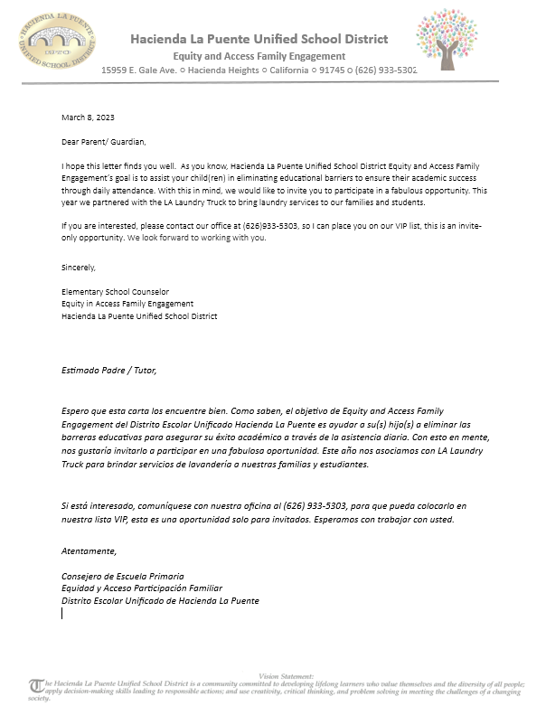
L.A. Laundry Truck Considerations (2)
Services provided to McKinney-Vento and low-income families
    Families are selected and invited to participate
      Phone banking
      Intake

Slide 27
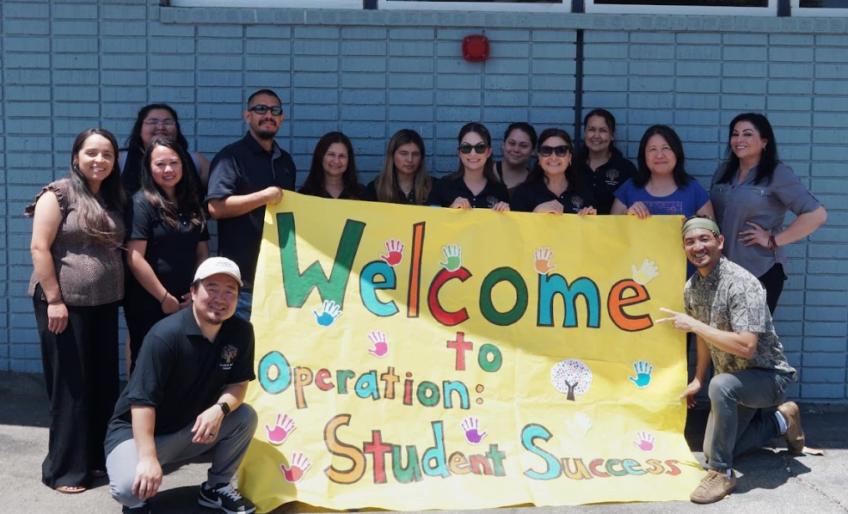

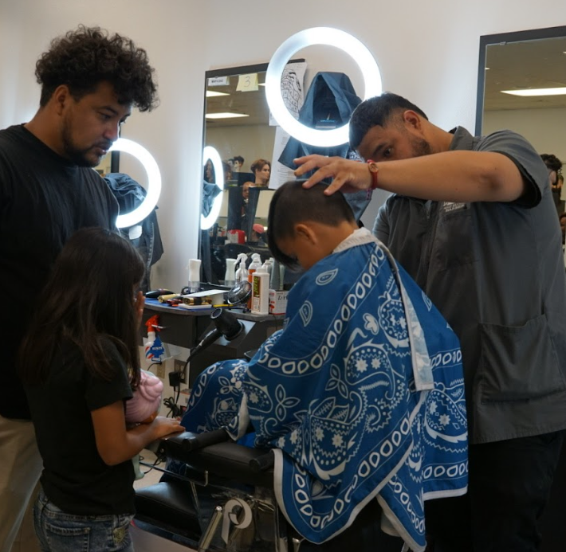

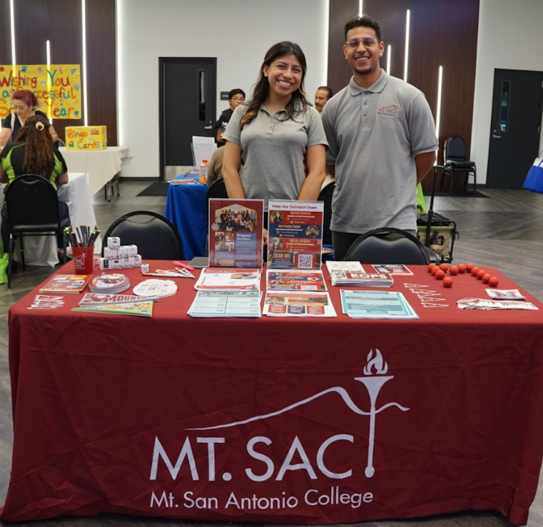
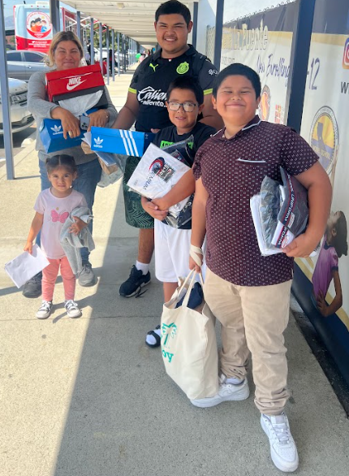
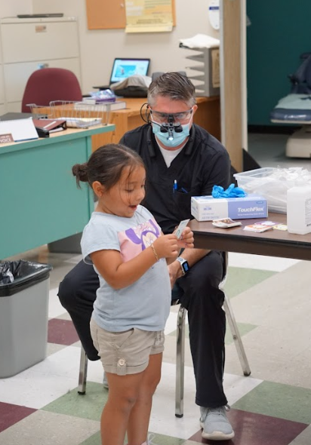







Hacienda Operation Student Success 2023

Slide 28

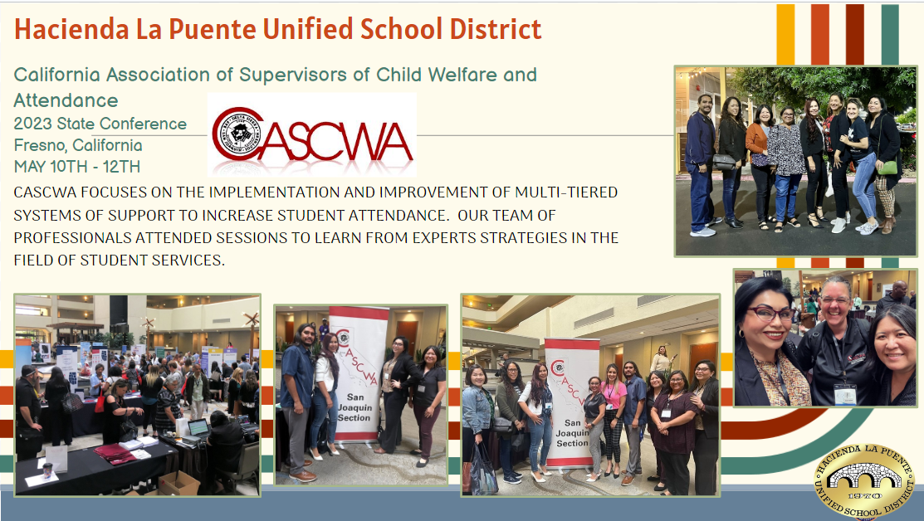
Hacienda Collaboration and Coordination

Slide 29

Strategies from the Field
Rocklin
Unified
Hannah Anderson
  Director of Innovation, School Programs, and Accountability
  handerson@rocklinusd.org
  Demographics – 21 schools; 13,282 total enrollment; 163 homeless enrollment; and, Received $28,559 in ARP-HCY II

Slide 30

Pedro A. Noguera Quote
“That’s at the core of equity: understanding who your kids are and how to meet their needs. You are still focused on outcomes, but the path to get there may not be the same for each one.”
~ Pedro A. Noguera

Slide 31
Rocklin Implementation – Services
Free transportation and breakfast/lunch
Field trip funding
Technology Loan Program including Chromebooks and Hotspots
School supplies/backpacks
Free Tutoring
Target/Walmart Gift Cards (upon request for clothing/school related needs)
Shoe and clothing referrals
Summer School (based on academic need)
Free after-school care (TK-6)

Slide 32
Rocklin Implementation – Supports
Handle with Care emails sent to school sites and teachers to bring awareness and provide resources
Priority placement in Learning Recovery classes/Everyday Math
Priority access to Counselors & Wellness Together, a school-based therapist
Consultation, guidance, and education for staff supporting youth/family
Referral to outside agencies – including social services, attendance assistance support, employment, mental health, food security, and housing
Joint home visits and direct outreach
Tier III school-based wraparound meeting/support

Slide 33

What is the Back to School Fair?
CORE Purpose: Create an opportunity for RUSD families to feel welcome in our District and ensure they have everything they need to start the year.
Check-in table RUSD information (bell schedules, contact information, etc.)
Transportation Nutrition Technology Tutoring Sign-ups
Translation (utilize RFEP students & adult translators)
School Supplies (CHOICES!) Hygiene Products Giveaways
After School Care (ELOP) Sign-ups Tutoring Sign-ups
Community Partnerships (Local organizations, County Office, Local Colleges)Data Confirmation/Back-to-School Paperwork & Printers
Future Goals - back to school haircuts, additional community partners, school picture companies

Slide 34
Use Your ARP-HCY Funds
But don’t stop there!
Use multiple funding streams to create an event like this one:
Title I
Title III
Supplemental/Concentration
Local Donations
Local Supplies Drives

Slide 35

Strategies from the Field
Ventura County Office of Education
Cathi Nye, MA
  Coordinator Special Populations - Homeless Education Program
  cnye@vcoe.org
Demographics – 28 school districts; 302 schools (including Charter programs); 132,087 countywide total enrollment; 5,839 countywide homeless enrollment; Received $403,361 in ARP-HCY I; and, Received $987,969 in ARP-HCY II countywide

Slide 36
Ventura Implementation (1)
McKinney-Vento:
  In the 2022−23 school year, we enrolled 8180 students per California Longitudinal Pupil Achievement Data System (CALPADS)
Using these funds, we have provided
  Hygiene kits
  Backpacks and school supplies

Slide 37
Ventura Implementation (2)
Using ARP-HCY funds, we provide support to all LEAs, through expenditures reimbursed
  Transportation fees, including gas cards
  Gift cards to Walmart, Vons, Target
  Emergency Motel Night
  ALC transportation fees
  Hot Spot fees
  Hiring of a Part-Time Outreach Specialist
  Lost Chromebook fees

Slide 38
Thank you, thank you, thank you!

Slide 39
Just Some Ideas (1)
Professional development
Translation of various forms
Create a hotline, media plan for outreach, website, etc.
Consider hiring staff to focus on a variety of issues, such as:
  Identification
  Attendance
  0-5 population or college/career
  Case-management, social workers, community liaisons, etc.

Slide 40
Just Some Ideas (2)
Increase liaison’s time, clerical staff, and/or data specialist
Provide more:
  Transportation services
  Enrichment activities and tutoring programs
  Preschool services
  Referral services
  Parent programs
Create a mentoring program for high school seniors

Slide 41
Just Some Ideas (3)
Collaborate with various entities in your community, such as:
  Shelter providers
  Faith-based organizations
  Local partners
  Motel/hotels
  Community-based organization
Start a food pantry and/or clothes closet which could include:
  School uniforms, physical education clothing, socks, shoes, etc.
  Hygiene kits, toiletries, basic food, etc.

Slide 42
Create a Plan
Month & Year | Activity
September 2023 | Create a spending plan, including deadlines for purchases Meet with fiscal staff to discuss plan and needs Reach out to local partners
October 2023 | Start the purchasing process Hire short-term employees or extend hours for staff
November 2023
Etc.

Slide 43

And Another Idea…Save the Date!

Slide 44
Uses of ARP-HCY Funds (1)
The CDE developed an ARP-HCY Resource Guide to guide LEAs on how to spend their ARP-HCY funds at https://www.cde.ca.gov/sp/hs/arphcyresourceguide.asp
The official Letter to Chief State School Officers Announcing Grant Award dated April 23, 2021, addresses these funds and can be found at https://oese.ed.gov/files/2021/04/ARP-Homeless-DCL-4.23.pdf
LEAs may use ARP-HCY funds to supplement existing programs and funding streams, including:
  Academic, social, emotional, and mental health needs
  Hiring staff to increase capacity

Slide 45
Uses of ARP-HCY Funds (2)
  Planning partnerships with community-based organizations (CBOs), among other strategies
  Dedicating resources
  Identify, enrollment, retention, and educational success of children and youth experiencing homelessness
Purchase needed supplies (e.g., personal protective equipment, eyeglasses, school supplies, personal care items)
Purchase cell phones or other technological devices for unaccompanied youth to enable the youth to attend and fully participate in school activities

Slide 46
Uses of ARP-HCY Funds (3)
Provide wraparound services (which could be provided in collaboration with and/or through contracts with CBOs, and could include academic supports, trauma-informed care, social-emotional support, and mental health services)
Provide transportation to enable children and youth to attend classes and participate fully in school activities
Services to attract, engage, and retain students in programs

Slide 47
Uses of ARP-HCY Funds (4)
Tutoring, supplemental services, and enriched educational services, including before school, after school, and summer programs
Expedited evaluations
Professional development
Student referral and services
Assistance to defray the cost of transportation
Early childhood education programs

Slide 48
Uses of ARP-HCY Funds (5)
Fees for tracking, obtaining, and transferring records
Parent education and training
Coordination between school and outside agencies
Activities to address issues related to domestic violence
Adaption of space and purchase of supplies for any non-school facility
Other extraordinary or emergency assistance to attend school

Slide 49
Uses of ARP-HCY Funds (6)
Provide access to reliable, high-speed internet for students through the purchase of internet-connected devices/equipment, mobile hotspots, wireless service plans, or installation of community Wi-Fi hotspots (e.g., at homeless shelters), especially in underserved communities
Provide store cards, prepaid debit cards, or gas cards to purchase materials necessary for students to participate in school activities
Pay for short-term, temporary housing (e.g., a few days in a motel to enable the homeless child or youth to attend school and participate fully in school activities (including summer school)

Slide 50
Uses of Various Cards (1)
The use of store cards, prepaid debit cards, or gas cards for a parent/guardian or youth experiencing homelessness can be used to purchase school, clothing, or hygiene supplies, as well as gas
    The ED has indicated that these are not considered to be gifts
LEAs and Title I, Part A programs can opt not to allow these methods due to elevated concerns about fraud, waste, or abuse; however, this has been seen as a promising practice nationwide

Slide 51
Uses of Various Cards (2)
LEAs should have procedures to reduce the likelihood of fraud, waste, or abuse, for example, by asking for receipts of items purchased with the store cards, prepaid debit cards, or gas cards.
The ED does not recommend that store cards, prepaid debit cards, or gas cards be the primary method for LEAs to distribute needed supplies or provide transportation to all its students experiencing homelessness.

Slide 52
Forms and Policies (1)
The Homeless Education Technical Assistance Center’s (HETAC) website have sample forms and polices as it relates to the use of store cards, prepaid debit cards, or gas cards at https://www.hetac.org/resources/cards
  These samples were collected by the CDE who asked the HETACs to post them
Forms included contract-like information such as
  The identification and signatures of the two stakeholders

Slide 53
Forms and Policies (2)
  The cards identifiers, amounts, and locations for tracking purposes
  The allowable uses of these cards, as well as the prohibited uses of these cards
    Walmart has a “charitable” prepaid store card that prohibits the purchase of alcohol, tobacco, lottery tickets, and firearms
  The process to submit receipts
Policies included steps for the LEA to disseminate these cards, use of the contract-like forms, and accountability steps

Slide 54
Is it Allowable?
The National Center for Homeless Education (NCHE) is the technical assistance center for ED. Some resources from NCHE are
  General ARP-HCY at https://nche.ed.gov/legislation/arp/
  Use of Funds Tip Sheet at https://nche.ed.gov/wp-content/uploads/2022/10/use-of-funds-tip-sheet.pdf
Remember…remove barriers to allow homeless children and youth to be identified, enrolled, and served
Remember…review and revise board policies and administrative regulations for homeless education

Slide 55
Quarterly Report Requirements (1)
ARP-HCY II Quarterly Reports can be found on the CDE’s Stimulus Funding Reporting web page at https://www3.cde.ca.gov/caresactreporting/
All LEAs that receive ARP-HCY II funds must submit quarterly reports which require both fiscal and program information
Please note that the fiscal agent is responsible for completing and submitting all quarterly reports on behalf of the consortium

Slide 56
Quarterly Report Requirements (1a)
Cycle Name | Reporting Period | Recipients Reporting Window Open (dates subject to change) | Final Day of Report (dates subject to change)
2023 Fall | 7/1-9/30/2023 | 9/24/2023 | 10/13/2023
2023 Winter | 10/1-12/31/2023 | 12/13/2023 | 1/12/2024
2024 Spring | 1/1-3/31/2024 | 3/18/2024 | 4/12/2024
2024 Summer | 4/1-6/30/2024 | 6/24/2024 | 7/12/2024
2024 Fall | 7/1-9/30/2024 | 9/23/2024 | 10/11/2024
2024 Winter | Corrections up to 9/30/2024 | 12/16/2024 | 1/15/2025
2025 Spring | Corrections up to 9/30/2024 | 3/24/2025 | 4/15/2025

Slide 57
Guidance and Resources (1)
CDE’s ARP ESSER HCY Fund website at https://www.cde.ca.gov/sp/hs/arphcyassurances.asp
CDE’s ARP-HCY Resource Guide web page at https://www.cde.ca.gov/sp/hs/arphcyresourceguide.asp
To assist with completing the ARP-HCY II Quarterly Reports, visit the Federal Stimulus Quarter Reporting Help Page at https://www.cde.ca.gov/fg/cr/reportinghelp.asp#HCYII
HETAC web page at https://www.hetac.org/
SchoolHouse Connection's How to Use ARP Funds web page is at https://schoolhouseconnection.org/how-to-use-arp-funds/

Slide 58
Guidance and Resources (2)
U.S. Department of Education’s Frequently Asked Questions web page is at Frequently Asked ARP-HCY Questions and Answers - Office of Elementary and Secondary Education
National Center for Homeless Education’s (NCHE) ARP-HCY web page is at https://nche.ed.gov/legislation/arp/ and https://nche.ed.gov/wp-content/uploads/2022/10/use-of-funds-tip-sheet.pdf
CDE Homeless Education Program general email is at HomelessED@cde.ca.gov
Lastly, my direct email at Lwheeler@cde.ca.gov

Slide 59
Questions?

