Slide 1
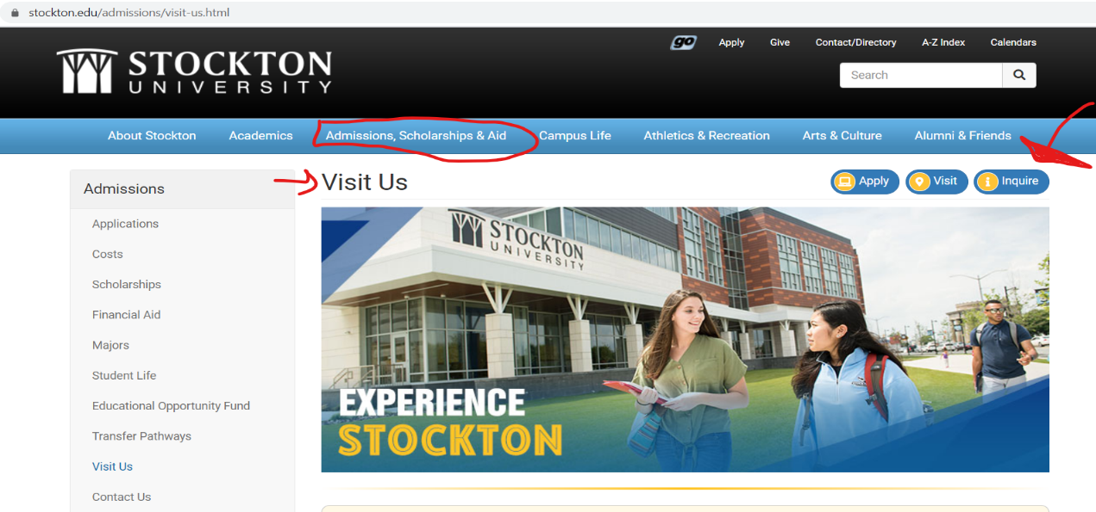

How To Visit Colleges Virtually or In-Person
GCIT Guidance Department
Notes:
NOTE:
To change the image on this slide, select the picture and delete it. Then click the Pictures icon in the placeholder to insert your own image.

Slide 2
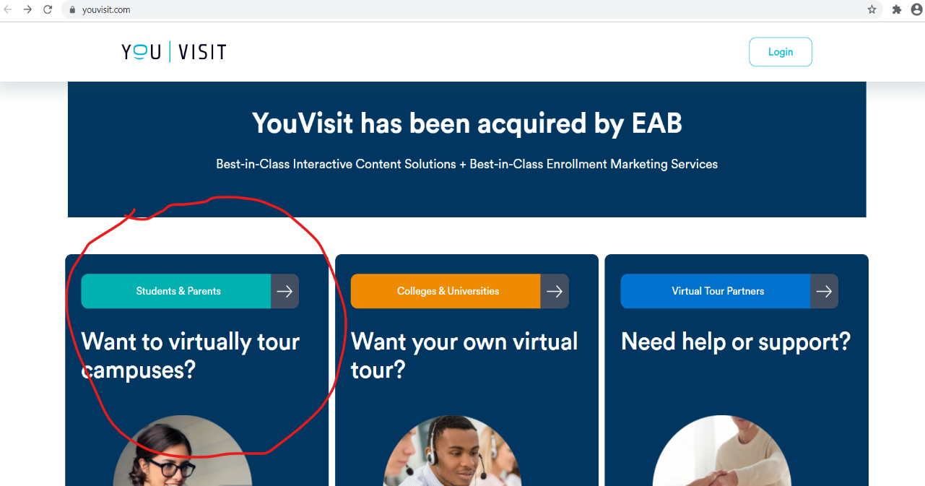
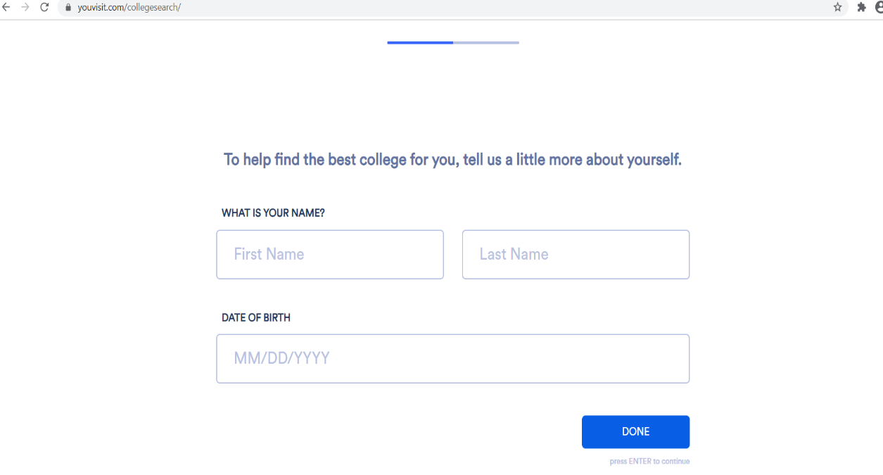
Virtual Visit with Just a Few Clicks!
1. For virtual visits, go to youvisit.com https://www.youvisit.com/collegesearch/
2. Choose Students & Parents
3. Enter Your Name and Birthdate

Slide 3
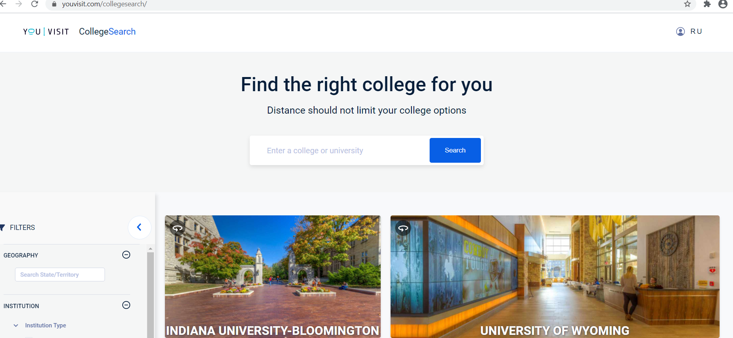
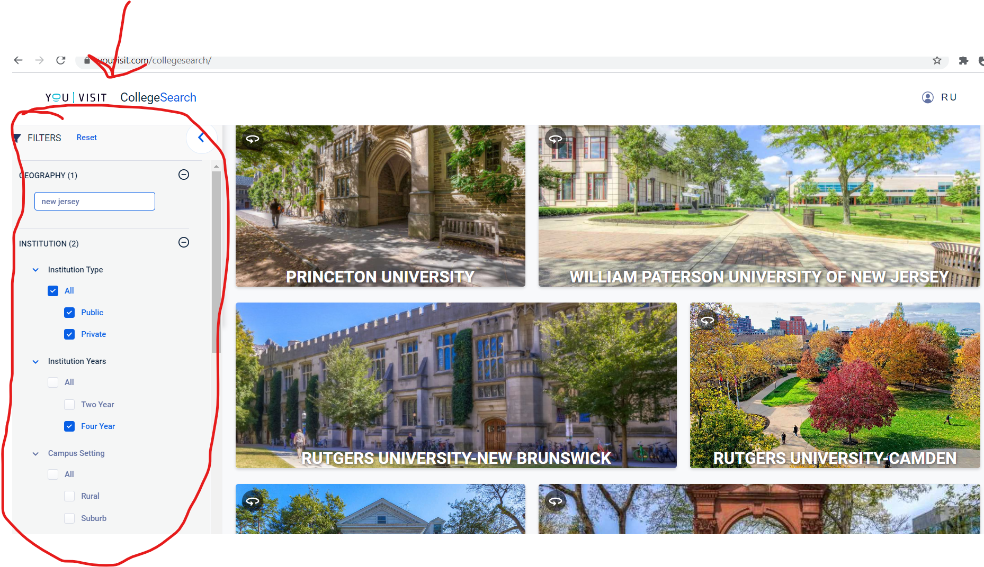
Visit Virtually From Anywhere… On Any
Device… at Your Convenience!
Search interested colleges by entering the name of school in the search box or use the filter on the left to check out various schools.

Slide 4
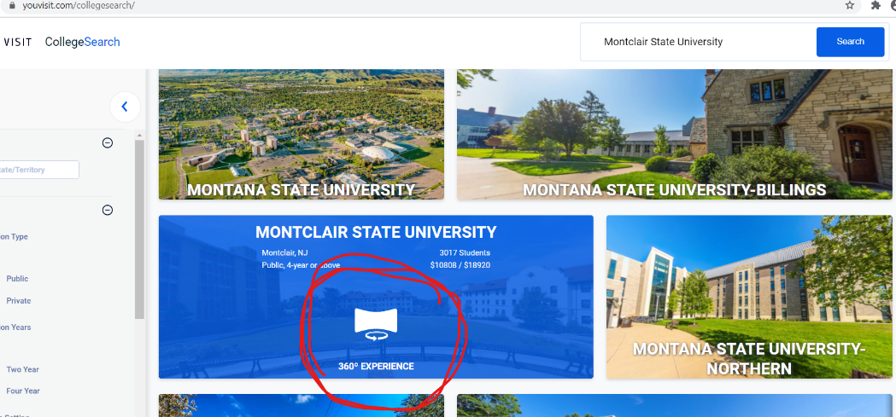
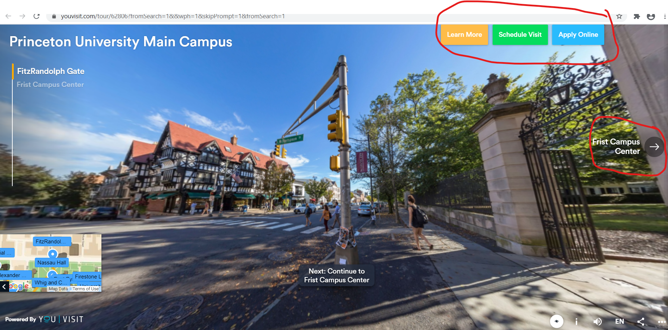
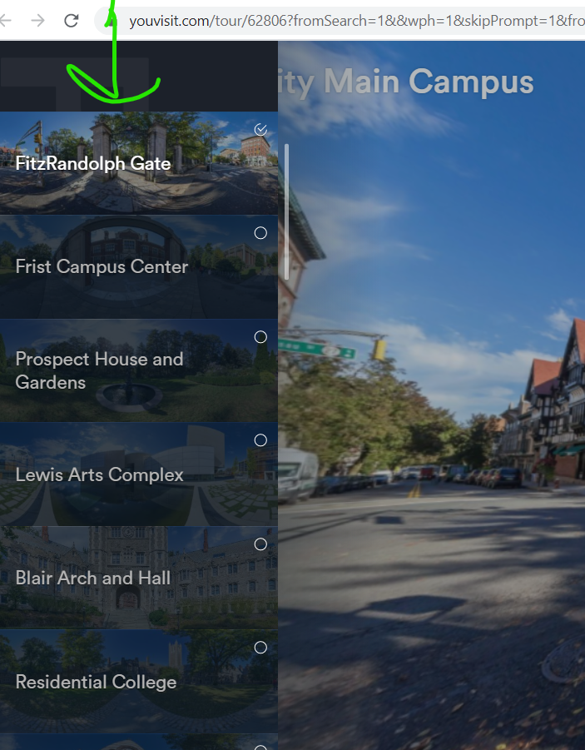
See the Campus Up Close Virtually
5. Click the
360-degree icon in the middle of the screen to see amazing views of the campus narrated by students.
6. You can choose to see just parts of the campus by clicking on the tabs to the left of the screen if you have limited time or choose to return later to the site to see it all.

Slide 5

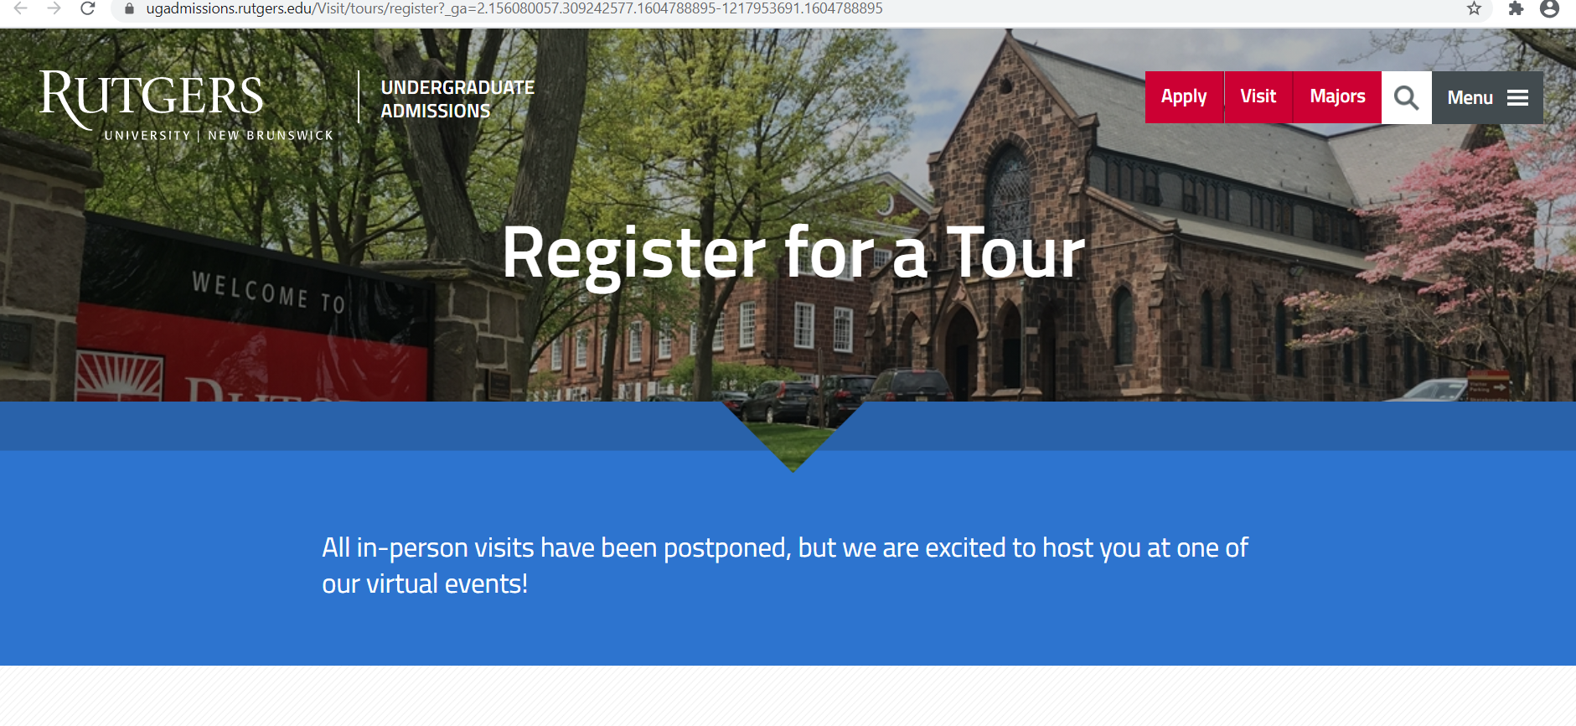
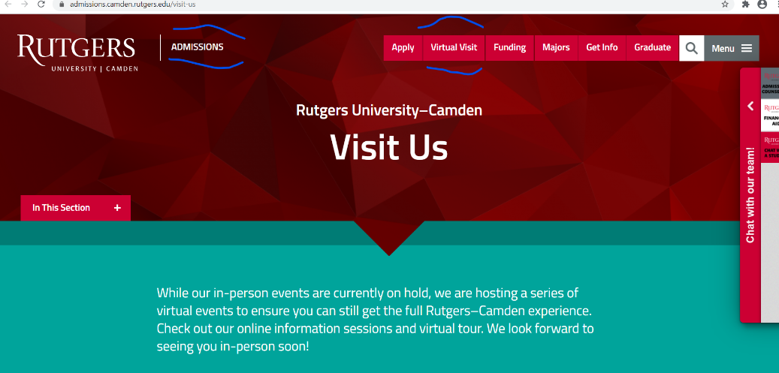
College Visits Made Easy!

Slide 6
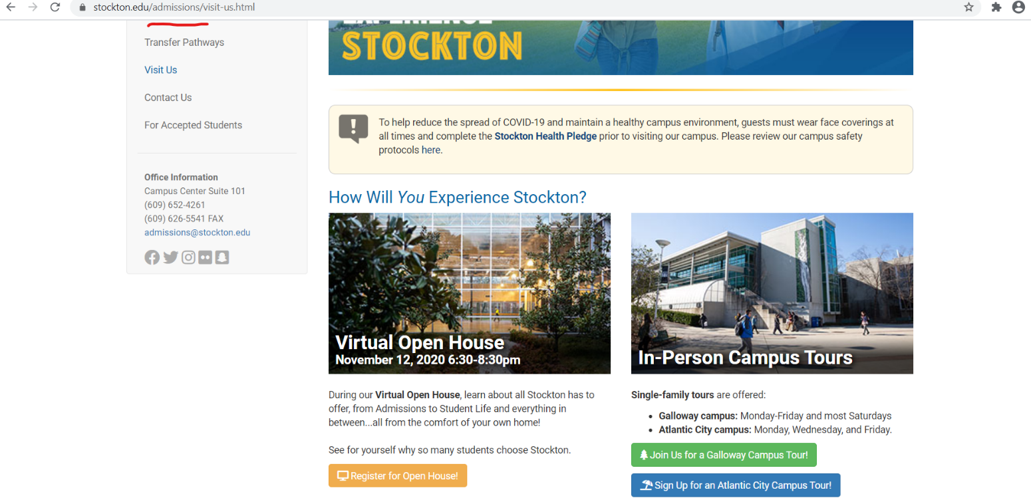
In-Person Visits
To visit in-person, visit the college undergraduate admissions page. If the college offers in-person tours or visits, follow the prompts to schedule your visit.
See next and final page on how to make the most of your college search & to compare colleges using the common data set.

Slide 7
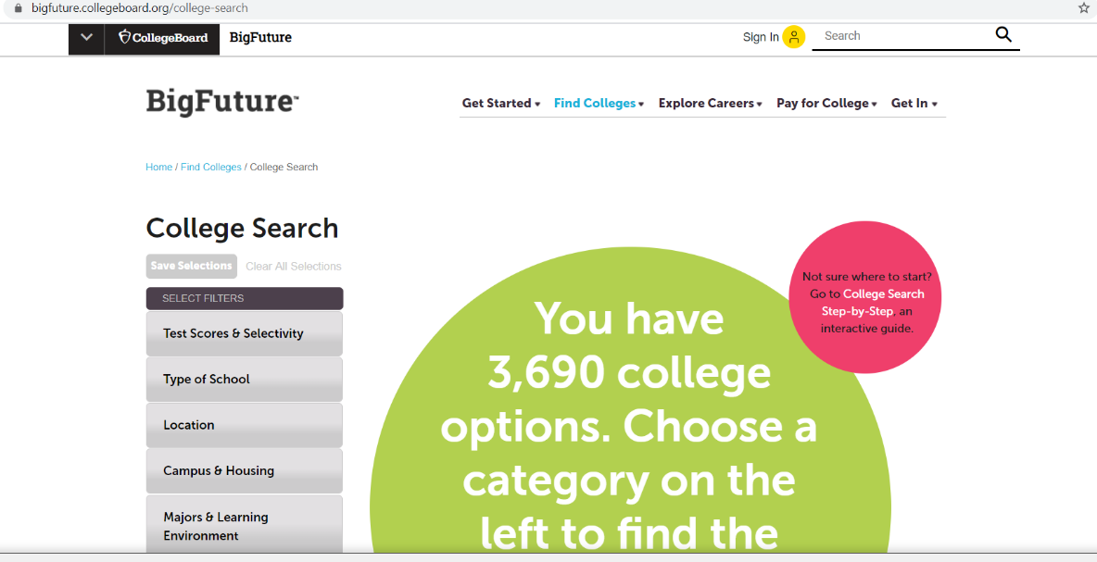
College Search & Comparison Tools
Search Colleges Using BigFuture
https://bigfuture.collegeboard.org/college-search
Compare Colleges Using Common Data Set
What is a Common Data Set?
It’s a data collection process that captures some information that isn’t available from the other major college resource, the government’s Integrated Post-Secondary Education Data Set (IPEDS).
Here’s what the Common Data Set includes, and what you can learn from the research. A group of publishers, including Peterson’s, the College Board, and U.S. News & World report, decided there was a need to provide accurate and timely data to families researching schools.
It reduces the workload on college administrators as well, by providing centralized information that everyone can access.
The group sends out the same core questions to every school, allowing accurate comparison between institutions. You can see the most recent
here:
https://commondataset.org/

