Slide 1
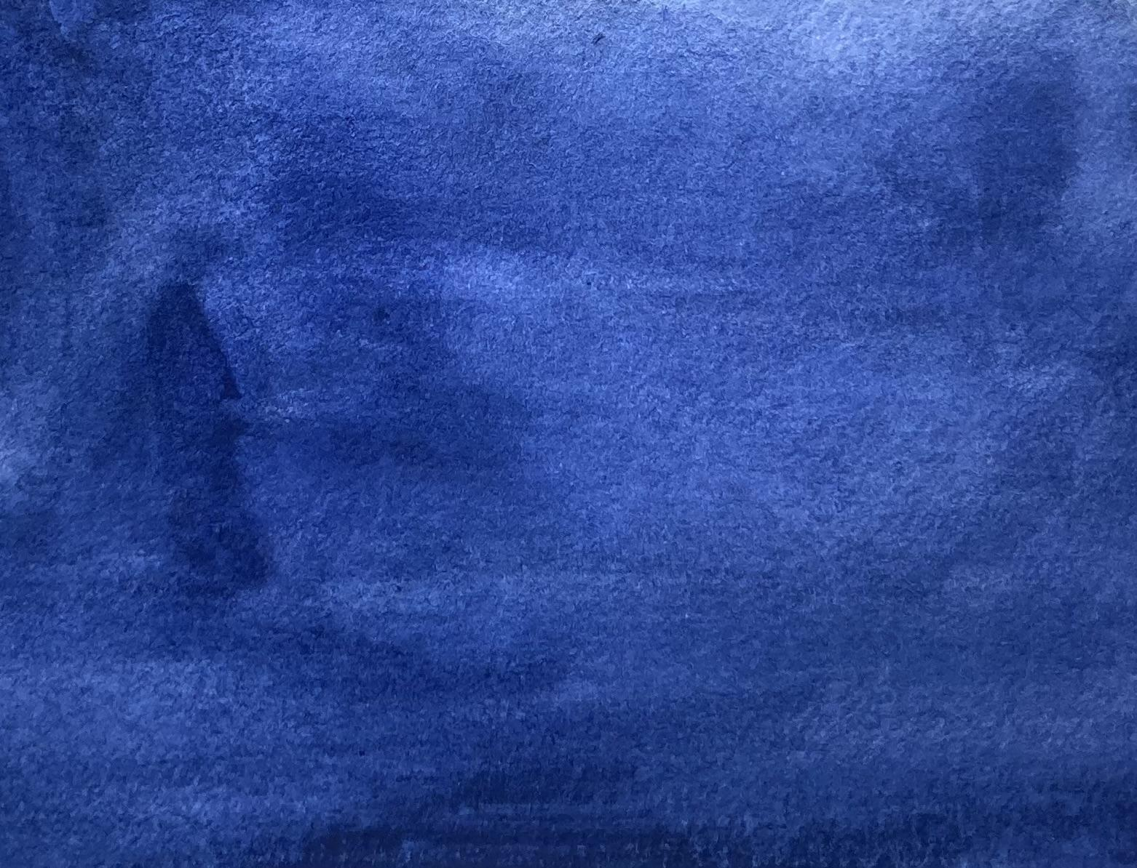


Slide 2
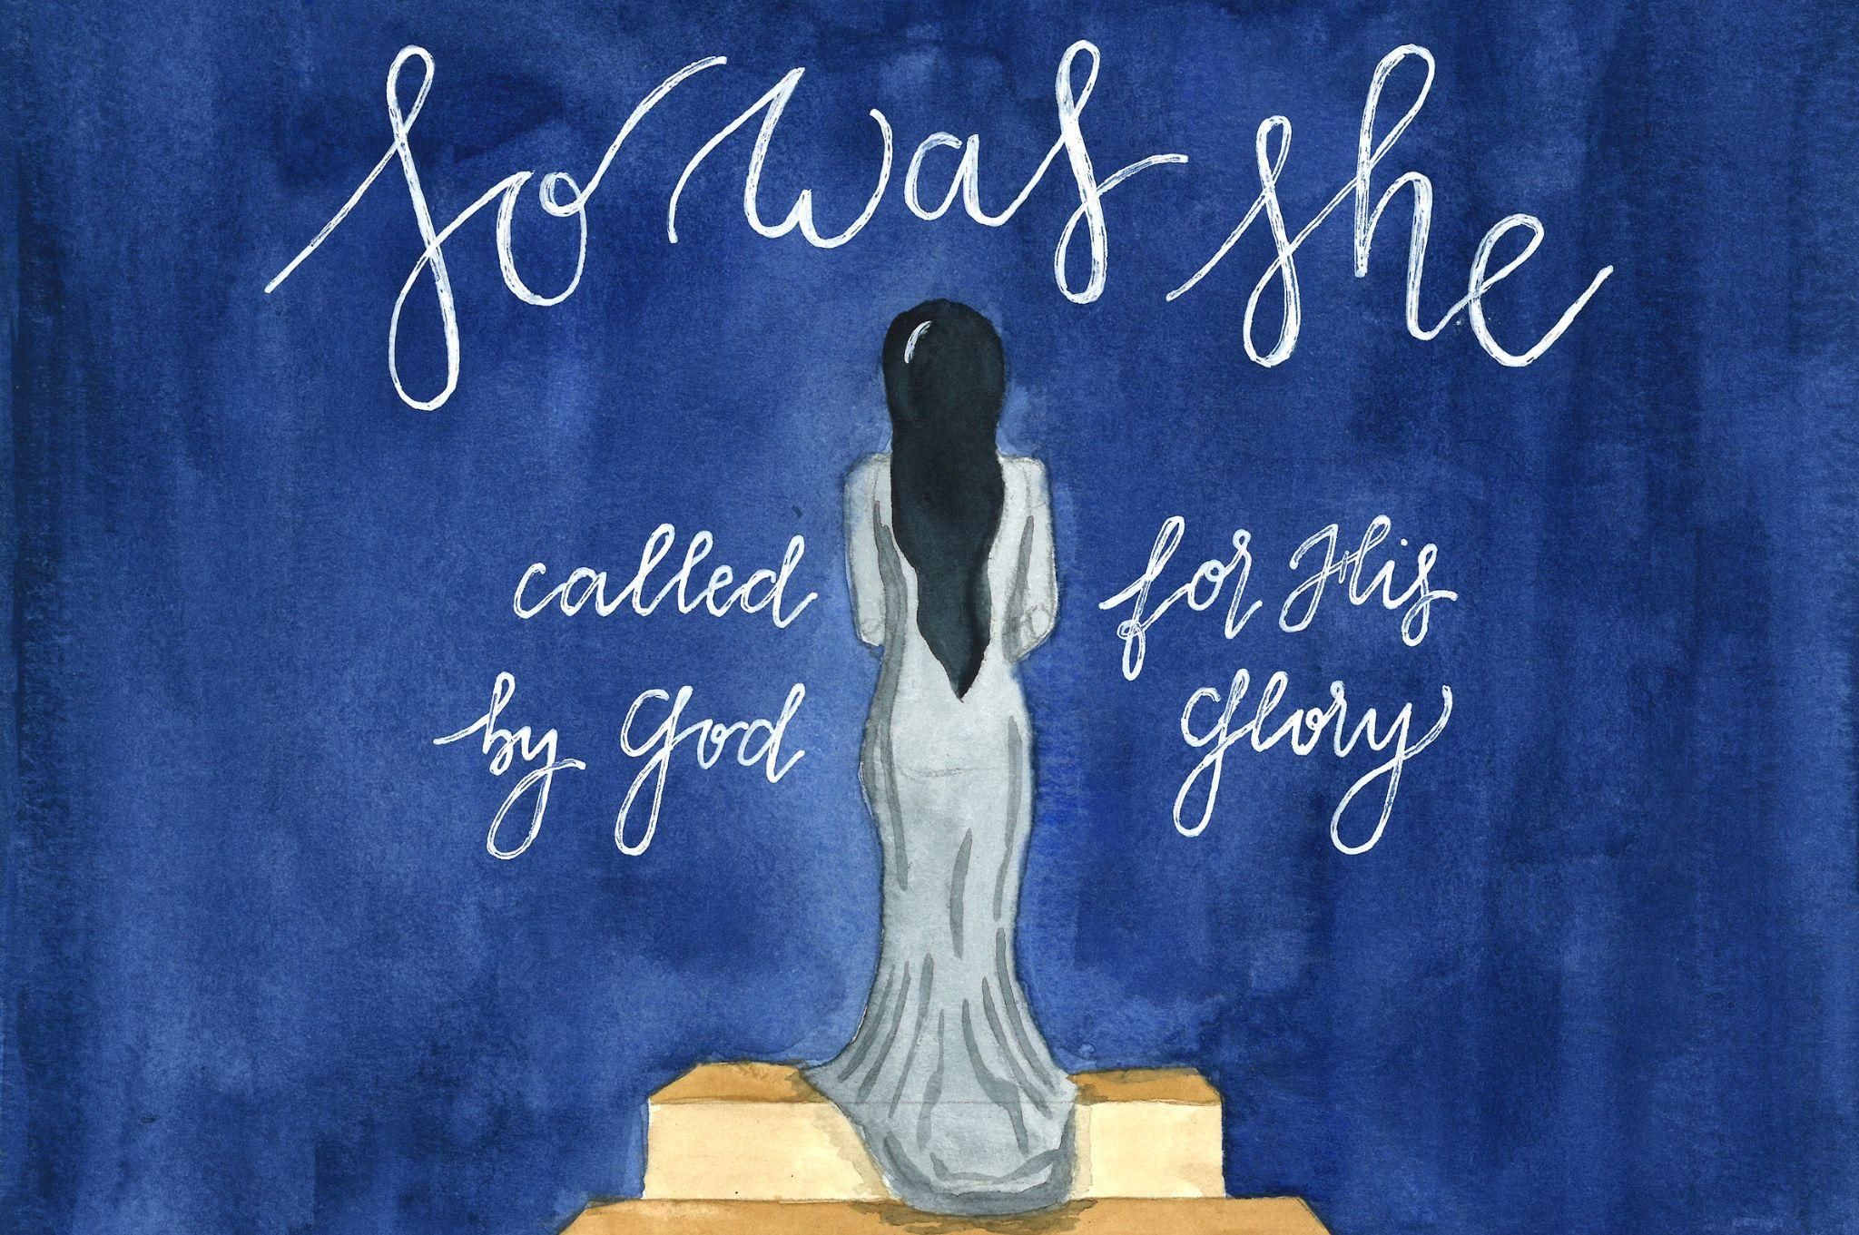

Slide 3
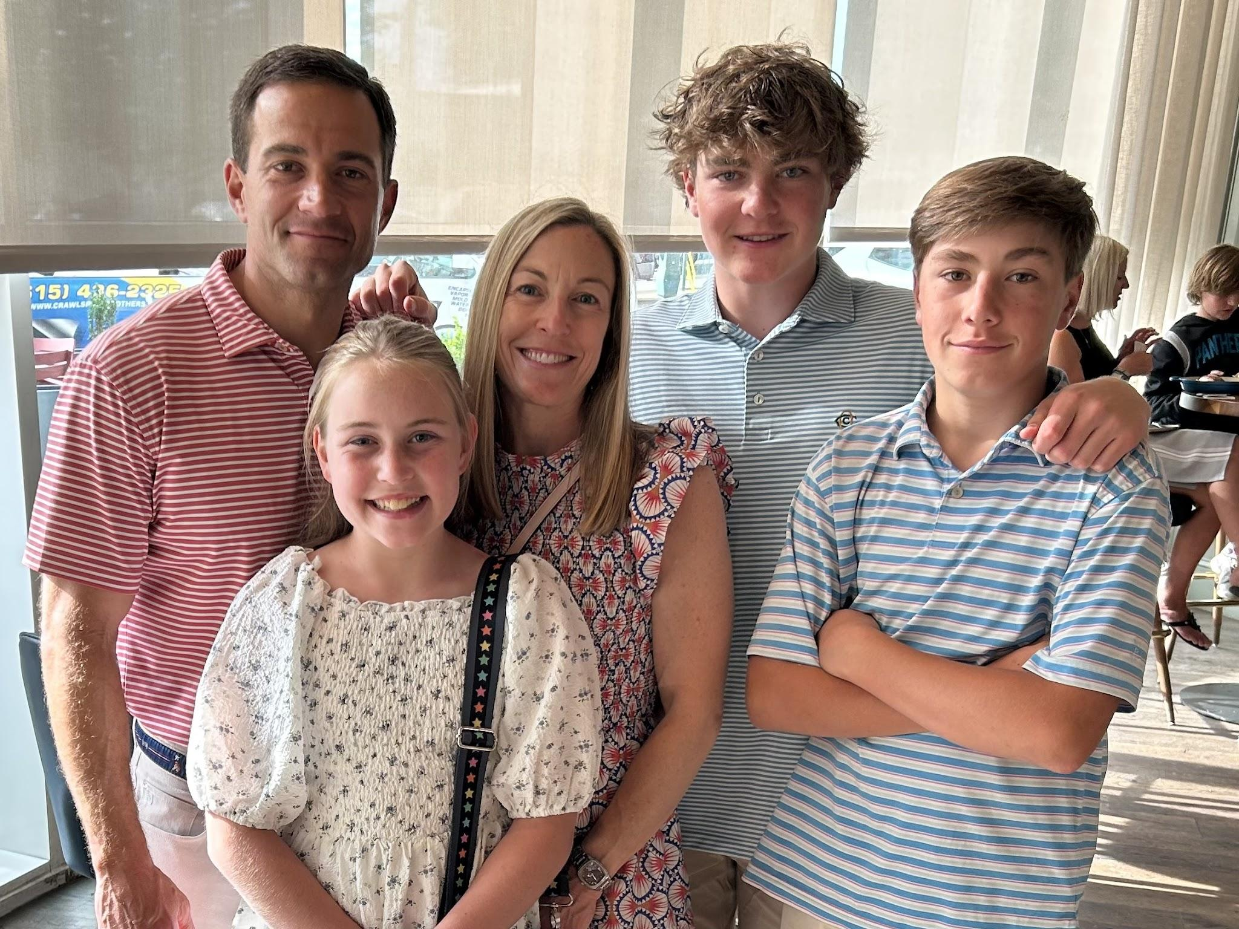

Slide 5

“The fear of the Lord is the beginning of wisdom; A good understanding have all those who do His commandments; His praise endures forever.”
Psalm 111:10

Slide 6
“His sister stood at a distance to find out what would happen to him.”
Exodus 2:4

Slide 7
Then his sister said to Pharaoh’s daughter, “Shall I go and call a nurse for you from the Hebrew women that she may nurse the child for you?”
Exodus 2:7

Slide 8
Pharaoh’s daughter said to her, “Go ahead.” So the girl went and called the child’s mother.
Exodus 2:8

Slide 9
reeds by the bank of the Nile
(Exodus 2:3)
Red Sea = Sea of Reeds = yam suph
(Exodus 14)

Slide 10
Prophet
Any person directed by the inspiration of God to proclaim his will.
Spoke God’s truth and warnings
Prophetess - Miriam, Deborah, Huldah

Slide 11
“Be careful against an infection of leprosy, that you diligently observe and do according to all that the Levitical priests teach you; as I have commanded them, so you shall be careful to do. Remember what the LORD your God did to Miriam on the way as you came out of Egypt.”
Deuteronomy 24:8-9

Slide 12
“Indeed, I brought you up from the land of Egypt And ransomed you from the house of slavery, And I sent before you Moses, Aaron and Miriam.”
Micah 6:4

Slide 13
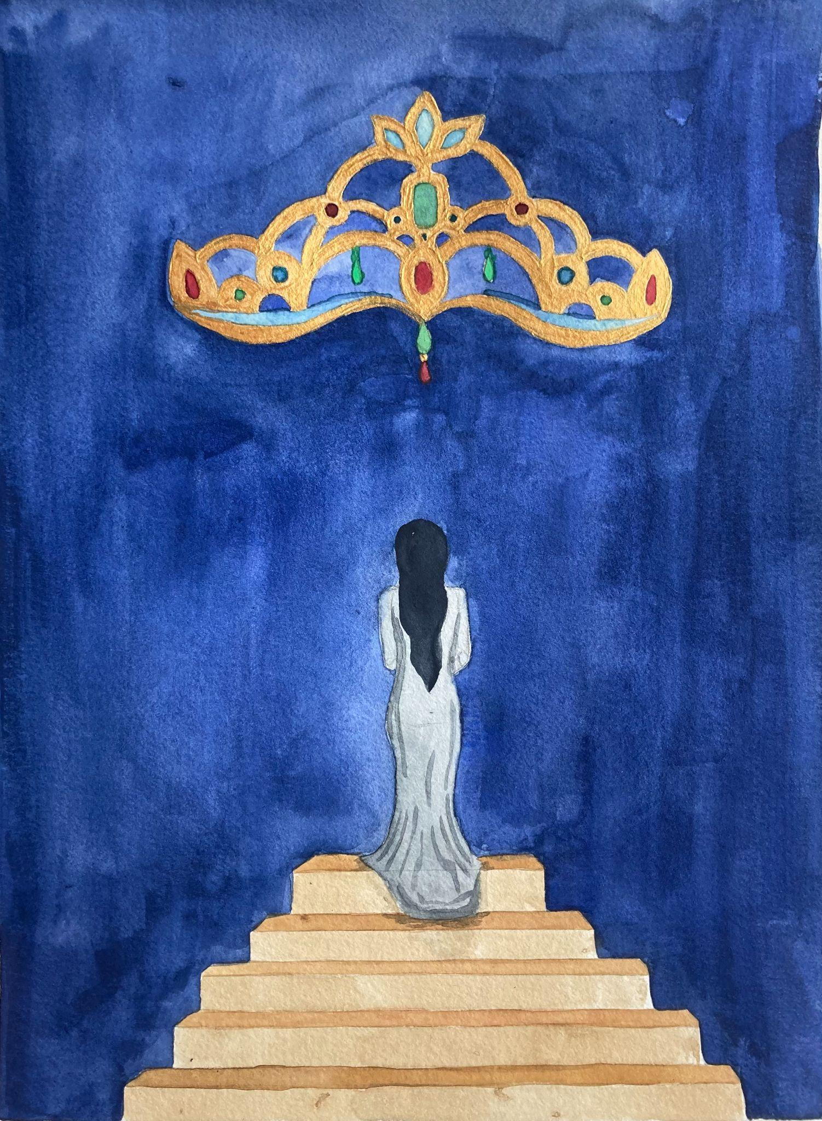
Miriam was called by God for his glory.
(_______) was called by God for his glory.
Right now I hear God calling me to _________________.

