Slide 1

Santa Fe ISD Policy and Guideline Advisory Committee
2023

Slide 2

Agenda
*Introduction and why we are here
*Dress Code
*Code of Conduct/Bullying
*Grading Guidelines
*Cell Phone Guidelines

Slide 3
What will this look like?
Take a few minutes to review the document and think about questions or concerns you might have.
*Ask questions, express concerns, look for areas that need to be more clearly defined.
  If a concern has to do with a specific student/incident, please wait until the end of the meeting to discuss privately.
  *Principal will facilitate the conversation if no questions initially.
  *Scribe- someone will need to record thoughts and ideas
  We will take all feedback after our meetings and edit the documents for final review for the 23-24 school year!

Slide 4
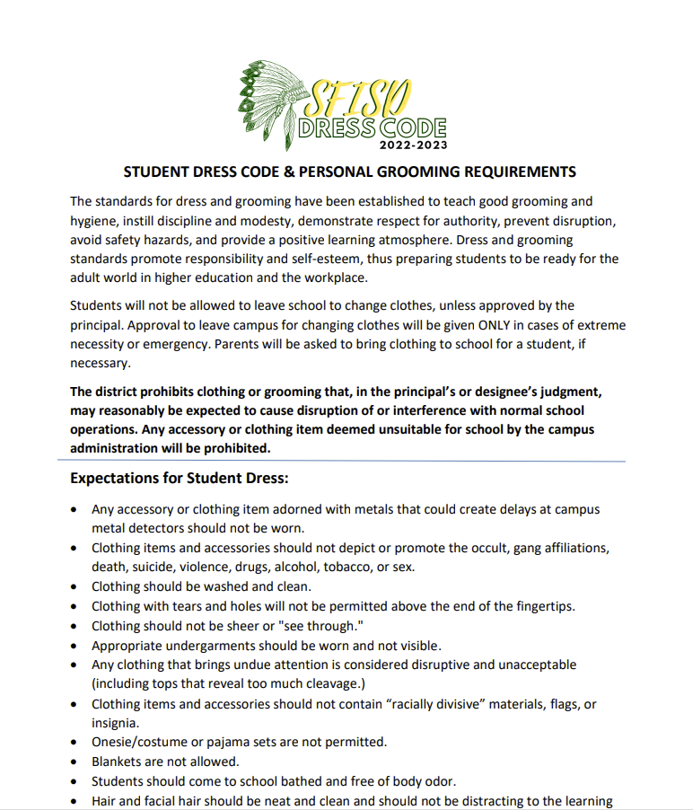

SFISD Dress Code

Slide 5
Dress Code
Big Changes in 22-23 (Why- Focus on instruction and safety)
  No hats
  Yoga pants allowed with dress code appropriate shirt
  3 inch above knee to fingertip length
  No hoods on during the day
  No restriction on pajama bottoms or slippers
Clarifications?
Concerns?
Additions?

Slide 6
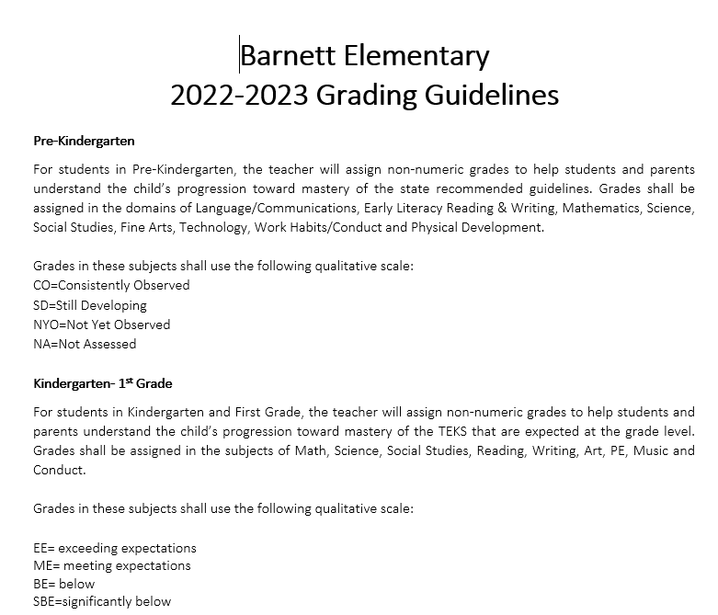
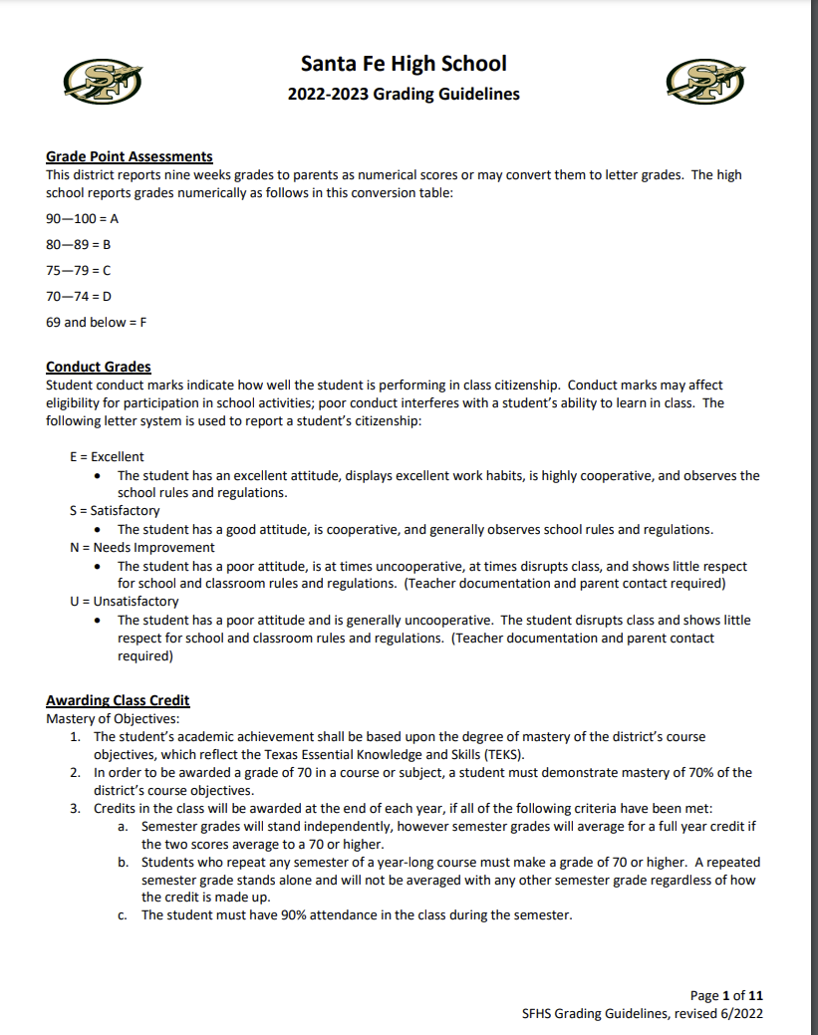
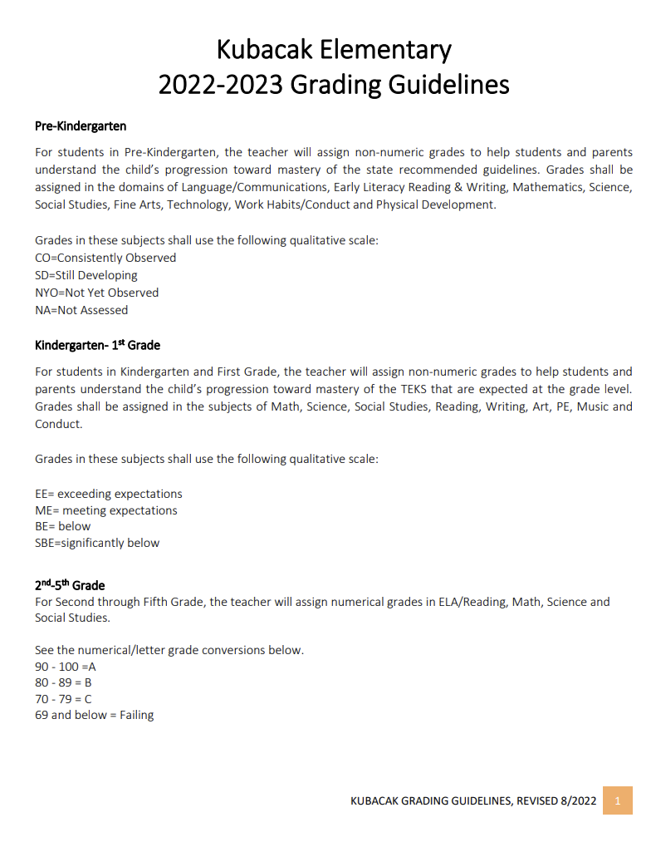
SFISD Grading Guidelines

Slide 7
Grading Guidelines
Clarifications?
Concerns?
Revisons?

Slide 8

SFISD Code of Conduct

Slide 9
Code of Conduct
*Based on Chapter 37 of the Texas Education Code and adopted by the school board
*Provides methods and options for managing students in the classroom or on school grounds, disciplining students, and preventing and intervening in student discipline problems.
*Law requires districts to define misconduct that may or must result in a range of specific disciplinary consequences including removal from the regular classroom or campus, OSS, DAEP, or expulsion.
*Provides information to parents and students regarding standards of conduct, consequences of misconduct, and procedures for administering discipline.

Slide 10
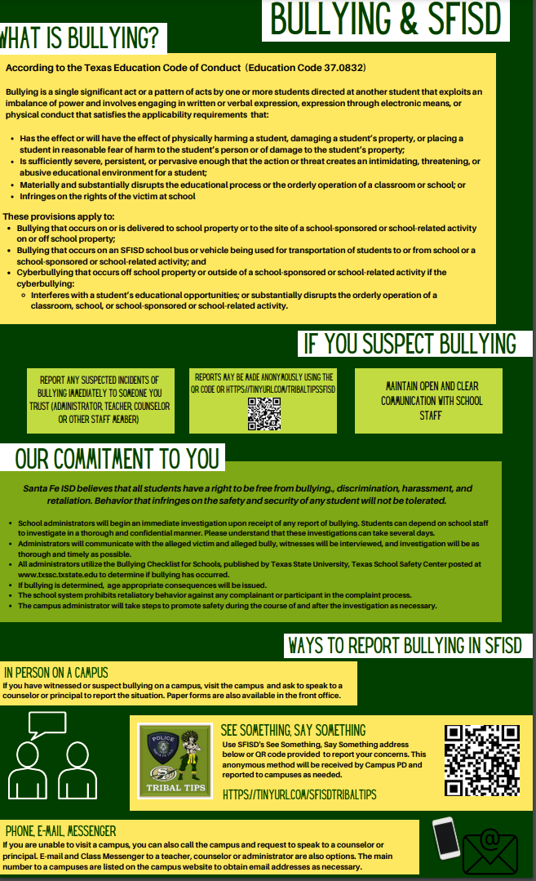
Code of Conduct
BULLYING FEEDBACK REQUESTED

Slide 11


Slide 12



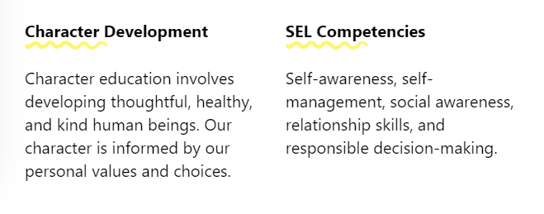
*Curriculum through Social Emotional Learning as a preventative measure
Clarifications?
Concerns?
Additions?

Slide 13
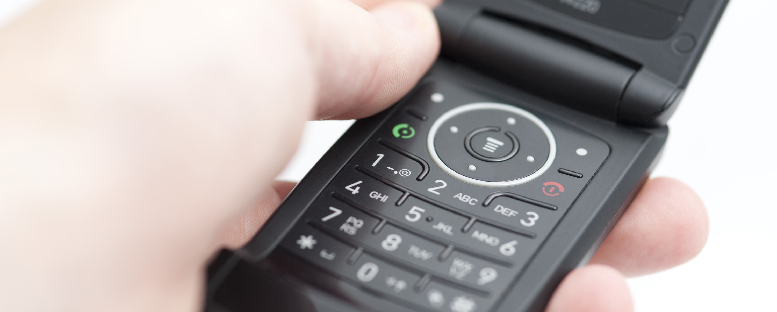
SFISD Cell Phone Usage Guidelines
This Photo by Unknown Author is licensed under CC BY

Slide 14
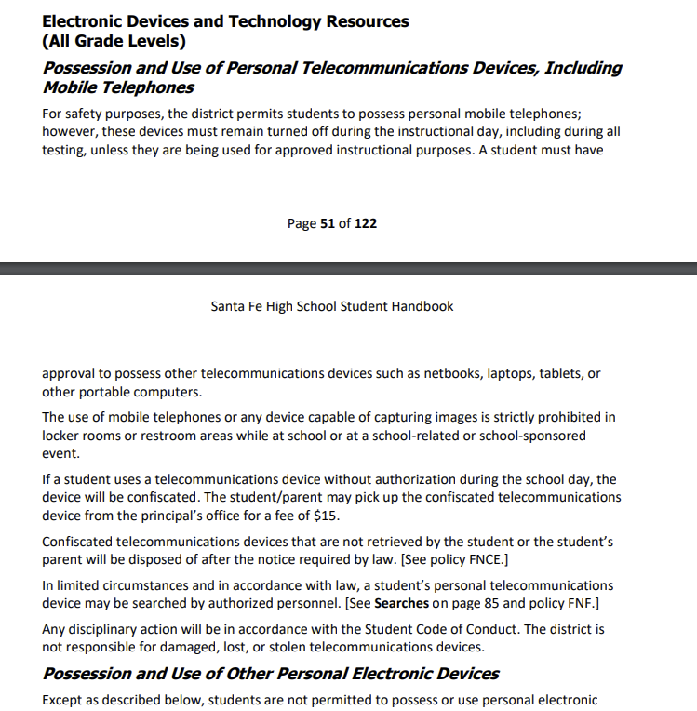
Cell Phones-
Cell phones must remain turned off during the instructional day unless approved for instructional uses

Slide 15
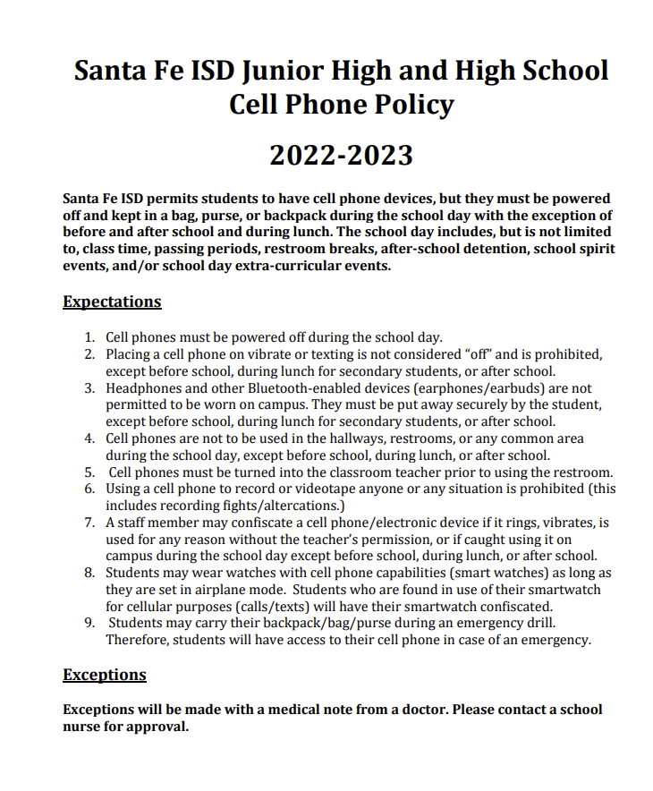
Cell Phones
Observations?
Concerns?
Changes?

Slide 16

Sara Ryan
Sara.ryan@sfisd.org

