Slide 1


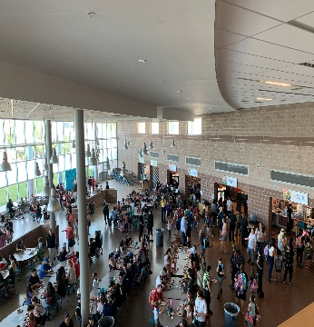
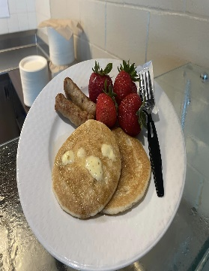
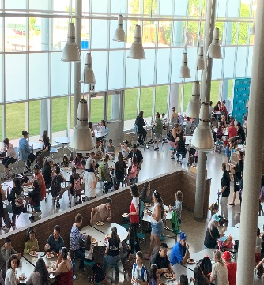
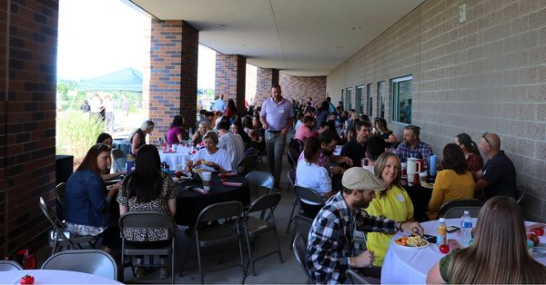

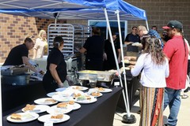

WPS Culinary Services
August 2023 Highlights
Welcome Back to School
Healthy School Meals for all
Welcome to your monthly newsletter! We are excited to share our story with you! Over the past month we have been serving up happy and healthy throughout the district with a variety of activities and programs.
August 5th Backpack Breakfast
Welcome Back BBQ & New Teacher Breakfast
August 15
  All Students Return to Schools
BILLIE THEYE
DIRECTOR OF DINING SERVICES
720-542-5174
btheye@mywps.org

Slide 2
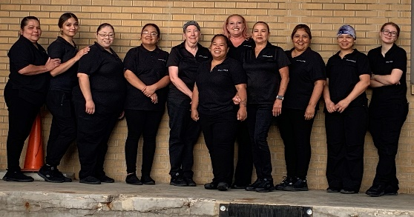
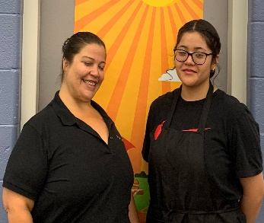
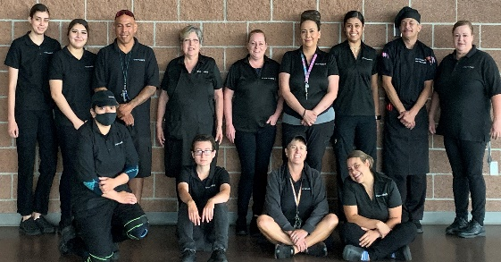
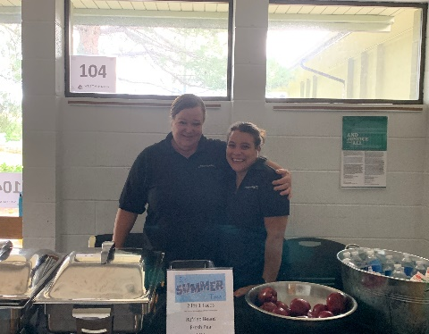
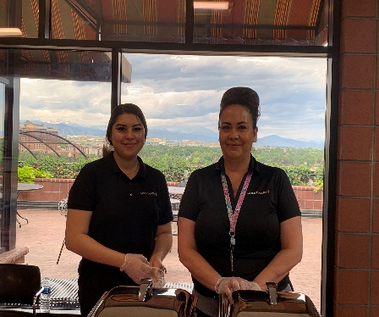
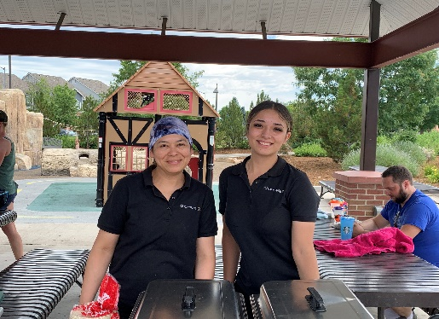
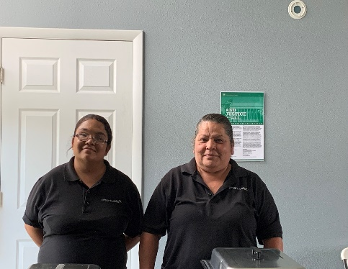
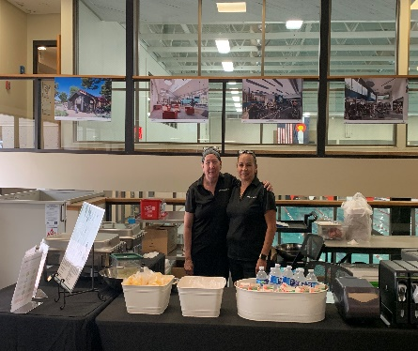
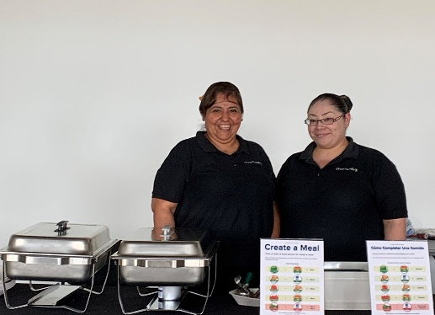

Thank You to our Summer Staff
Summer Staff
Our Summer Staff did a fabulous job with feeding Happy & Healthy Meals all our community through out the Summer and working tireless on many large Caterings for the District and the Community
Summer Sites
Thanks to our Summer Staff we were able to feed over 68,000 meals to our community

