Slide 1

CLASS of 2023
Welcome to College Application Night
Seniors and Parents!

Slide 2


Agenda
General information
Process
Application
additional information
Financial aid- Lynda mckendree, u of st thomas
Notes:
Completely revamped presentation
If you have older kids- not the same process so the presentation cannot be the same.

Slide 3
DHS COUNSELORS
Prestal Malloy A-Col***
Chris Daniel Com-han
Kori Spruce, Lead Counselor Hap-jon
Brittanee Morris Joo-nea***
Jessica Sellers neb-sik
Bob Paluszak sil-z
Jessica Frasier Student Support
Shara Schlitzberger ****

Slide 4
COUNSELING OFFICE
Christi Peterson, Scholarships
Joni Cantu, Secretary
Natasha Patterson, Registrar
Diane Tenorio, Registrar Clerk
Daisy Garcia, Student Data Specialist

Slide 5
Scholarship Coordinator
Christi Peterson
Online list is updated at least weekly
www.pearlandisd.org/Page/1123
Start locally
Consider smaller awards
Remember, more work = less applicants
Submit your best work

Slide 6
FAFSA
In accordance with Texas education code (TEC), 28.0256, beginning with students enrolled in 12th grade during the 2022-2023 school year, each student must do one of the following in order to graduate:
Complete and submit FAFSA
Complete and submit TAFSA
Submit a signed opt-out form
Notes:
Will start receiving emails in January for non-completers. Once a month in the first couple of months, once a week as we get closer to graduation.

Slide 7
Self reported Academic Record (SRAR)
self-report courses and grades that have been completed, or will be attempted (e.g., senior year courses in-progress), for high school credit.
please use an unofficial transcript/grades report (e.g., online report card) or score report as a reference when you complete the SSAR.
Notes:
So important to use the same email address for this service as all college applications.
Colleges such as Texas Tech, TAMU are using this to put all students on a 4.0 scale.

Slide 8
“The college application process is an exercise in following directions.”
-Emory College admission officer
Notes:
I would add- Meeting deadlines
No exceptions
No extensions/no do-overs

Slide 9
Get organized
*Testing
*Visit Colleges
*Finalize list
*APPLY, watch deadlines
*Keep grades up
FALL
Create a spreadsheet with deadlines, testing requirements, what application system, completion date
Create one email address with appropriate labeling
Winter
*Monitor Applications/Deadlines
*Complete FAFSA
*CHECK EMAILS
*Keep your grades up!
*Visit colleges again after admit decisions
*Keep counselor informed
*Keep your grades up!
SPRING
Notes:
Handout with a more in-depth outline.
Counselors will meet with every senior during the last week of September. We met with every junior prior to the end of school.
Cannot emphasize college visits enough- UT/UH example, get the feel of the university.

Slide 10
Double Reach
1-2 Reach Schools
College Application Diamond
3-5 Match Schools
1-2 Safety Schools
Notes:
Safety, also called likely schools. One where your academic credentials fall comfortably ABOVE the school’s range for the average freshman. You are reasonably certain that you will be admitted to your likely schools. GPA & Test Score & Class Rank = Good idea of chances for admission
Match or target schools. Your academic credentials (grades, test scores) fall well within or even exceed the college’s range. There are no guarantees but it’s not unreasonable to be accepted to several of your match schools.
Reach schools are ones where your academic credentials fall below the school’s range for the average freshman. I would also argue that the admittance rates are low.
Double reach schools are long shots for everyone who applies. DO NOT approaches like the lottery, “….if I apply to all ivy league schools, one is bound to admit me.” Each school differs…goes back to FIT
HOW do we get to this list of 10ish schools?

Slide 11

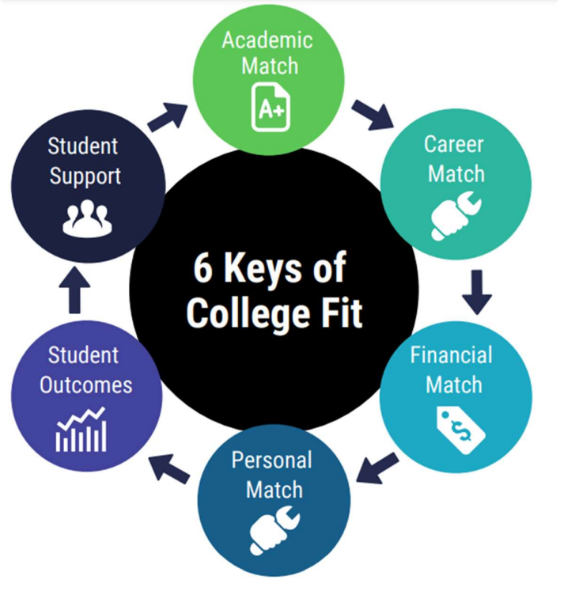
Factors to consider:
Public vs. private
In state vs out of state
Financial aid/loan availability
Match for major
LOCATION, LOCATION, LOCATION
Size
Diversity, Equity, Accessibility
Research/Internship opps
Campus activities
bigfuture.collegeboard.org
nces.ed.gov/collegenavigator
Notes:
Academic match- looking at test scores, GPA, selectivity
Financial match- net price v. sticker price, debt of graduates
Personal match- diversity, living arrangements
Student outcomes- retention/graduation rates, debt/salary info
Student support- disability services, writing center
Also keep in mind that some majors have additional requirements for admissions. For example for science and engineering majors at UT, have to show calculus readiness at the time of the application vs. UH where the SAT/ACT requirement is higher.

Slide 12

Choosing a major
Make list of 10 things you love
Make list of strengths/weaknesses
Use Roadmap to Careers on College Board to connect the loves/strengths
What are your career goals?
Most will change majors 3 times in college, and 80% change at least once.
www.texascareercheck.com
www.mynextmove.org
Notes:
Please raise your hand if you changed your major? Keep your hand up if you changed it more than once.
Most students change majors 3 times in college, and 80% change at least once.
__________________
What do you think is the #1 factor in admissions?

Slide 13
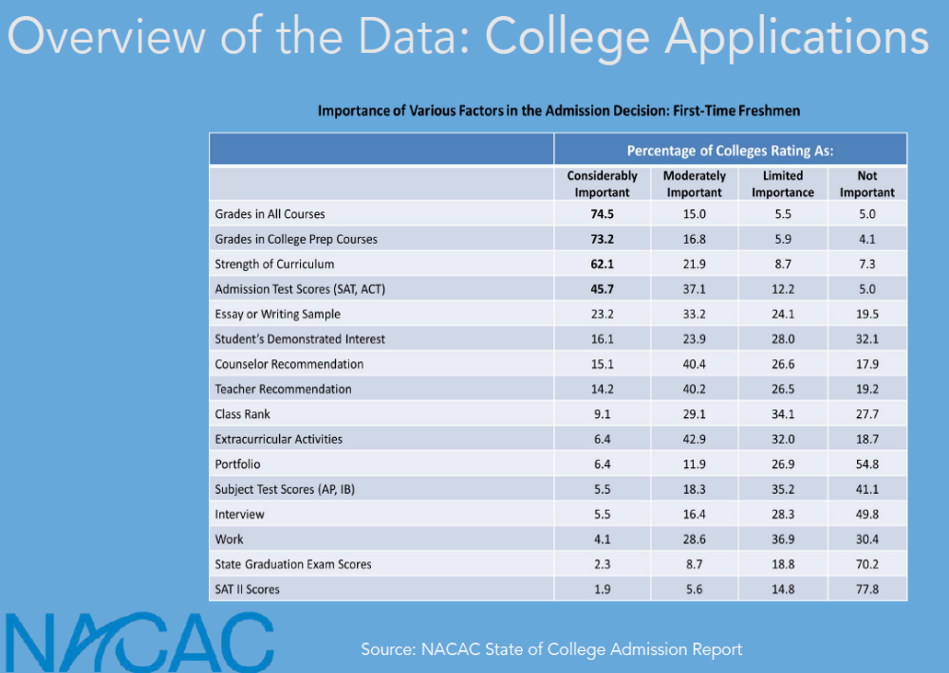
What are colleges looking for?
Notes:
This next section of slides are “borrowed” from a college prep session at our conference this summer. National data

Slide 15
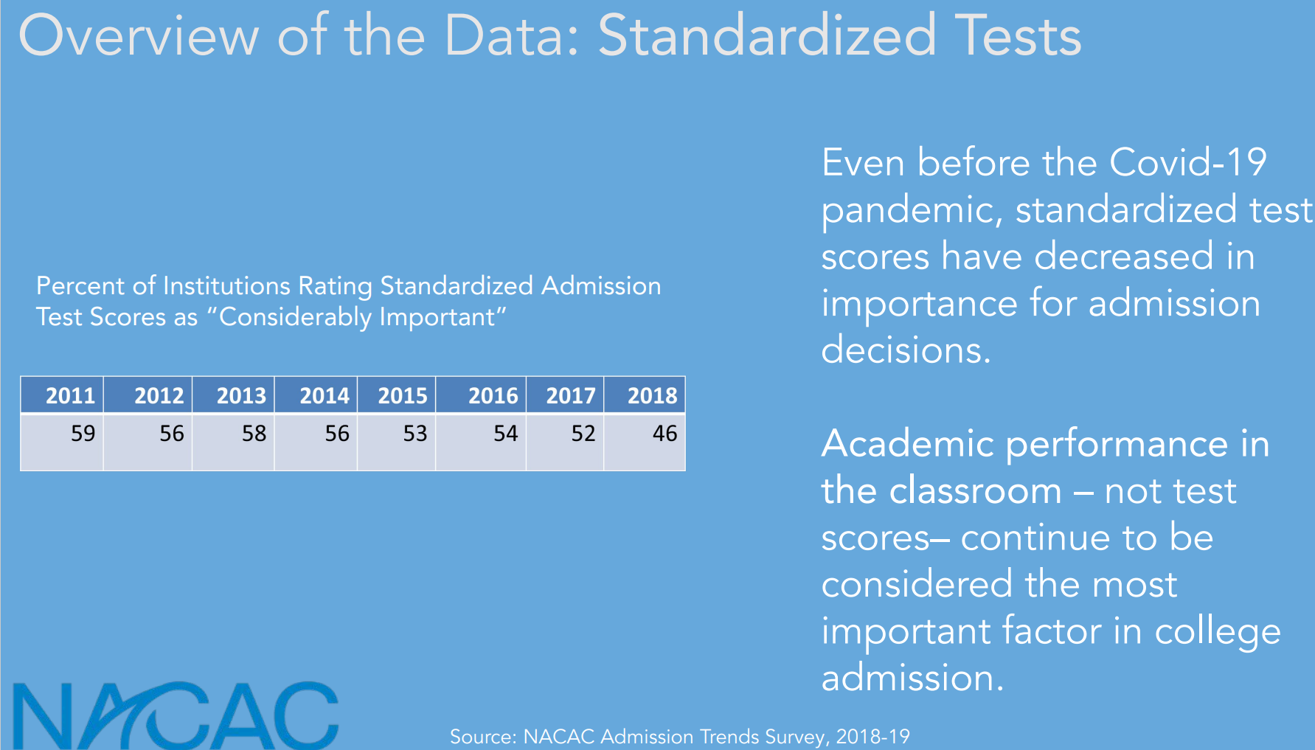
Notes:
The landscape of college admissions has been changing for 3-4 years and COVID has pushed it forward.
Colleges are saying that it is performance in the classroom that is their most important factor.

Slide 16
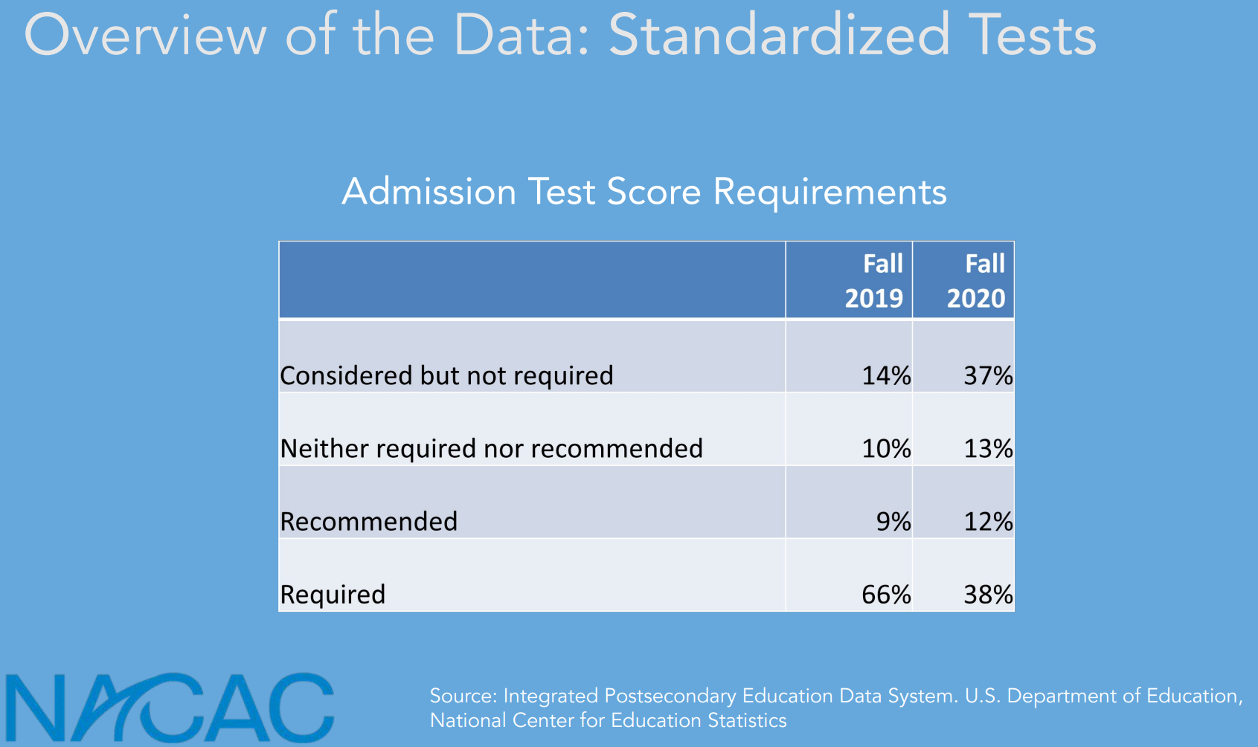

Slide 17
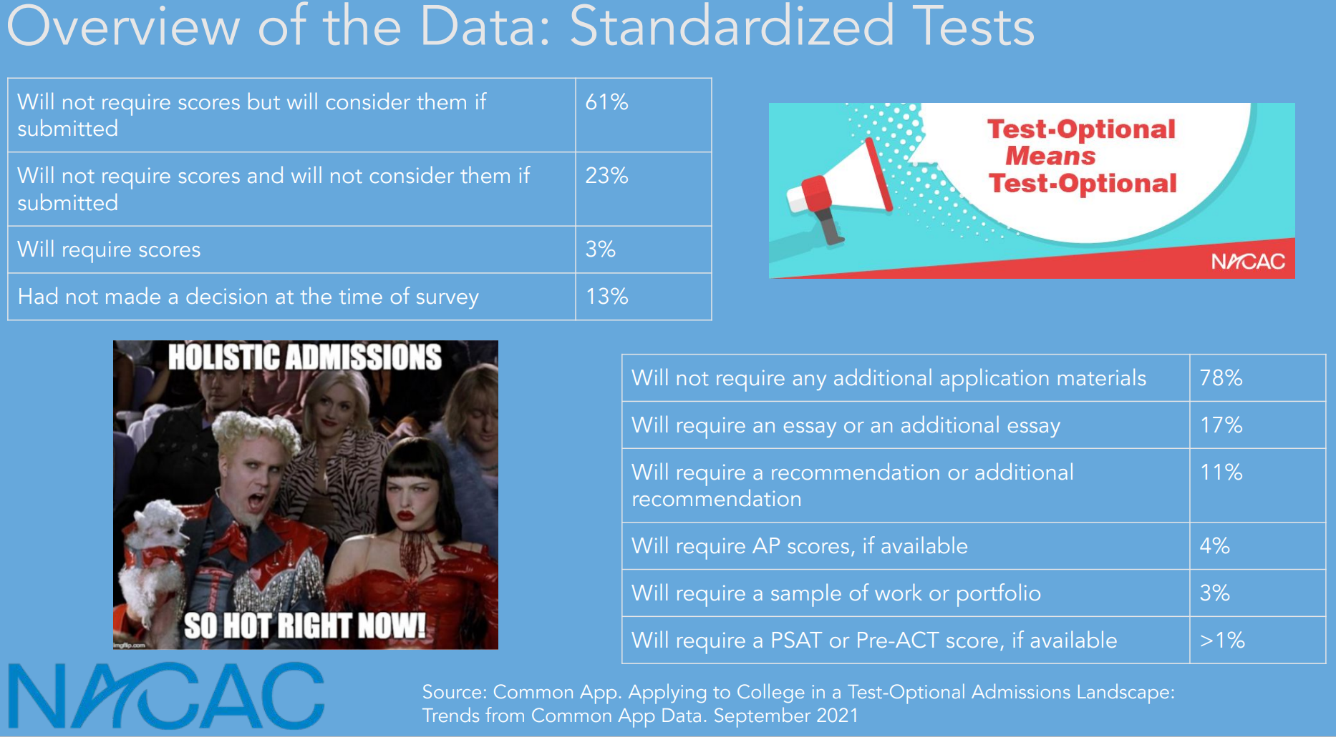
Notes:
In Sept 2021—colleges said…. I am waiting to hear from 2022 how this data has changed.
When a college says test-optional, they truly mean test optional. Every college update has said that if a student chooses to not send a score, it is not held against them.

Slide 18


Which to choose? SAT/ACT
Teens who do well on SAT tend to share these characteristics:
Possess strong vocabulary
Avid readers
Like test-taking strategies
Enjoy puzzles
Teens who do well on ACT
tend to share these characteristics:
Fast readers
Process information quickly
Possess strong memory.
SAT Reading Test Portion
Number of questions: 52
Time allowed: 65 minutes
ACT Reading Test Portion
Number of questions: 40
Time allowed: 35 minutes

Slide 19
TSI: Texas Success Initiative
College Readiness
Dawson High School
$39 for all tests
Will be offered every Wednesday in the Spring starting in January.
EXEMPTIONS can be made based on high PSAT, SAT or ACT scores.

Slide 20
Transcripts
*Fill out student request for transcript
*Available in Counseling office or College/Career Center
*Return to ms. Peterson in College/Career Center
*Allow time for processing and mailing on both sides
*include all requested information
*$1/transcript
*webstore: https:/pearlandisd.revtrak.net
Notes:
Texas schools are sent via Trex. There is processing time on both ends of the process.
Common Application- transcript is uploaded by counselor.

Slide 21
Letters of Recommendation
*Not every school requires them
*Ask teacher/counselor for brag sheets
*typically a 2-3 week turnaround time, up to 4 during busy seasons
*
Notes:
A general letter of recommendation is not helpful, it is best to get a letter from someone who sees your child daily and knows them.
People ask me for a letter of recommendation outside of my alpha split and I am not the best person because I don’t know that child. Colleges want to KNOW the kid better through the letter.

Slide 22

Applications
*apply Texas- www.applytexas.org
*Common Application-www.commonapp.org
*School’s own system
***please do not use Coalition
Notes:
We’ve told families for several years to not use the Coalition because it was not a friendly system. Now the colleges are pulling away from being a part of the Coalition application. So if you come across a school that still is, PLEASE do not use Coalition.
Most Texas public colleges are also on the Common App. Used to be the divide of public v private.

Slide 23
Defining ED vs EA
Early Decision
Only 1 ED application- #1 choice
Deadline typically nov 1st
Receive decision by December
Agree to attend
Can apply to other schools but have to withdraw if accepted ED
Early action
Apply to as many schools as you want
Review your acceptance offers
Don’t have to commit to any school right away
Accept offer by for any school by may 1st
Rolling admissions- no deadline, are accepted throughout the year.
Regular decision- most have deadlines between January 1 and February 1st.
Notes:
Want to review some definitions that you’ll encounter and to help make decisions.
Early decision and early decision 2- permitted to apply to only one college or university. Legally bound to attend if accepted. ED applications are due in November. ED 2 tend to be shortly after.
Early Action- open/restricted (check college guidelines)
How to choose ED? My question is WHY? Do not select as a pride status. For me to sign the ED agreement, I want a good WHY? Are you born and raised and bleed the school colors?

Slide 24








TOP 10%
Automatic admission to TEXAS public colleges other than UT ( Top 6%) !
Must graduate Foundation with Endorsement
Does NOT include COLLEGE TUITION!
Does not guarantee major of choice
Notes:
UT- “We will miss out on good kids”, only admit 8% out of state
Texas law that drives college decisions and stress in high school
UPDATE on college admission information for UH, TTU, TAMU, UT
University of Houston- average scores for UH admissions is 1236 on SAT/ 26 on the ACT. 59% admitted are in the top 20%. 54% applied without a score. Only one that gave more information on how they handle without a test score. (handout)
University of Texas- no more 10/15 priority deadline, they have an early action of 11/1 but there is no advantage of applying early. All due 12/1. 60K apps, 18K admitted,, 9100 enrolled. Engineering and sciences require Calculus readiness by the time they apply for UT. Overall admittance rate is 15%.
Texas A&M- 52K applications, 27K admits, 12K from top 10%- less than half compared to UT’s 80%.
Texas Tech- top 11-25% 1180SAT/24ACT, second quarter 1240SAT/26SAT

Slide 25
University of Texas
Houston Admissions Center
3201 Allen Parkway, suite 225
Houston, Texas 77019
713.871.BEVO
Texas A&M University
Prospective Student Center
1225 North Loop West, Suite 200
Houston, Texas 77008
713.454.1990

Slide 26
College Preview days
Texas a&M- Aggieland Saturday oct 22, 2022 and spring 2023
uh- oct. 15th and nov 5th
Sam Houston- Saturday @ sam sept 24th, 2022
Tx state- bobcat days oct 15th, nov 12th, feb 18th, april 15th
Stephen f Austin- showcase Saturday nov 12th
Ut- visit their website for options

Slide 27
college night
Thursday, October 27th, 2022
5:30 – 7:30 PM
Friendswood high school
Colleges, Military representatives

Slide 28
DATES
March 10th (approx.) - Honors Ranking for Graduation
April 15th - Prom
May 26th, 2023- Graduation

Slide 29
Thoughts & Tips
If it is important to you, it matters.
Student MUST be in charge of this process!
Make the car a college-free talking zone
Add 1 hour to the family calendar on Sunday (or any day) to discuss college so all of your conversations do not revolve around college
Visit the schools on your list

