Slide 1
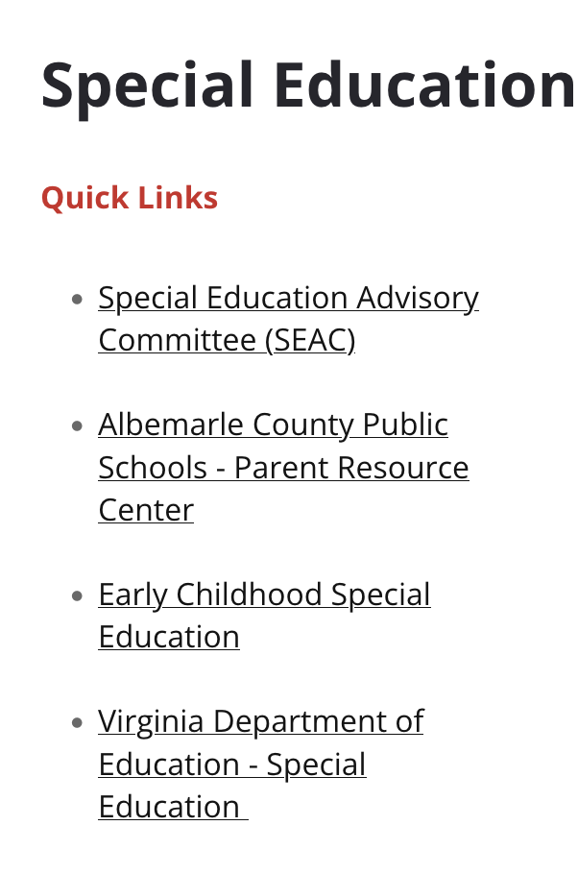
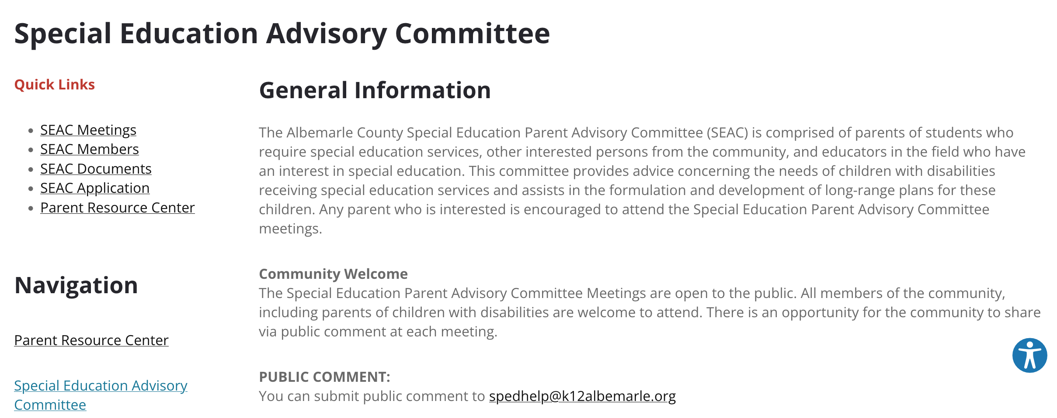
www.k12albemarle.org/our-departments/special-education

Slide 2
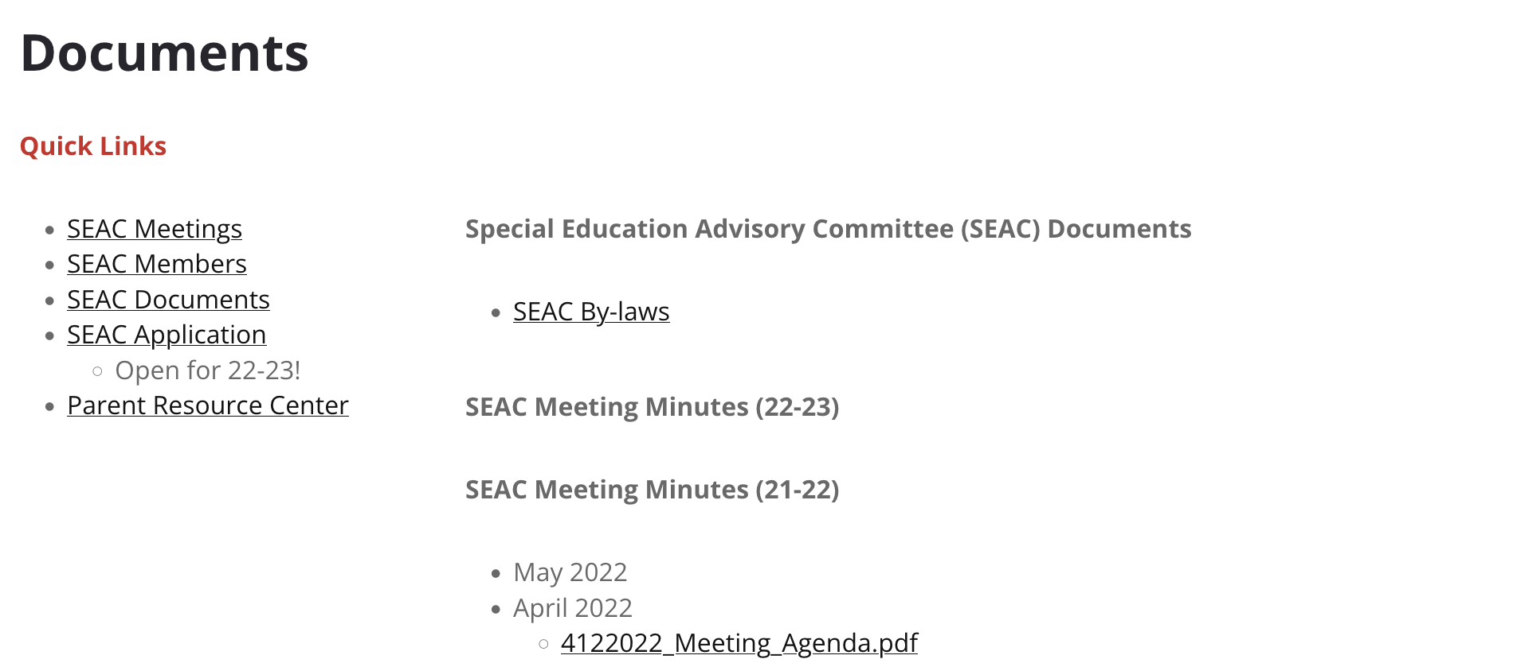
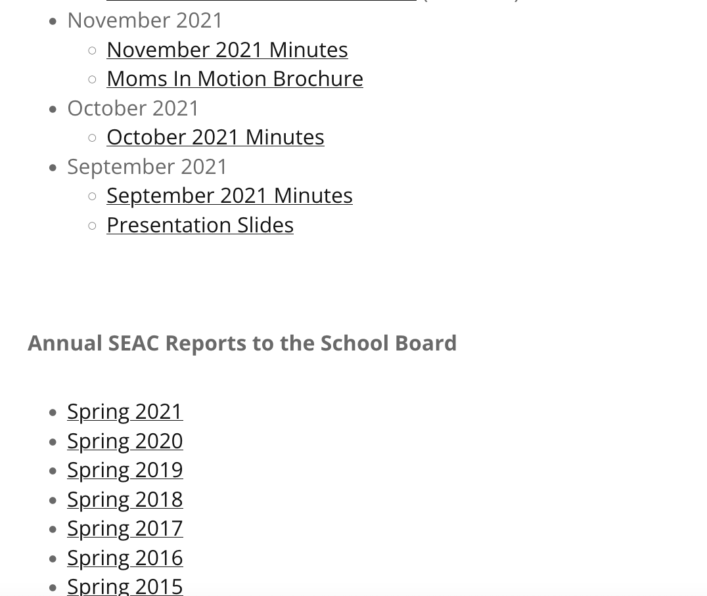

Slide 3
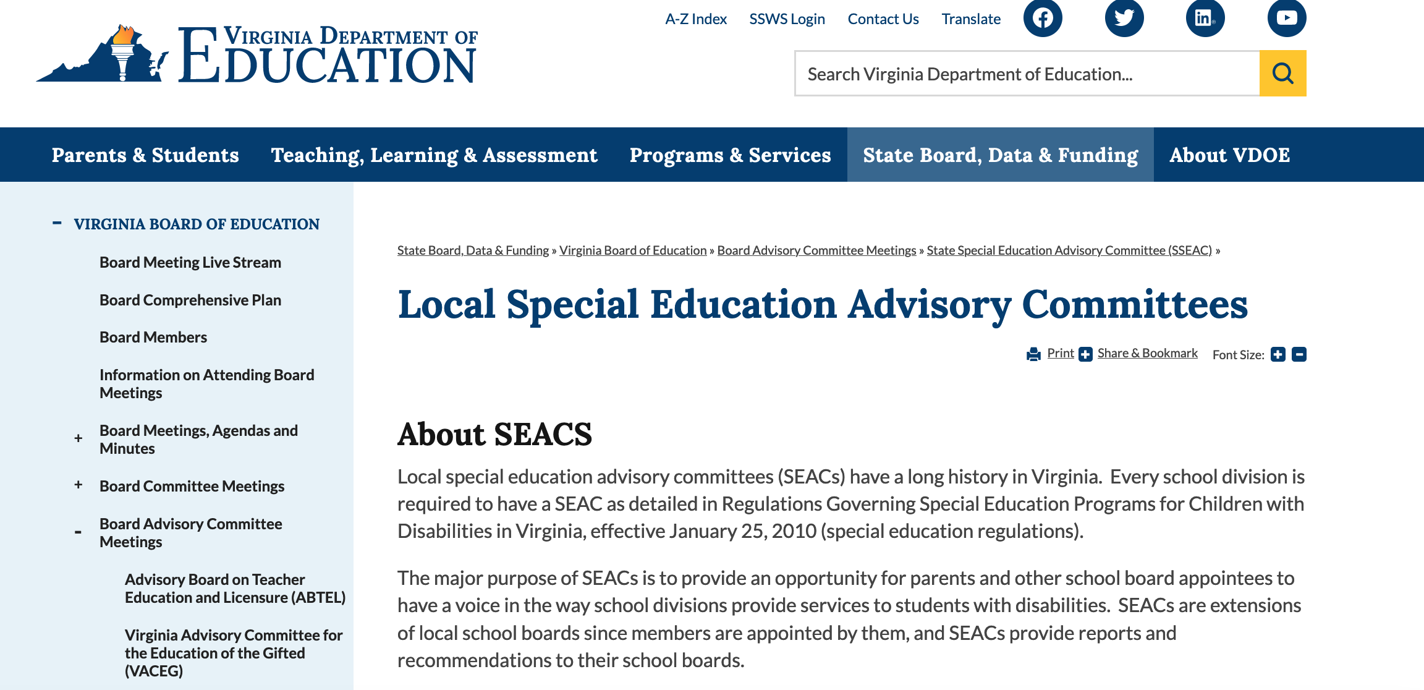
https://www.doe.virginia.gov/data-policy-funding/virginia-board-of-education/board-committee-meetings/state-special-education-advisory-committee-sseac/local-special-education-advisory-committees

Slide 4
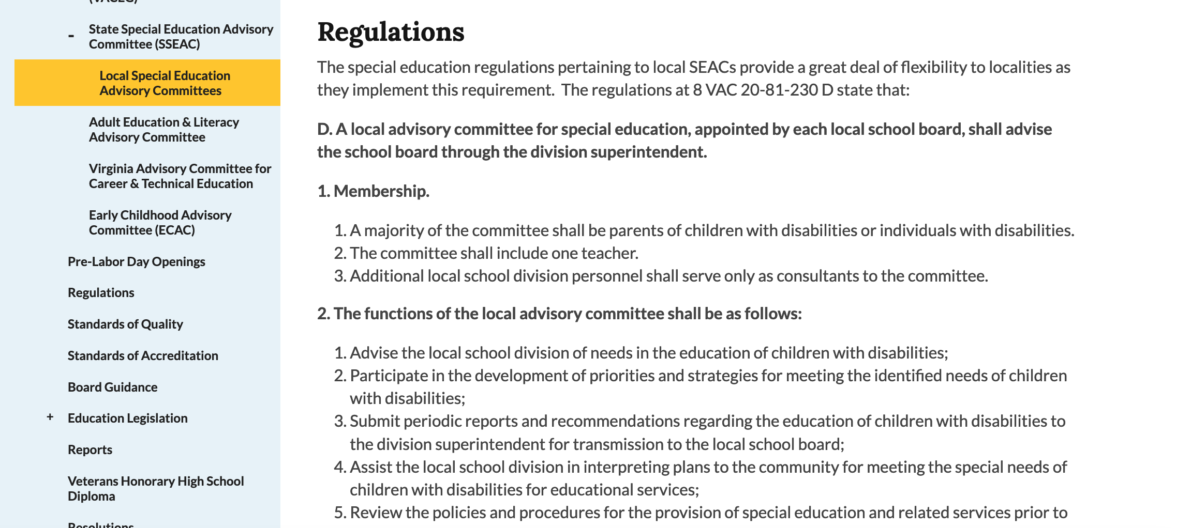
https://www.doe.virginia.gov/data-policy-funding/virginia-board-of-education/board-committee-meetings/state-special-education-advisory-committee-sseac/local-special-education-advisory-committees

Slide 5
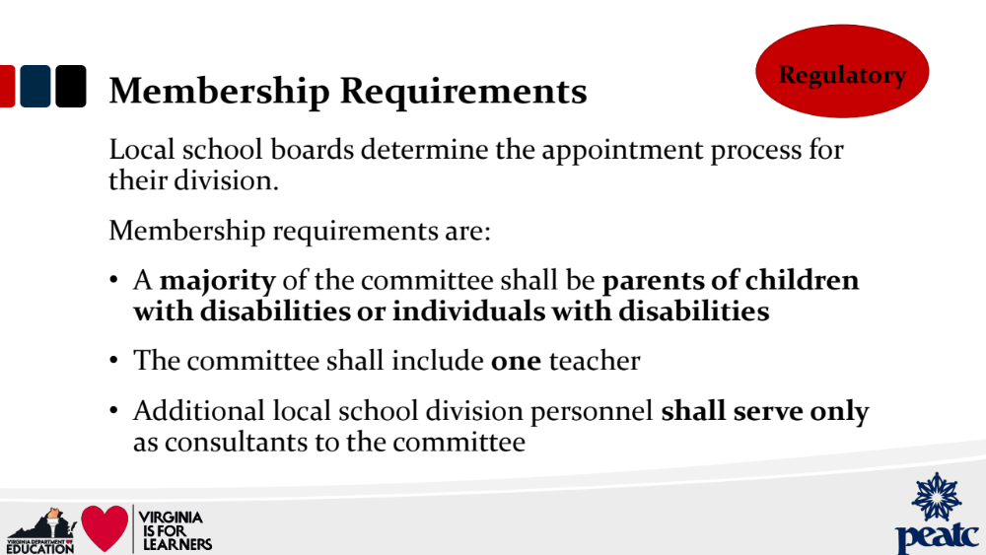

Slide 6
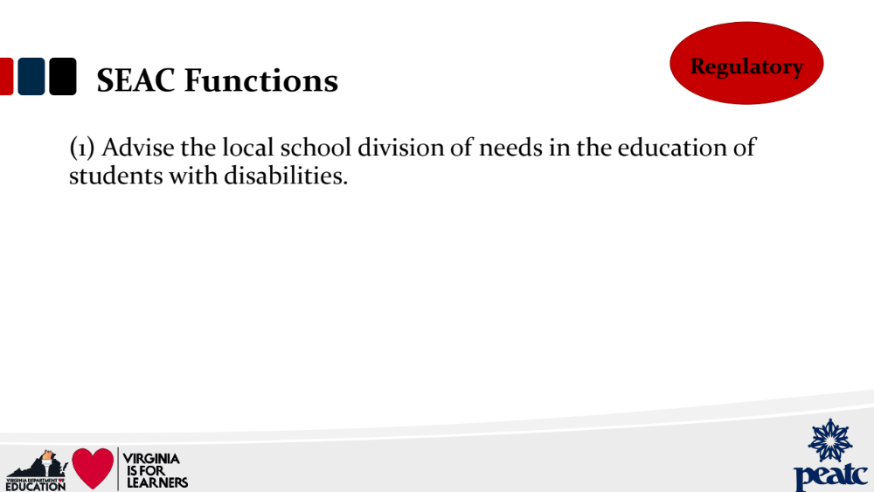

Slide 7
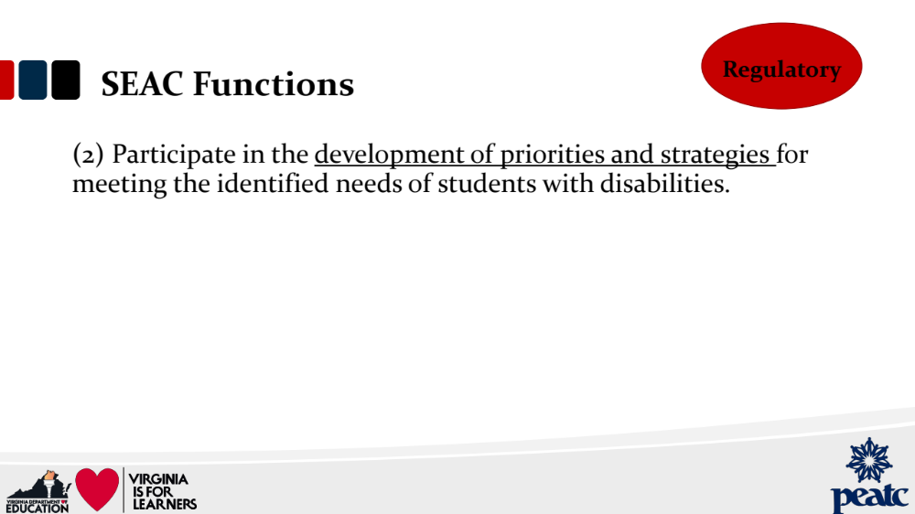

Slide 8
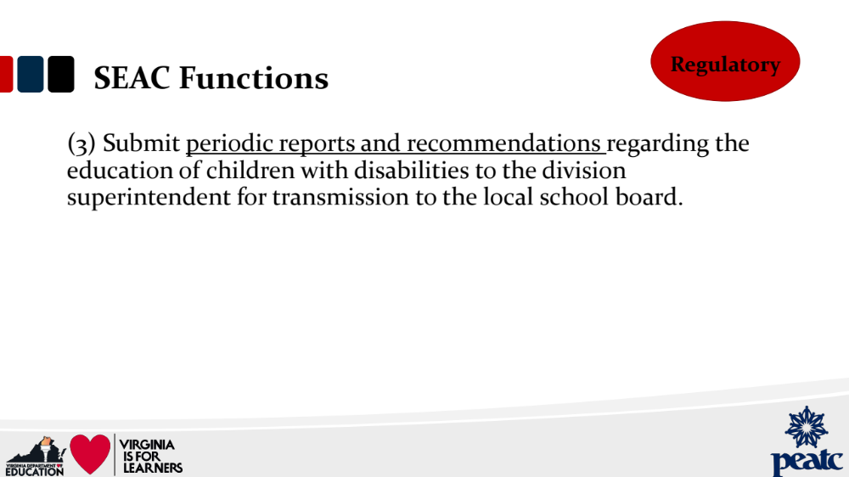

Slide 9
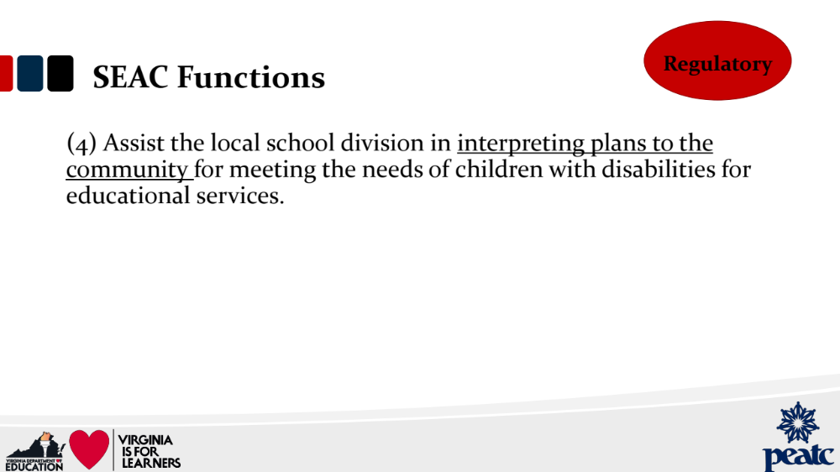

Slide 10


Slide 11
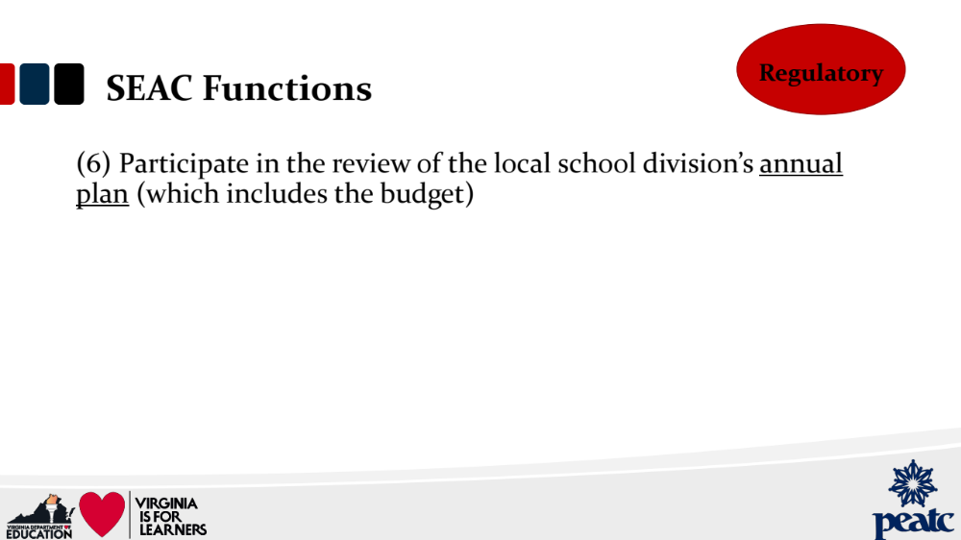

Slide 12
Timeline
Engage with your community and encourage family feedback – beginning now ☺
SEAC family survey – late September/early October
Annual report – finalized by November? Presented to school board in December?
Review of division annual plan, including budget, March?

Slide 13
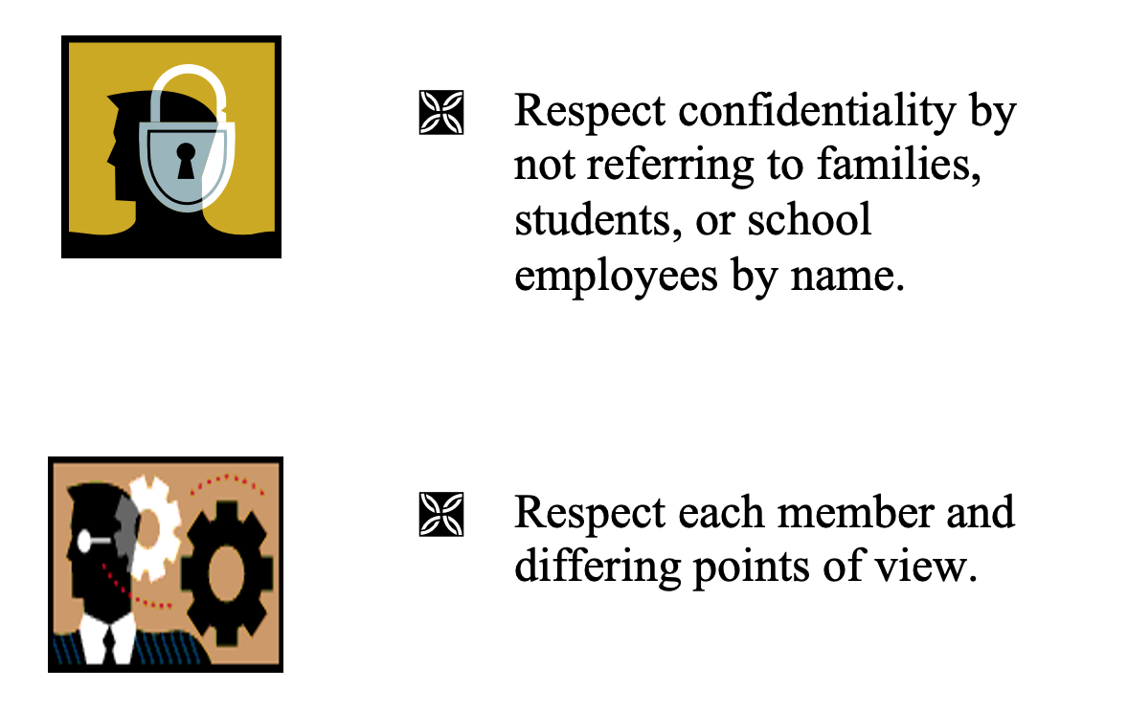
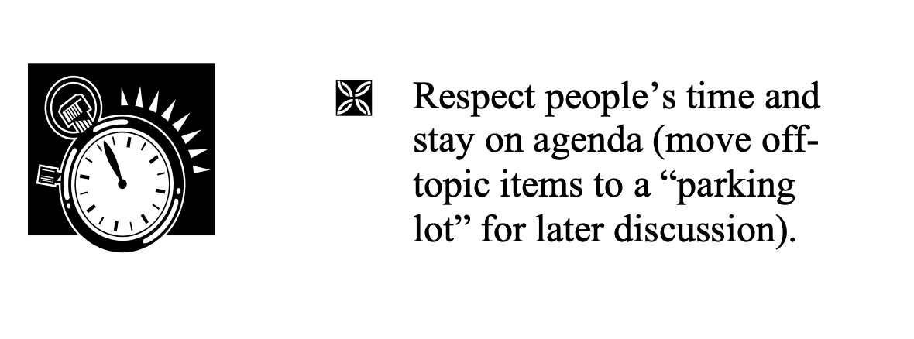
Team Rules

