Slide 1
Annual Review
Strategies for Effective Preparation
Notes:
In order for a parent to participate effectively they need to know the process. The first place to look for clarification is the regs. Regs are the ‘users manual’ for special education.
In NYS it is the Part 200 Regulations that define how special education is established. (show Regs)
You can find the regs online by googling ‘Part 200 Regulations”

Slide 2
Westchester Institute for Human Development:
WIHD www.wihd.org
  University Center for Excellence in Developmental Disabilities
  Develop best practices for individuals with disabilities from birth through adulthood
  Other programs: Parent to Parent, ECDC, RCA, Article 28 Medical Clinic, AT Center

Slide 3
Annual Review Requirements:
The IEP of each student with a disability shall be reviewed and, if appropriate, revised, …not less than annually to determine if the annual goals for the student are being achieved.
Conducted at a CSE or sub-CSE
Based upon review of current IEP and other info pertaining to student performance
          Section 200.4(f)
Notes:
At the annual review, the Committee must:
First paragragh:
Determine if the annuals goals of the student are being achieved
Review, revise and Develop the IEP
Consider student’s progress, current level of functioning and other current information pertaining to the student’s performance.

Slide 4
The Annual Review Meeting:
Strengths of the student
Parental concerns
Evaluation results
Results on state or district-wide assessments
Needs: academic, developmental and functional
Special factors
Educational progress
Ability to participate in regular education and LRE
Section 200.4(f)(1)
Notes:
These are some of the questions that need to be considered at the meeting:
What are some of the successes for the year?
What has been effective for the student?
What does the student need in order to participate successfully in general education?
What concerns do the parent have?
What information has the parent provided?
What do the results of any new evaluations or assessment data indicate about current functioning and needs?
What skills does the student have or need to master content of general education curriculum?
What accommodations, modifications, AT and support and/or related services are necessary for the student to achieve progress towards his annual goals?
Are services or supports indicated on current IEP still necessary?
What special challenges presented themselves this year that need to be addressed?
How has the student changed, and how will that impact his progress towards new goals?
Finally, each year the committee must reconsider LRE and reconsider what that is for the individual student
Each year brings new standards and challenges. For some students, each year represents a transition challenge, with new teachers and new classrooms.
Each student’s IEP must be considered in the context of the student’s changing needs, the new curriculum the student must master, and any State or district wide assessments for that upcoming year.
It is important to consider the fact that the GOALS guide decisions of placement and services. The NEEDS define the goals. It is important to make sure that all areas of need are articulated and discussed in the meeting so that appropriate goals are developed based on accurate present levels of performance. As a Parent be sure to express all your concerns.
Debbie:
At Hastings :
Everyone wants to talk about services
Remember

Slide 5
Let’s get organized . . .How?
Locate your child’s IEP, evaluations, reports, meeting notices, report cards, and all other documents you’ve received from your district
Organize your papers
Review your papers
Prepare a parent report including a list of questions and concerns.
Notes:
How we feel when someone comes to a meeting with draft
Prepare thoughts or lose them

Slide 6

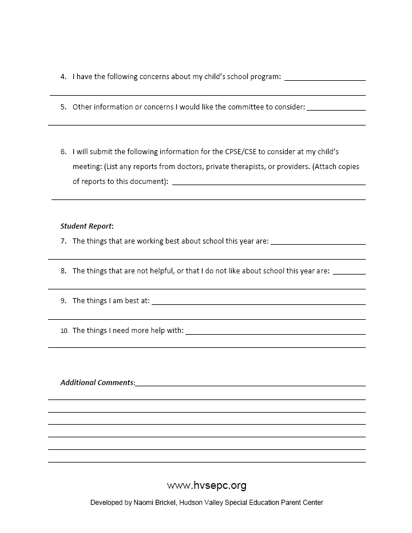
Preparation Tool:

Slide 7
Other considerations…
Remember you are a part of the problem solving team for your child.

Slide 8
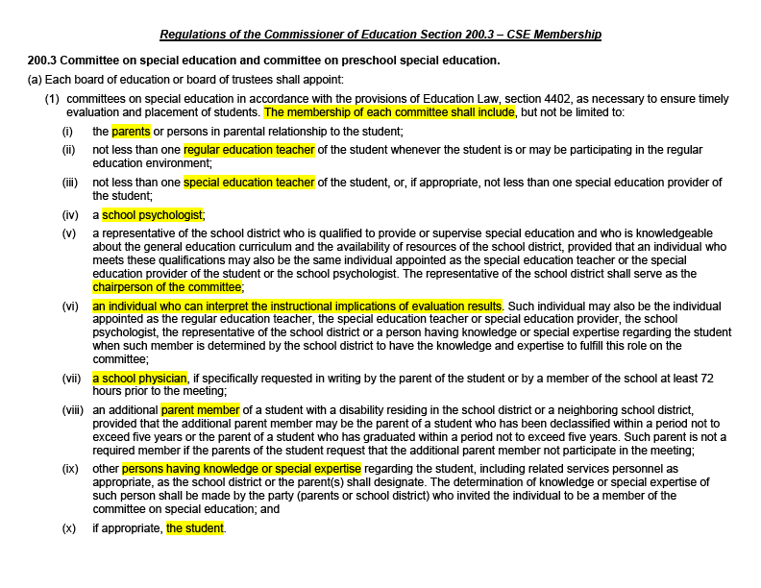
CSE Membership

Slide 9
Other considerations…
Understand the roles of the
other CSE members.
Notes:
Multi-disciplinary process of a committee

Slide 10
Other considerations…
Be active in the evaluation process.
Notes:
Share concerns – Edie story

Slide 11
Other considerations…
Reports
3Rs : request, review, reciprocate
Notes:
Timeline non-existent. Be proactive

Slide 12
Other considerations…
Understand the process of IEP development
  http://www.p12.nysed.gov/specialed/publications/iepguidance.htm
Notes:
Laws, IDEA
The laws are the playbook be familiar with them
LRE – Gen Ed inclusion SWIFT Grant KU $25M
Guide to Quality IEP Development and Implementation
http://www.p12.nysed.gov/specialed/publications/iepguidance.htm
Google NYSED IEP

Slide 13
Other considerations…
Read your child’s IEP!

Slide 14
Other considerations…
Recognize the emotional component.
Notes:
Grief process. We really are crazy parent’s recognize and work on that.
Acorn story

Slide 15





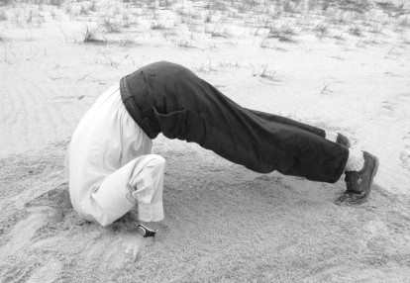
Notes:
Stages of greif _ Mindy story
Jackie Vasquez

Slide 16
Other considerations…
Consider the end goal: What are the desired outcomes for your child?
Notes:
Push
O
CSE process is service driven, intended to be goal driven
Every service imposed takes away opportunity for student to learn the skill
Less is more
Schools don’t think about life after gradualtion – 18 or 21
Colege and Career ready – for all students
Thinking about life after school as early as middle school
ver dependent. Focus on what he can do and where we can go, rather than what he needs.

Slide 17
Other considerations…
Get involved and be informed….

Slide 18
Sometimes we forget who we are there for
-or at least to include him
YOUTH SELF ADVOCACY!
Notes:
JohnPaul story – self-advocacy
Letter in mail – mindy, meaningful particiaption (research)

Slide 19
Contact info:
Phone: (914) 493-7665
Email: nbrickel@wihd.org
Website: www.hvsepc.org

