Slide 1
Dual Enrollment
PORTAL HIGH SCHOOL
FOR SCHOOL YEAR 23-24

Slide 2
What is Dual Enrollment?
Dual Enrollment---You are a high school and college student at the same time. Courses count for high school and college credit
All tuition, mandatory fees, and books are paid for by the Georgia Student Finance Commission
All coursework added to high school transcript, some satisfying graduation requirements.
Students must be in 11th or 12th grade. 10th grade student may be eligible for some classes.
Students may take 30 credit hours total under Dual Enrollment while in high school. (about 10 courses)

Slide 3
Who is eligible for D.E.?
Students who are:
-self-motivated
-independent learners
-be able to handle college responsibilities
Students who meet the criteria of the postsecondary institutions---You must be an 11th or 12th grade student.
Students provide their own transportation to GSU or EGC.
Bulloch BOE planning on bus transportation for OTC for first period; return by end of second period.

Slide 4
Courses you will be taking…
Are college level courses and count toward your High School GPA and High School Hope GPA.
Dual Enrollment courses do not count toward a student’s College Hope GPA. (This restarts after a student graduates from high school).
Dual Enrollment courses do not count toward a student’s College Credit Hour Maximum of 120.

Slide 5
Dual Enrollment Grades
College Grades are given as A, B, C, D, F
But for your high school transcript:
A=99
B=89
C=79
D=70
F=60

Slide 6
STUDENTS MAY TAKE UP TO 30 CREDIT HOURS PAID FOR BY THE GSFC. (TYPICALLY 10 CLASSES)
2 COURSE WITHDRAWAL MAXIMUM (STUDENTS ARE UNABLE TO TAKE MORE COURSES AFTER 2 WD)
STUDENTS CANNOT ENROLL IN THE SAME CLASS 2 TIMES
STUDENTS MUST BE MAKING SATISFACTORY ACADEMIC PROGRESS, AS DETERMINED BY COLLEGE, USUALLY A 2.0 GPA.

Slide 7
Courses available…
Courses are listed in the D.E. Course Directory by institution, located at www.gafutures.org under the Dual Enrollment Application Information.
Examples: College Freshman English ENG 1101, 1102
Sociology SOC 1101, Psychology PSY1101
Welding, Automotive, Nursing
Online will be available—be sure that is a good fit before enrolling.
Some EOC tests are required for D.E. students. American Lit EOC is required.

Slide 8
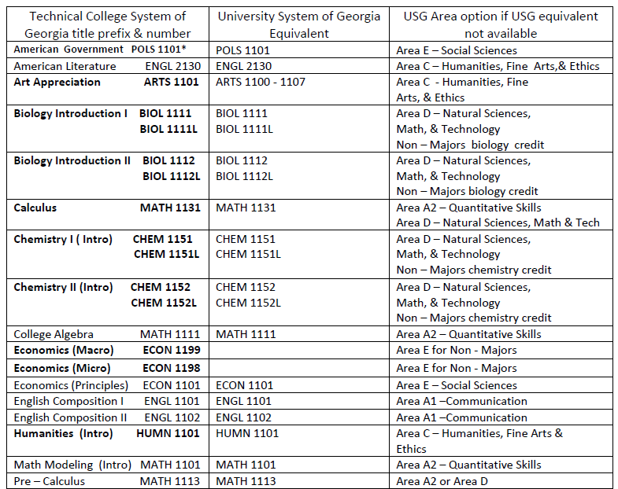
Courses that will transfer from a Technical College in GA to a University System School in Ga.

Slide 9
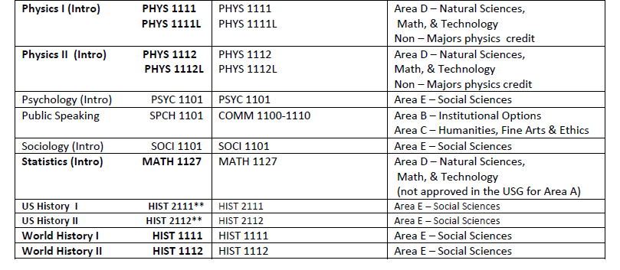
Courses that will transfer from a Technical College in GA to a University System School in Ga. –con’t.

Slide 10
Benefits of D.E.
Earn college credit while still in high school
Get a head start on adjusting to the college experience while still in high school
May be able to take courses that are not offered at our high school.

Slide 11
Requirements for Acceptance
Georgia Southern University
-Academic GPA of 3.0
-Meet PSAT, SAT, ACT or Accuplacer Score requirement
(PSAT or SAT 480 ERW 440 Math) (ACT 17 English or Reading, 17 Math)
(Accuplacer 237 Reading, 4 WritePlacer, 258 Math, 266 for College Algebra)
-To sign up for Accuplacer: call 912-478-5415, (Testing Center, Cone Hall, 2254 Southern Drive, or go online under Ga Southern Admissions Testing----free to take.
Go to www.georgiasouthern.edu/dualenrollment For more information
GSU Dual Enrollment Advisors:
912-478-2564
Devon Hodges dhodges@georgiaSouthern.edu 912-478-5391

Slide 12
Requirements for Acceptance
East GA State College
-Academic GPA of 3.0
www.ega.edu/admissions For more information
Students need qualifying SAT, ACT or Accuplacer.
East GA Advisor:
Swainsboro Campus Mike Moran mmoran@ega.edu 478-289-2022
Statesboro campus 912-623-2400

Slide 13
Ogeechee Technical College
Offers College/University level courses and traditional technical courses. College/University courses will transfer to GSU, UGA, and every other public university in GA. The courses will transfer to most private universities and out of state universities.
Be a Junior or Senior and be at least 16 years old. Some tenth grade students may qualify for certain classes.
Advisors: Lucy Brinson (lbrinson@ogeecheetech.edu) or Catherine Groover (cgroover@ogeecheetech.edu) 912-681-5500

Slide 14
Sample Courses to be offered at OTC
Air Conditioning Repair
Automotive Engine Performance Technician
Electrical Technician (Electrician)
Carpentry
Culinary Arts
Welding
Medical (Nursing, EMT)

Slide 15
Sample OTC Courses Offered (continued)
Academic/University System courses:
English 1101, 1102, 2130,
Psychology 1101, Sociology 1101
History 2111, Music Appreciation
College Algebra Math 1111
(Course list subject to change)

Slide 16
Interested in D.E?
Concentrate on your grades (need 3.0 Academic GPA)
Check Dual Enrollment websites of GSU, EGC, OTC for more information
Learn the application requirements of each institution

Slide 17
Next steps…
Discuss the Dual Enrollment program with your parents
Apply to GSU /EGC or OTC , application fee is waived for Dual Enrollment students. Online application at each College’s Admission Website.
Complete the Dual Enrollment Funding application at www.gafutures.org
Email Mr. Bettinger once you have completed your GSU, EGC or OTC Admissions Application, so we can send your transcript.
If applying to GSU or EGC, sign up through GSU or EGC to take the Accuplacer if you need qualifying score.

Slide 18
Pros and Cons
      GSU
      Pro: More Courses offered at all times of the day
      Con: Sometimes Larger class sizes
      Pro: Organized, professional staff and campus
      EGC
      Pro: Smaller Class Sizes
      OTC
      Pro: Morning Class Program with bus transportation
      Pro: Morning Classes with other Bulloch High School students
      Con: Fewest Academic Courses to Choose
      Pro: Smaller Class Sizes

Slide 19
My Recommendation:
Most of our students are doing Dual Enrollment with OTC. Currently, We have about 51 at OTC, 9 at GSU and 3 at EGSC……..OTC offers small class sizes and mostly high school students in their morning Academic classes. We also have a bus going to OTC in the morning at 8:00 AM and returning at 10:00 AM for students to take a class on M/ W or Tue/Th.
For students starting out in Dual Enrollment, I recommend most of our students to start at OTC as 11th grade. Students can then continue at OTC or apply to GSU or EGSC as 12th graders if they want to. The courses at GSU and EGSC are slightly more challenging than at OTC from what I have seen and heard from students. So, starting at OTC makes the most sense for most of our students. I recommend taking 1 or 2 classes per semester in the morning at OTC for most 11th grade students. The typical 11th grade Dual Enrollment student should take English 1101, Hist 2111 or 2112, English 2130 and Psychology 1101 or Sociology 1101.

