Slide 1
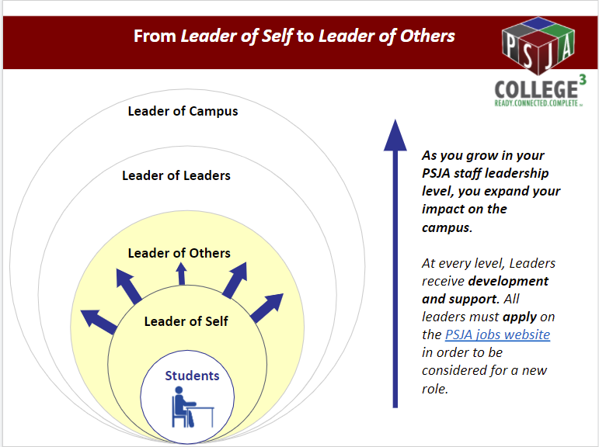
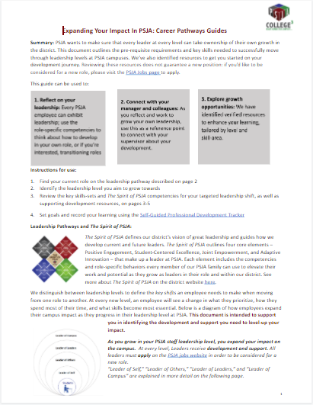
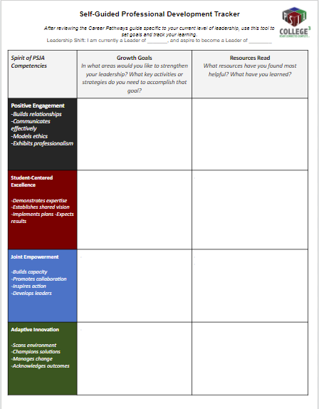
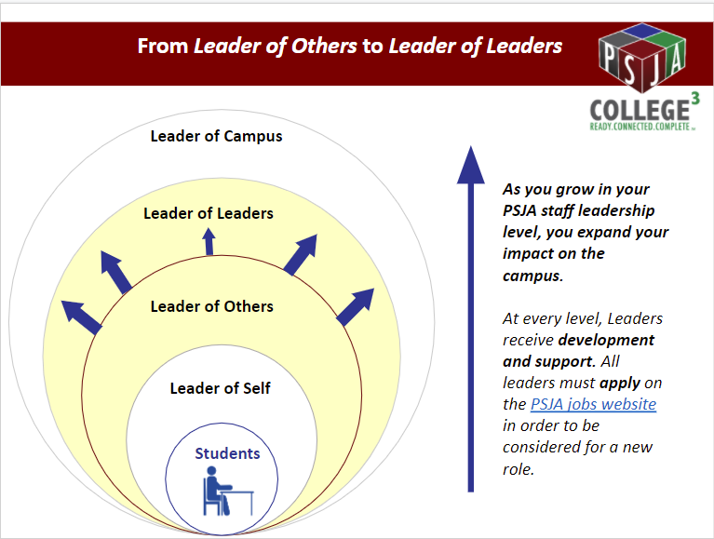
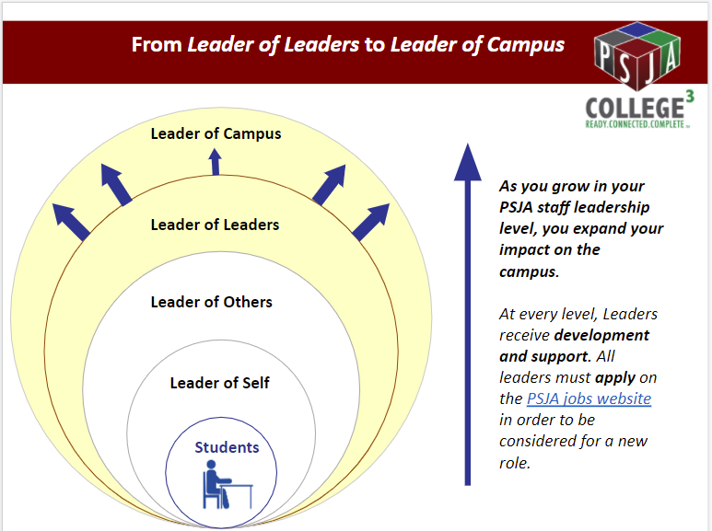
Expanding Your Impact in PSJA:
Resources Instructions
The district has created several tools to support you in owning your own growth and development.
If you are a.... | ...and you want an in-depth guide to career pathways, first read these instructions, and then read the booklet specific to your level: | ...or, if you want a summary guide, read this: | We also recommend you track your learning using this tool:
Teacher (“Leader of Self”)
Collaborative Learning Leader, Content Department Head, Grade Level Chair, or Instructional Coach (“Leader of Others”)
Assistant Principal (“Leader of Leaders”)
Guide 1: Leader of Self to Leader of Others Booklet
Guide 2:
Leader of Others to Leader of Leaders Booklet
Guide 3:
Leader of Leaders to Leader of Campus Booklet
“Quick-Read” Career Pathways Guide, with one-pagers for each leadership shift
Self-Guided Professional Development Tracker
Please note: Reviewing these resources does not guarantee a new position: if you’d like to be considered for a new role, please visit the PSJA Jobs page to apply.

