Slide 1
Expanding Your Impact in PSJA:
Introduction to Career Pathways Guidebooks

Slide 2
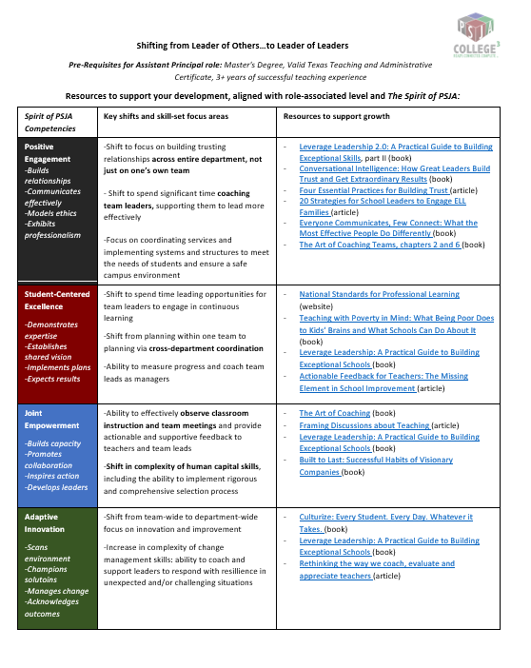

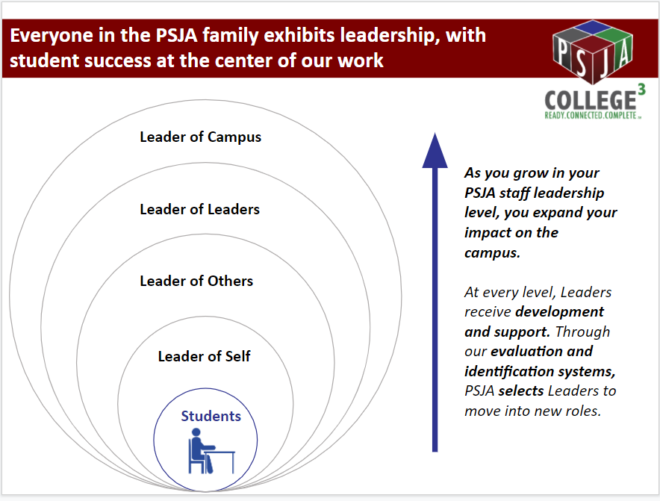
PSJA has developed resources to provide clear career pathways and support you in owning your growth
We are committed to clarity and transparency around the leadership competencies that are critical to success at every level of campus leadership.
Resources to support you in your career development:
The Spirit of PJSA
“Quick Read” Shift Descriptions + Development Tools
Descriptions of Leadership Shifts + Development Tools
We’ve worked together to create a common language around leadership and clarity on what it looks like at all level
We’ve created booklet guides for every leadership level that outline key distinctions between roles and development opportunities to help you expand your impact
We’ve also created one-page summaries of the key shifts involved in expanding your impact at every level in the campus leadership pathway

Slide 3
Guides for Growth in Campus Leadership: Descriptions of Leadership Shifts + Development Tools

Slide 4
PSJA’s guides outline key distinctions in responsibilities and skills at every level of campus leadership
For staff at every level of leadership, these guides can be used to:
Reflect on your leadership
Every PSJA employee can exhibit leadership; use the role-specific competencies to think about how to develop in your own role, or if you’re interested, transitioning roles
Explore growth opportunities
We have identified verified resources to enhance your learning, tailored by level and skill-area.
Connect with your manager and colleagues
As you reflect and work to grow your own leadership, use this as a reference point to connect with your supervisor about your development.
For a “quick-read” summary of each leadership shift, see this document.
Please note: Reviewing these resources does not guarantee a new position: if you’d like to be considered for a new role, please visit the PSJA Jobs page to apply.

Slide 5
To guide you in owning your development, these resources define key skills & growth opportunities at every level
Instructions for use:
Find your current role on the leadership pipeline described in slides 9 and 10
Identify the leadership level you aim to grow towards
Review the key shifts in responsibilities and skills, aligned with The Spirit of PSJA
As you reflect on and work to grow your leadership skills, feel free to use this document as a reference point to connect with your supervisor about expanding your impact within PSJA.
Please note: Reviewing these resources does not guarantee a new position: if you’d like to be considered for a new role, please visit the PSJA Jobs page to apply.

Slide 6
The Spirit of PSJA and Role-Specific Framework & Behaviors

Slide 7
The Spirit of PSJA defines our vision of great leadership
and guides how we develop our current and future leaders
The Spirit of PSJA was developed in partnership with several members of the PSJA Family through a comprehensive process during the 2017-2018 school year.
The goal is for this definition to be used by each member of the family to evaluate their work and potential as they continue to grow as leaders within their role and within our organization.
To learn more about our leadership definition, watch this video:
https://player.vimeo.com/video/297334573
Spirit of PSJA - Ice Breaker

Slide 8
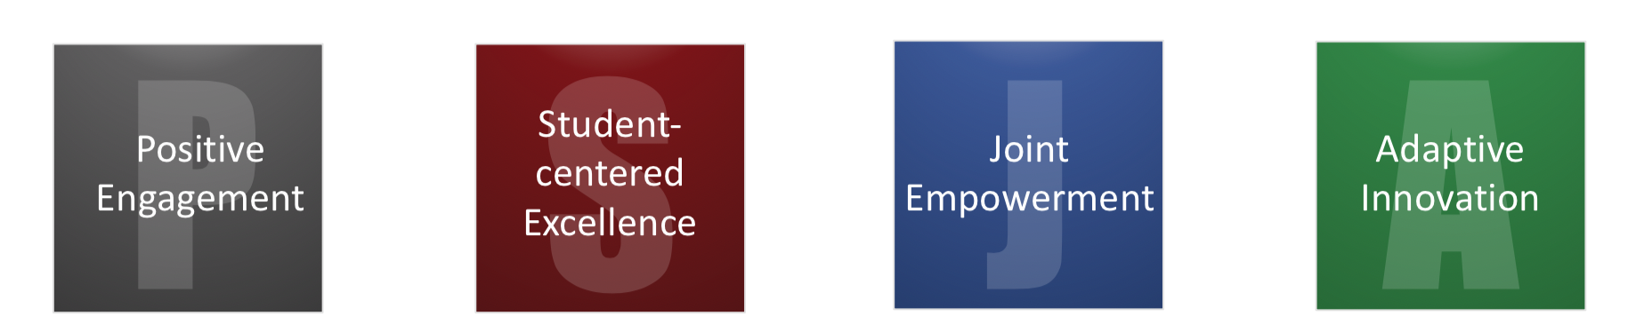
The Spirit of PSJA outlines 4 core categories of leadership—
each one contains multiple characteristics and behaviors
Spirit of PSJA - Ice Breaker
Welcomes staff, students, parents, and community as honored members at the district table
Holds vision and expectations for success for all students and all staff
Develops and empowers individuals and teams for effective action
Maintains district at the forefront of educational service providers
Click here to see the full version of The Spirit of PSJA, broken down into competencies and role-specific behaviors

Slide 9

Everyone in the PSJA family exhibits leadership, with
student success at the center of our work
Leader of Campus
As you grow in your PSJA staff leadership level, you expand your impact on the campus.
At every level, Leaders receive development and support. All leaders must apply on the PSJA jobs website in order to be considered for a new role.
Leader of Leaders
Leader of Others
Leader of Self
Students

Slide 10
We distinguish between leadership levels to define the
key shifts in moving from one role to another…
 | Leader of Self | Leader of Others | Leader of Leaders | Leader of Campus
Overview | Individual contributor, team player, role model for junior/new team members | Leads a team and is responsible for delivering results through others | Delivers results through other leaders; develops the skills of other leaders and creates conditions for them to succeed | Is accountable for the culture and performance of the campus
Roles | Teacher Librarian Counselor Nurse Teacher Aide Social Worker + More | Collaborative Learning Facilitator Content Department Heads Grade Level Chair Instructional Coach | Assistant Principal | Principal
Pre- Requisites | Bachelor’s degree Valid Texas teaching certificate with required endorsements or training for subject and level assigned One-year student teaching or approved internship | Bachelor’s degree Valid Texas teaching certificate with required endorsements or training for subject and level assigned 3+ years of successful teaching | Master's Degree Valid Texas Teaching and Administrative Certificate 3+ years of successful teaching experience | Master's Degree Valid Texas Teaching and Administrative Certificate 3 Years of successful teaching experience 5 years of experience in instructional leadership in a school or district level
Where on the leadership pipeline does your current role sit? Where would you like to go? These reflections should guide your development plan.

Slide 11
…because for every shift in leadership level, a leader faces
new priorities and leverages new skills
 | From Leading Self…to Leading Others | From Leading Others…to Leading Leaders | From Leading Leaders…to Leading the Campus
What are the changes in my priorities and values? | Shift from focusing on “doing the work” to getting work done through others | Shift to take a department-wide view, rather than thinking of just one team | Shift from a department-wide to a campus-wide perspective; value a shared vision and longer-term strategy and goals
What are the changes in how I spend my time? | In addition completing role-assigned work, spend time getting work done through others | Time is now spent almost entirely on managing others and coaching them to be more effective, not on individual contributions | Shift to spending a significant amount of time on strategic, long-term planning and inspiring the entire employee population
What skills become most essential? | Planning work, assigning work, motivating, coaching, and measuring the work of others | Ability to assign leadership work to “leaders of leaders,” measure their progress, and coach them as managers; department-wide budget management | Skills related to longer-term strategic and cross-functional thinking, and differentiated communication skills; campus-wide budgeting and strategic planning

Slide 12
For example, this pathway in campus leadership includes three key shifts
Shift:
Leads leaders to leads organization
Shift:
Leads others to leads leaders
Principal
Shift:
Leads self to leads others
Prerequisites for this role:
Master's Degree
Valid Texas Teaching and Administrative Certificate
Three (3) Years of successful teaching experience
Five (5) years of experience in instructional leadership in a school or district level
Assistant Principal
Collaborative Learning Leader (CLL)
Prerequisites for this role:
Master's Degree
Valid Texas Teaching and Administrative Certificate
Three (3) Years of successful teaching experience
Teacher
Prerequisites for this role:
Bachelor’s degree
Valid Texas teaching certificate with required endorsements or training for subject assigned
3+ years of successful teaching
Prerequisites for this role:
Bachelor’s degree
Valid Texas teaching certificate with required endorsements or training for subject and level assigned
One-year student teaching or approved internship
Key technical skill shifts:
More complex skills in instructional leadership, human capital, and operations areas, especially relating to evaluating teaching effectiveness. As an AP, they will also manage a department budget.
Key technical skill shifts: Ability to manage campus-wide budgets, and develop and implement campus-wide strategic plans aligned with campus and district vision and goals
Key technical skill shifts:
New skills are needed to coach and develop teachers and improve the quality of classroom teaching.

Slide 13
Now, open the toolkit for your specific shift. There, you’ll find a detailed look at how your shift aligns with The Spirit of PSJA, and resources to support your growth and development.
Click here if you are a teacher and you aspire to become a CLL or other Leader of Others role
Click here if you are a CLL or other Leader of Others role, and you aspire to become an AP or other Leader of Leaders role
Click here if you are an AP or other Leader of Leaders role and you aspire to become a Principal

