Slide 1

Facilities Maintenance
770-473-2825
Extension 160100
Help Completing the Clayton County Public Schools
Facility Use Contract

Slide 2
Clayton County Public Schools Facility Usage Board Regulation:
Before submitting a Facility Use Contract, please take a moment to review the CCPS Facility Usage Board Regulation, linked below.
As outlined in Board Regulation KG-R(1):
“The Clayton County Public Schools (CCPS) Superintendent and/or designee may grant the temporary use of school facilities to other organizations as provided herein. The Principal or designated Building Administrator has primary custody of school facilities assigned to him/her by the Superintendent and Board of Education and must have knowledge of the group that wishes to use the facility and must personally approve the person to be in charge of the activity.”
https://simbli.eboardsolutions.com/ePolicy/policy.aspx?PC=KG-R(1)&Sch=4038&S=4038&C=K&RevNo=1.22&T=A&Z=R&St=ADOPTED&PG=6&SN=true

Slide 3
Your role in the approval process:
Applicants: It is the role of the applicant to complete the Facility Use contract, obtain the insurance policy and the certificate of insurance, and provide payment for the facility 48 hours prior to the event date. Before submitting a Facility Use contract, please be reminded to review the procedure located on the CCPS Maintenance website. For further assistance and clarification, please call Maintenance; 770-473-2825, dial 9.
Schools/ Facilities: It is the role of the Building Administrator to notify applicants of any updates to the Facility Use contract and to review the contents before submitting to the Area Superintendent’s Office.
Area Superintendent/ Safety and Security: It is the role of these departments to review Facility Use contracts before sending to the next step in the approval process.
***Director of Nutrition: In the event that the kitchen is being requested for a contract, the signature of the Director of Nutrition must be obtained before an approval is issued.
Maintenance: Maintenance reviews contracts and contacts the locations if more information or a correction is needed. Once all required information and signatures are received, Maintenance notifies the school and departments of the approval.
STEP 1
Applicant contacts the Building Administrator to determine availability
STEP 2
Applicant contacts Safety and Security to inquire potential safety charges.
STEP 7
Safety and Security reviews the contract, signs and submits original contract to Maintenance.
STEP 8
Maintenance reviews the contract to ensure it is complete and that all required documents have been received, assigns a contract number, and emails the contract to all departments.
Step 9
Principal/Building Administrator informs applicant of status and forwards payment and copy of the approved contract to business services for deposit
STEP 4
Building Administrator reviews contract and completes “Principal’s Recommendation for Fee Waiver”
STEP 5
Building Administrator submits original contract with signatures to the Area Superintendent’s office.
STEP 3
Applicant completes and signs Facility Use contract and submits (with cert. of insurance AND policy) to Building Administrator. ***
STEP 6
Area Superintendent’s office reviews contract, provides a signature and submits the original contract to Safety and Security.

Slide 4
How to Locate the Facility Use Contract
Always print the Facility Use contract directly from the Clayton County Public Schools Maintenance website in order to ensure that the most recent contract and price list is being used. Out dated contracts will not be issued an approval.
www.clayton.k12.ga.us
Use of Facilities
(Left hand side bar)
Departments
Maintenance

Slide 5
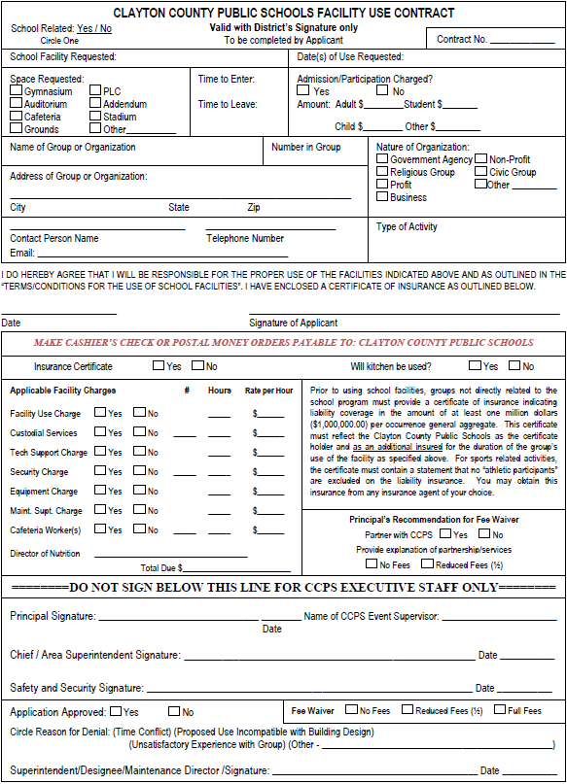
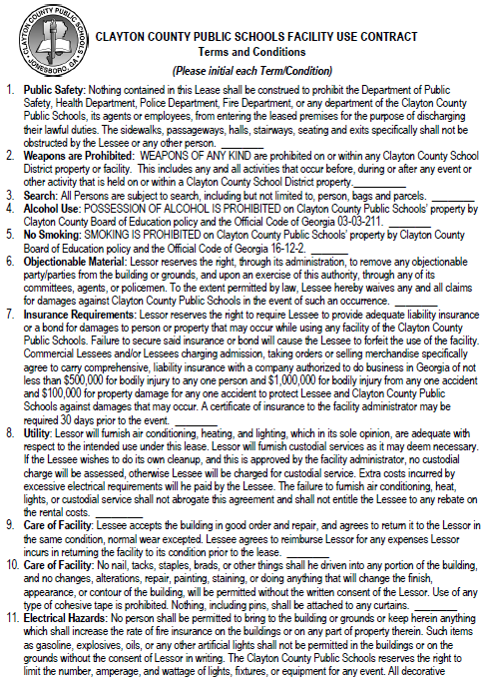
Completing the Facility Use Contract
The Clayton County Facility Use Contract includes 3 pages of Terms and Conditions. Each item must be initialed by the requesting group/ organization. If the contract and/or the terms and conditions are not filled out entirely, the approval for the contract will be delayed.

Slide 6
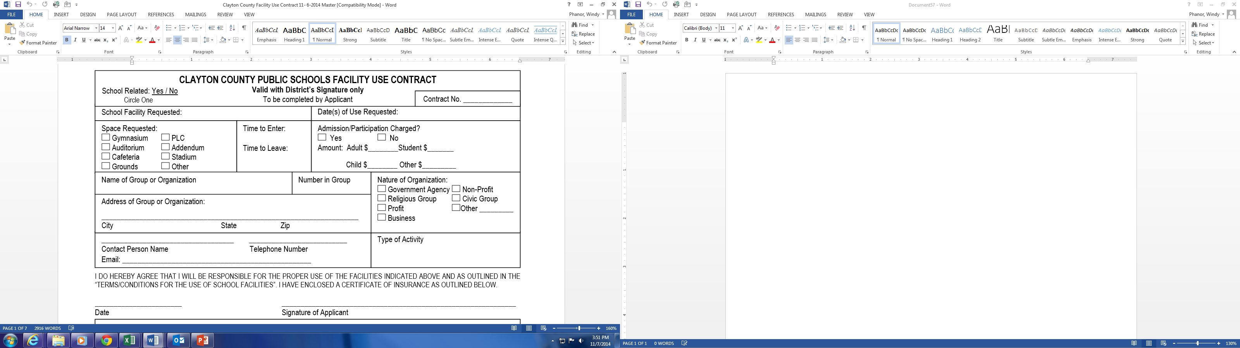
Completing the Facility Use Contract
Applicants MUST:
Complete the entire top portion of the contract
Review and initial each Term and Condition
Provide payment in the form of a Cashier’s Check or Postal Money Order
Maintenance HS 5/5/2018
X
6:30 pm
9:30 pm
X
$ 8.00
$ 4.00
Provide a certificate of insurance, which must reflect “Clayton County Public Schools 1058 Fifth Avenue, Jonesboro GA 30236” as the certificate holder and as an additional insured
Note:
This is a legal document. Please do not leave any section blank or your contract cannot be processed.
Organization Name 80
X
1234 Rental Ave
Jonesboro GA 30234
John Doe 770 ###-####
Johndoe@gmail.com Dance Off/ Contest
October 1, xxxx John Doe

Slide 7
Certificate of Insurance & Insurance Policy
Prior to using school facilities, groups not directly related to the school program must provide a Certificate of Insurance in addition to the Insurance Policy indicating liability coverage in the amount of at least one million dollars ($1,000,000.00) per occurrence general aggregate. The certificate must reflect Clayton County Public Schools as the Certificate Holder and as an Additional Insured for the duration of the group's use of the facility as specified above.
For sports related activities, the certificate must state that no "athletic participants" are excluded on the liability insurance.
An insurance agent of your choice can provide this coverage.

Slide 8
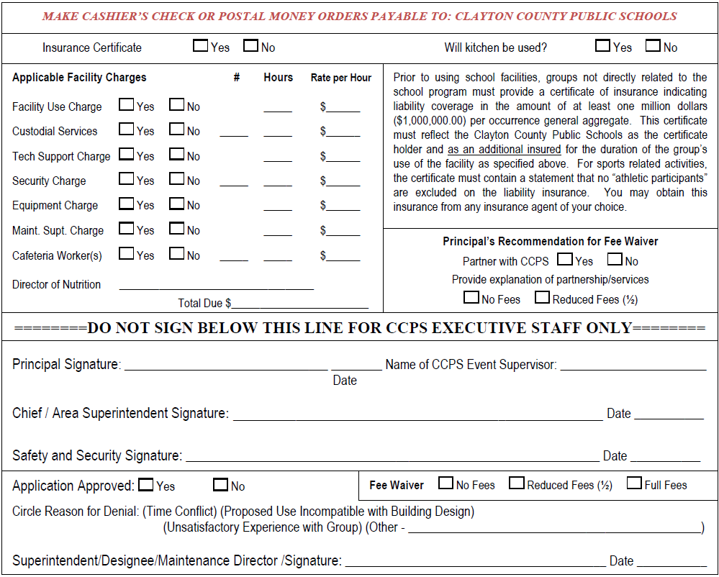

Principal/ Building Administrator must:
Completing the Facility Use Contract
verify that all sections of the contract are complete and required documents are received
complete the “Applicable Facility Charges” section using the price list to calculate total due (contact departments i.e. Safety & Security and School Nutrition, to determine proper charges)
verify that insurance policy is received and that certificate of insurance reflects CCPS as the certificate holder
approve or deny contract
forward the original signed contract, insurance certificate and policy, and a copy of the payment to the Area Superintendent
keep a copy of all forwarded documents for your records
forward the payment (Cashier’s Check or Postal Money Order) to Alma Phillips in Business Services on a cash collection form
Safety & Security will determine how many officers will be required for each event.
Maintenance Department will give the final decision by denying or approving/signing the contract.
X 3 150
X 3 35
X
X
X
X
Principal Signature 10/6/xx School Contact
& Phone Number
X 2 3 45
$ 825.00
Area Superintendent Signature 10/10/xx
Safety and Security’s Signature 10/14/xx
X
Maintenance Director’s Signature 10/20/xx

Slide 9
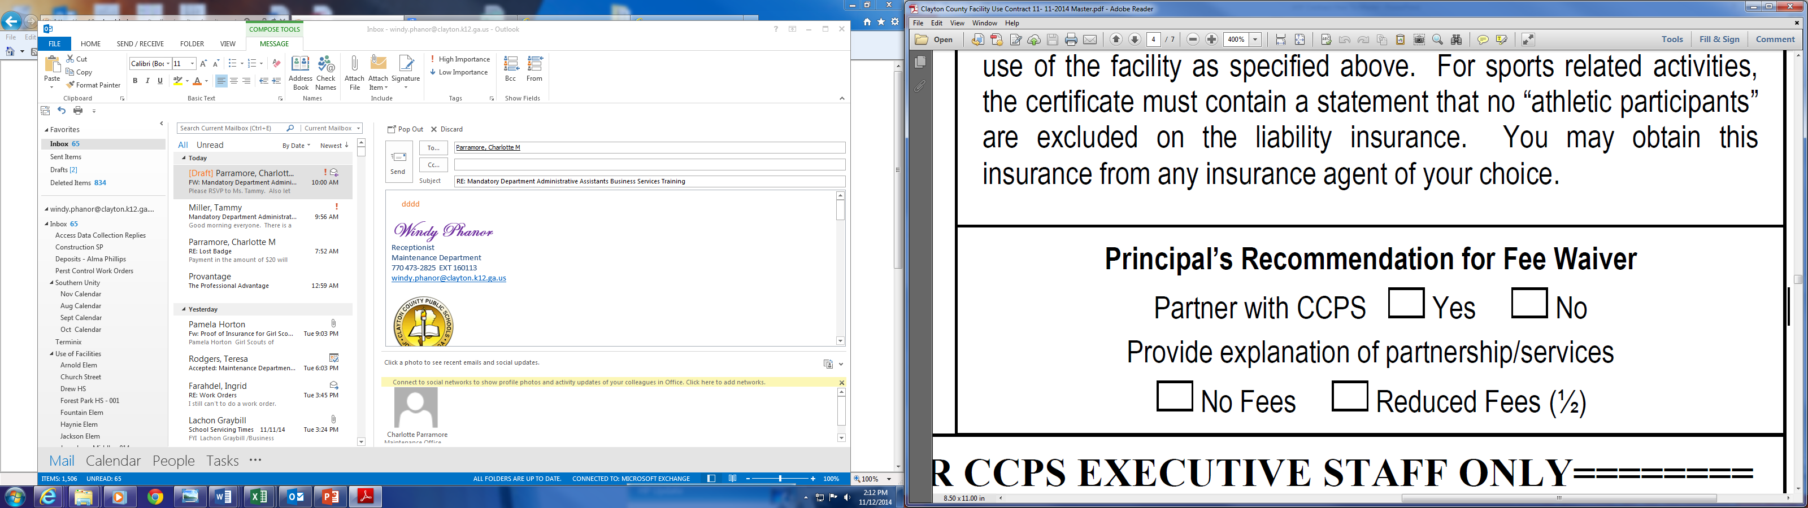
Principal’s Recommendation for Fee Waiver
If the Principal/ Building Administrator would like to request that a contract be approved for no or reduced fees, they must provide a letter dated and signed that outlines the following:
Explanation of the already established partnership between the organization and CCPS.
Account of in-kind or monetary services that the organization has donated to CCPS.
Why this organization should be eligible for reduced facility usage fees.
**Note that ONLY the Facility Use Fees may be considered for reduction, all other fees are still applicable unless otherwise stated by the Superintendent and/or Designee .
As stated in Clayton County Public Schools Board of Education regulation KG-R(1), “Facility fees may be waived for activities that are directly related to school programs and/or youth centered, provided there is no admission fee for the activity involved...Superintendent and/or Designee will give final approval for waivers of fees.“

Slide 10
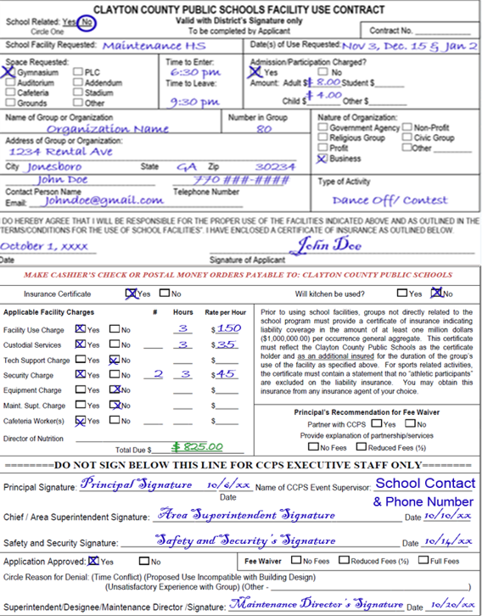
Facility Use Contract Approvals
Once the contract has been signed and approved by the Maintenance Director or Designee:
a contract number will be assigned
the contract will be scanned and emailed to:
  Principal/Building Administrator
  Facility Bookkeeper
  Area Superintendent
  Energy Management
  Safety and Security
  Nutrition Director (If applicable)

Slide 11
CCPS Facility Use Contract
Who to Contact:
Schools and Facilities Contact individual School or Facility
Performing Arts Center Rental (PAC) Contact PAC at 770-473-2875
Professional Learning Center (PLC) Contact PLC at 770-473-2795
School Field Rentals Contact individual School Athletic Director
Stadium Rentals Contact Athletic Director 770-473-2845

Slide 12
CCPS Facility Use Contract
Points to remember:
Allow at least 2 -3 weeks to process request.
The most updated contract should always be used (Facilities/Maintenance website).
To avoid delays, the certificate of insurance and insurance policy should be provided when the contract is submitted or no later than 48 hours prior to the event date.
Clayton County Public Schools 1058 Fifth Avenue, Jonesboro 30236 (as stated) should be listed as the Certificate Holder.
To avoid delays, payment must be received when the contract is submitted or no later than 48 hours prior to the event date.
Payment must be made in the form of a Cashier’s Check or Postal Money Order no personal checks or cash will be accepted.
Payments should be made payable to Clayton County Public Schools with a copy of payment forwarded to Maintenance and applicable departments for record keeping (Custodial, Safety and Security, etc.). Please scan a copy of the payment and email it to the Maintenance Admin, or forward via Interoffice with the contract.

Slide 13
Facility Use Contract
For any further assistance, please contact the Maintenance office:
770-473-2825, dial 9
Extension 160100
Thank you.

