Slide 1

Bullying in the 21st Century....
LaSalle-Peru Township High School
Town Hall Meeting
February 19, 2015
Notes:
Steve W

Slide 2

WE BELIEVE THAT...
...STUDENTs NEED A SAFE SCHOOL.
Source: LPHS District Beliefs
Notes:
Steve W

Slide 3
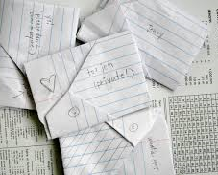
Remember when passing notes looked like this??
Notes:
Steve W

Slide 4






“PASSING NOTES” in the 21st Century
Notes:
Steve W

Slide 5
Defining Bullying & Cyberbullying……
Public Acts 98-0669 & 98-0801
Any severe or pervasive physical or verbal act or conduct, including communications made in writing or electronically, directed toward a student or students that has or can be reasonably predicted to have the effect of one or more of the following…..
Placing the student or students in reasonable fear or harm to the student‘s or students’ person or property;
Causing a substantially detrimental effect on the student’s or students’ physical or mental health;
Substantially interfering with the student’s or students’ academic performance; or
Substantially interfering with the student’s or students’ ability to participate in or benefit from the services, activities, or privileges provided by a school.
Recent changes in the law….
January 1, 2015 ~ School district access to students’ social media passwords if evidence of a school rule/policy violation.
Notes:
Steve W & Matt

Slide 6
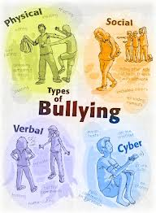
Forms of Bullying (not an exhaustive list)
Harassment
Threats
Intimidation
Stalking
Physical Violence
Sexual Harassment
Sexual Violence
Theft
Public Humiliation
Destruction of Property
Retaliation for asserting or alleging an act of bullying
Notes:
Steve S

Slide 7
Parents- Did you know?
Conflict- is a natural part of development it may be defined as a struggle or contest between people with opposing needs, ideas, beliefs, values, or goals.
Bullying- is aggressive behavior that is intentional, repeated over time, and involves an imbalance of power or struggle.
Notes:
Steve S.

Slide 8
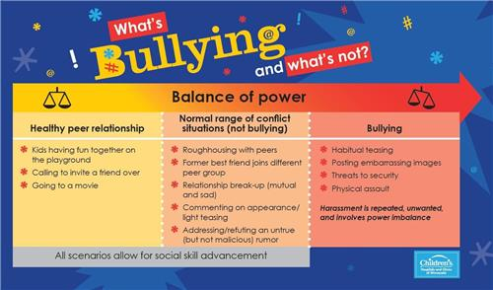
Notes:
Steve S

Slide 9

Addressing bullying at LPHS
Notes:
Jeremiah

Slide 10
Who Do I Report To...
In School and/or Connected to School
Non-School Related
District Website
Students
  Security
  Counselor
  Teacher
  Dean
  Nurse
  School Psychologist
  Social Worker
  Administration
  Resource Officer
Parents
  Counselor
  Social Worker
  Dean
  Administration
Students
  Parents
  Police
  Resource Officer
Parents
  Police
Notes:
Matt and Jeremiah

Slide 11

LPHS Procedures
ALL reports are Investigated!
This includes getting statements from:
  Students Involved
  Witnesses
Areas of importance during an investigation...
  1. Witnesses
  2. Documentation
  (notes, social media, etc.)
  3. Time
  4. Location
Notes:
Jeremiah

Slide 12
LPHS Resources
STUDENT SUPPORT SERVICES
Counselors/Psychologist/Social Worker
Education (large group or individual)
Individual counseling
  Advocate
  Educate
  Teach coping skills
  Gather information
Group counseling
Referral services
ENCOURAGEMENT
Students are encouraged to...
Select positive peers
Get involved
  Athletics & Activities
Learn positive social skills
**Encourage student to walk away and report to an appropriate adult
Notes:
Emmy

Slide 13

Parents - Pay Attention
Unexplained Injuries
Change in Behavior
Lost or Destroyed Personal Items
Change in Eating Habits
Avoidance of School or Social Situations
Monitor General Behaviors
Monitor Social Media
  Know Passwords
  Know How to Block Others
  Know How to Report
Notes:
Emmy

Slide 14
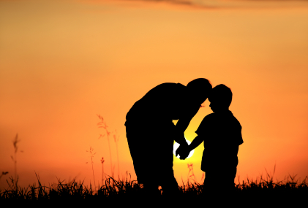
Parents –
What do I do if the bully is my child?
Take the problem seriously
Listen carefully and verify the facts
Explore reasons for your child’s negative behavior
Hold your child accountable
Help your child change their behavior
  Clear and consistent family rules
  Follow through with consequences
  Monitor your child’s social media and other activities
  Spend more time with your child….who are their friends? What do they do?
  Build on your child’s strengths
  Reward your child for positive, caring actions and for peaceful problem solving
Notes:
Emmy

Slide 15

Questions & comments

Slide 16
THANK YOU!

