Slide 1
Needs Assessment
Please go to this link to complete:
https://bit.ly/2020needsassessment

Slide 2
SENIOR PRESENTATION:
POST-GRADUATION PREP
Presented by: The LP Counseling Office

Slide 3

Today’s Agenda
EMAILS!
Counselor/Senior Student Meetings
Post High School Options
ACT/SAT
College Applications
Transcript Requests
Letters of Recommendation
College Visits
Scholarships and Financial Aid
IVCC
College Athletics
Young Alumni Network
ISAC

Slide 4

Check Your Emails!
Should be checking throughout the day
  2 times before noon, 2 times noon to 3pm
Teachers, counselors, and administrators will be using as main form of communication
As things are continuously changing, email is how you will be receiving updates and important information
Good habit to begin practicing!!

Slide 5


Counselor/Senior Student Meetings
Graduation Credit Check
Class Rank and GPA

Slide 6

Post High School Options
Apprenticeships
Vocational/Technical School
Military
College
Work Force

Slide 7


ACT & SAT
ACT
www.actstudent.org
Cost: $55 ($70 with writing)
Must upload photo
SAT
www.collegeboard.org
Cost: $52 ($68 with writing)
Must upload photo

Slide 8

LP Fall SAT
LP is hosting the SAT on October 14th
To register seniors must go to the Bookstore and give your name and ID number
Remote Learners must contact Mr. Gibson to register
  cgibson@lphs.net
  Ext. 705

Slide 9
Applying to College
Consider joining College 101
Complete/submit an application (online)
Send an official high school transcript
Apply for FAFSA
Apply for Scholarships

Slide 10

College 101
Need help with the College Application Process?!
Prize drawings will be at each meeting for a chance to win gift cards and College Swag
Upcoming Meeting Dates (1:30-2pm)
  September 30th – Applications
  October 21st – FAFSA/Scholarships
  November 11th – Next Steps
  December 9th – IVCC Scholarships
Sign-up through a Google Form
  Invite sent to student emails
Text number: 81010 with the
message @LPcoun to join today!

Slide 11
College Applications
Apply online
  Watch deadlines and priority deadlines.
  Majority of schools begin accepting applications on Sept. 1
  Priority deadlines are usually first week in November
Common Application (online only)
  www.commonapp.org
  Available August 1
Other Application Items:
  Essays (Use paragraphs, check spelling, sell yourself)
  Lists of school activities and community service
  Gpa/Rank (Do not round up-be exact based on semester applying)

Slide 12
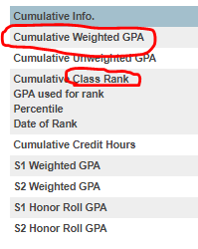
PowerSchool “About Me”
Go under ‘Cumulative Info.’ to access your GPA and Class Rank for college applications

Slide 13
Transcript Requests
Form found online (www.lphs.net) and Counseling Office
  - If under age 18, a parent must sign the form
Let counselor know when you have applied
  - Allow time for processing
Common Application – transcripts uploaded via Internet
  - Form still required to send these
IVCC dual credit and AP scores sent by student directly to college/university
  - IVCC Registrar’s Office / www.collegeboard.org

Slide 14

Letters of Recommendations
Request Form online and in Counseling Office
  Counselor can make additional copies for you once completed
Allow time for completion and mailing

Slide 15

College Visits
College representatives at LP
  Suspended at this time, will update students second semester
To visit a college pick up form in Counseling Office
  Limit 1 college day per semester
  Tours, overnights, classroom visits
Campus of the Week
  Keep a lookout for weekly emails from the Counseling Office spotlighting different colleges

Slide 16
Scholarships and Financial Aid
Posted on bulletin board outside Counseling Office and online
Watch deadlines and follow directions
Neatness, accuracy of information and correct spelling are extremely important
University scholarship deadlines may be different than application deadlines
Internet scholarship searches: www.studentaid.ed.gov/scholarship, www.fastweb.com, www.StudentScholarships.org
For federal financial aid (FAFSA), use www.fafsa.ed.gov to apply after October 1st
Create your FSA ID
  https://fsaid.ed.gov/npas/index.htm
Financial Aid Night at LP in September TBD
Financial Aid Completion Night in October TBD

Slide 17

IVCC
www.ivcc.edu
College Night/Financial Aid Seminar TBD
Placement testing in spring
  ACT/SAT scores may be used to exempt from testing
IVCC-specific checklist given during counselor/senior conferences

Slide 18

College Athletics
NCAA eligibility form available at www.eligibilitycenter.org
  There is an application fee
  Send transcripts from LP High School
  Send test scores directly from SAT (collegeboard.org) or ACT (www.actstudent.org)
See counselor for assistance with eligibility requirements
NAIA & NJCAA
Parent Power Session in March

Slide 19
LPHS Young Alumni Network
To help our current students make the best decisions for their further education and career goals after LPHS, a network of young alumni has formed to provide real-world advice to Cavaliers. We hope that our students reach out to these great Cavalier alumni as they make plans for their future.
www.lphs.net -> Academics -> Counseling -> Young Alumni Network
OR
https://www.lphs.net/Page/691

Slide 20
ISAC
Illinois Student Assistance Commission
Assistance with college planning, applications, FAFSA and financial aid, etc.
ISAC College Q&A – Real person help
  text name to 815-242-4630
  Or go to isac.org/collegeQA
https://studentportal.isac.org/student

Slide 21
Communication
Counseling website
  www.lphs.net > Academics > Counseling
Instragram: lpcounselors
Twitter: @LPCounselors
Be sure to start checking your student email!
  Counselors will be mailing out important forms and information
  Colleges will expect to be able to communicate with you via email

Slide 22

Acceptance Page
Email your counselor where you have been accepted!
We will post our seniors’ future plans on our website ☺

Slide 23

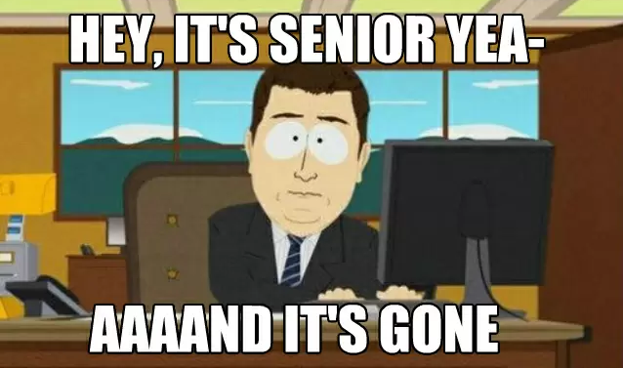
The End
THANK YOU FOR COMING!!
Sign up to see your Counselor anytime
WE WILL MEET WITH YOU SOON!

