Slide 1
Preparing All Colorado Students for the SAT

Slide 2

It’s About Confidence
http://bit.ly/sat_confidence
Notes:
Let’s start the discussion of Official SAT Practice on Khan Academy by talking what it’s really about: building student confidence and giving all students the feeling that they can succeed on the SAT and open up opportunities for their future.
[In slideshow mode, click the image of the video to launch the YouTube link. Make sure you have internet access and are hooked up to speakers. If you don’t have internet/speakers, try and download in advance to play, or you can direct attendees to http://bit.ly/sat_confidence to view themselves.]

Slide 3
Four Key Words
Free
Optional
Secure
Personalized

Slide 4
Setting Up A Student’s
College Board Account

Slide 5
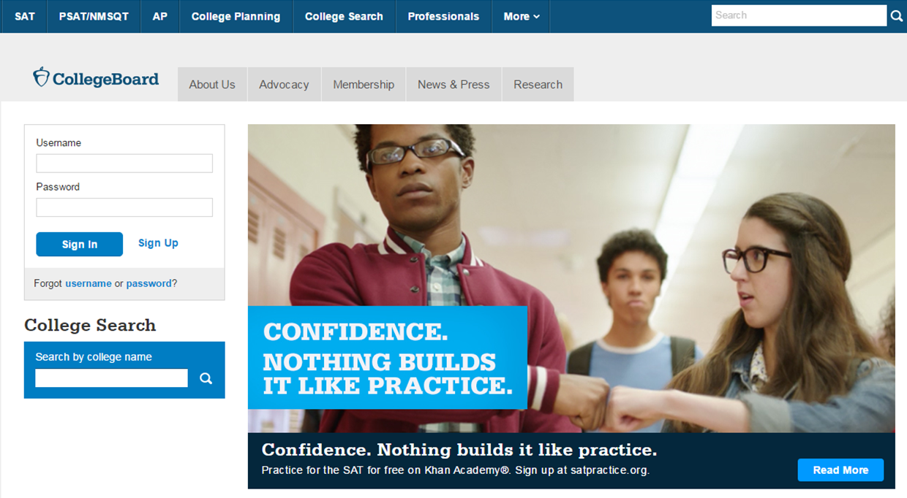
Students Should Go To Collegeboard.org
Click on
Sign Up

Slide 6
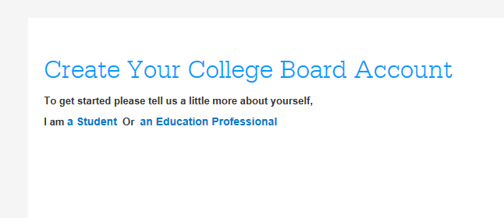
Next Step
they should select
I am a student

Slide 7
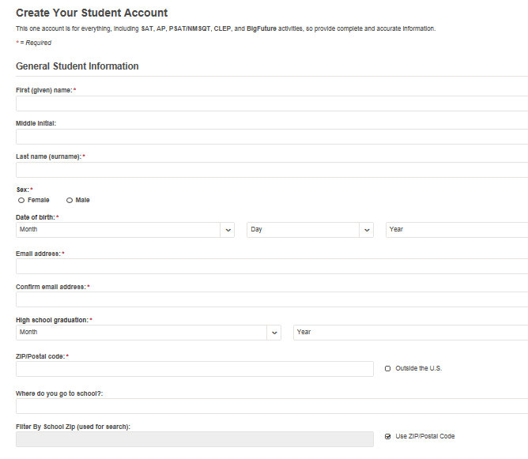
Enter your personal information
Enter their name, sex, date of birth, email address, graduation date, zip code and school name –
then scroll down for the next step

Slide 8
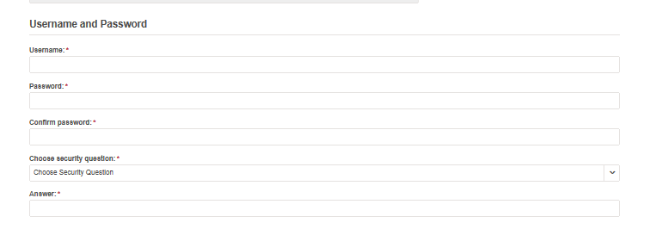
Set Their User Name
and Password
Set their user name and password (students should remember to record it so they don’t forget it!)
They should choose a security question and provide the answer – this will enable them to recover their user name and password.
Scroll down for
the next step

Slide 9
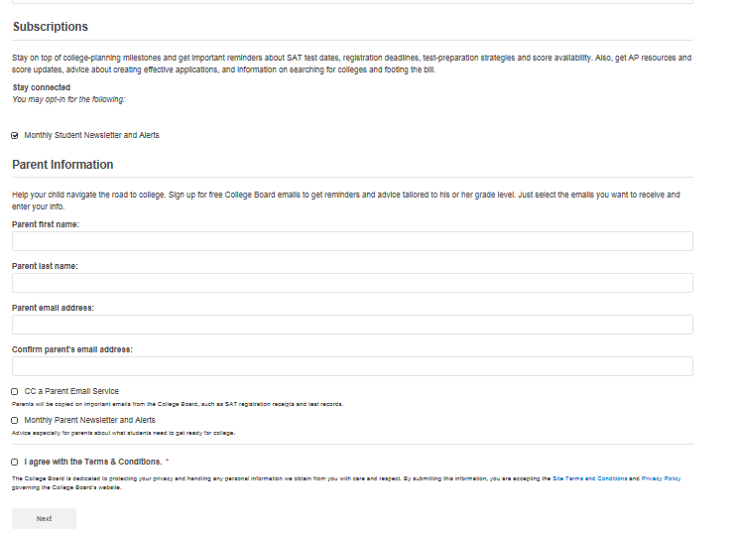
Customize Student Communication
Students can choose monthly alerts to help them stay connected
They can enter their parent’s information and email address, so parents can support them in your college and career journey!
Students must agree to the Terms and Conditions by clicking on the box to go to the next step
Notes:
Students should discuss the option of creating a College Board account with a parent. Encourage students to share the terms and conditions, as well as the privacy policy, with a parent.

Slide 10
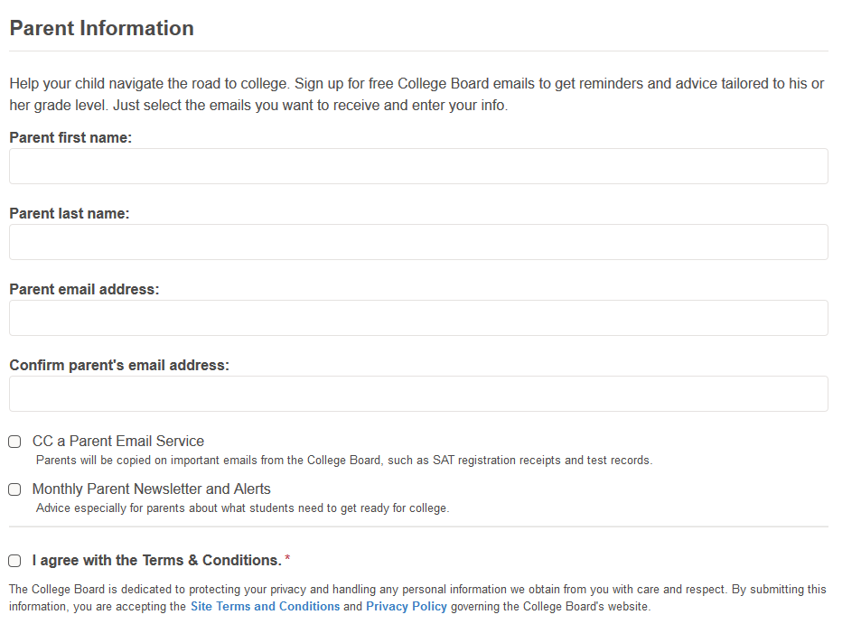
Protecting student privacy and personal information

Slide 11
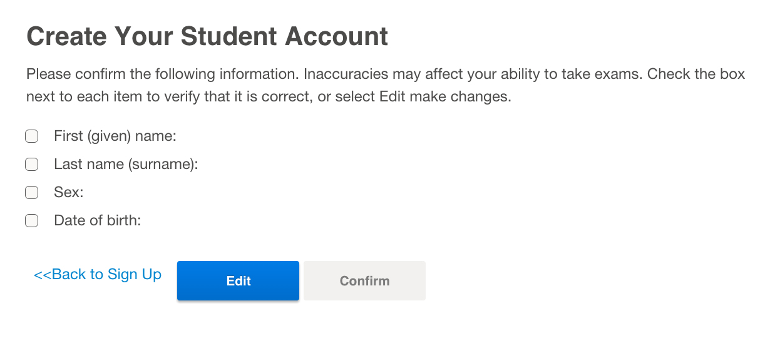
Confirm Their Information, and Create Their Account
Once students confirm that their information is correct by clicking each box, they can
confirm and their account will be created

Slide 12
Linking A Student’s
College Board and
Khan Academy Accounts

Slide 13
Benefits to Linking Student’s Accounts
Students will be able to link their College Board and Khan Academy accounts when they get their PSAT 10 results.
Linking accounts will further personalize student practice: the practice recommendations on Khan Academy will be based on their PSAT 10 score results.
All future scores from the SAT, PSAT/NMSQT, PSAT 10 and PSAT 8/9
will also be sent to help customize student practice and recommendations on
Khan Academy.
Students will be able to jump right into practice without having to take any additional diagnostic quizzes or practice tests to get personalized recommendations.
NOTE: Students can terminate their account linking at any time.
Notes:
When we first read in their PSAT information, we use their specific question results to generate practice recommendations for them. However, we do not store any of their actual results or their score.
Each time the user logs in, we query College Board to find out what their PSAT score was, just so we can display it on their SAT Dashboard. If they then choose to disconnect their CB and KA accounts, we will no longer have nor display that score information.

Slide 14

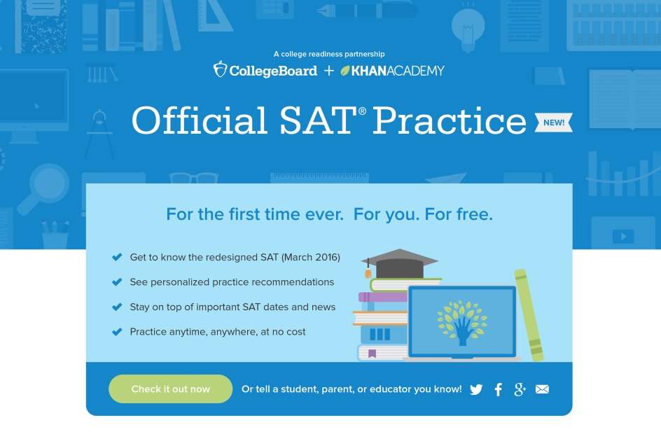
Steps to Link College Board and Khan Academy Accounts
Step 1
Students can log in to or create their Khan Academy account at satpractice.org
Step 2
When prompted, students should agree to link their Khan Academy and College Board accounts
Step 3
Students should then sign in or create their College Board Account and hit “Send” to send their scores
Encourage Students To
Sign up. Link up. Get practicing.
Notes:
Alternate text for screen shot:
A screen shot is titled: Official SAT Practice NEW! A subhead reads For the first time ever. For you. For free. There are four bullet points: Get to know the redesigned SAT (March 2016); See personalized practice recommendations; Stay on top of important SAT dates and news; Practice anytime, anywhere, at no cost.

Slide 15
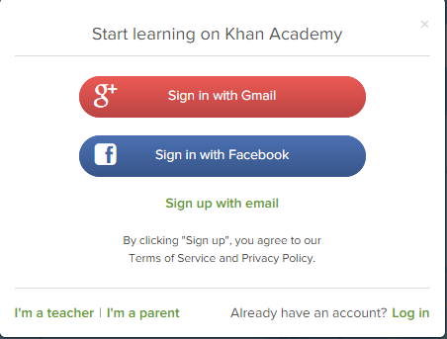
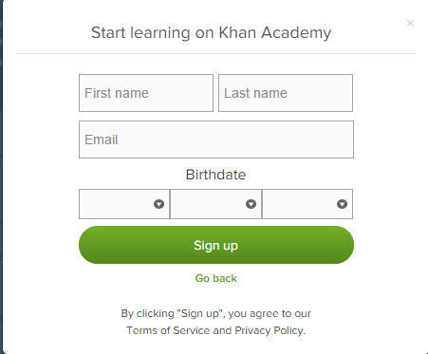
Step 1:
Creating a Khan Academy Account
Students go to satpractice.org
Student should log in or create their Khan Academy account
Students should click the green button labeled “Check it out now”
Students should then click “Sign up with email”
  Enter in First Name/Last name/Email/Birthdate and click “Sign Up”
      An email will been sent to their account to verify; they should then sign into email
      Students should then open email from Khan Academy accounts and click on the “Finish Signing Up” button
      A welcome screen will appear where they will enter username and password and click “Sign Up”
Notes:
A screen shot shows that users may sign in with Gmail or Facebook. A fillable form is titled Start learning on Khan Academy. It requires users to enter first name, last name, email and a birthdate. When complete to click the green sign up button.

Slide 16
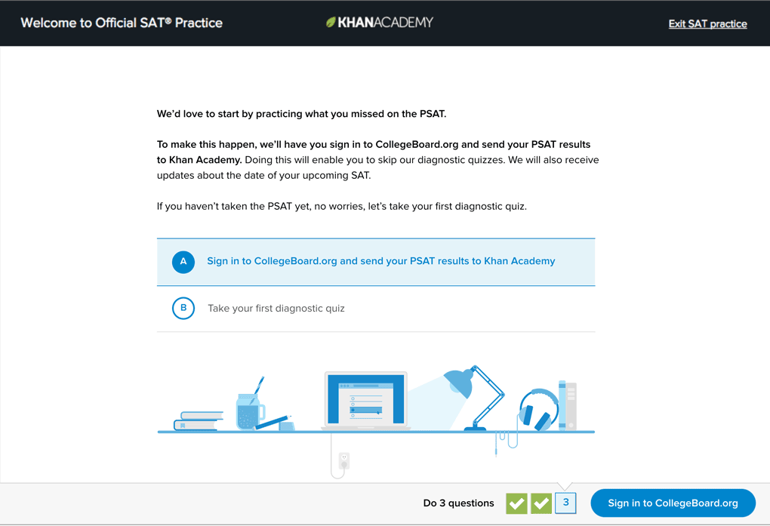
Step 2:
Linking Student Accounts
When Students log into
Khan Academy for the first time they will be asked if they would like to send PSAT results
If they already have a Khan Academy account, a prompt will appear asking
if they want to send your PSAT results to Khan Academy
After choosing that option, they will be directed to collegeboard.org
Notes:
A screen grab is titled: Welcome to Official SAT Practice Khan Academy. Type reads: We’d love to start by practicing what you missed on the PSAT. To make this happen we’ll have you sign in to the CollegBoard.org and send your PSAT results to Khan Academy. Doing this will enable you to skip our diagnostic quizzes. We will also receive updates about the date of your upcoming SAT. If you haven’t taken the PSAT yet, no worries, let’s take your first diagnostic quiz. There are two options: A Sign in to CollegeBoard.org and send your PSAT results to Khan Academy or B Take your first diagnostic quiz.

Slide 17
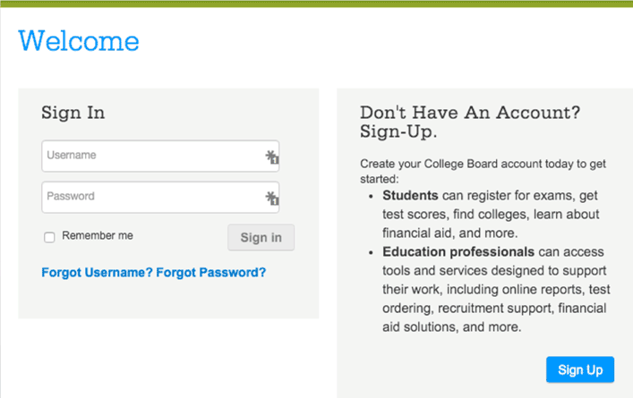
Step 3:
Creating a College Board Account
Students should sign in to their College Board account; if they do not have a College Board account, they should click 'Sign Up' to create one.
The steps for creating a
College Board account are:
  Click on the “Sign up” blue box
  Fill in the fields to create the
  student account ensuring all information is correct
  Click “Next” at the bottom
  when all fields are completed
  They will then be Signed In
Please note that students under 13 cannot create a College Board Account.
Notes:
A screen shot shows to fillable boxes a user must fill in to create a College Board Account: username and password. A remember me box may be clicked. A side note advises Students can register for exams, get test scores, find colleges, learn about financial aid and more. Education professionals can access tools and services designed to support their work, including online reports, test ordering, recruitment support, financial aid solutions and more.

Slide 18
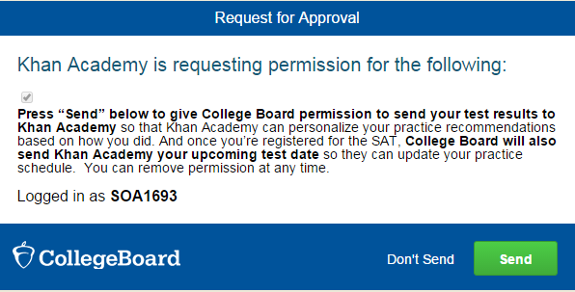
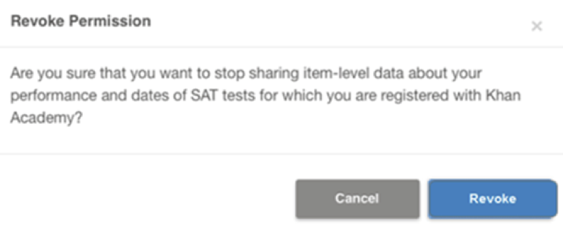
Step 3:
And Hit Send to Link Accounts
After successfully logging in to their College Board account,
students will be asked for permission to link their accounts.
After clicking “Send” they will
be redirected to SAT practice
on the Khan Academy site.
Students can remove the link at
any time, by clicking on
“Revoke” which is found in College Board account settings.
Notes:
A screen shot is titled Request for Approval: Khan Academy is requesting permission for the following: Press send below to give College Board permission to send your test results to Khan Academy so that Khan Academy can personalize your practice recommendations based on how you did. And once you’re registered for the SAT College Board will also send Khan Academy your upcoming test dates so they can update your practice schedule. You can remove permission at any time. A green send button is highlighted. Below is a step titled Revoke Permission. Clicking on the blue button labeled Revoke will do so.

Slide 19
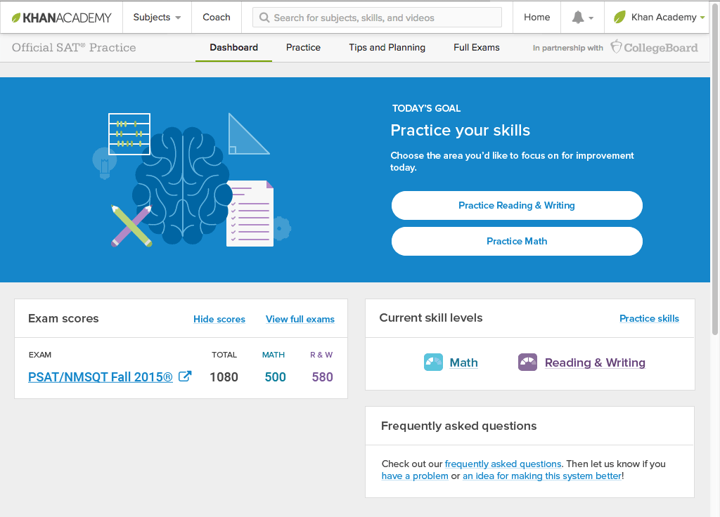
Now Students Can Start Personalized Practice with Khan Academy
Students can start their practice in either Math or Evidence Based Reading & Writing.
The recommendations
are based on how students did on the PSAT 10.
Keep practicing –
with each additional problem and activity
the personalization gets stronger and gets students closer to their goal
score on the SAT.
Notes:
A screen grab is titled Today’s Goal: Practice your skills. Users may click on Reading & Writing or Practice Math to begin their practice. A sample combined score of 1080 is shown: 500 for math; 580 for reading and writing. A section called current skill levels is shown as is frequently asked questions.

Slide 20
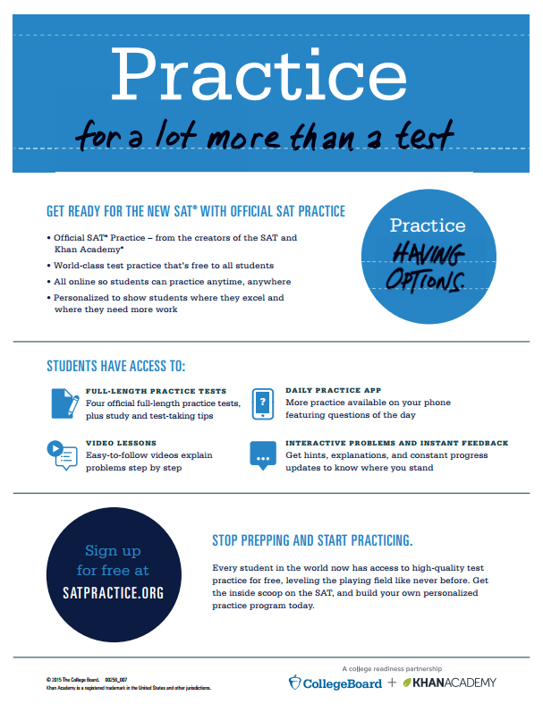

Khan Academy® Resources
Go to satpractice.org/k12 for resources about Official SAT® Practice on Khan Academy.
View sample study plans and study-group ideas at sat.org/studygroup. Student resources for the SAT and PSAT-related assessments are at sat.org/k12.
Instructional videos on Khan Academy are at youtube.com/collegeboard.
Notes:
In order to broaden the reach of these world-class tools and deepen their impact with students, it is imperative that we support educators.
Khan added 2 new tests in August, followed by automatic essay scoring this fall.
Developing a coach feature for educators is a high priority, but still cannot place a date on when that feature will be ready.
Everyone should bookmark satpractice.org/k12 for great resources including flyers like the one you see here.
To watch a walkthrough video of Official SAT Practice on Khan Academy, visit the “Tips and Strategies” tab after logging in at satpractice.org
To Access sample study plans and guidance for creating study groups visit sat.org/studygroup
For Resources and tools to help prepare students visit sat.org/k12
To watch a walkthrough video of Official SAT Practice on Khan Academy, visit the “Tips and Strategies” tab after logging in at satpractice.org
Watch helpful videos at youtube.com/collegeboard for instructions on Khan Academy features
PRESENTER NOTE: Some slides in the program updates section of the presentation will have a WEBINAR ICON in the bottom right or left hand corner. Speaker notes have been added to highlight the webinar which will be covering the material presented in the slide.
WEBINAR ICON: “Creating Personalized SAT Practice Using Khan Academy” – December 13, 2016 at 1pm ET. Webinar registration is available through the CW registration site.

Slide 21
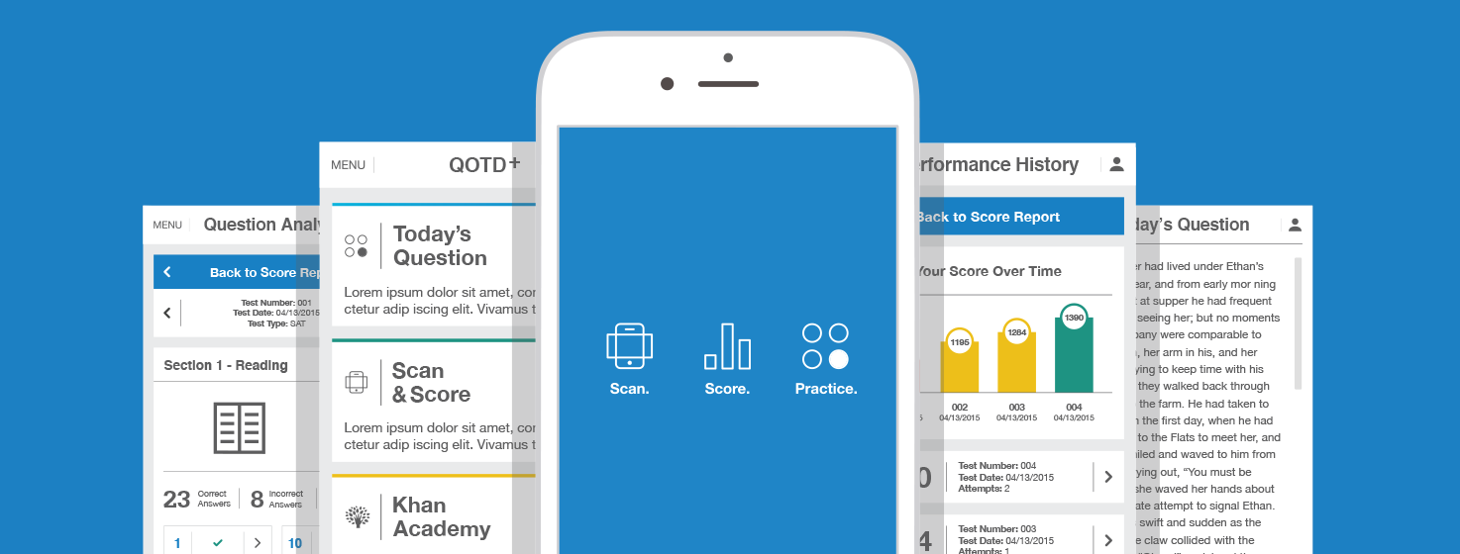
Daily Practice for the New SAT®
Daily SAT practice questions
Instant practice test scoring
Notes:
The SAT Daily Practice App is available in through the App Store or via Google play for android users.
The app has many helpful functions that include:
Daily practice questions!
Scan and Score feature: When students take practice tests on Khan Academy (which entails printed the test and filling in the answer sheet), they are then able to take a picture of their answers sheets on their phone and receive a scored exam momentarily!
Students’ practice test data goes directly to inform their Khan Academy practice instantly, which further updates their personalized practice.
Students are able to see information about their practice tests, such as how many questions they answered correctly, incorrectly, or omitted altogether. By the way, students should not be omitting questions since the SAT now has no penalty for guessing.
Students can see your performance history from your practice tests, allowing them to better track their progress.
If students accounts are linked, they can connect directly to the mobile version of Khan Academy from the Daily Practice App.

Slide 22
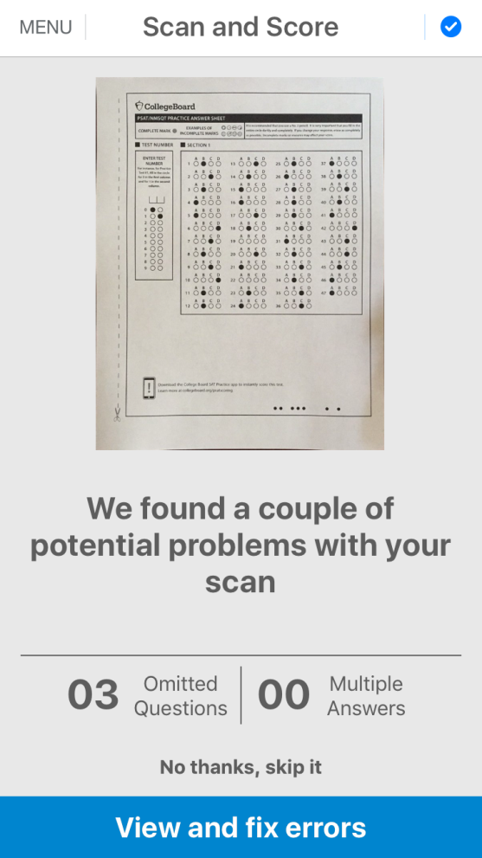
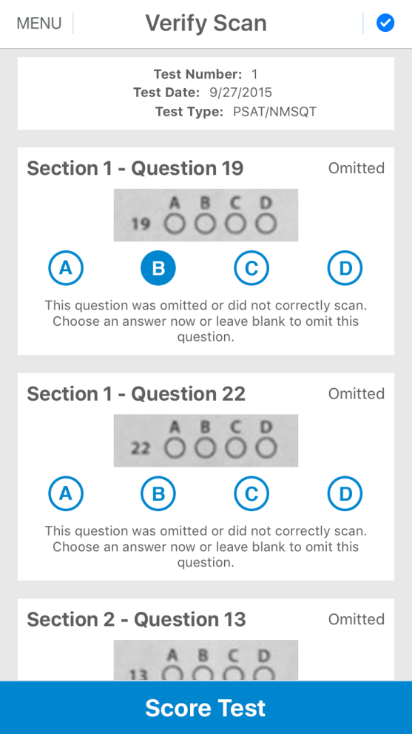
Scan answer sheets and correct mis-bubbles
Notes:
Note the error checking to make sure that we get accurate answers.

Slide 23
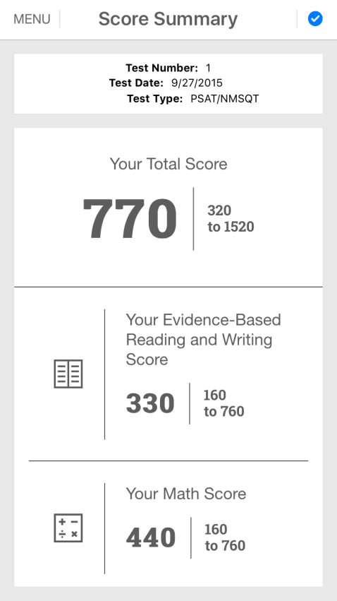
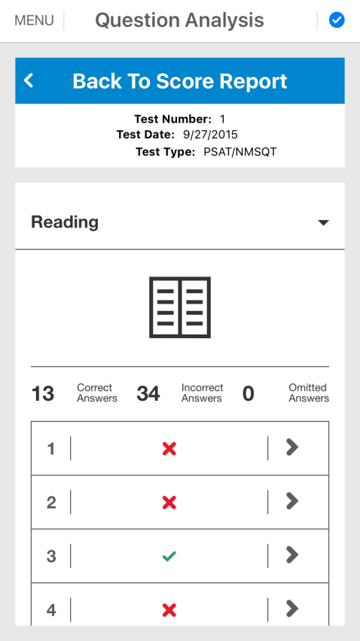
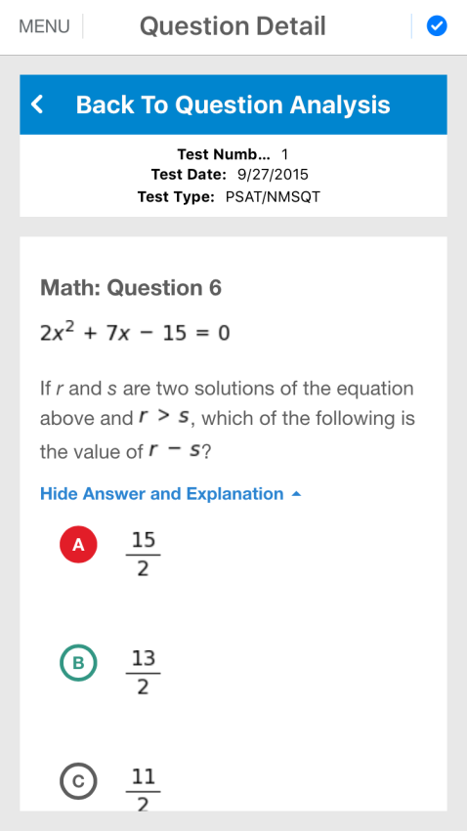
Immediately view your scores and detailed analysis and answer explanations

